Slide 1
CBSC16 Meeting
30th May – 1st June 2018, Goa (India)
Captain Lamberto Orlando LAMBERTI
Vice Chair CBSC
Building a new National Hydrographic Service:
The Italian-Lebanese collaboration
Lamberto Orlando LAMBERTI and Nicola Marco PIZZEGHELLO (Italy),
Afif GHAITH, Elie el JBEILY and Christian FAHED (Lebanon)
Article published to the XXVI FIG Congress (6-11 May 2018, Istanbul):
FIG 2018 WEB SITE (Article 9373)

Slide 2
CBSC16 Meeting
30th May – 1st June 2018, Goa (India)
DISCUSSION
The Framework
The Collaboration
The Project

Slide 3
CBSC16 Meeting
30th May – 1st June 2018, Goa (India)
THE MISSION
Collaborate between Lebanon and Italy in order to build an independent Lebanese Hydrographic Service
Collaborate: NOT AUTORITATIVE
Independent: all tasks, from surveys to products within a data-centric approach

Slide 4
CBSC16 Meeting
30th May – 1st June 2018, Goa (India)
THE INTERNATIONAL FRAMEWORK
IHO publication M2 - THE NEED FOR A NATIONAL HYDROGRAPHIC SERVICE
Chapter 1
“….In addition to supporting maritime trade, hydrography underpins almost every other activity associated with the sea, including safety of navigation, protection of the marine environment, national infrastructure development, coastal zone management, marine exploration, marine resource exploitation (minerals, fishing, etc.), maritime boundary delimitation, maritime defence and security, and coastal disaster management.”
UN GGIM publication - Future trends in geospatial information management: the five to ten year vision SECOND EDITION
Chapter 9.3
“The demand for marine geospatial information, for uses other than safety of navigation is growing at high speeds with regards to the blue economy, security and emergency requirements for a wide range of users.”
TAKE-AWAY:
NOWADAYS HYDROGRAPHY IS NOT CONNECTED WITH
SAFETY OF NAVIGATION
ONLY

Slide 5
CBSC16 Meeting
30th May – 1st June 2018, Goa (India)
THE FIRST STEP - TRAINING
TAKE-AWAY:
THE COURSE IS NOT ONLY ABOUT LEARNING OUTCOME
BUT ALSO ABOUT
IMPROVING RELATIONSHIPS
IHO/FIG/ICA STANDARD OF COMPETENCE (RECOGNIZED by International Board for Standard of Competence)
2 CAT A Lebanese Hydrographic Surveyors trained in Italy (14 months)
5 CAT B Lebanese Hydrographic Surveyors trained in Italy (9 months)
Key points:
Joining theory and practice
Trainers from the Italian Hydrographic Institute

Slide 6
CBSC16 Meeting
30th May – 1st June 2018, Goa (India)
THE PROJECT WITHIN THE INTERNATIONAL FRAMEWORK
IHO publication M2 – THREE PHASES
Maritime Safety Information (MSI): organising the collection and circulation of nautical information, required to maintain and update existing charts and publications;
Creation of a hydrographic surveying capability;
Ability to produce and maintain charts and publications independently.
Phases within our project:
1. The SHMAL (Lebanese Hydrographic Service) is in place;
Critical Issue: authorities awareness about the exchange of information with SHMAL
Mostly done, ambition of sharing data with external authorities (e.g. Scientific Centers, Port Authorities, National Geodetic Service)
Critical issue: need to establish formal and clear win-win relationships
Long term, in progress
Critical issue: it is a legal obligation with benefits but duties too
TAKE-AWAY:
TECHNICAL ASPECTS ARE OFTEN SOLVED BY INDEPENDENT WORK;
EXTERNALLY LINKED ASPECTS NEED DEEPER INVOLVMENT
Notes:
6

Slide 7
CBSC16 Meeting
30th May – 1st June 2018, Goa (India)
THE PROJECT WITHIN THE NATIONAL FRAMEWORK
TAKE-AWAYS:
SEEK BUDGET OUTSIDE THE HYDROGRAPHIC LEVEL
ROME WASN’T BUILT IN A DAY
IHO publication M2 – 2 and 3 PHASES
CRITICAL ASPECTS:
EXPENSIVE
equipment and software purchase and maintenaince at an hydrographic level
(but not at a national level)
LONG TERM
have a mid-term plan…
Notes:
7

Slide 8
CBSC16 Meeting
30th May – 1st June 2018, Goa (India)
THE LONG VIEW
HYDROGRAPHIC LEVEL
Technical Arrangement between the two Countries, in the field of hydrography and cartography
for co-production nautical documentation (charts and publications)
NATIONAL AND BILATERAL LEVEL
Hydrography as enabler of collaboration between National Stakeholders and between
Lebanon and Italy
INTERNATIONAL LEVEL:
Lebanese Hydrographic Service into the Geospatial and Hydrographic Community
TAKE-AWAY:
TAKE INTO CONSIDERATION HUMAN RELATIONSHIPS
TO EHANCE GEOSPATIAL MATURITY OF SOCIETIES
Notes:
8

Slide 9
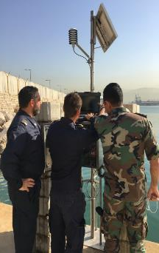
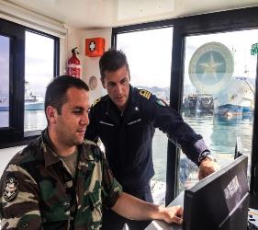
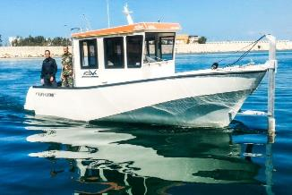
CBSC16 Meeting
30th May – 1st June 2018, Goa (India)
THE HYDROGRAPHIC PHASE
Complete up-to-date new equipment and software
Installation and professional courses delivered together with hardware and software
At least yearly Italian mentoring teams in Lebanon
Notes:
9

Slide 10
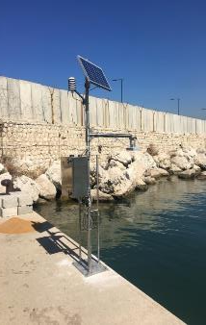
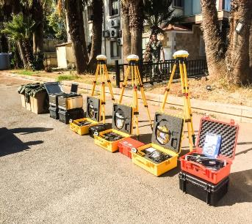
CBSC16 Meeting
30th May – 1st June 2018, Goa (India)
THE REFERENCE FRAME
4D reference frame
Connecting the National Geodetic Reference Frame with the Hydrographic one
Connecting Autorities in charge
Notes:
10

Slide 11
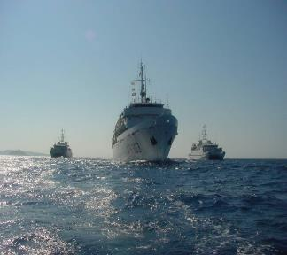
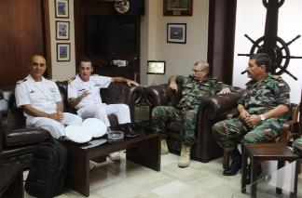
CBSC16 Meeting
30th May – 1st June 2018, Goa (India)
FUTURE PLANS
Full training period by an Italian hydrographic vessel in Lebanon
Technical arrangement between Hydrographic Offices
International Involvement of the Lebanon Hydrographic Service
QUESTIONS?
Notes:
11

