Slide 1
UK CME PROGRAMME
16 November 2019

Slide 2
What is the CME Programme?
UK Government Funded Programme
Focus on initiatives to promote economic growth and prosperity
Cross government programme using the expertise of Cefas, NOC and UKHO
SIDS within the Caribbean and Pacific Oceans in scope
Local projects enabled in conjunction with the Target State
UK led projects combined with capacity building and knowledge transfer
Notes:
.

Slide 3
CME Programme Aims
The Programme will:
Enable countries to better realise the potential of their blue economies (in a sustainable manner that conserves their oceans and marine resources in accordance with United Nations Sustainable Development Goals).
Assist SIDS to understand the nature, extent and potential of their precious marine resources (acquire and apply the skills necessary to use them sustainably).
Assist SIDS in the protection of their marine environments.
Help build capacity (by providing states with a wide range of expertise in key marine and maritime areas).

Slide 4
Current data does not support the needs of the Maritime Economy
Due to the age and type of data currently held of the waters in the Commonwealth SIDS:
It is largely inadequate for safe navigation
It does not comply with international standards and requirements
It reduces efficiency of maritime trade
It is largely inadequate for modelling
It does not support fisheries management
It does not support resource exploitation
It can discourage some shipping from visiting

Slide 5
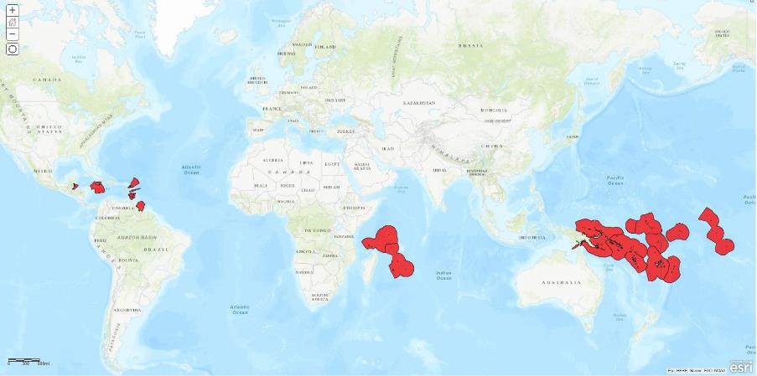
CME Programme – Areas of Activity

Slide 6
UKHO CME Programme
Process for determining projects
TAV
Risk Assessment
Liaising with local stakeholders
Seabed mapping
Training and Capacity Building to develop local capability and an ongoing legacy
Notes:
)

Slide 7
Stakeholder Input to Survey Priorities
      Following in country briefings and meetings with stakeholders key areas for seabed mapping were identified.
      Examples of benefits expressed by stakeholders included:
      Navigational Risk Mitigation
      Compliance with international conventions (SOLAS)
      Encouraging increased / larger cruise vessels
      Better design of shipping routes
      Improved definition of marine habitats
      Improved valuation of marine resources
      Improved disaster mitigation
      Coastal protection

Slide 8
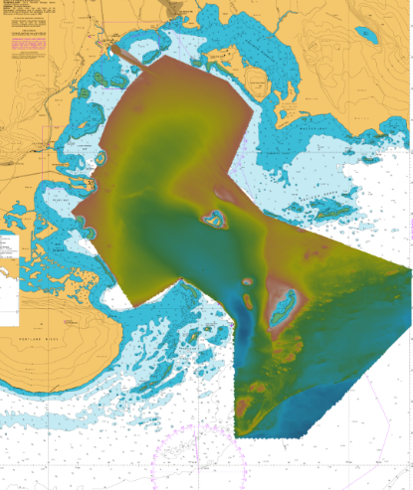
CME Programme Overview – Recent Activity
Jamaica

Slide 9
CME Programme Overview – Recent Activity
Dominica

Slide 10
CME Programme Overview – Recent Activity
St Lucia

Slide 11
CME Programme Overview – Recent Activity
Grenada

Slide 12
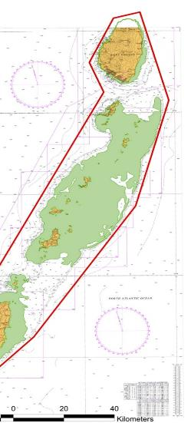
CME Programme Overview – Recent Activity
St Vincent and Grenadines

Slide 13
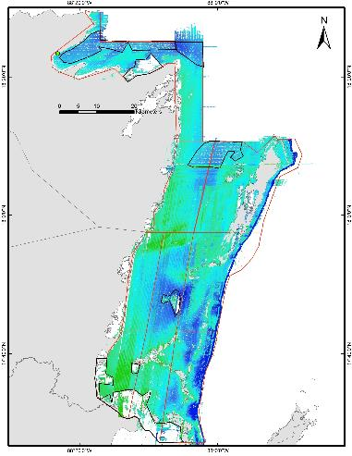
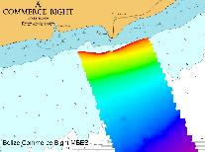
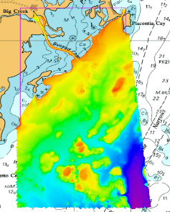
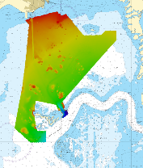
CME Programme Overview – Recent Activity
Belize

Slide 14
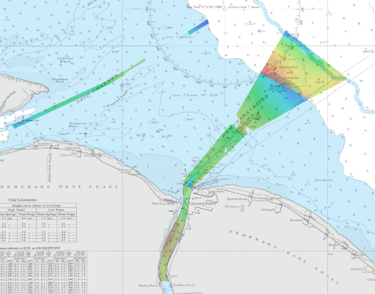
CME Programme Overview – Recent Activity
Guyana

Slide 15
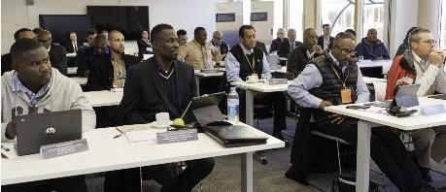
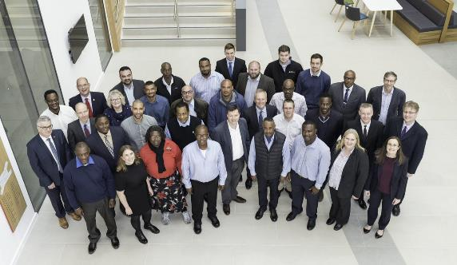
Hydrographic Governance Workshop

Slide 16
CME Programme Summary
Programme aimed at Commonwealth SIDS
Understanding current capability
Improving seabed mapping
Increasing local capacity

