Slide 1
Updating the GEBCO Grid
Pauline Weatherall, GEBCO Digital Atlas Manager, British Oceanographic Data Centre (BODC), National Oceanography Centre (NOC), Liverpool, UK
TSCOM/SCRUM meeting Viňa del Mar, Chile, October 2016

Slide 2
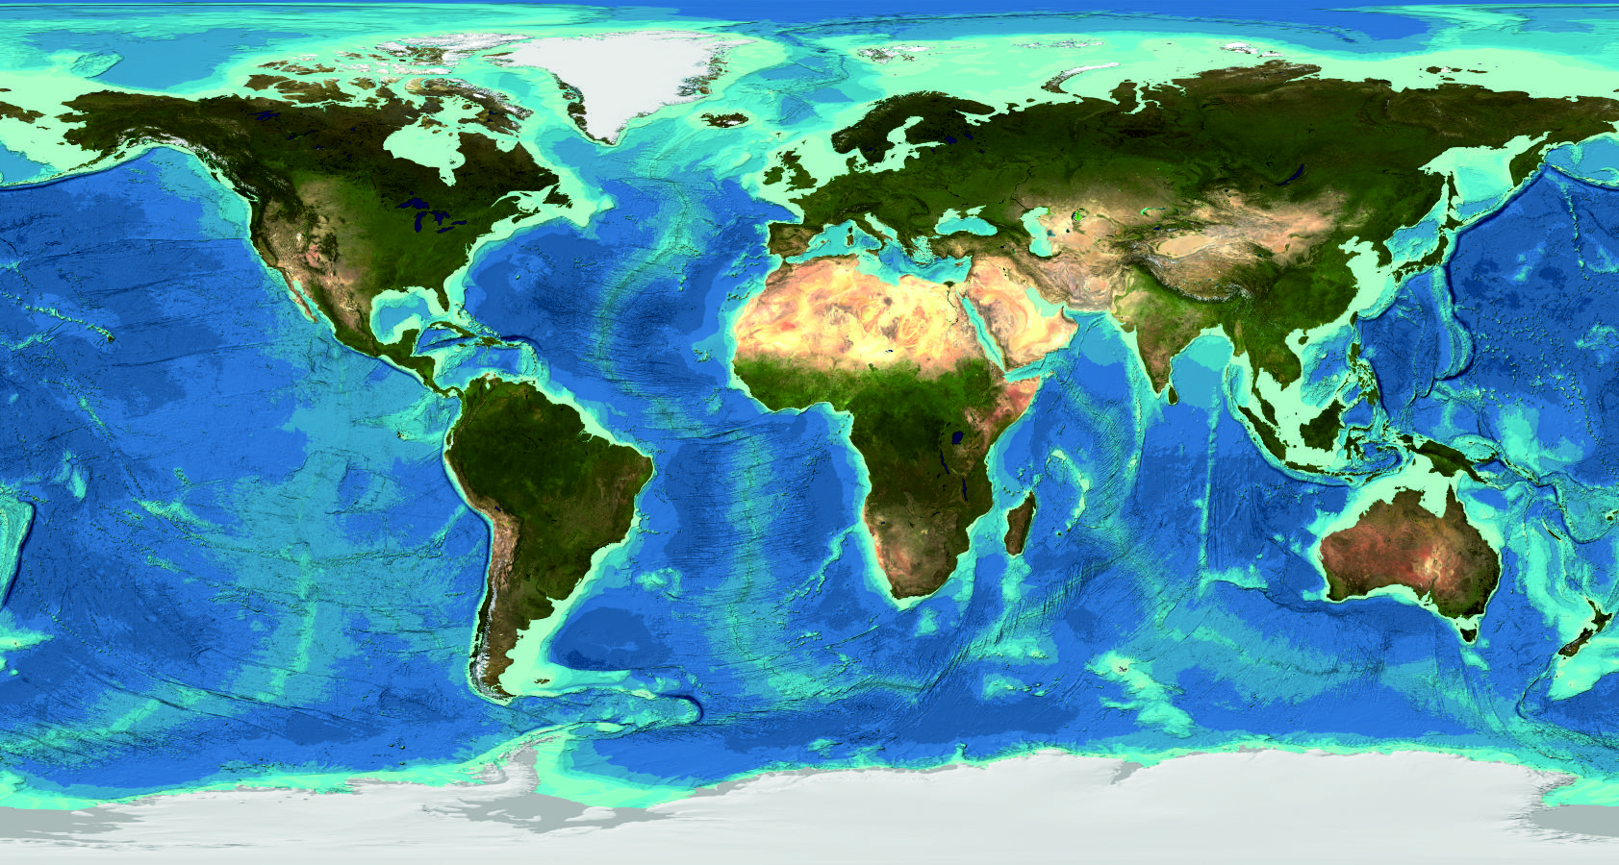
Current GEBCO grid – GEBCO_2014

Slide 3
Current GEBCO grid – GEBCO_2014
Released in December 2014
Global terrain model at 30 arc-second intervals
Update to previous grid, GEBCO_08, last published in 2010
‘Base grid’ is SRTM30_plus v5
Includes data from a number of regional mapping projects and from contributed data sets
Accompanied by a Source Identifier grid (SID) – shows which grid cells are constrained by data/grids and those based on interpolation

Slide 4
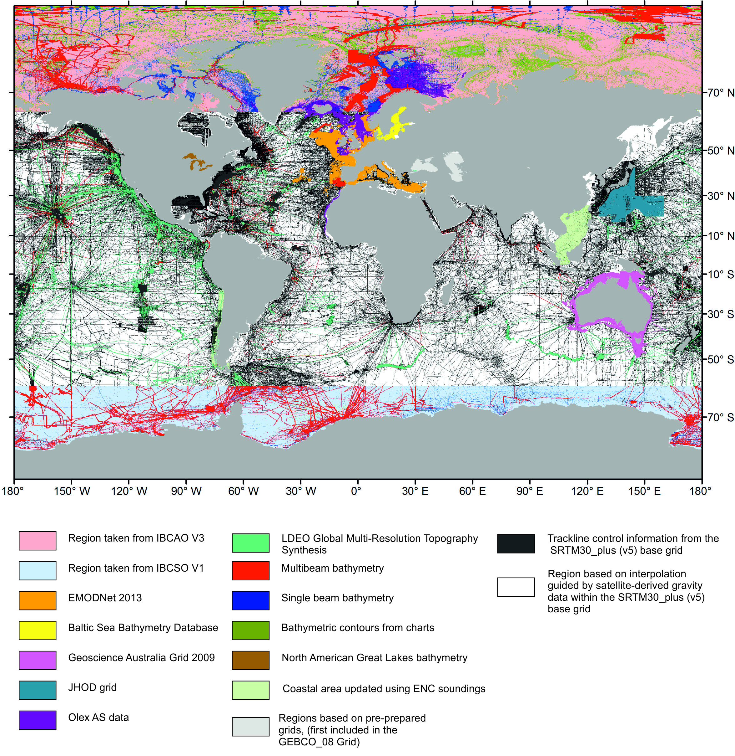
Current GEBCO grid – GEBCO_2014

Slide 5
Plans for a new GEBCO grid (2017)

Slide 6
Plans for a new GEBCO grid (2017)
It’s is aimed that the grid shall:
Be a global grid at 30 arc-second intervals
Use the existing GEBCO_2014 Grid as a base
Include a number of new regional grids, multibeam bathymetry data sets and areas updated with ENC soundings

Slide 7
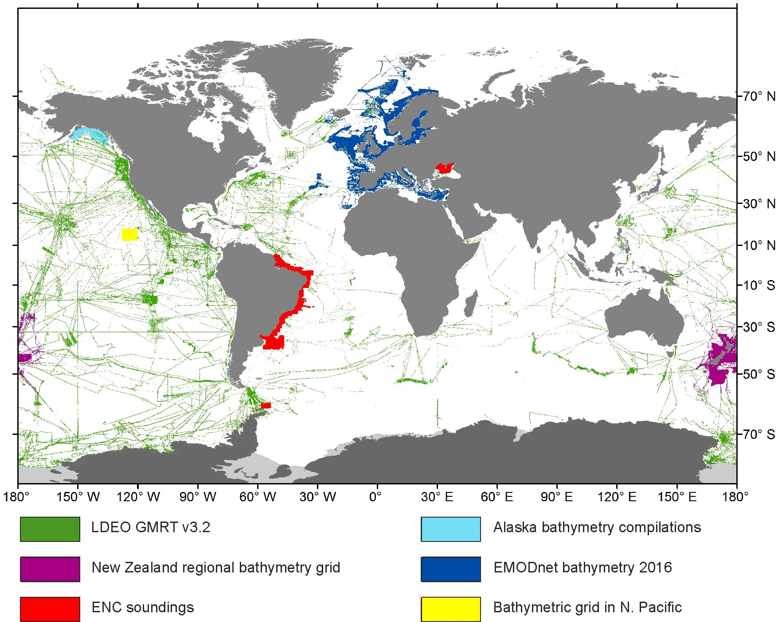
Plans for a new GEBCO grid (2017)
In addition to bathymetric trackline data sets made available through IHO DCDB and other databases. A number of new data sets have been received for inclusion in the global GEBCO grid.

Slide 8
Plans for a new GEBCO grid (2017)
New Zealand Regional Bathymetry grid – made available by the National Institute of Water and Atmospheric Research (NIWA), New Zealand.
EMODnet 2016 release – bathymetric grid for European waters.
Global Multi-Resolution Topography Data Synthesis (GMRT) v3.2 - compilation of edited multibeam sonar data provided by the Lamont-Doherty Earth Observatory (LDEO) of Columbia University, USA.
ENC bathymetric sounding data sets supplied for their coastal waters by Brazil, Ukraine and Uruguay.
Alaska bathymetry compilations for the Aleutian Islands, Cook Inlet, central Gulf of Alaska and Norton Sound. Made available by the Alaska Fisheries Science Center.
Bathymetric grid, based on multibeam data, for a region of the North Pacific, 1,800 km southwest of the Mexican Baja Peninsula. Provided by the DEME group, Netherlands.
Bathymetric grid for the Israeli EEZ.

Slide 9
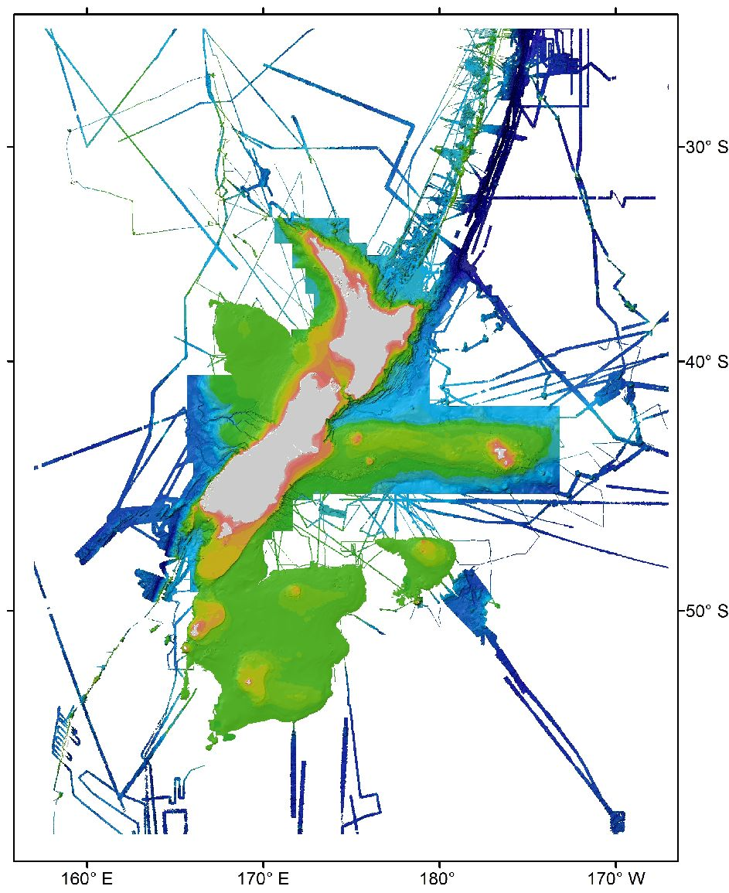
New Zealand Regional Bathymetry grid – made available by the National Institute of Water and Atmospheric Research (NIWA), New Zealand

Slide 10
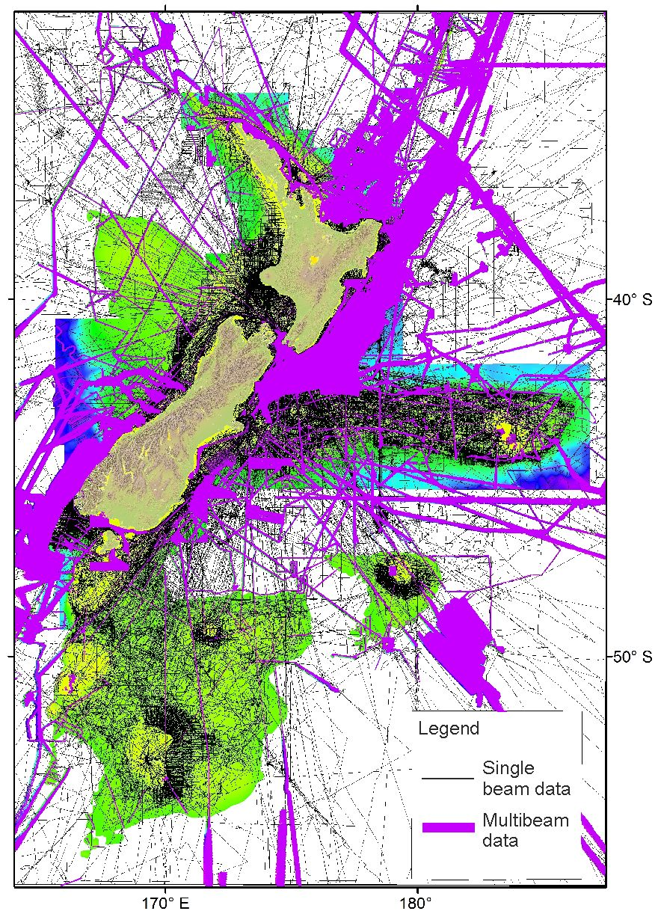
New Zealand Regional Bathymetry grid – made available by the National Institute of Water and Atmospheric Research (NIWA), New Zealand

Slide 11
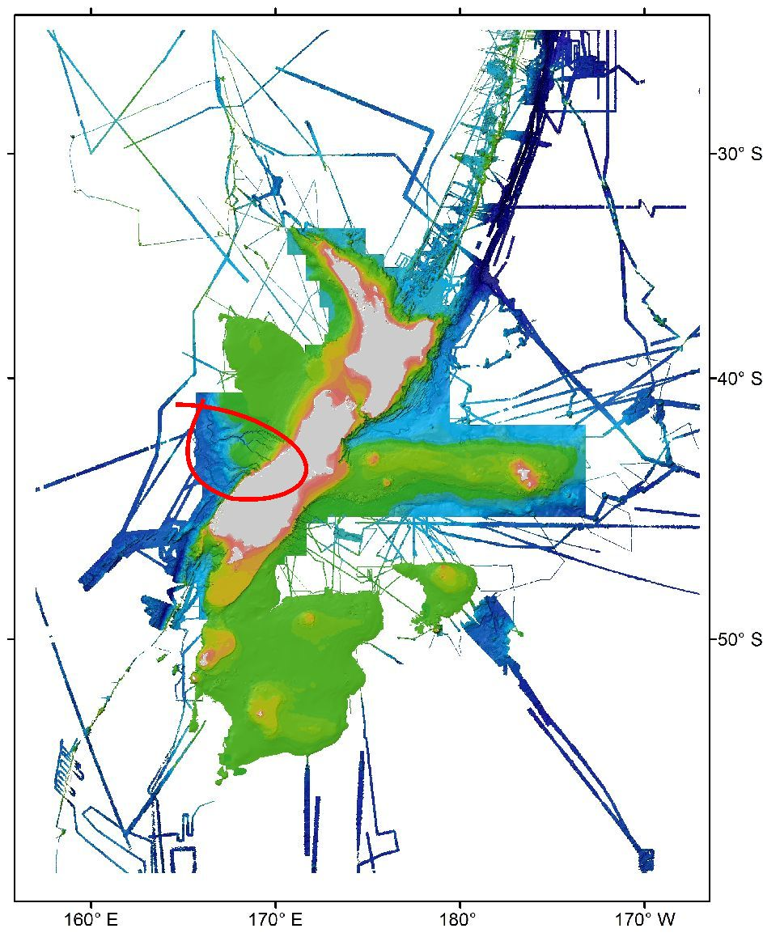
New Zealand Regional Bathymetry grid – made available by the National Institute of Water and Atmospheric Research (NIWA), New Zealand

Slide 12
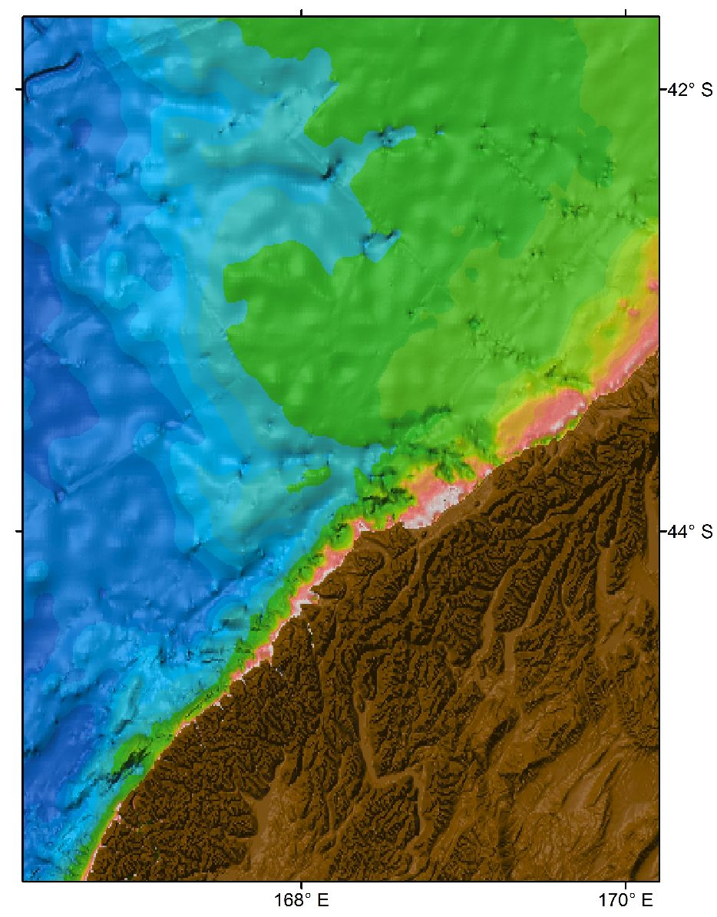
New Zealand Regional Bathymetry grid – made available by the National Institute of Water and Atmospheric Research (NIWA), New Zealand
GEBCO_2014
Depth (m)

Slide 13
New Zealand Regional Bathymetry grid – made available by the National Institute of Water and Atmospheric Research (NIWA), New Zealand
GEBCO_2014
GEBCO_2014 updated with NIWA data set
Depth (m)

Slide 14
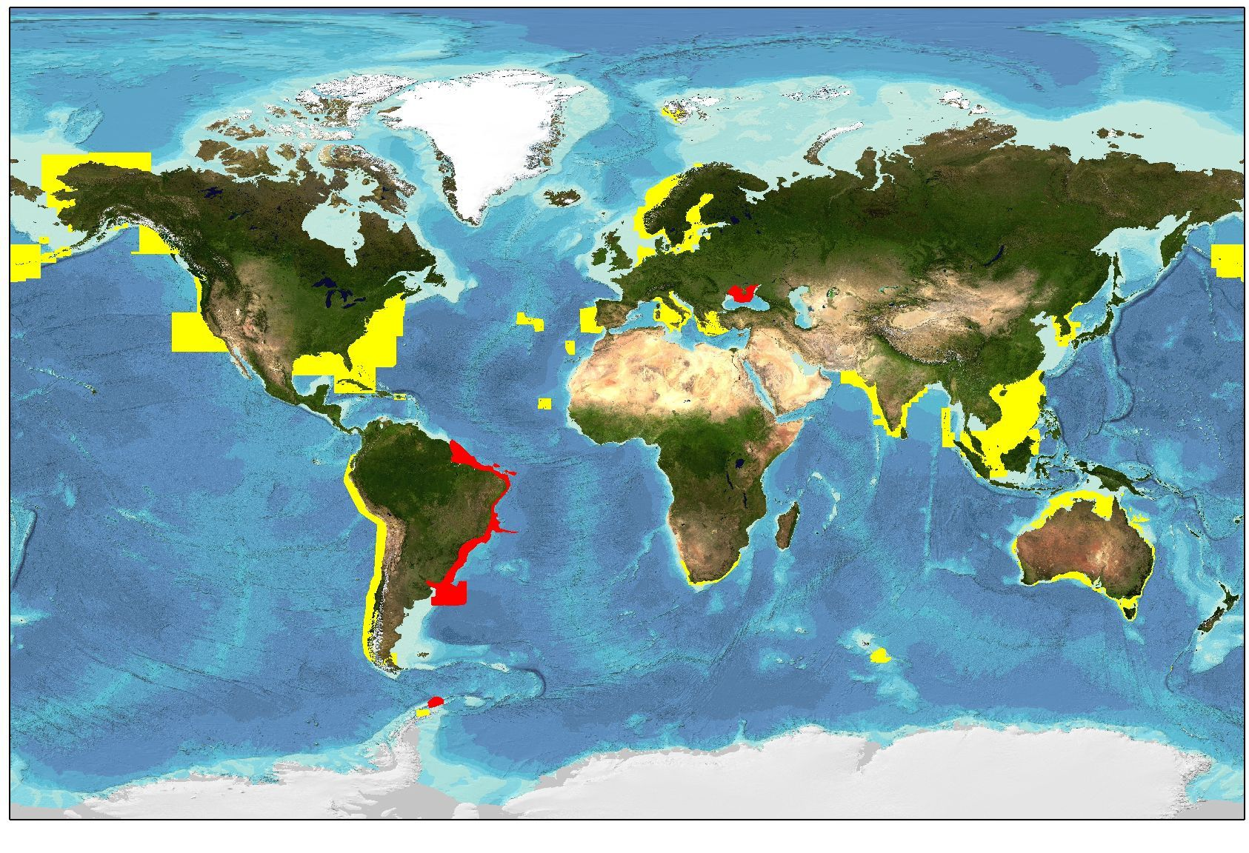
ENC bathymetric sounding data coverage – provided by IHO Member States
ENC coverage supplied in 2016 shown in red

Slide 15
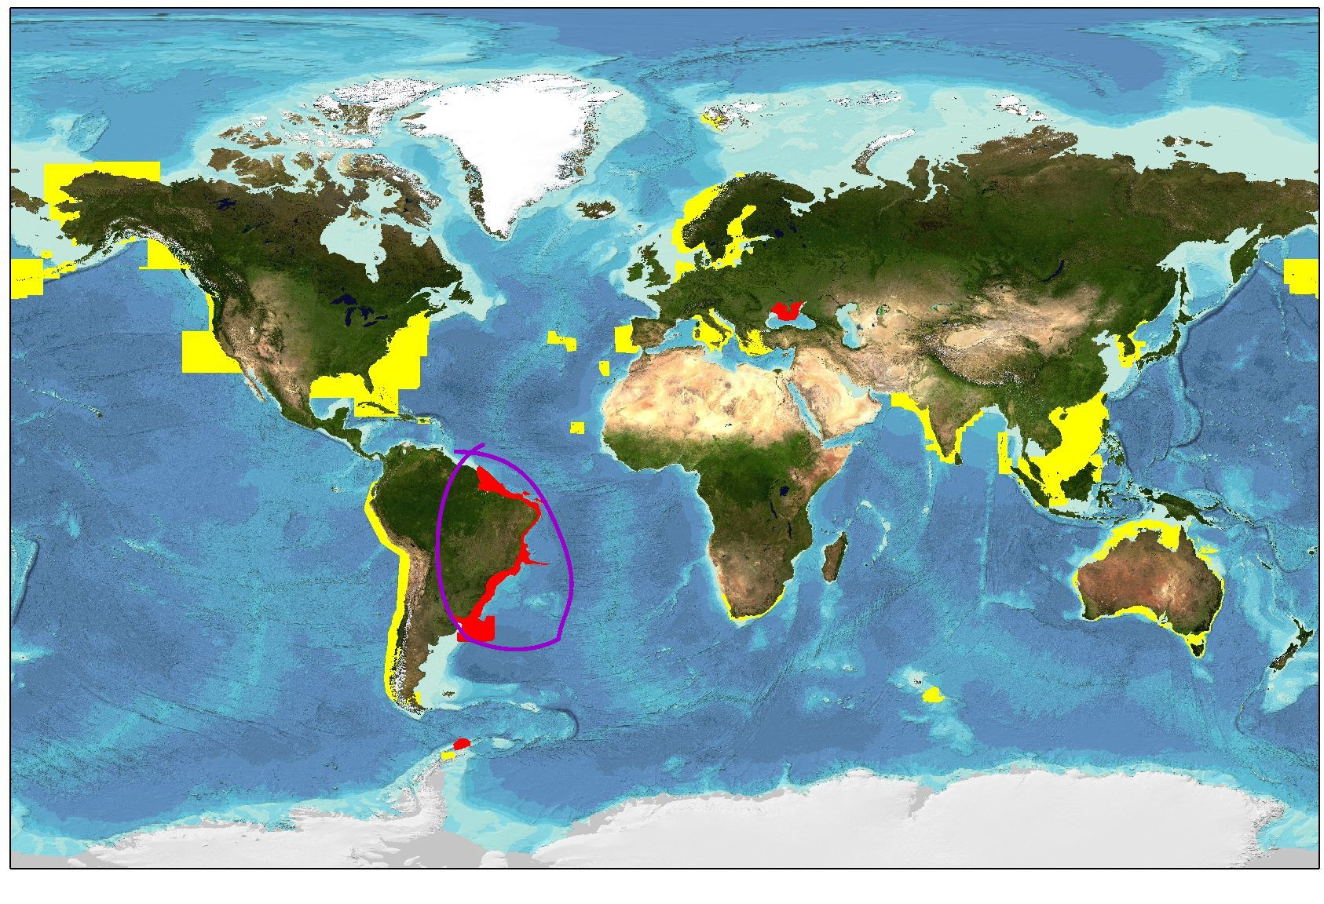
ENC bathymetric sounding data coverage – provided by IHO Member States
ENC coverage supplied in 2016 shown in red

Slide 16
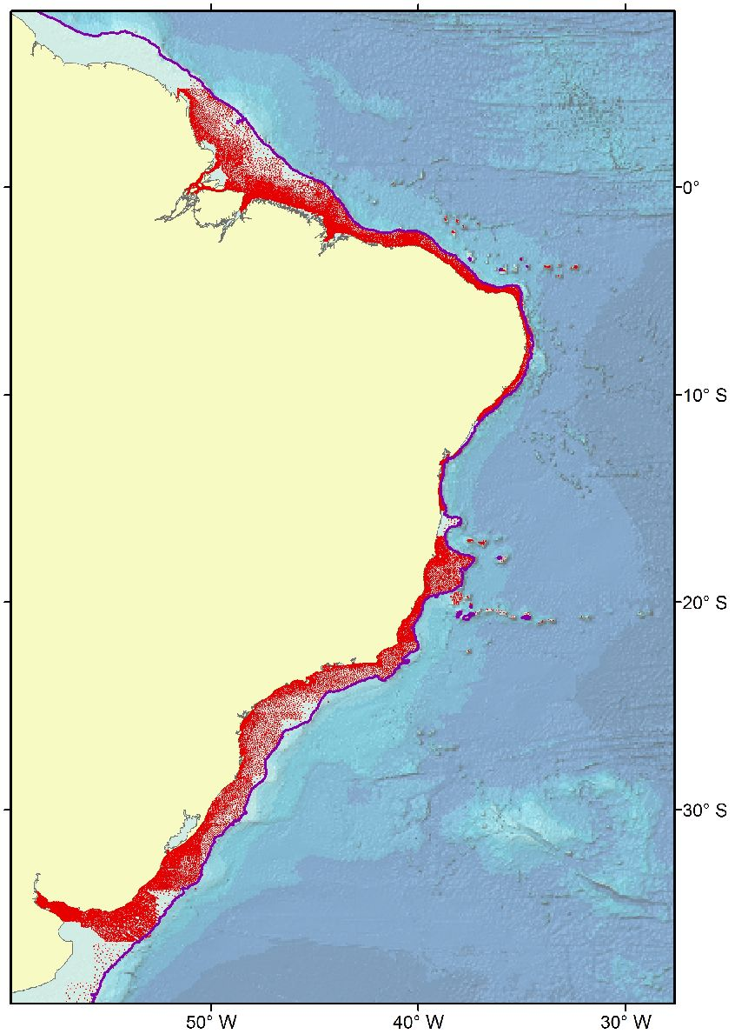
ENC bathymetric soundings
Coverage of ENC bathymetric sounding points (red) recently supplied to GEBCO by Brazil and Uruguay
200m contour shown in purple

Slide 17
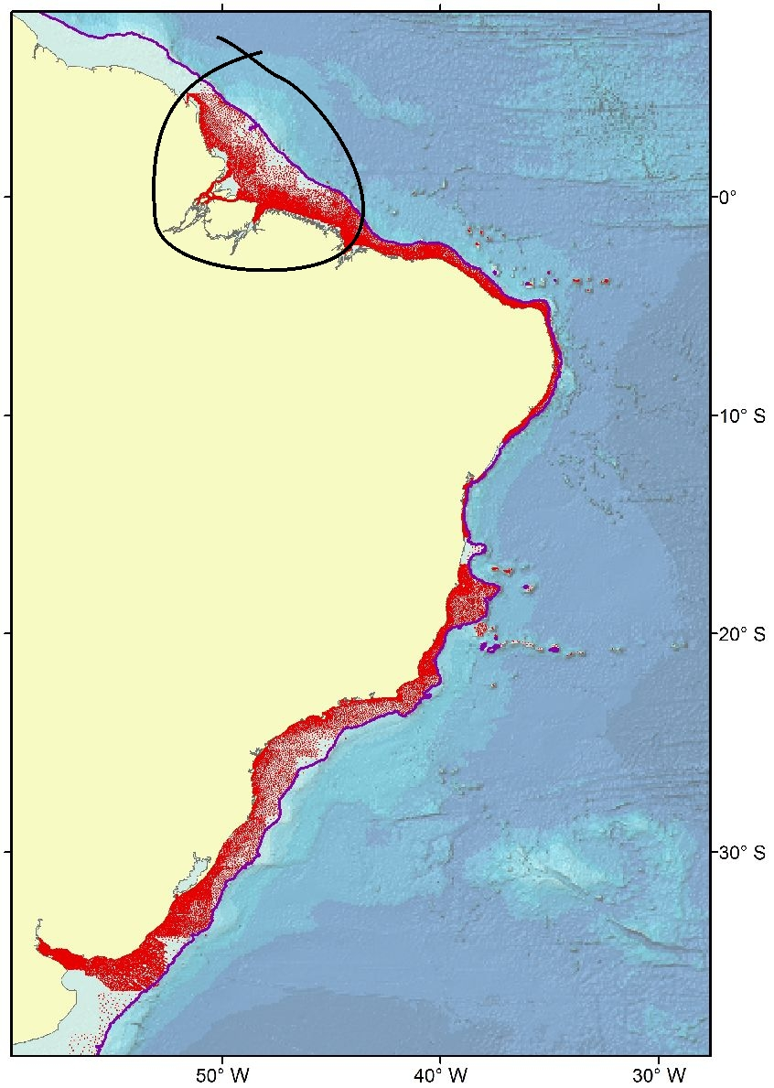
ENC bathymetric soundings
Coverage of ENC bathymetric sounding points (red) recently supplied to GEBCO by Brazil and Uruguay
200m contour shown in purple

Slide 18
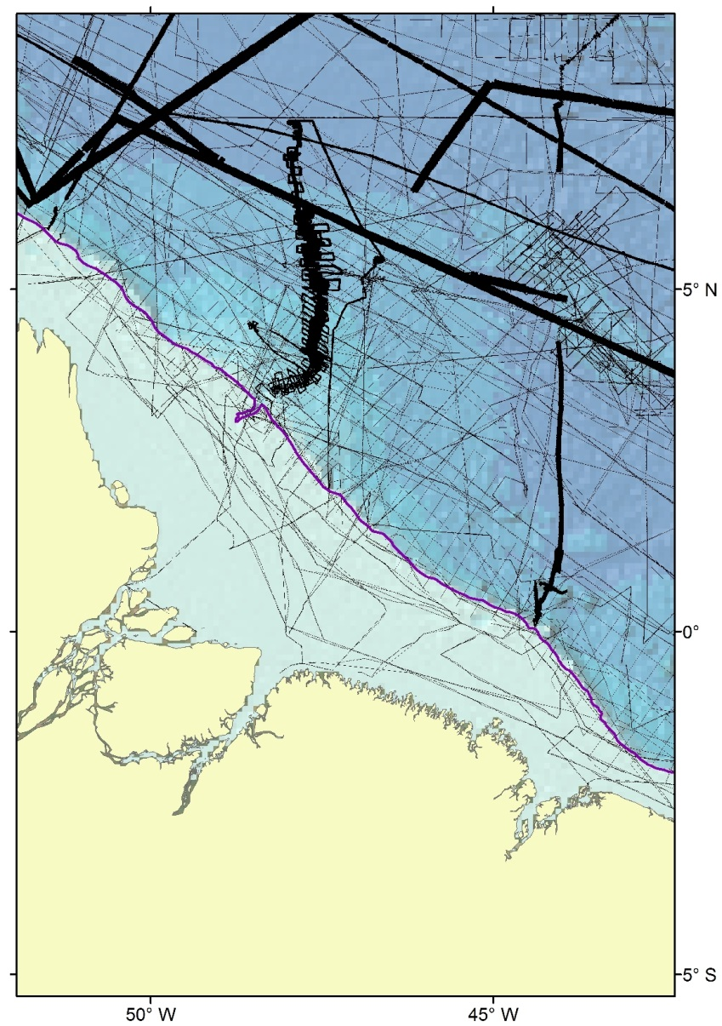
ENC bathymetric soundings
Trackline coverage used in developing GEBCO_2014 (black lines)
200m contour shown in purple

Slide 19
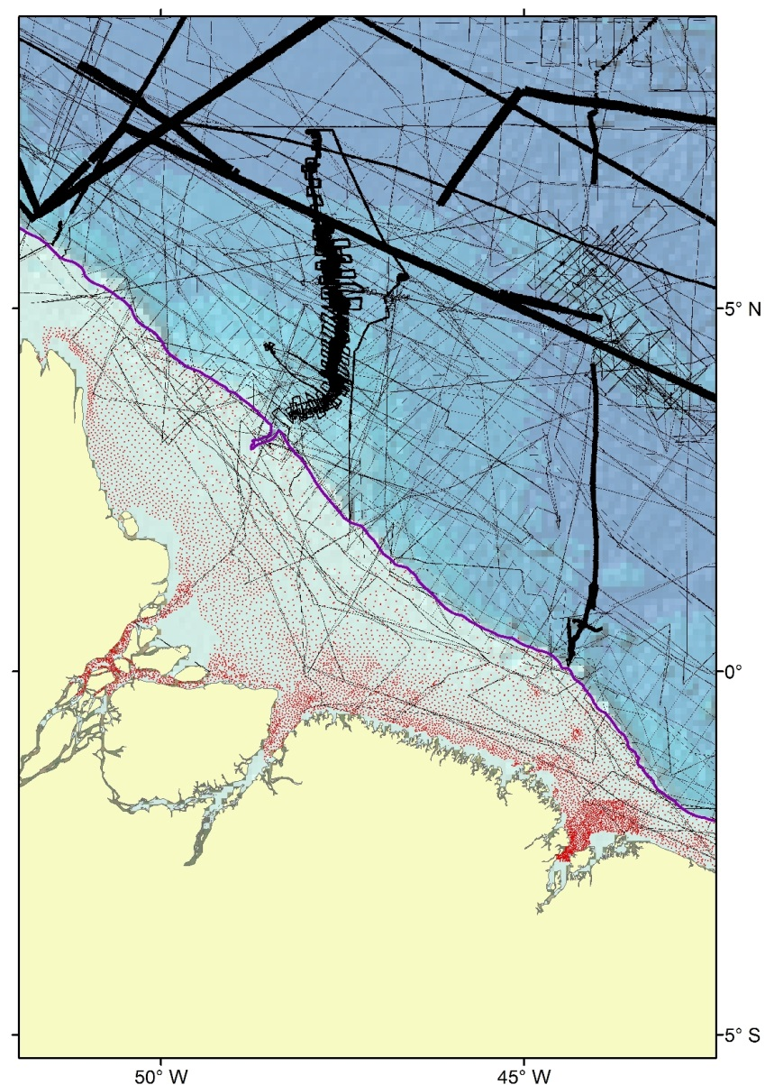
ENC bathymetric soundings
Trackline coverage used in developing GEBCO_2014 (black lines)
Part of the ENC sounding data set (red) recently supplied by Brazil
200m contour shown in purple

Slide 20
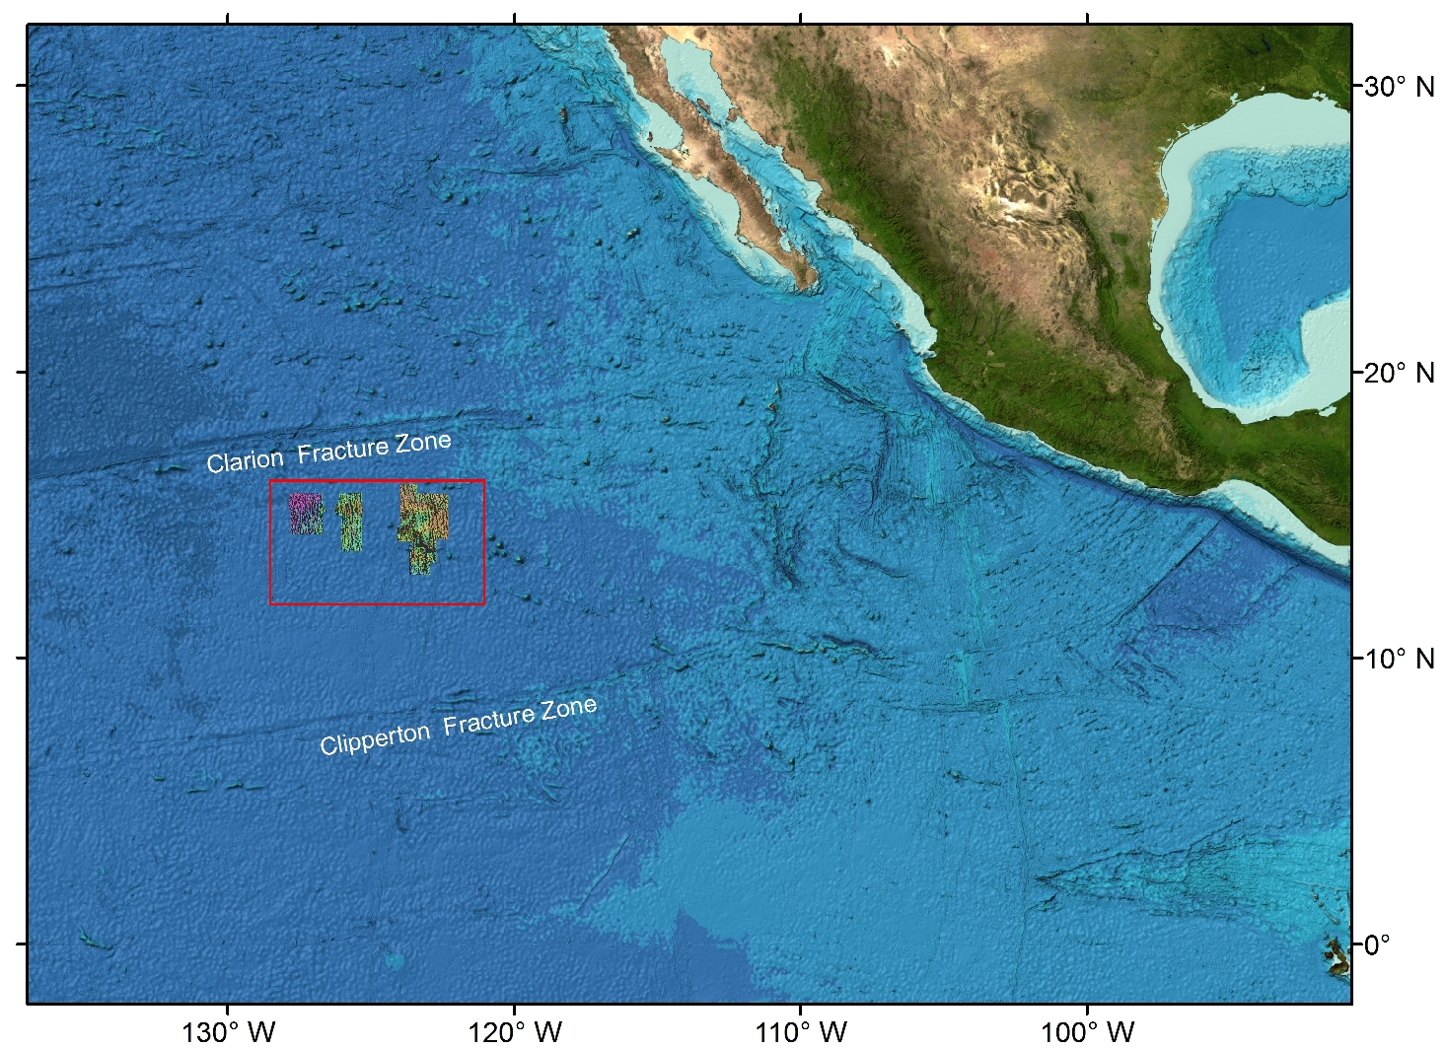
Multibeam bathymetric grids – Pacific Ocean

Slide 21
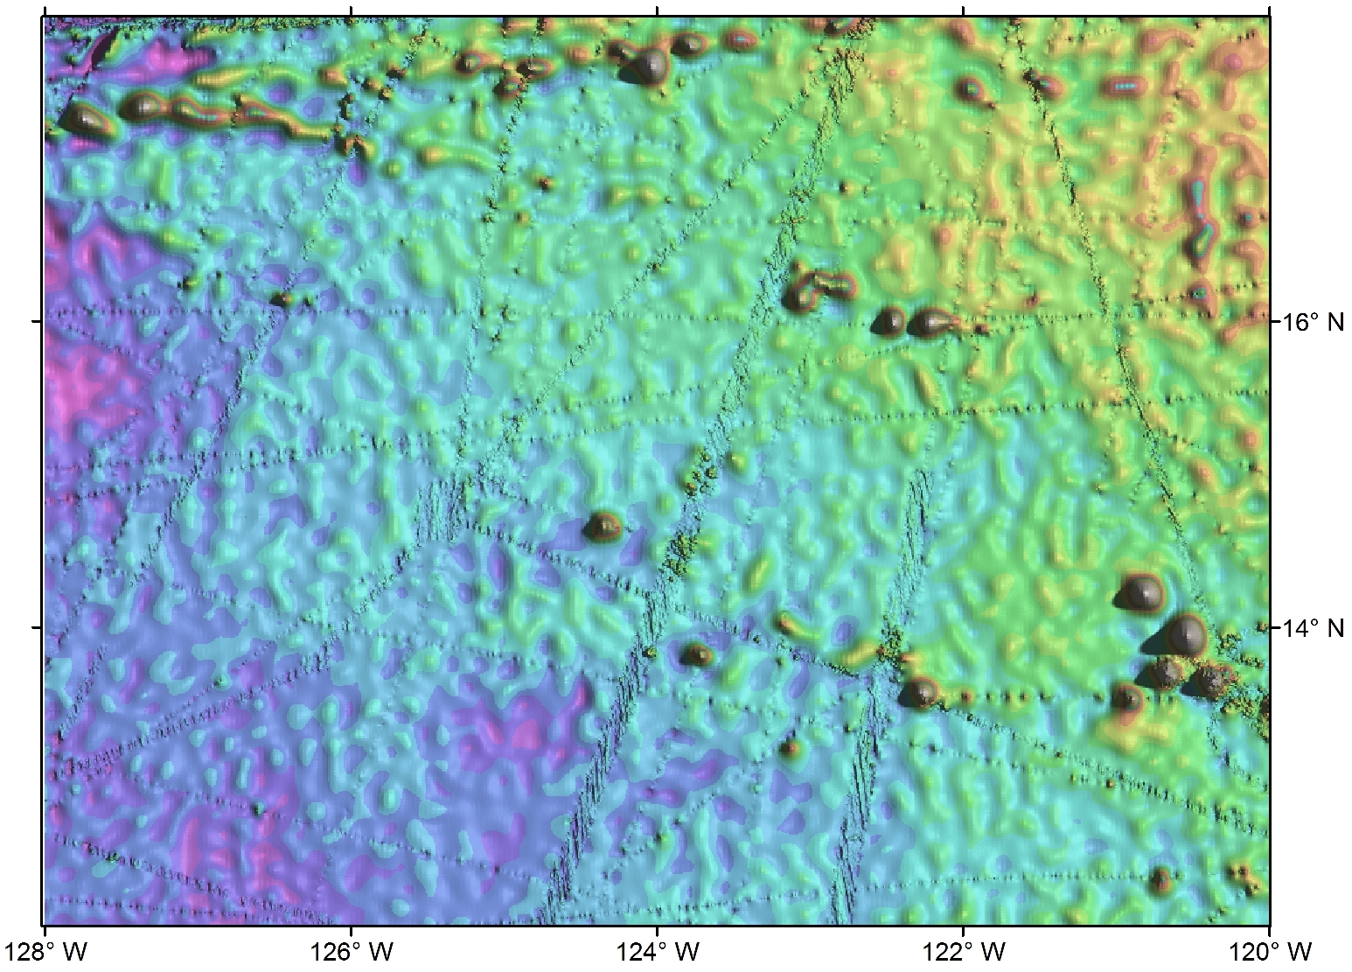
Multibeam bathymetric grids – Pacific Ocean
GEBCO_2014

Slide 22
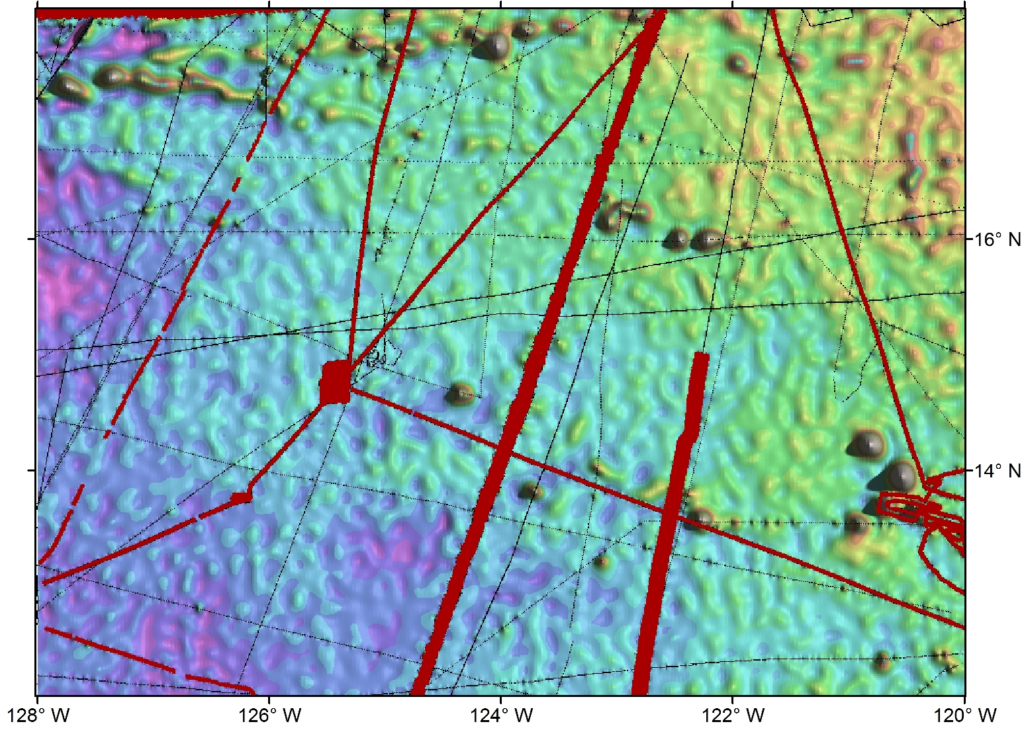
Multibeam bathymetric grids – Pacific Ocean
GEBCO_2014 overlain by track line control. Red = multibeam; black = single beam

Slide 23
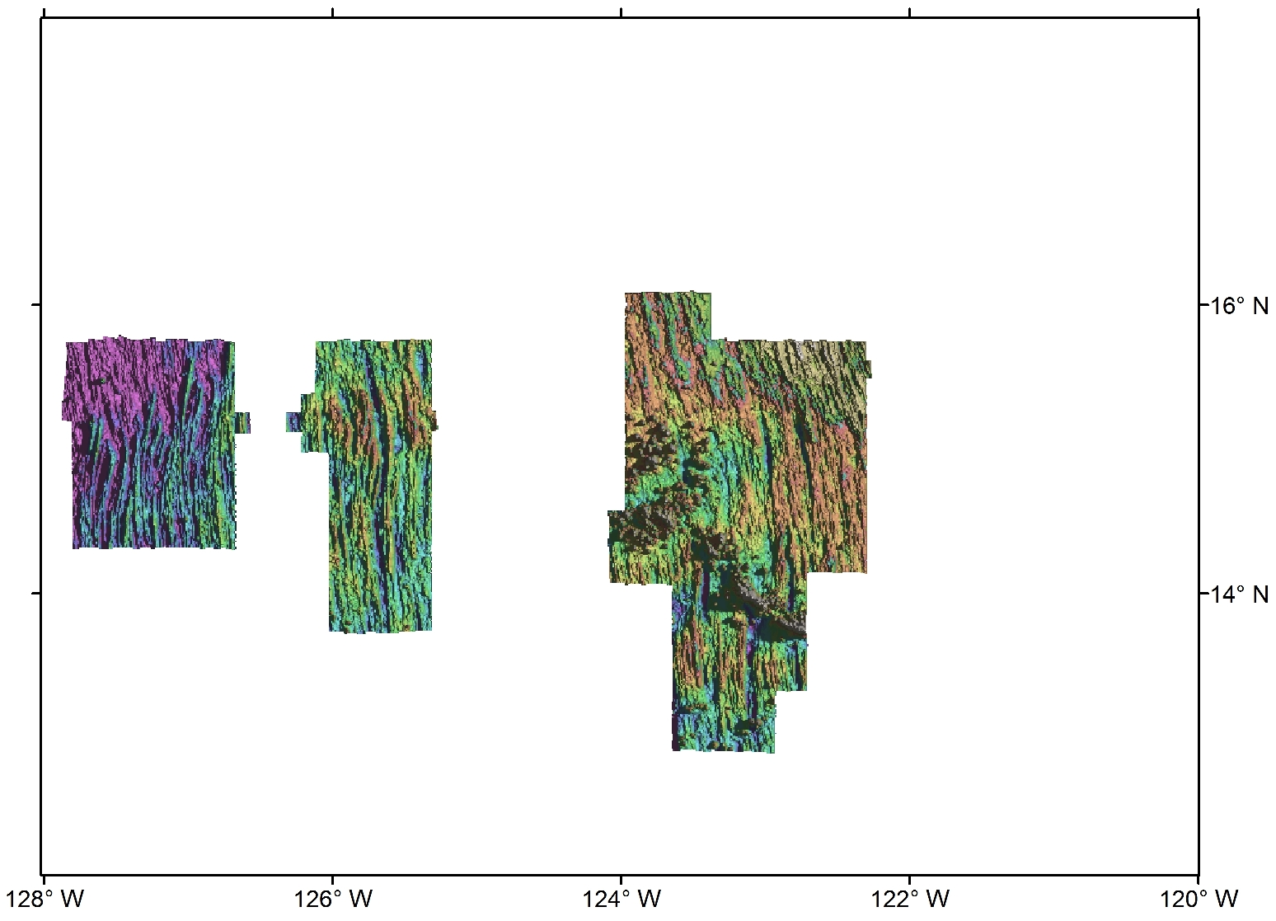
Multibeam bathymetric grids – Pacific Ocean
Bathymetry provided by DEME Group – based on multibeam

Slide 24
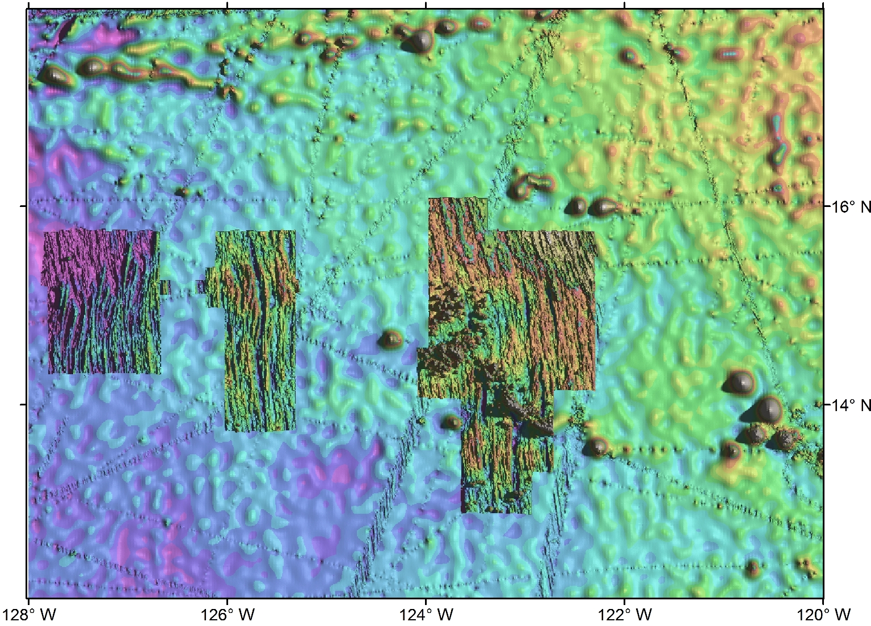
Multibeam bathymetric grids – Pacific Ocean
DEME Group data overlain on GEBCO_2014

Slide 25
Thank you
Any questions?

