Slide 1
Report of the S-124 Correspondence Group of the WWNWS Sub-committee
submitted by Canada (CCG)
S-124 Product Specification progress since HSSC9
Hydrographic Services and Standards Committee

Slide 2
Membership
The members are Australia (AMSA), Brazil, Canada (CCG), China, Denmark (DMA), France, Greece, Japan, New-Zealand, Norway, Republic of Korea (KHOA), Sweden, Turkey, United-Kingdom (UKHO), United States (NGA&USCG), CIRM, Furuno, KRISO, INMARSAT and TRANSAS.
Furuno has joined in the reporting period.

Slide 3
Passing the baton…
  Yves Le Franc (France) has lead the CG since it has been created in October 2013. He is now much less available for this task, and therefore asked to be replaced. Eivind Mong (Canada) took over as chair in February 2018.
  Yves remains a member of the CG, and his continued support of the work is greatly appreciated.

Slide 4
Introduction
S-124 CG is focused on the development the S-100 ProdSpec for the Navigational Warnings (NWs) of the World Wide Navigational Warning Service (WWNWS)
The WWNWS is part of the MSI service of the Global Maritime Distress and Safety System (GMDSS) – The WWNWS sub-committee monitors and guides the WWNWS, studies and proposes new methods to enhance the provision of Maritime Safety Information
NAVAREA, Sub-area and coastal warnings produced by Coordinators and currently broadcast via SafetyNET and NAVTEX in a TELEX format
S-124 should be also suitable for local NWs
MET forecasts and MET warnings are not in scope, and is actively being developed by WMO. S-124 CG chair is in contact with the development group for possible model syncronization.
S-124 will be a technical component of the e-navigation and of the modernization of the GMDSS

Slide 5
Principal activities and achievements
Modelling; following the encoding exercise in 2016 and the comments received from the model review an updated model has been produced.
  Model is explained in greater detail and definitions have been added.
  Improvements to facilitate the shared mechanism for managing the NWs status (in-force or cancelled) on the client side according to the information provided by the Coordinator.
  Implementation of the MRN concept as the globally unique identifiers (GUID).
  Ability for short legends to be displayed on ECDIS.
Additional rounds are required to stabilize the model with the advice of the S-100WG.
➔ The draft Product Specification will continue to evolve.

Slide 6
New version of the data model
- New version is out for review among the S-124CG membership, and testing in the STM Validation and SMART Navigation Projects.
- Plan to seek S-100WG input after initial CG review.
Notes:
This is an abbreviated version of the latest data model. Correspondence group review ended April 30 and adjudication of the comments is underway.

Slide 7
Status of action HSSC9/44
Several members of the CG, including the Chair, attended NIPWG5 where the development of S-124 was reported on as well as a demonstration of the Canadian Navigational Warning Issuing System was given. Many synergies were observed in the discussions.
Several members of the CG, including the Chair, attended S-100WG3. A status report of S-124 development was given. A joint paper with NIPWG chair was submitted requesting change in S-100 Metadata. Many of the papers presented have direct impact on the ongoing development of S-124, and lessons learned will be used going forward.

Slide 8
Some of the future work
Use of the Maritime Resource Name (MRN) concept:
  MRN for Unique Id of a NW
  MRN for linking the NW and the object subject of the NW (e.g. A NW related to a dysfunctional AtoN identified by its MRN)
  Need to consider how S-53 ID can be harmonized with S-124 ID.
Use of HTML for a better presentation of the textual information (description of the danger), may require a new data type in S-100.
Harmonization of short legends to be displayed on ECDIS (“light unlit”, “drifting container”, “firing exercise”…)
Continue to develop mechanism for managing the NWs status (in-force or cancelled) on the client side according to the information provided by the Coordinator

Slide 9
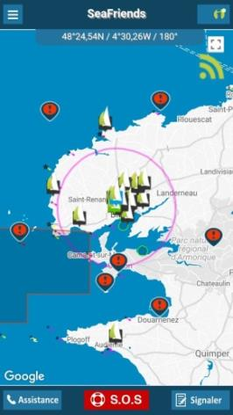
Some principles followed in the development
S-124 should target ECDIS but also other clients
(websites, apps, etc.)
A NW will be issued simultaneously in S-124 and in the current form (S-53, likely generated from S-124 data)
The S-124 form and the S-53 form should provide the same information to the end-user

Slide 10
Technical Services
An objective of Maritime Services is to reduce the load of work on the users and the risks of errors via digitalized information and services.
The delivery of data should be more machine-to-machine.
  This is a domain where harmonization is also needed, in addition to the formatting of the data via Product Specification (e.g. S-124).
NWs services (MSI/MS 5) will be implemented by Technical Services able to deliver S-124 data from the coordinator’s system (machine) to clients systems (machines).
  STM Validation Project is working on a Technical Service Description that hopefully can be leveraged.

Slide 11
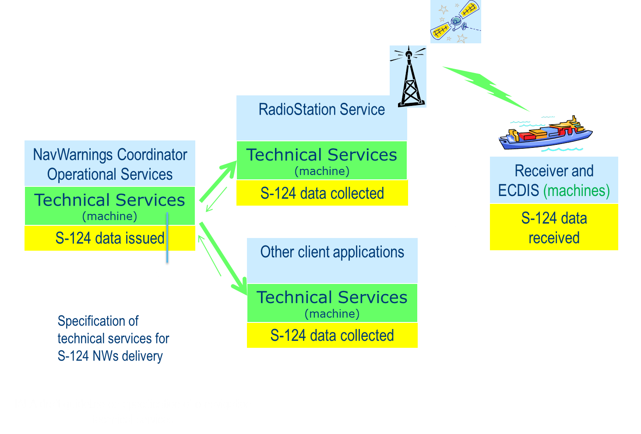
Technical Services
Notes:
This slide gives a high-level architectural view of how S/124 distribution of information is expected to work, and how a technical service is likely to be defined.
There is a two way relationship between the NavWarning Coordinator Operational Service and the Radio station, as well as with other potential client applications such as mobile apps. This is anticipated to allow for efficient exchange of safety critical information.

Slide 12
E-navigation projects support
The e-navigation projects are essential to the development of S-124.
They provide the necessary experience in implementation and testing while the draft standards prepare the basis of harmonized solutions.
Some experts involved in projects and in S-124 CG looked for ways to further help the S-124 development. They have come up with is a set tests that are important to verify some of the assumptions with S-124.
Tests will verify the critical points along all the chain, from the production of the NW to its display in the navigation system. The SMART Navigation project and the STM Validation project have agreed to run the tests and to report the results to the S-124 CG.

Slide 13
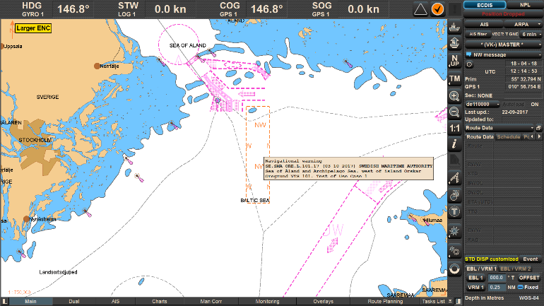
E-navigation projects support
The STM Validation Project is developing the new Baltic Navigational Warning Service, NWs can be sent directly to the on-board ECDIS via digital communication, machine to machine.
After a test in the European Maritime Simulator Network; “an Officer on Watch said in the debriefing afterwards that he now could fully focus on safe navigation knowing that the navigational warnings of relevance would show up directly in the ECDIS on board”.

Slide 14
Thank you for your attention

