Slide 1
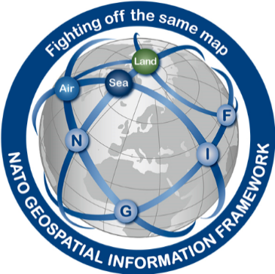
Report of Defence Geospatial Information Working Group (DGIWG)
Hydrographic Services and Standards Committee
Slides provided by Stephane Garcia (FRA) and Al Armstrong (USA)

Slide 2
Principal activities and achievements
DGIF / NGIF Relationship
NGIF 1.0
DGIF 2.0
NGIF 2.0
DGIF 2.1
DGIF 2.2
DGIF 2.x
DGIF 3.0
NGIF 3.0
Notes:
Some confusion of difference

Slide 3
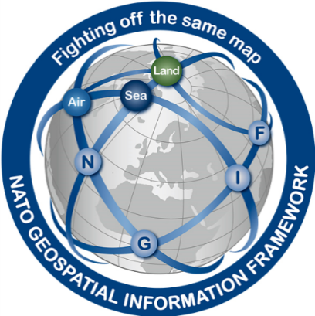
Principal activities and achievements
Implications/Benefits of DGIF to Nations
Nations are able to influence the formation/development of the model
Burden Sharing with other nations – We don’t have to do it all on our own
Standardized Mappings
Model Maintenance
Defence Collaborative Environment – UML based – Tools developed
Ensure a Holistic Geospatial Modelling Approach…

Slide 4
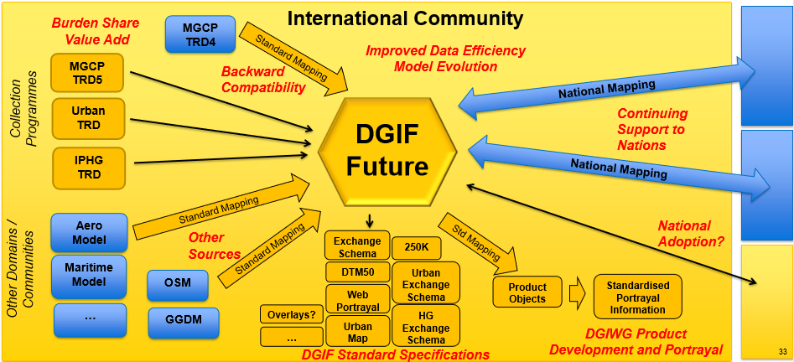
The DGIF Vision
Notes:
The DGIF Vision……

Slide 5
Principal activities and achievements
NGIF2 (AGeoP-11 ed. B) is published (2018)
Based on DGIF 2 (DGIWG 200)
Include DGIWG standards for Imagery (GeoTIFF) and elevation based on DGED
NGIF1 withdrawn
DGIF 2 (DGIWG 200) is the current up-to-date DGIWG standard
Published by DGIWG in 2017
Still being maintained

Slide 6
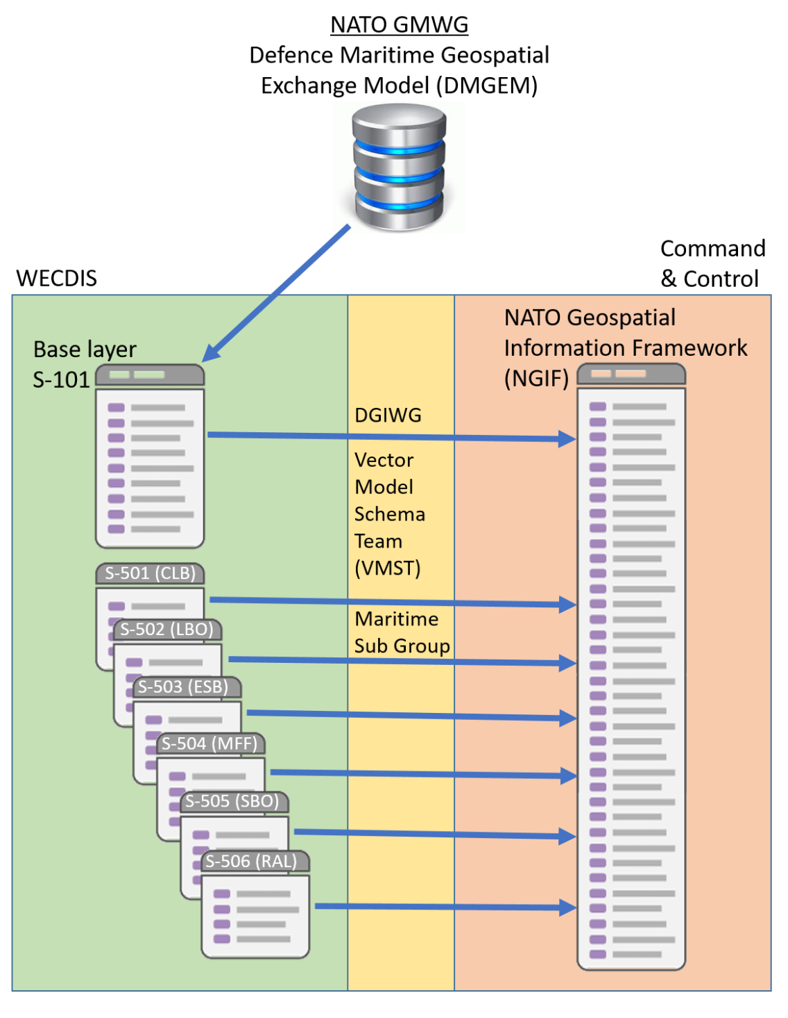
Principal activities and achievements
Maritime focus: S-101 to DGIM mapping
Led by UKHO
Mapping undertaken by NGA
DGIWG support
Further work needed
Updating for DGIM 2.0
Processing of proposals
Addition of AML features and Attributes
A draft mapping is to be provided by end of 2019 based on S-101 v1.0

Slide 7
Problems or outstanding issues
Major Factors in Delay of Gap Analysis
S-101 content vastly reorganized since January 2014.
Team familiarity with the data model.
DGIF model in HTML text format.
Benoit More (FRA) produced new spreadsheet output of DGIF v2 Model
Training to be offered on using Sparx Enterprise Architect software
DGIWG is working on a tool to automate spreadsheet production from the UML model
Major takeaway:
Full gap analysis will require more work.
A first draft of the mapping based on S-101 v1.0 is due for end of 2019
A list of the association roles not to be removed from DGIF will be provided
S-101 content will change over next 2 editions over 4 years.

Slide 8
Action requested of HSSC
To note recent and ongoing maritime relevant activity

