Slide 1
4th IHO-EU Network WG Meeting
EMODnet Coastal Mapping
SHOM
gael.morvan@shom.fr

Slide 2
Objectives
Assess the current availibility of digital coastal maps in the EU
Disseminate this information by EMODnet
Share experience of coastal mapping in the EU
Develop standards for best practices
Propose how a future JECMaP could operate

Slide 3
Deliverables
Every 2 months : progress report
After 6 months : first version of portal on-line
After 9 months : interim report
Summary of challenges involved in preparing portal
Results of task 2(d)i :
Listing and summarizing past experience indicating at least cost, depth range, turbidity, furthest distance from coast, vertical and horizontal tide range.
Results of task 2(d)ii :
Developing and testing an algorithm for choosing most appropriate surveying method.

Slide 4
Deliverables
After 18 months :
final version of portal on-line
final report
executive summary of final report
After 20 months : stakeholder workshop
After 36 months : maintenance report

Slide 5
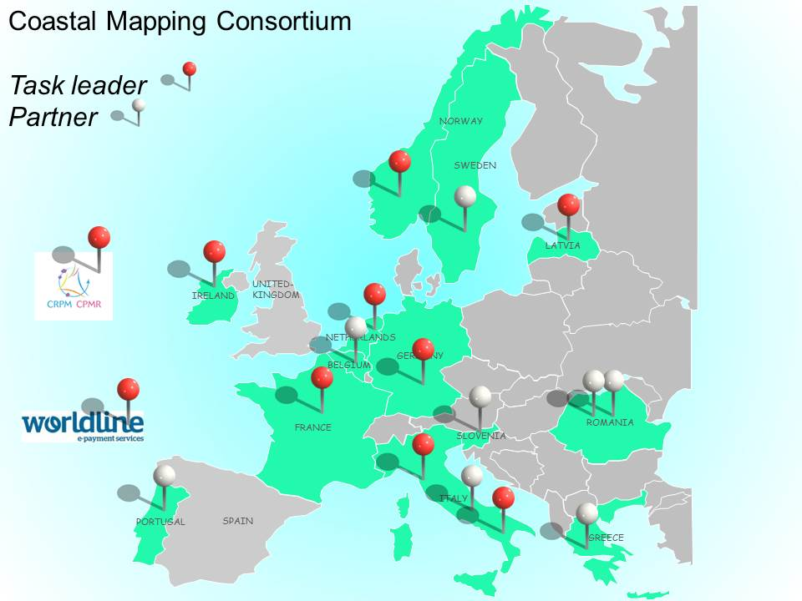
Consortium
Hydrographic offices :
FRANCE – BELGIUM – GERMANY – GREECE – IRELAND – ITALY – LATVIA – NORWAY – PORTUGAL – SLOVENIA – SWEDEN
Regions :
CPMR – Regione Lazio
Public Bodies :
ISPRA – RWS - GeoEcomar – DDNI
IT company :
Worldline
Observers
Hydrographic offices :
UNITED KINGDOM - SPAIN

Slide 6
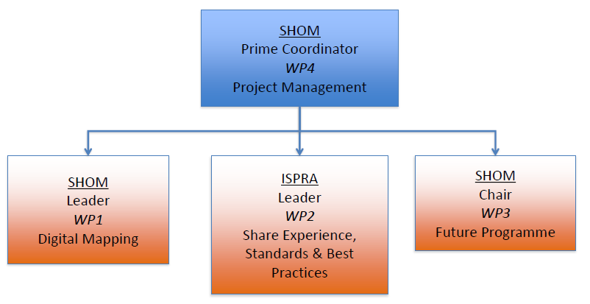
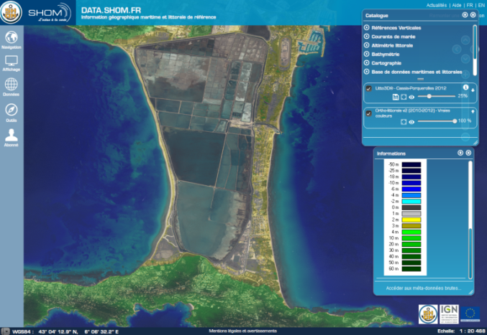
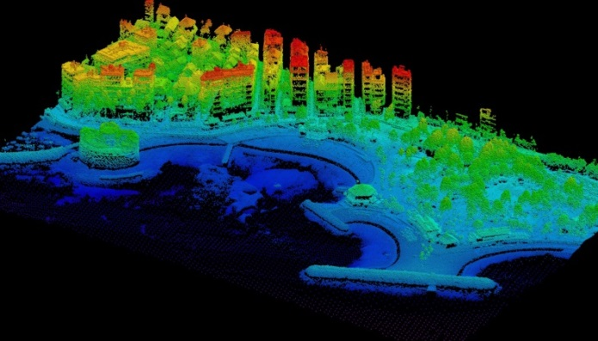
Organisation

Slide 7
Meetings
Kick-off : 24th June 2015
Specification review (M3) : 21st-22nd October 2015 (EMODnet Jamboree)
Portal (M5) : 1st-2nd December 2015
Algorithm (M9) : early March 2016
Interim (M12) : June 2016
Interim (M16) : October 2016
Final (M18) : December 2016 – Brussels
Stakeholder (M20) : Feb. 2017 – To be defined

Slide 8
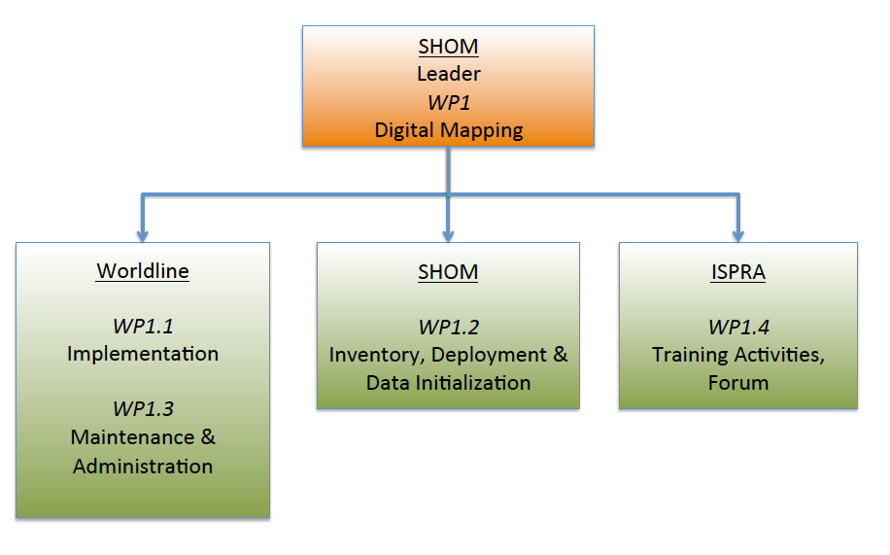
WP1 : Digital Mapping

Slide 9
WP1 progress :
Forum (partners only)
Specifications of the portal : validated in Ostend!
Implementation of the portal itself : done!
Opening to the partners : 18th December
Public opening : 23rd December
Training activities
1st training organized during the algorithm meeting (03/2015) for the partners only
One or more trainings later for other users

Slide 10
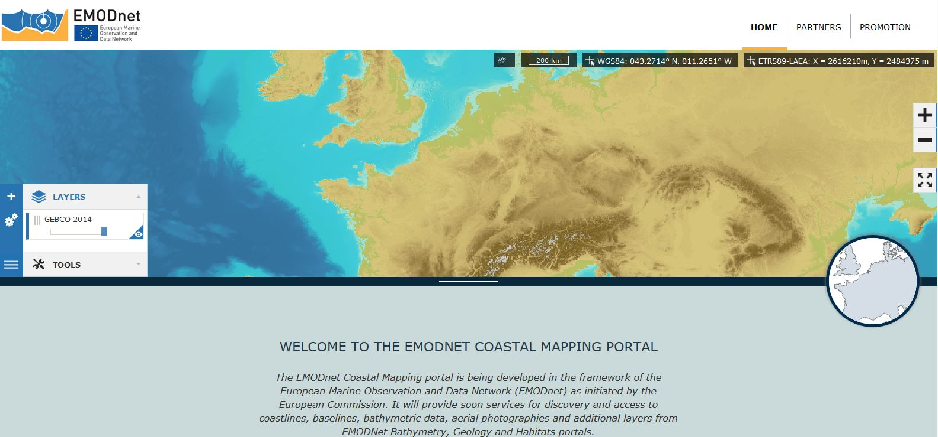
About the portal (1st release) :
Direct access from the website
Default projection EPSG:3035 (ETRS89/ETRS-LAEA)
Can be changed to EPSG:4326 (WGS84) or EPSG:3857 ‘Web Mercator)
WMS and WFS available (WCS later)
Basic Tools for the first release
Data initialization in progress

Slide 11
Behind the Portal:
Backend
Dissemination services
Data Warehouse
Services
Access Control Management
Identity Control Layer
Access Control Layer
Partner Administrator
Internet

Slide 12
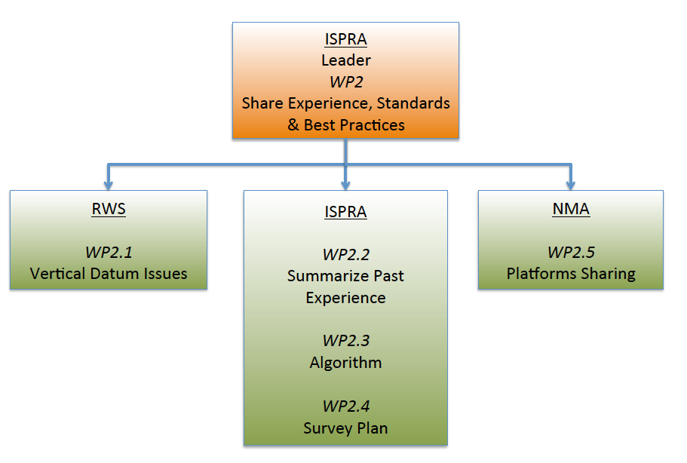
WP2 : Share Experience, Standards and Best Practices

Slide 13
WP2 progress (1/2) :
Assess consistency of the existing vertical datum
Inventory of the used vertical references : in progress
Inventory of available transformations and current developments (national projects) : in progress (survey)
Listing and summarizing of past experiences
Survey on-line(operated by Lime Survey)
Informations on area and on survey
Communicated to the partners and other operators
To be filled in before end of January

Slide 14
WP2 progress (2/2):
Development of an algorithm to help the coastal survey planning at regional level
Coastal Mapping Planner (CMP) basic concepts elaborated
CMP decision tree will use the fuzzy logic
Build a technical and economical strategy
Refinement of the algorithm by adding the cost analysis – not yet started
Sharing plateforms
compilation of the partners contributions in progress

Slide 15
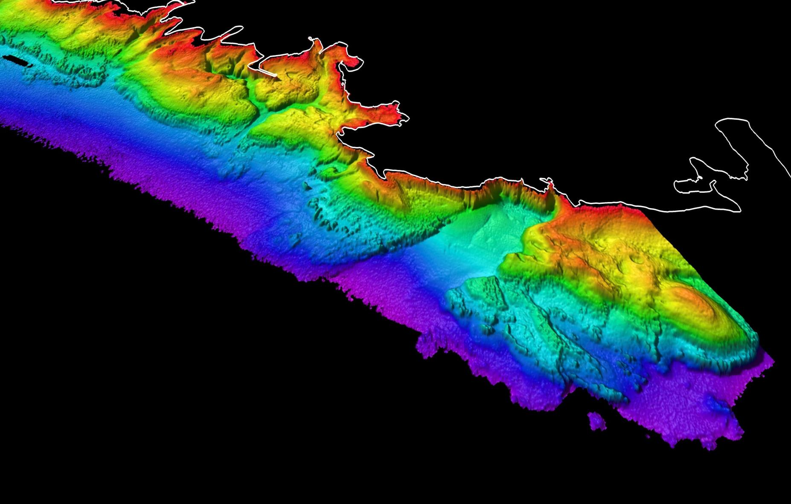
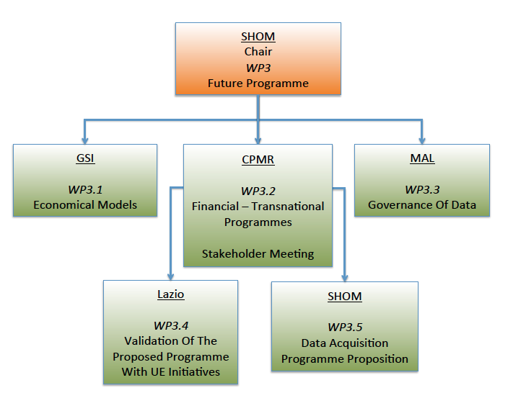
WP3 : Future programme

Slide 16
WP3 progress (1/2):
Inventory of the current economic models
Common survey with Governance topic
Current EU fundings
Template for analysis – Selection of regions – in progress
Analysis of the transnational programmes – in progress
Analysis of the research framework programme – in progress
Governance of bathymetric data management
Survey analysis in progress (already filled in by most of the partners)

Slide 17
WP3 progress (2/2) :
Validation of the programme
Inventory of the tools : Initiatives related to coastal areas (Bologna Charter, Intercoast, Facecoast, TNEC,…)
Inventory of the needs : coastal protection, ICZM, deposits management…
Future programme
Not started – will result from the other tasks.

Slide 18
Thank you!

