Slide 1
IRCC-10
Meso-American and Caribbean Sea Hydrographic Commission Report to IRCC

Slide 2
Organization
Chair: RADM Enrique Flores Morado (MX) Vice Chair: Kathryn Ries (US)
Members: Brazil, Colombia, Cuba, France, Guatemala, Jamaica, Mexico, Netherlands, Suriname, Trinidad and Tobago, United Kingdom, United States of America, Venezuela.
Associate Members: Antigua and Barbuda, Barbados, Belize, Costa Rica, Dominican Republic, El Salvador, Grenada, Guyana, Haiti, Honduras, Nicaragua, Panama, Saint Lucia, Saint Kitts and Nevis, Saint Vincent and the Grenadines.
Industry Participation – EOMAP, Fugro Pelagos, IIC Technologies, Ocean Wise Ltd., Teledyne CARIS, and ESRI
Organizational Participation – IALA, IC-ENC, IMO, INEGI, THSOA, University of the West Indies and York University
Notes:
13 members
14 associate members

Slide 3
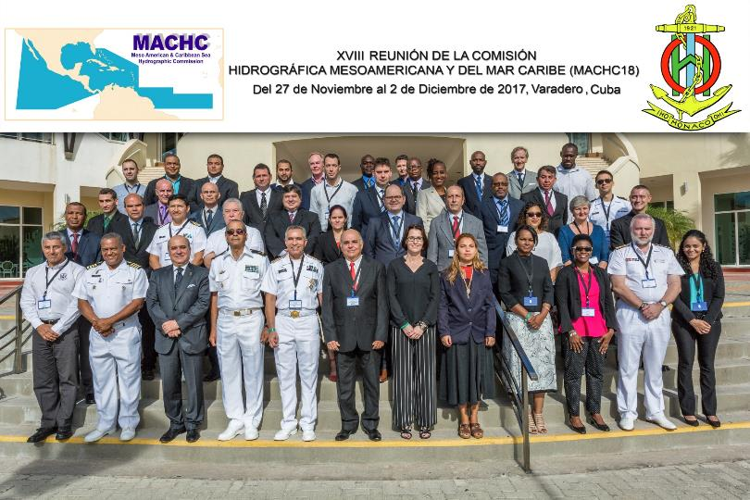
Last Meeting
Notes:
13 members
14 associate members

Slide 4
Capacity Building Committee Chair: Jeff Bryant (UK)

Slide 5
Activities Completed in 2017
Technical Implementation Visits were undertaken to Dominican Republic (January 2018) and El Salvador (December 2017)
Training Courses
An MSI Training Course was delivered in St Michael, Barbados, in June 2017.
Seminars
A two-day Hydrographic Awareness Seminar was organized to precede the main MACHC meeting in Varadero, Cuba in November 2017.
Data Management Workshop with SWAtHC in Montevideo, Uruguay, November 2017.
• Digital Photogrammetry with Satellite Images training course with SWAtHC in Buenos Aires, Argentina, October 2017.

Slide 6
Activities planned for 2018
Technical Visit to Guatemala
Seminar on Raising Awareness of Hydrography
MBES Processing
Tides & Water Levels Workshop for Spanish Speakers

Slide 7
Marine Economic Infrastructure Program Chair: Jim Rogers (US)

Slide 8
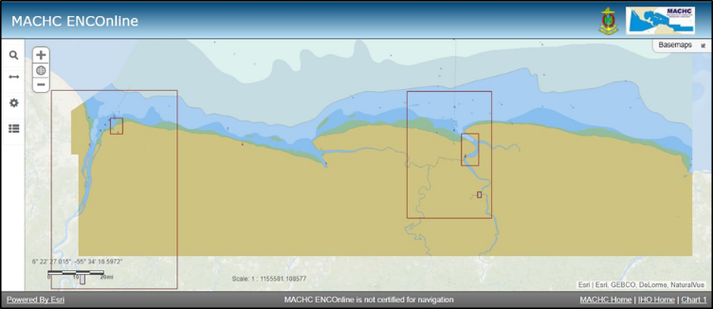
Marine Economic Infrastructure Programme (MEIP) WG
The MACHC password protected ENC Viewer was discontinued. Only the open ENC Viewer remains available.
Suriname has contributed their ENC to the ENC Viewer in 2017. Eight Member States (MS) currently contribute their ENC. The MEIP WG continues to encourage MS to contribute ENC to the Viewer in the future.
Suriname ENC in the MACHC ENC Viewer

Slide 9
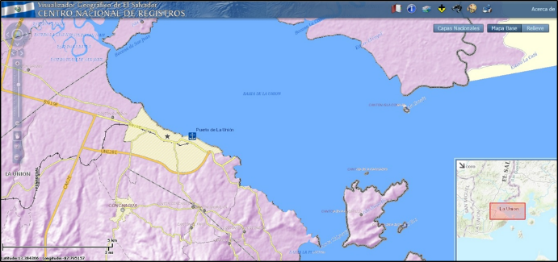
Marine Economic Infrastructure Programme (MEIP) WG
SDI / MSDI website research was conducted by the MEIP WG during 2017. Website addresses were noted by the MEIP WG.
There are many SDI / MSDI websites available within the MACHC community. Individual countries and GeoSur make data available for other purposes within the MACHC region.
El Salvador SDI GIS Portal

Slide 10
MACHC Integrated Charting Committee Chair: John Nyberg (US) Vice Chair: Ricardo Freire (Brazil)

Slide 11
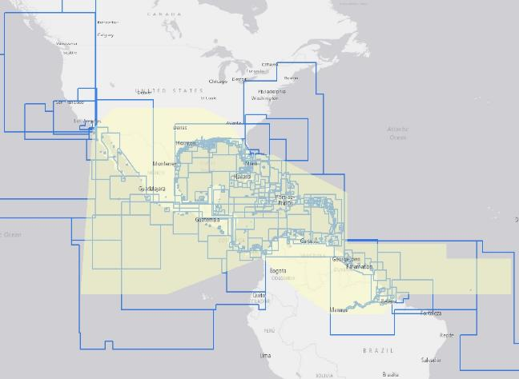
MACHC Integrated Charting Committee (MICC)
842 Available ENC’s
12 Band 1
34 Band 2
106 Band 3
239 Band 4
406 Band 5
45 Band 6

Slide 12
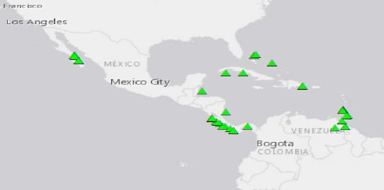
Cruise Ship Port Analysis
Cruise ship analysis identified 43 ports lacking large scale coverage
14 of these 43 ports have ENC coverage planned

Slide 13
Difficulties encountered and challenges yet to be addressed
Promoting the Spanish language with training courses and translations.
Low budget allocated to hydrography which hinders the Hydrographic capacities.

Slide 14
Difficulties encountered and challenges yet to be addressed
Although most of the member countries are in phase 3 of the hydrographic capacity development strategy of the IHO, many of the countries in the region have an insufficient hydrographic development.

Slide 15
Achievements/Outputs/Conclusions
Coverage of nautical charts in the region has not been reached, however it has been possible to identify areas of cartographic interest through of cruise ship analysis through AIS information, there is also a great interest in the development of a methodology for the evaluation of hydrographic risk of the region by the different countries.

Slide 16
Achievements/Outputs/Conclusions
Some countries in the region have contributed funding to strengthen the hydrographic capacities in the Region like Mexico with FOCAHIMECA.
There is also a renewed interest in MSDI with the involvement of some of the countries of the region in the working group on marine spatial information of UN-GGIM.

Slide 17
Actions Required of IRCC 10
Please note this report

Slide 18
Thank You

