Slide 1
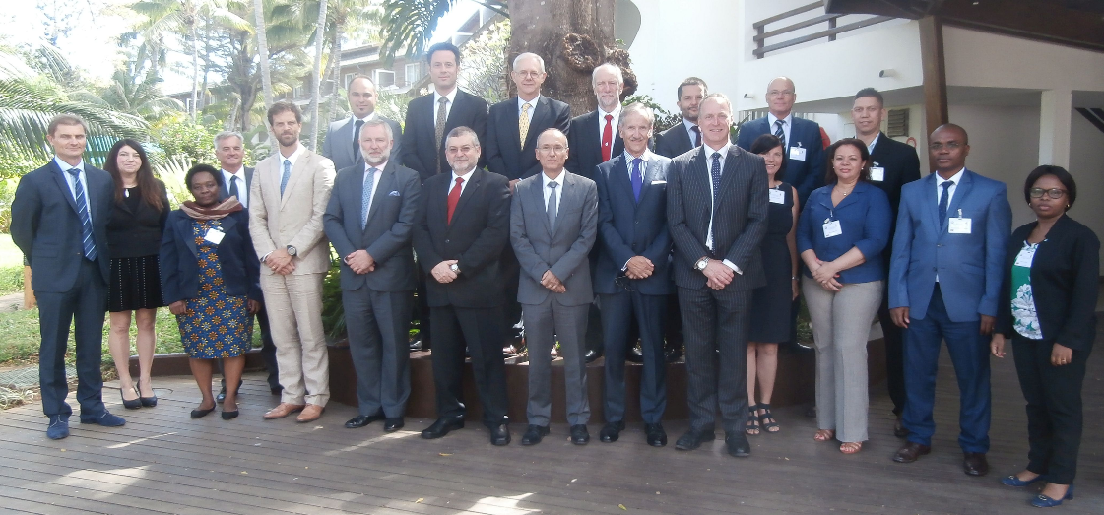
Southern African & Islands Hydrographic Commission (SAIHC) Report

Slide 2
Southern African & Islands Hydrographic Commission (SAIHC) Report
Report of the 14th SAIHC meeting, La Réunion (6 to 8 September 2017)
  The SAIHC meeting was hosted by France (SHOM) in La Réunion.
  The 6th SAIHC INT Chart Coordination Working Group
  (ICCWG) meeting was held prior to the14th SAIHC meeting.
  The 14th SAIHC meeting was chaired by the Vice-Chair, Rear Admiral Tim Lowe (United Kingdom), as Captain Theo Stokes (South Africa) was unable to attend.
  Rear Admiral Tim Lowe (UK) and Captain Theo Stokes (ZA) were later elected as SAIHC Chair and Vice-Chair, respectively.

Slide 3
Southern African & Islands Hydrographic Commission (SAIHC) Report
Topics of note from the 14th SAIHC meeting:
  Improving attendance at SAIHC meetings
  SAIHC Capacity Building Strategy
  Developing the SAIHC ENC Scheme
  Developing an ‘in-region’ MSDI

Slide 4
Southern African & Islands Hydrographic Commission (SAIHC) Report
Improving attendance at SAIHC meetings
  Output from session held on how to improve attendance at SAIHC meetings
    Finance is probably the greatest single issue preventing attendance at SAIHC meetings
    Simplify the approval process to attend - timing of invitation, facilitating visas, etc
    What are the benefits? - make attendance attractive, make it interesting, etc
    Educational awareness for nations Government - high level engagement with potential coastal state Governments from IHO Director

Slide 5
Southern African & Islands Hydrographic Commission (SAIHC) Report
SAIHC Capacity Building Strategy
  The SAIHC has a three year CB Plan covering the period 2018-2020
  SAIHC members are encouraged to review and to suggest new or different activities which are not currently covered in the plan
  The SAIHC CB Coordinator will develop a regional strategy by the next meeting in August 2018

Slide 6
Southern African & Islands Hydrographic Commission (SAIHC) Report
Developing the SAIHC ENC Scheme
  draft SAIHC ICCWG ENC scheme for all usage bands produced - to be discussed at the next ICCWG meeting in August 2018.
  work continues on defining ENC scheme from Mozambique to SAIHC norther border.
  consideration will be given to ENC requirements of emerging offshore energy sector and cruise industry

Slide 7
Southern African & Islands Hydrographic Commission (SAIHC) Report
Developing an ‘in-region’ MSDI
  IRCC9 Action 18 - to encourage Member States in the region to nominate RHC MSDI Ambassadors to promote MSDI and to help Member States to prepare the national reports with respect to the status of MSDI
  Agenda item planned at the next SAIHC meeting to discuss the value to the region of developing an in-region MSDI and the nomination of RHC MSDI Ambassadors.

