Slide 1
GEBCO
GENERAL BATHYMETRIC CHART OF THE OCEANS
Annual report to IRCC-10
Shin Tani (VADM. ret.)
Chairman
Joint IHO-IOC Guiding Committee for GEBCO
Goa, India
5 June 2018

Slide 2
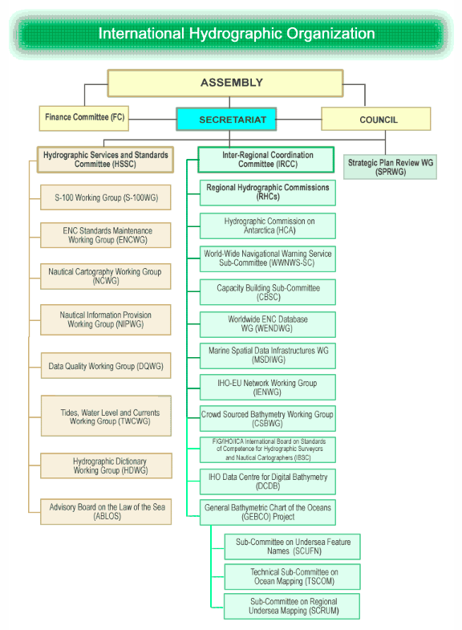
UNESCO IOC

Slide 3
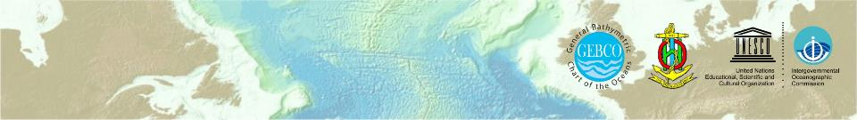
Gatherings
Guiding Committee (GGC)
  34th GGC November 16-17 Busan, Republic of Korea
Sub-Committee for Undersea Future Names (SCUFN)
  30th SCUFN October 2-6 Genoa, Italy
Technical Sub-Committee on Ocean Mapping (TSCOM)
Sub-Committee on Regional Undersea Mapping (SCRUM)
  33rd TSCOM･SCRUM November 13-14 Busan, Republic of Korea
  1st GEBCO Symposium on Bathymetry
  November 15 Busan, Republic of Korea
Notes:
GEBCO operates under the auspices of the International Hydrographic Organization (IHO) and the Intergovernmental Oceanographic Commission (IOC) of UNESCO.

Slide 4
Challenges and Direction
SCUFN ･･････ Sub-Committee on Undersea Feature Names
Maintains and makes available a gazetteer of undersea feature names
  GEBCO Gazetteer of Undersea Feature Names
Gazetteer ･･････････････ important tool for outreach
Contents ････････････ relies on IHO contractor
WEB and DB ････････ relies on IHO DCDB or NOAA’s NCEI
Continued financial allocation for contractor’s job
Potentially very dangerous situation
Notes:
GEBCO operates under the auspices of the International Hydrographic Organization (IHO) and the Intergovernmental Oceanographic Commission (IOC) of UNESCO.

Slide 5
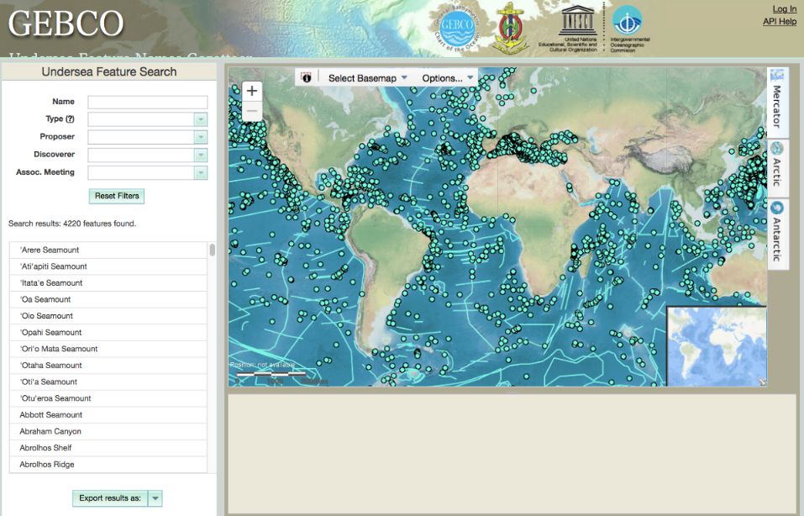

Slide 6
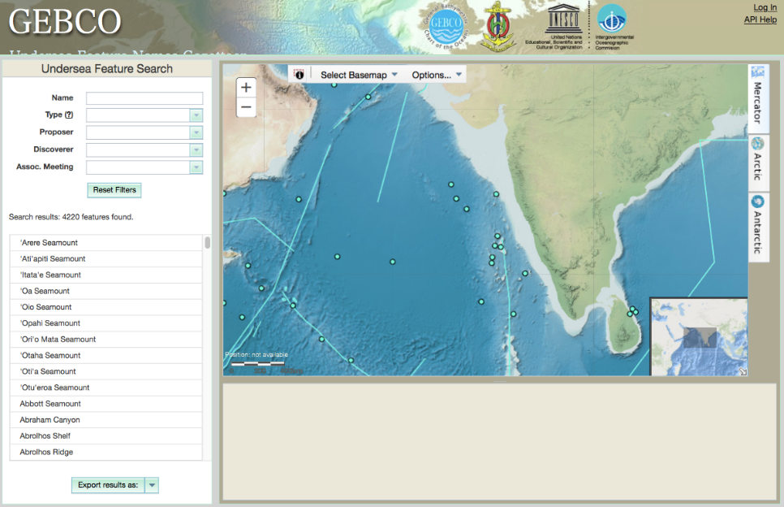

Slide 7
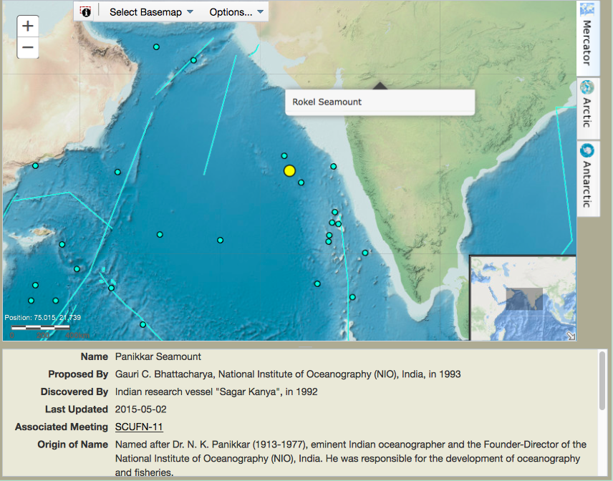

Slide 8
Challenges and Direction
SCUFN ･･････ Sub-Committee on Undersea Feature Names
Maintains and makes available a gazetteer of undersea feature names
can skyrocket along with the progress of Seabed 2030
Increasing # of proposal ･･････
Rep. of Korea’s support to the SCUFN examination is highly appreciated
Not many but some proposals which contain potential of political disputes are stressful to SCUFN members
Notes:
GEBCO operates under the auspices of the International Hydrographic Organization (IHO) and the Intergovernmental Oceanographic Commission (IOC) of UNESCO.

Slide 9
Outcome
TSCOM and SCRUM
Aims to provide the most authoritative, publicly-available
bathymetric datasets for the world’s oceans
  GEBCO 2014 (30 arc-second bathymetric grid)
  GEBCO World Map 2014
Notes:
GEBCO operates under the auspices of the International Hydrographic Organization (IHO) and the Intergovernmental Oceanographic Commission (IOC) of UNESCO.

Slide 10
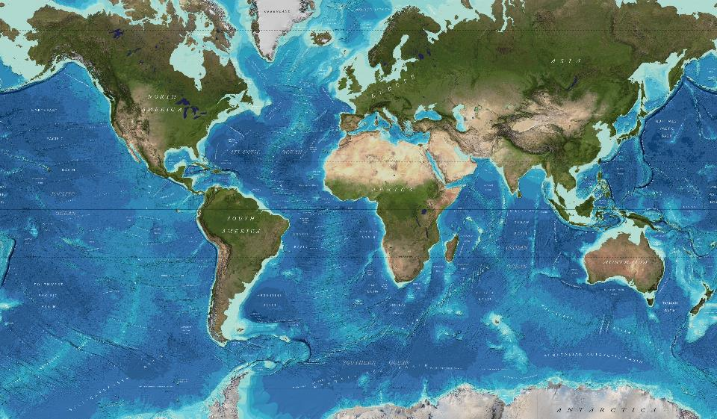

Slide 11
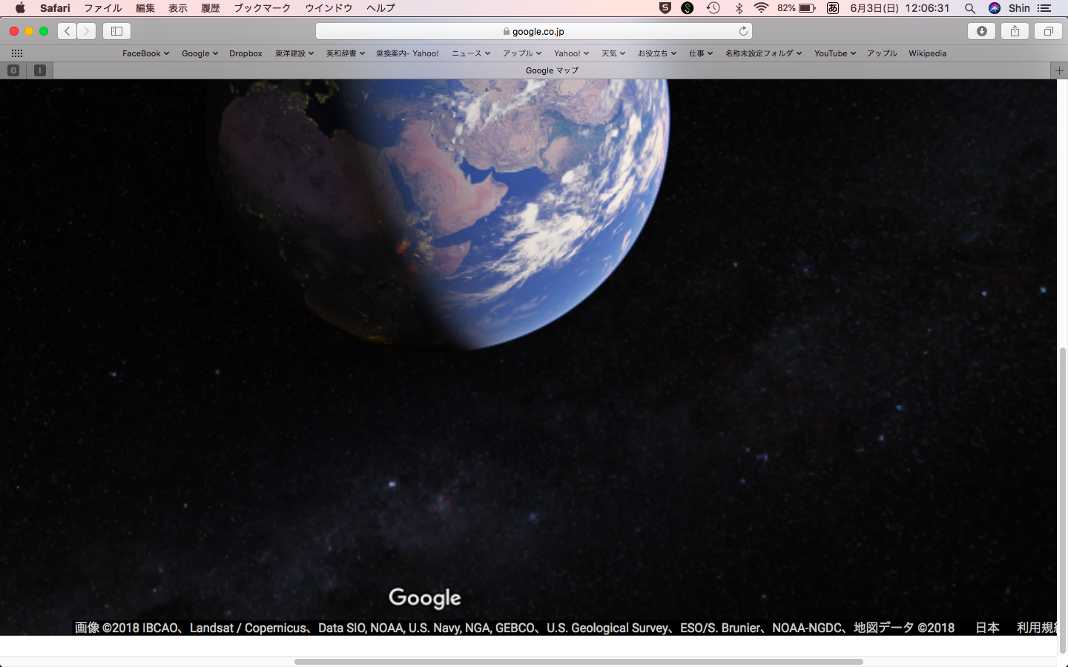

Slide 12


Slide 14
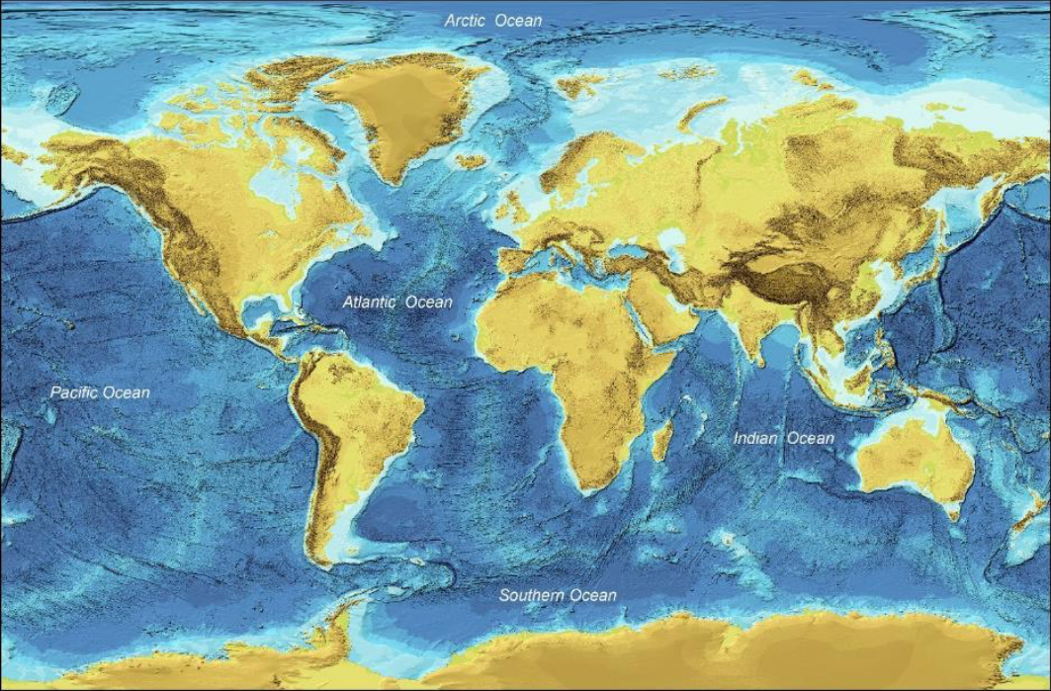
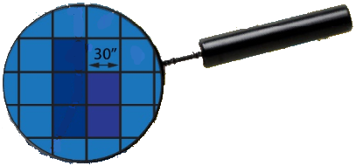
only 18% of grids are supported by sounding data

Slide 15
Lead soundings
multi-beam bathymetry
Single beam bathymetry

Slide 16
GEBCO grids

Slide 18
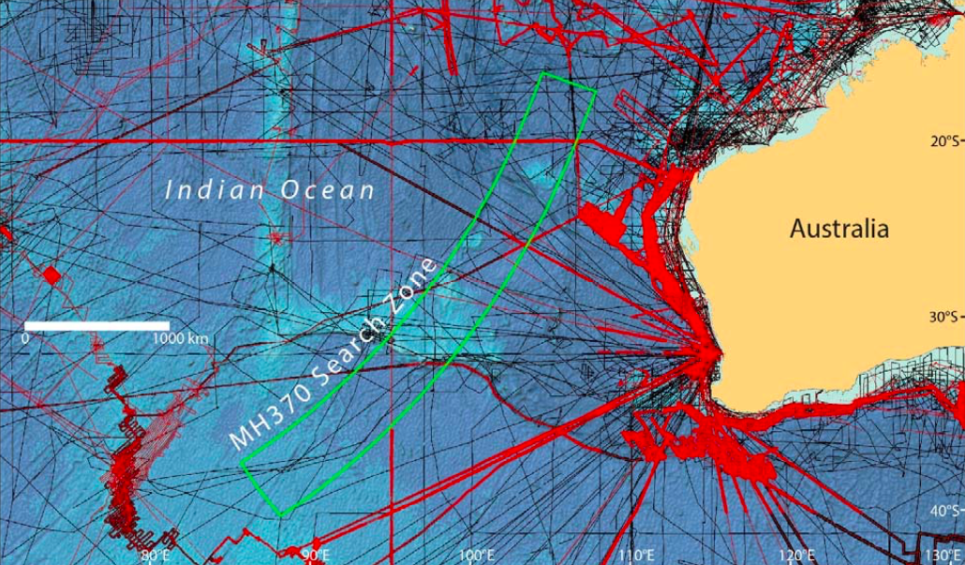

Slide 19
Seabed 2030
Initiated by the Forum for Future Ocean Floor Mapping
held in Monaco in 2016
Declared by Mr Sasakawa of The Nippon Foundation
on the occasion of Ocean Conference at the UN in 2017
GGC approved …… at its 34th Session in Busan
Major success at Busan
Notes:
GEBCO operates under the auspices of the International Hydrographic Organization (IHO) and the Intergovernmental Oceanographic Commission (IOC) of UNESCO.

Slide 20
defense
coastal processes
tsunami
shipping
science
ecology
tourism
habitats
UNCLOS
climate
charting
MPA
fishery
dredging
energy
mining
maps, grids
data
measurements

Slide 21
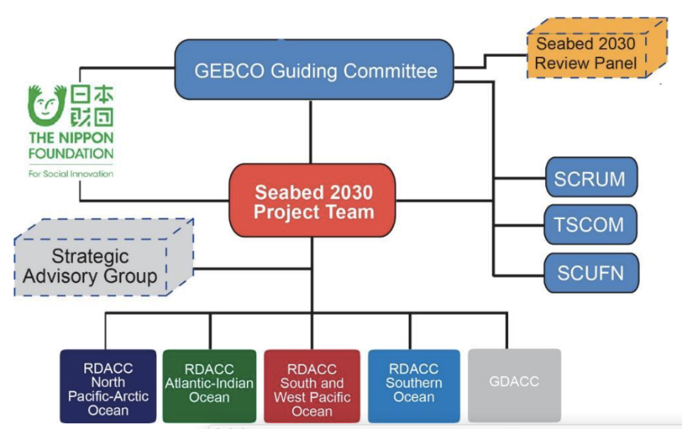
IHO DCDB

Slide 22
RDACCs and GDACC
The North Pacific and Arctic Oceans Center
  University of Stockholm, Sweden
  University of New Hampshire (UNH), USA
The South and West Pacific Oceans Center
  National Institute of Water and Atmospheric Research (NIWA), Wellington, New Zealand
The Atlantic and Indian Oceans Center
  Lamont Doherty Earth Observatory (LDEO), Palisades, NY, USA
The Southern Ocean Center
  Alfred Wegner Institute (AWI), Bremerhaven, Germany
Global Data Assembly and Coordination Center
  British Oceanographic Data Centre (BODC), National Oceanographic Center, Southampton, U.K

Slide 23
Seabed 2030
Initiated by the Forum for Future Ocean Floor Mapping
held in Monaco in 2016
Declared by Mr Sasakawa of The Nippon Foundation
on the occasion of Ocean Conference at the UN in 2017
GGC approved …… at its 34th Session in Busan
Mr. Satinder Bindra
Project Director in 2018
Seabed 2030 project started as from February 20th 2018
is appointed as Seabed 2030
Major success at Busan
Notes:
GEBCO operates under the auspices of the International Hydrographic Organization (IHO) and the Intergovernmental Oceanographic Commission (IOC) of UNESCO.

Slide 24
Seabed 2030
The GEBCO - Nippon Foundation - Seabed 2030
  a global program with the focused goal of compiling
  Digital Bathymetric Model (DBM)
    openly available
    at the highest resolution possible
    from the coast to the deepest trenches
    by the year 2030
    leave no features of the World Ocean floor larger than 100 m
    unmapped

Slide 25
Seabed 2030
To empower the world to
  make policy decisions,
  use the ocean sustainably and
  undertake scientific research
  for the sustainable development,
  based on the detailed bathymetric information
  of the Earth’s seabed.

Slide 26
How to increase data
Dig up existing data
Create new data flow, such as;
  crowd sourced bathymetry (CSB)
  Data harvesting from ENC
  Expansion of GEBCO family
include data from new survey technologies, such as;
  satellite derived bathymetry (SDB),
  lidars,
  AUVs, ROVs, gliders, data buoys

Slide 27
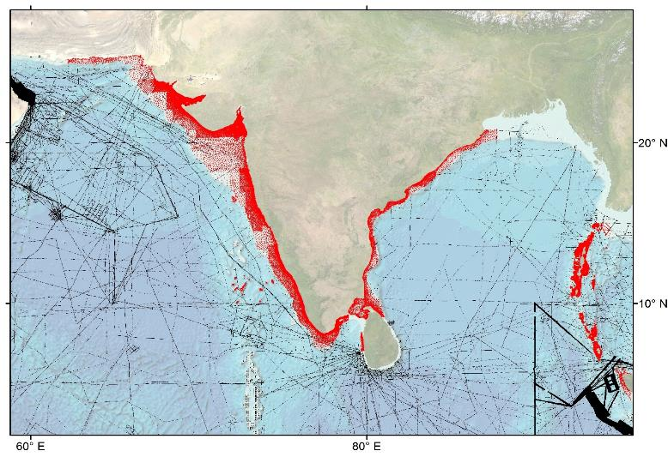
How to help improve
global bathymetric models
Coverage of source bathymetry data used to develop GEBCO’s global grid in the region
of the
North Indian Regional Hydrographic Commission.
Red: ENC-Soundings Black: Grid cells in the GEBCO grid constrained by ship-track soundings
Notes:
Shows how data coverage improved considerably by input of enc data

Slide 28
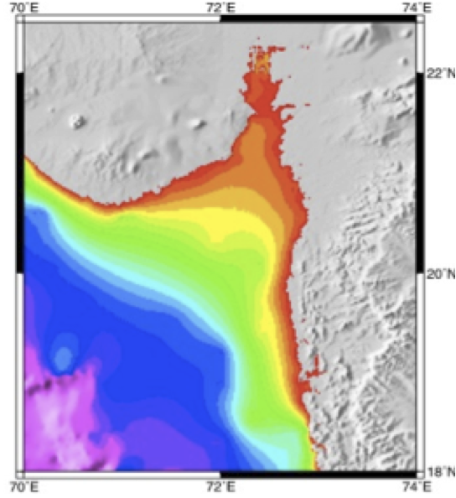
Shallow water
bathymetry initiative
Notes:
Shows how data coverage improved considerably by input of enc data

Slide 29
Shallow water
bathymetry initiative
Notes:
Shows how data coverage improved considerably by input of enc data

Slide 30
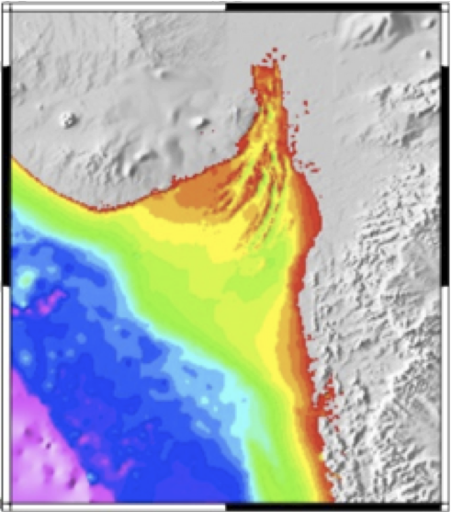
Shallow water
bathymetry initiative
Notes:
Shows how data coverage improved considerably by input of enc data

Slide 31
Importance of hydrographic data
Quality assured data
Mostly for shallow waters where GEBCO did
not touch upon for years
Good and in many cases only source for
calibration of CSB and SDB data.

Slide 32
Challenges and Direction
GEBCO Science Day → GEBCO Symposium on Bathymetry
Not only for scientists but for all stakeholders, which is
in line with Seabed 2030
Major success at Busan
Major success at Busan
Notes:
GEBCO operates under the auspices of the International Hydrographic Organization (IHO) and the Intergovernmental Oceanographic Commission (IOC) of UNESCO.

Slide 33
Members of GGC
IHO Appointed Members: Term Period:
VADM (ret.) Shin Tani (Japan) (Chair) (2013-2018)
RADM Patricio Carrasco (Chile) (2013-2018)
Prof. Hyo Hyun Sung * (Republic of Korea) (2014-2019)
Capt. Norhizam Hassan (Malaysia) (2015-2020)
Dr. Graham Allen (United Kingdom) (2015-2020)
IOC Appointed Members:
Dr. Martin Jakobsson * (Sweden) (Vice-chair) (2013-2018)
Dr. Robin Falconer * (New Zealand) (2013-2018)
Dr. Marzia Rovere (Italy) (2014-2019)
Dr. Johnathan Kool (Australia) (2016-2021)
Capt. Leonid Shalnov (Russian Federation) (2016-2021)
Ex-officio Members:
Dr. Hans-Werner Schenke (Germany) (Chair of SCUFN)
Dr. Karen Marks (USA) (Chair of TSCOM)
Dr. Vicki Ferrini (USA) (Chair of SCRUM)
Ms. Jennifer Jencks (USA) (Director of IHO-DCDB)
Notes:
GEBCO operates under the auspices of the International Hydrographic Organization (IHO) and the Intergovernmental Oceanographic Commission (IOC) of UNESCO.

Slide 34
Members of GGC
Membership
5 IHO nominated and 5 UNESCO-IOC nominated members
5-year term, two terms maximum
Geographical balance and expertise mix have to be taken
into account.
Increased and widened responsibility require continuation
and smooth transition of members
IHO Secretariat and UNESCO-IOC Secretariat have agreed
to commence selection earlier
GGC hopes to have new members with experiences in
GEBCO activities such as Sub-Committees work.
Major success at Busan
Notes:
GEBCO operates under the auspices of the International Hydrographic Organization (IHO) and the Intergovernmental Oceanographic Commission (IOC) of UNESCO.

Slide 35
IRCC is invited to
note the contents of the report;
endorse the work plan 2018-2019;
continue to encourage RHCs to organize contribution of bathymetric data in shallower coastal areas from their member states to GEBCO in order to support the production of higher resolution gridded data products of GEBCO;
encourage RHCs to invite and communicate with GEBCO members to their meetings as appropriate; and
take any actions deemed necessary.

