Slide 1
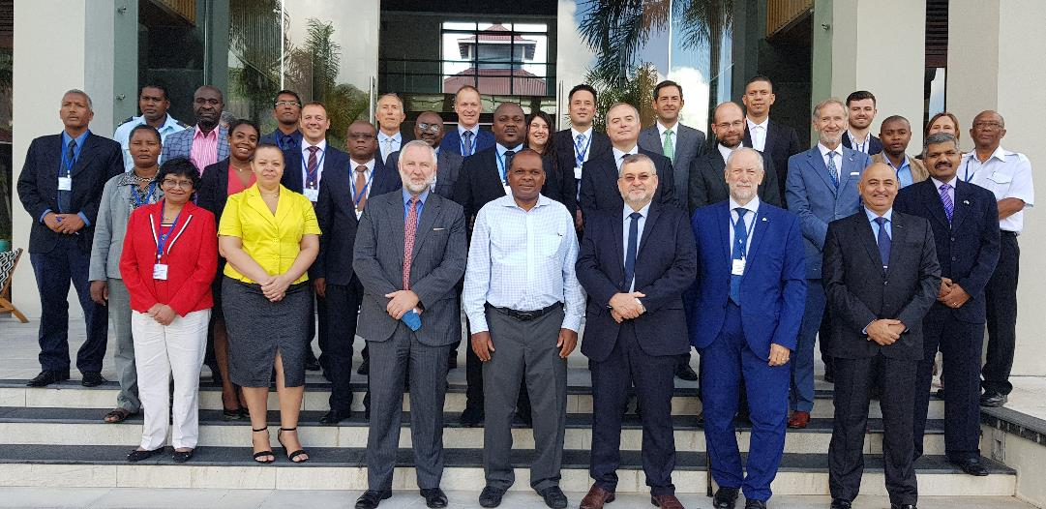
Southern African & Islands Hydrographic Commission (SAIHC) Report
11th Inter-Regional Coordinating Committee (IRCC) Meeting, Genoa, Italy, 3 to 5 June 2019

Slide 2
Southern African & Islands Hydrographic Commission (SAIHC) Report
Report of the 15th SAIHC meeting, Seychelles (27 to 30 August 2018)
The SAIHC meeting was hosted by Seychelles at Eden Island
The meeting was chaired by Rear Admiral Tim Lowe (GB) and the vice-chair was Captain Theo Stokes (ZA)
The 7th SAIHC INT Chart Coordination Working Group (ICCWG) meeting was incorporated into the 15th SAIHC meeting
The 15th SAIHC established a MSDI Working Group

Slide 3
Southern African & Islands Hydrographic Commission (SAIHC) Report
Topics of note from the 15th SAIHC meeting:
Improving attendance at SAIHC meetings
SAIHC Capacity Building Strategy
Developing the SAIHC ENC Scheme
Developing an ‘in-region’ MSDI
Proposed update to RHC report to IRCC template

Slide 4
Southern African & Islands Hydrographic Commission (SAIHC) Report
Improving attendance at SAIHC meetings
Excellent contributions to SAIHC14 on how to improve attendance at SAIHC meetings resulted in greatly improved attendance at SAIHC15
Members: France, Mauritius, Mozambique, Norway, South Africa, Seychelles, and United Kingdom.
Associate Members: Angola, Comoros, India, Kenya, Madagascar, Malawi, Namibia, Portugal and Tanzania.
Observers: GEBCO, IALA, RENCs and Industry representatives.

Slide 5
Southern African & Islands Hydrographic Commission (SAIHC) Report
SAIHC Capacity Building Strategy
The SAIHC has a three year CB Plan covering the period 2018-2020
CB Activities completed in 2018/19
A High-Level visit to Angola, An MBES Processing and Data Base training course for Mozambique, Seminar on Raising Awareness of Hydrography was held prior to SAIHC15
SAIHC thanks the IHO Capacity Building fund for sponsoring attendance at the Hydrographic Awareness Seminar and SAIHC15
Angola, Comoros, Kenya, Madagascar, Malawi, Mauritius, Mozambique, Namibia and Tanzania
In 2018, Seychelles was welcomed as a full Member of the SAIHC having become the 88th Member of the IHO

Slide 6
Southern African & Islands Hydrographic Commission (SAIHC) Report
Developing the SAIHC ENC Scheme
Further progress has been made the SAIHC ICCWG ENC scheme for all usage bands
The ENC scheme from Mozambique to the northern limit of SAIHC Region H is undergoing assessment and risk analysis (Mozambique, Tanzania and Kenya)

Slide 7
Southern African & Islands Hydrographic Commission (SAIHC) Report
Developing an ‘in-region’ MSDI
SAIHC MSDI Working Group established at the 15th SAIHC meeting.
Tim Lewis (UK) agreed to Chair the SAIHC MSDIWG
IRCC10 Action 10 – MSDIWG to develop basic MSDI training material in order to allow RHCs to deliver training with their own personnel.
SAIHC MSDI Working Group to discuss how best to utilise and develop basic MSDI training material planned to be produced by the IHO MSDIWG.
SAIHC CB Coordinator liaising with the Chair IHO MSDIWG concerning planned Phase 1 and 2 MSDI training material.

Slide 8
Southern African & Islands Hydrographic Commission (SAIHC) Report
Proposed update to RHC report to IRCC template
The "Instructions for the Submission of Reports and Proposals“ ‘IRCC’ document requires a revision in the light of:
The IRCC10 decision to reclassify IRCC Actions related to RHCs as “Recommendations to RHCs”
Member State’s comments to the revised draft IHO Resolution 2/1997 as amended (IRCC10 Actions 2-6)

Slide 9
Southern African & Islands Hydrographic Commission (SAIHC) Report
In conclusion, the IRCC is invited to:
note the report.
consider updating the RHC report to IRCC template, to include “IRCC recommendations to RHCs”.

