Slide 1
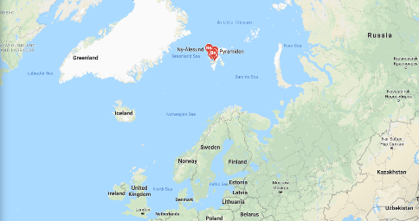
Regional Hydrographic Commission Report to IRCC11
Genoa, Italy
June 3-5, 2019
Arctic Regional Hydrographic Commission

Slide 2
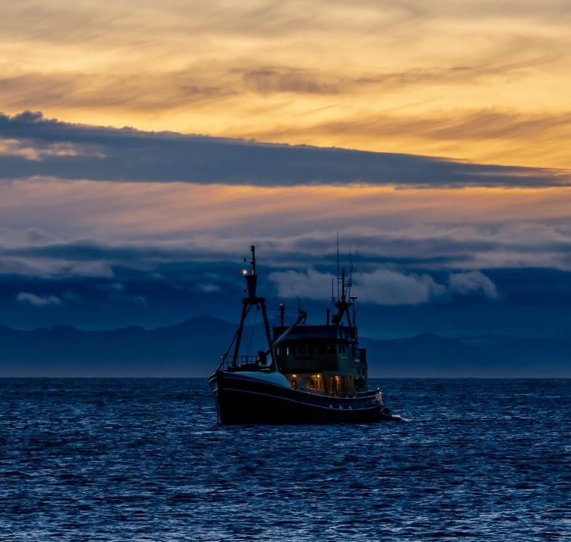
ARHC
Chair: CAPT Sergey Travin (Russian Federation)
Vice-chair: RDML Shepard M. Smith (USA)
Members: Canada, Denmark, Norway,
Russian Federation, USA
Associate Members: Finland, Iceland, Italy (new)
Observers: -
Associate Member Application Pending: UK

Slide 3
ARHC – meeting since IRCC-10
IHO Program 3 Priorities (2019):
Capacity Building Provision, INT and ENC schemes, Crowd-sourced Bathymetry, Project Seabed 2030, and Marine Spatial Data Infrastructures (MSDI).
ARHC8 Conference - 11-13 September 2018, Longyearbyen, Svalbard, Norway
Concurrent with Open Forum and joint ARHC ARMSDIWG-Arctic SDI working group meeting
including Arctic Science Workshop
Notes:
Shoutout to Norway as Chair and host
The Program priorities are as articulated at IRCC meeting in 2018.

Slide 4
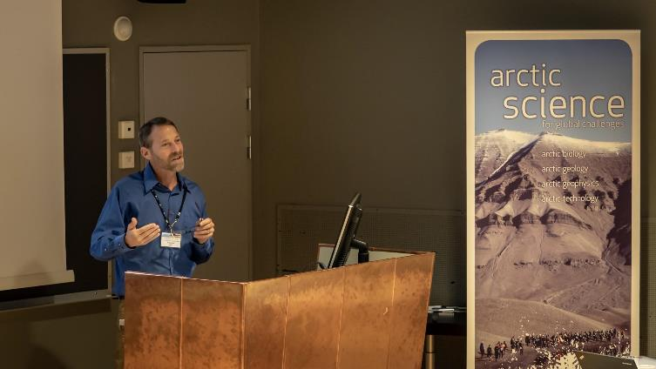
ARHC Agenda Items
Open Forum “Improving Marine Knowledge in the Arctic”
Council preparations
Contributions to IHO Work Program
Autonomous Vehicles, WEND, MSDI, echo sounder impacts, Risk Assessment, Data Policy, CSB
Outreach
Capacity Building

Slide 5
Cooperation with Stakeholders
Arctic Science Workshop
2018: focus on needs and drivers in Svalbard, Norway
Arctic Council
PAME
3rd Annual Arctic Shipping Best Practices Information Forum (June 3-4)
2019 Theme “Polar Code Implementation: From Theory to Practice”
https://pame.is/index.php/projects/arctic-marine-shipping/the-arctic-shipping-best-practices-information-forum/third-meeting-of-the-forum
Arctic Council WG’s (AMAP, CAFF, eppr and PAME) and Arctic SDI
Notes:
An important way the ARHC involves local stakeholders so we can gain insights into the practical and current issues communities face in the arctic is through our one day science workshops which immediately preceed the two day regional commission meeting. Last year, the workshop (add something about participants, orgs represented and an interesting fact that came out)
We have also been actively seeking to support and inform the discussions of the Arctic Council about the important role hydrography plays in the context of its governance deliberations. As many you are well aware, the Arctic Council is the senior-most advisory body composed for Foreign Ministers of ## nations and other organizations. talking points on PAME… This week, PAME is holding its 3 rd annual ASBPIF where in prior years CA and NO have participated. This year, the US HO is sending a representative. The theme of the two day Forum this year is Polar Code implementation. To this, the ARHC, member states and organizations have contributed content and context to the Polar portal which I will touch on in a moment.
IN addition the Conservation of Arctic Flora and Fauna is another subcommittee of the Arctic Council. In support of this, a group has formed the Arctic Spatial Data Infrastructure to inform the CAFF of the geospatial considerations to be taken into account in their deliberations. The ARHC, through its MSDI-working group, has been working closely with the Arctic SDI to add much maritime content to the framework. More on this later.

Slide 6
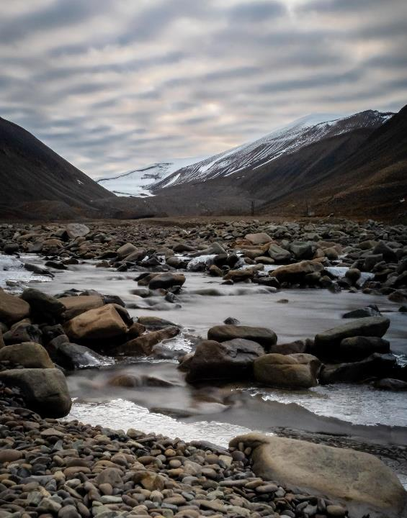
ARHC Achievements
Focused Working Groups functioning
ARMSDIWG, OTWG
Contributions to global initiatives
SB 2030 Gap Analysis
UNGGIM
ARHC-PAME MOU draft
Connectivity to IHO prioritization and the planning cycle of in the IHO Annual Work Program
ARHC Logo
Notes:
Guiding much of the preparation for the ARHC meetings are working groups- two active ones include the ARMSDIWG and the OTWG.
The ARHC is also contributing to the SeaBed 2030 by analyzing the holdings of the DCDB in Region N. This analysis is currently underway with NO, CA, and US taking an initial lead conducting the analysis of coverage of holdings current holdings meeting the target of Seabed 2030.
ARHC and the Arctic Council PAME have identified a utility to officially recognize the mutual assistance the two bodies can provide each other and to formalize a cooperative, nonbinding relationship through an MOU. The desire to establish such an MOU was confirmed last year and the first draft is currently under review by both bodies. Conceivably, it could be formalized this or next year.
I also want to note what I think is an important governance achievement we are making- namely actively participating in IHO governance bodies, such as the IRCC and Council, and ARHC response to IHO Program 3 priorities and inclusion of ARHC milestones and deliverables in the IHOs annual work programs. While the connectivity has always been there, we are deliberating trying to make this more readily visible to the broad community.

Slide 7
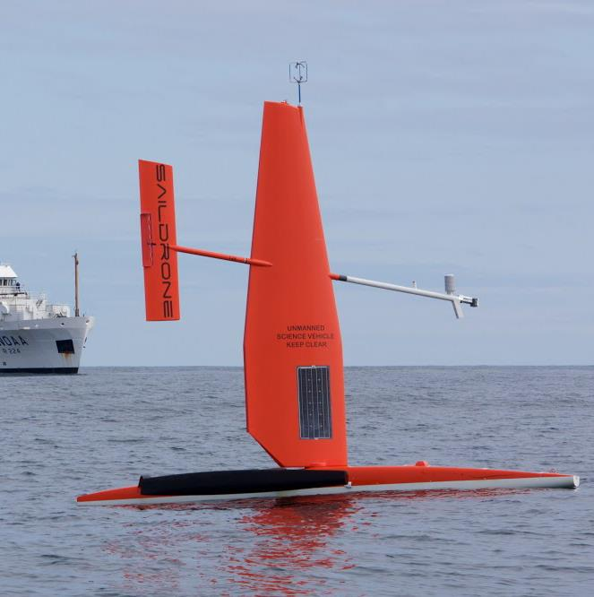
Support for SB 2030
Gap Analysis performed to SB2030 resolution by US, CA, NO
Standing agenda item to review progress, share mapping plans, identify opportunities for data sharing and joint mapping campaign activities.
Communications with Martin Jacobsen (Stockholm University) and Larry Mayer (UNH) on regional gap analysis and to promote data sharing
Notes:
Guiding much of the preparation for the ARHC meetings are working groups- two active ones include the ARMSDIWG and the OTWG.
The ARHC is also contributing to the SeaBed 2030 by analyzing the holdings of the DCDB in Region N. This analysis is currently underway with NO, CA, and US taking an initial lead conducting the analysis of coverage of holdings current holdings meeting the target of Seabed 2030.
ARHC and the Arctic Council PAME have identified a utility to officially recognize the mutual assistance the two bodies can provide each other and to formalize a cooperative, nonbinding relationship through an MOU. The desire to establish such an MOU was confirmed last year and the first draft is currently under review by both bodies. Conceivably, it could be formalized this or next year.
I also want to note what I think is an important governance achievement we are making- namely actively participating in IHO governance bodies, such as the IRCC and Council, and ARHC response to IHO Program 3 priorities and inclusion of ARHC milestones and deliverables in the IHOs annual work programs. While the connectivity has always been there, we are deliberating trying to make this more readily visible to the broad community.

Slide 8
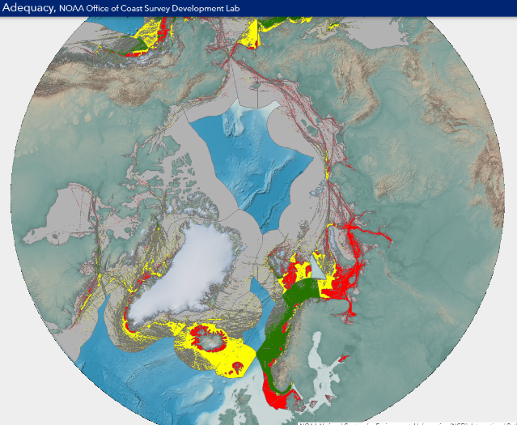
Operations and Technology Working Group (OTWG)
Assessment of Arctic Hydrography
Initial Assessment (2015)
REF: IHO ARHC5-C2
Updated (2018)
REF: IHO ARHC8-C1a
Summarizes methodology, area of study/concern, vessel traffic and conclusions
Echo sounder impacts
Autonomous Vehicles
Further information:
Corey.Allen@noaa.gov (Chair) and
National Focal Points
https://noaa.maps.arcgis.com/apps/webappviewer/index.html?id=2e0f077b8a0147149c8229c9204332d7
https://noaa.maps.arcgis.com/apps/webappviewer/index.html?id=2e0f077b8a0147149c8229c9204332d7

Slide 9
Conclusions of the Re-Assessment
We have high confidence in the survey data of only 2% of the area.
Nearly half (42%) of all areas transited by vessels in the Arctic is in areas we consider of high navigational concern.
Much of the area is unassessed from a CATZOC perspective. A review and classification of existing holdings will improve this analysis.
This traffic-based analysis may be used to prioritize new data acquisition.
The very high traffic densities in some areas, notably in the Norwegian, Barents, and Kara Seas suggest that crowd based approaches to acquire new hydrographic data may be attractive.
In areas dominated by corridor-like transits, such as the Northern Sea Route across the top of Siberia and the Northwest Passage across Canada, establishment and survey of traffic lanes would improve the hydrographic data available to the most users.

Slide 10
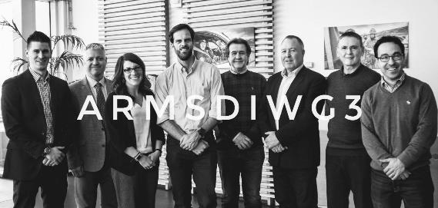
ARMSDIWG
ARMSDIWG3 Meeting - 03-05 April 2019, Reykjavík, Iceland
Arctic Voyage Planning Guide (AVPG) – ARMSDIWG representatives are currently completing an Initialization Survey in order to immediately identify common web services currently available or their gaps in each AVPG theme. Available web services will be used in a AVPG prototype (projected Fall 2019).
OGC MSDI-Concept Development Study (MSDI-CDS) – discussion of current status of the study: MSDI-CDS Engineering Report projected for release in late June 2019 through Open Geospatial Consortium (OGC). Potential for follow-on Pilot with Arctic use-case (among other use-cases).
Project – providing available webservices based on Arctic Council user-identified marine data needs (ref. Norwegian-organized User Survey Report: Better access to geographic data for Arctic marine and ocean areas).
Notes:
ARMSDIWG met for their 3rd annual, in-person meeting, was hosted by Icelandic Coast Guard (LHG) in Reykjavík, Iceland.
ARMSDIWG conceptualized the implementation of a geospatially-enabled Arctic Voyage Planning Guide (AVPG). Regarding the AVPG, it was decided that an Initialization Survey should be created in order to immediately identify common web services currently available or web service/data gaps in the themes of the AVPG, upon response from each ARMSDIWG representative. The results from the survey will be utilized to provide an initial catalog of services to an AVPG prototype (projected Fall 2019).
ARMSDIWG looks forward to the release of the MSDI-CDS (organized by OGC and supported by NGA on behalf of IHO), and will continue discussions for a potential follow-on Pilot activity through OGC.
Similar to the AVPG approach, a future Initialization Survey will be created to identify web service from each ARMSDIWG hydrographic office that can address user needs identified by the Arctic Council through the Norwegian-organized User Survey Report: Better access to geographic data for Arctic marine and ocean areas.

Slide 11
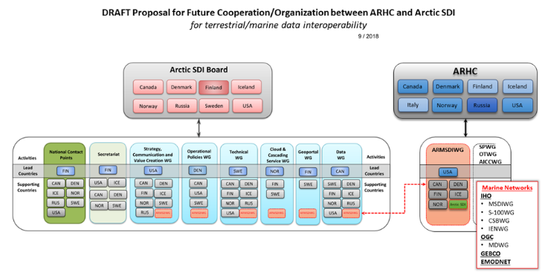
ARHC ARMSDIWG and Arctic SDI
Joint Meeting Arctic SDI + ARMSDIWG - 04 April 2019, Akranes, Iceland
Joint Statement of Intent – expected to be approved by Arctic SDI Board and ARHC in Fall 2019.
Proposed Cooperation Structure for better co-facilitation of terrestrial and marine domains in regional SDI.
UN-GGIM Marine / Arctic Side Event – both groups will give a joint presentation at the UN-GGIM Working Group on Marine Geospatial Information side-event in AUG 2019 to discuss terrestrial/marine spatial data interoperability and cooperation in a common, regional infrastructure, as a proven practice.
Notes:
ARMSDWIG and Arctic SDI held a joint meeting hosted by the National Land Survey of Iceland on 04 APR in Akranes, Iceland. This joint meeting was also attended by the Executive Secretary of the Arctic Council’s Conservation of Arctic Flora and Fauna (CAFF) working group, which helped to provide an Arctic Council perspective to group discussions.
At the joint meeting with Arctic SDI, an Arctic SDI/ARMSDIWG Joint Statement of Intent was finalized and well-received by both working groups. It is expected to be approved by both groups’ governing bodies in Fall 2019. The two groups discussed in further detail what a closer partnership could look like (see diagram on slide) with representation from both organizations in relevant sub-working groups and projects – truly becoming co-facilitators for the regional SDI.
Potential pilot projects were discussed, based on specific user needs defined in the Norwegian User Survey Report conducted by Norway, and information contained in the forthcoming OGC MSDI CDS engineering report.
Both groups will give a joint presentation at the UN-GGIM WG-MGI side-event in AUG 2019.

Slide 12
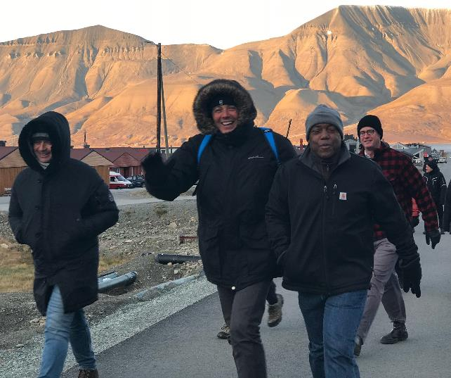
Welcome Italy to ARHC!
First meeting as Associate Member
Italy is a strong contributor of Arctic data
Has a long history and strong ongoing program of Arctic science

Slide 13
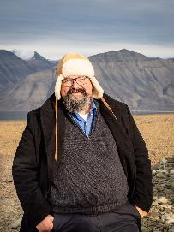
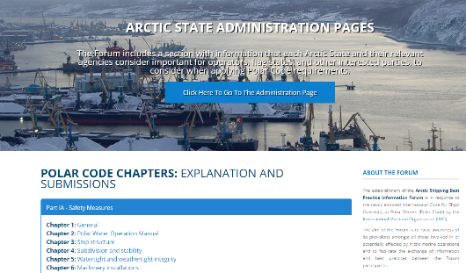
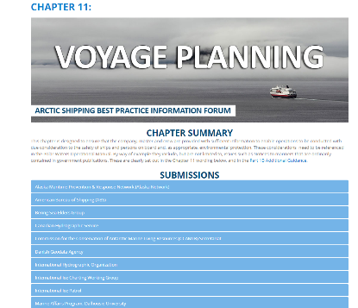
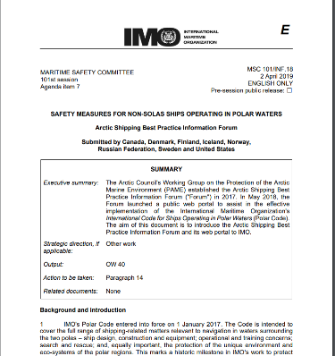
Partnerships Connecting to the IMO
Arctic Shipping Best Practices Information Forum
ARHC Delegate-2018 and 2019
Notes:
Earlier I touched upon partnerships with groups such as the Arctic Council subcommittees. Here I just want to touch on the substantive connectivity of the work of the HOs to support the realization of the Polar Code. I mentioned the ASBPIF and its information web-portal that is evolving and growing. The portal is organized along the ## chapters of the IMO Polar Code many of which are not anchored in the hdyrographic world. However, Chapter 11, Voyage Planning, is. In this chapters, member states have provided links to relevant content to assist the mariner and general viewer access important information to be considered in voyage planning.
In April, the introduction of this resource was brought to the attention of the IMO and (check if it was noted in the minutes of the IMO meeting…)

Slide 14
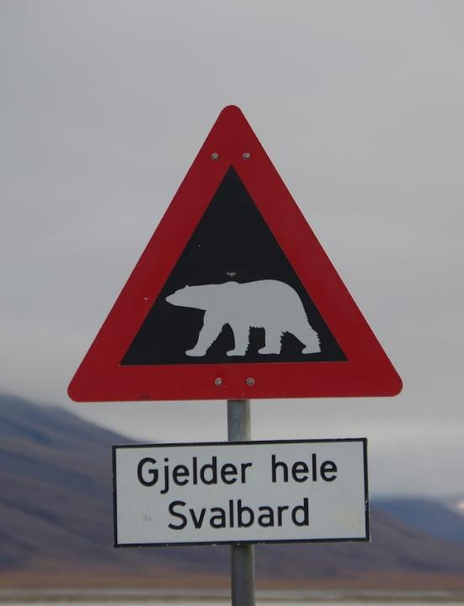
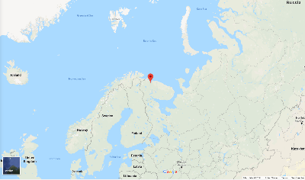
Challenges
Building the synergies with many important efforts and stakeholders (local communities, academic networks, etc…)
Defining the right balance with the right partners
Continuing along path raising awareness of importance of hydrography in the Arctic to all other challenges being discussed
Next meeting:
ARHC-9
Sept 17-19, 2019
Murmansk, Russia
Notes:
Note: UKHO application to join

Slide 15
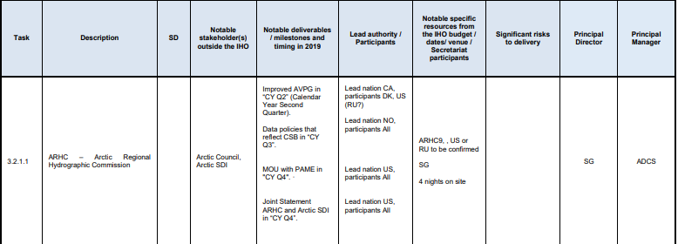
ARHC Notable Deliverables/Milestones and timing in 2020
IHO Work Program 3 Task 3.2.1.1
Due to planning cycle, ARHC priorities are best informed by IRCC annual meeting (June), deliberated and confirmed at the ARHC annual meeting (September) and proposed by the ARHC Chair at the Council meeting (October)
Under Consideration:
Launch the pan Arctic Voyage Planning Guide (II) based on feedback from prototype
Sign MOU with PAME
Contribute to Arctic Council’s Protection Arctic Marine Environment Working Group on ASBPIF
2019:
Notes:
source of image: https://www.iho.int/mtg_docs/misc_docs/basic_docs/IHO_Work_Programme_for_2019_final.pdf

Slide 16
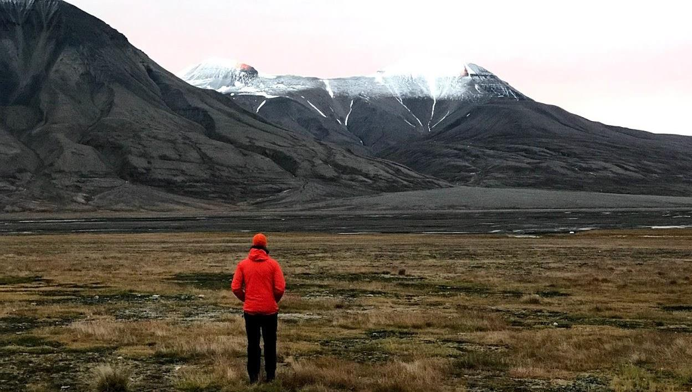
Thank you!

