Slide 1
IRCC-8
IHB Report
Mustafa IPTES
Director, IHO

Slide 2
Priorities of the IHB Directing Committee
IHO Outreach and raising awareness
Capacity Building
Increasing IHO membership, especially for Significant IMO Flag states
MSDI and provision of geo-data
S-100 implementation and development
Data gathering, data maximizing, Crowd-Sourced Bathymetry
Supporting implementation of e-Navigation

Slide 3
Ratification of Protocol of Amendments on IHO Convention
*47 of 48 approvals received.
* Member States yet to indicate their position:
Bahrain, Colombia, Croatia, Ecuador, Egypt, Fiji, Guatemala, Indonesia, Jamaica, Kuwait, Malaysia, Mozambique, Myanmar, Nigeria, Oman, Philippines, Singapore, Syrian Arab Republic, Thailand, Tonga, Trinidad and Tobago, United Arab Emirates, Uruguay, and Venezuela.
* Next IHC will be Assembly-1 if One more approval received before 23 January 2017.

Slide 4
Awaiting accession
Bulgaria (1992)
Haiti (2012)
Mauritania (1991)
Sierra Leone (2010)

Slide 5
New Applications for IHO membership
(in the course of approval)
Malta (31 of 53 required)
Vanuatu (31 of 54 required)
Solomon Islands (33 of 55 required)
Republic of the Congo (33 of 55 required)

Slide 6
Suspended Member States
Congo, Dominican Republic, Serbia
IHO membership stands at 85
82 Member States having the right to vote
Majority: simple = 42
2/3 = 55 (abstention = NO)

Slide 7
Diplomatic Engagement
-The Directing Committee is continuing its programme of visits to brief high officials of non-Member States on the global status of hydrography and the relevance of the IHO to non-Member States.
-The Directing Committee, with the assistance of the representatives of the Government of Monaco, stands ready to assist, through diplomatic or other channels, any States’ representatives that may be encountering difficulties in progressing outstanding approval of the Amendments to the IHO Convention or the consideration of outstanding applications for Membership of the IHO.

Slide 8
IHO GIS Development
IHO Country Information Database
Regional Information Database
IHO ENC Catalogue
INToGIS (INT Chart Management and Catalogue)
On-Line Registration Service for IHO Meetings

Slide 9
Preparation of the next Conference / Assembly
-The next International Hydrographic Conference or first IHO Assembly is scheduled from 24 to 28 April 2017.
-It is likely that the meeting will be the first session of the Assembly, subject to the ratification of the Protocol of Amendments to the IHO Convention by the required two-thirds majority not later than three months before the opening day of the meeting (23 January 2017).
-Please review the CCLs via IHO web site (www.iho.int)

Slide 10
Day 1 | Monday 24 April | AM | Opening Ceremony Opening of the Hydro. Industry and the MSs Exhibitions
 |  | PM | WP 1: Reports, Proposals and Topical Issues
Day 2 | Tuesday 25 April | AM | WP 1: Reports, Proposals and Topical Issues (continued)
 |  | PM | WP 1: Reports, Proposals and Topical Issues (continued)
Day 3 | Wednesday 26 April | AM | WP 2: Reports, Proposals and Topical Issues
 |  | PM | WP 2: Reports, Proposals and Topical Issues (continued)
Day 4 | Thursday 27 April | AM | WP 3: Reports, Proposals and Topical Issues
 |  | PM | WP 3: Reports, Proposals and Topical Issues (continued)
Day 5 | Friday 28 April | AM | Election of Directors / Sec. General and Directors Hydro. Industry and Member States Exhibitions close
 |  | PM | 2018-2022 (2020) Work Programme and Budget Closing Ceremony

Slide 11
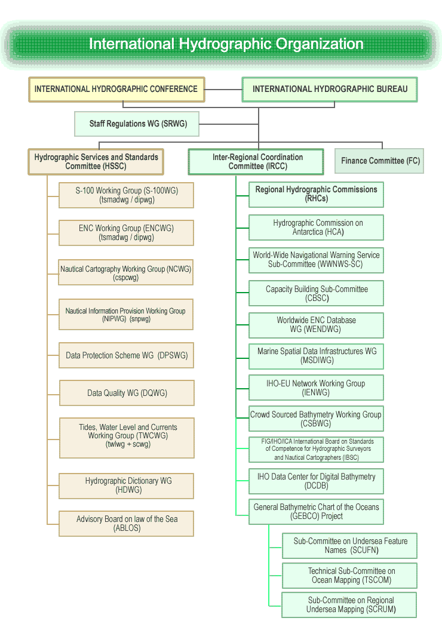
Technical Programme
Inter-Regional Coordination and Capacity Building Programme

Slide 12
(Conference) Assembly
All Member States
Frequency of meetings: 3 years
Other Int. Bodies
Finance Committee
Frequency of meetings:3 yrs
(IHB) Secretariat
Secretary General
2 Directors
5 Assistant Directors
(New) IHO Council
30 MS (or 25% if greater)
regional & interest representation.
Frequency of meetings: annual
Hydrographic Services & Standards Committee (HSSC)
meeting at least annually
Inter-Regional Coordination Committee
(IRCC)
meeting at least annually
HSSC Working Groups:
Chart Standardization
Transfer Standard
Digital Information Portrayal
Marine Spatial Data Infrastructure
Tides and Water Level
……..
…
RHC
RHC
RHC
RHC
RHC
Accredited Non-Governmental International Organizations
RHC
RHC
ABLOS
RHC
IRCC BODIES

Slide 13
Preparation of the next Conference / Assembly
In accordance with the General Regulations of the IHO that will enter into force once the Protocol of Amendments is ratified, the first Assembly will have to approve the list of the members of the IHO Council.
If the first Assembly meets in April 2017, the selection process for the establishment of the Council should be initiated by the Secretary-General not later than October 2016. Therefore it is expected that all RHCs will have agreed before that date on the process by which they will select, and possibly instruct, their representatives in the Council.

Slide 14
Preparation of the next Conference / Assembly
The agenda of the Conference/Assembly will include a review of the IHO Strategic Plan and consideration of the IHO Work Programme for the next 3-year or 5-year cycle (CCL 01 dated 21 April refers).
The IHB has invited Member States, HSSC and IRCC to submit proposals to update the Strategic Plan (CL 17/2016 dated 31 March refers). These proposals are expected to be circulated to all Member States in August 2016.

Slide 15
IHO Outreach
Theme for World Hydrographic Day-2016:
"Hydrography – the key to well-managed seas and waterways"
This theme will enable all stakeholders involved in hydrography to highlight the significance and importance of their particular activities which could include, but is not limited to, the support of safety of navigation, protection of the marine environment, coastal zone management, marine spatial data infrastructures, defence, resource exploration, and all other components of the blue economy.

Slide 16
IHO Outreach
Member States are invited to forward as soon as possible to the IHB any material that is created in support of national WHD-2016 celebrations for posting on the IHO website.
This will enable the widest possible dissemination of publicity and support material for the event. The IHB will be providing some supporting material on the IHO website.

Slide 17
IHO Outreach
* International Hydrographic Review (IHR) provides an opportunity for Member States to publicise technical and other achievements in the region.
*An editorial board comprising a representative from each region has been established. Papers for consideration for publication in the IHR should be forwarded directly to the IHB (ihreview@iho.int) with a copy to the Editor (ian.halls1@defence.au.gov).
The deadlines are:
- End of January for the May Edition
- End of July for the November Edition

Slide 18
IHO Capacity Building Programme
Capacity Building is one of the strategic objectives of the IHO.
In the last ten years, more than 1,200 individuals from 65 IHO Member States and 60 non-Member States have benefited from training activities sponsored by the CB programme.
CB Budget has been increased from 50,000 Euros to almost 1 Million Euros
CB Programme is considered as a “Success Story” of the IHO.

Slide 19
CB Programme
In 2015 the IHO capacity building programme reached a new level of achievement.
The level of activity of the IHO Capacity Building (CB) Programme continued to increase. Expenditure in the IHO 2015 CB Work Programme (930,907 Euros) was 118% greater than the budget for the previous year.
This was a result of the ongoing financial support provided by the Nippon Foundation of Japan and the Republic of Korea, supplemented by a contribution from the IHO budget and in-kind support from Member States and from industry.

Slide 20
CB Programme
In 2015, 86% of the budgeted CB Work Program (also 93% of the CB provisions) was executed and paid for. Some planned CB activities could not take place because of administrative and other issues in host nations, the unavailability of nominated personnel, or other late changes to the planned events.
Most of the activities that could not take place were postponed and transferred to the 2016 CB Work Programme for execution

Slide 21
CB Programme
The Directing Committee:
-continues its campaign to find additional donor States and funding organizations,
-tries to increase the level of external CB fund and CBWP budget,
-encourages and coordinates several large scale Regional Hydrographic Projects (Caribbean, S.West Pacific and West Africa) and initiates institutional relationship with global funding institutions, in particular with World Bank.

Slide 22
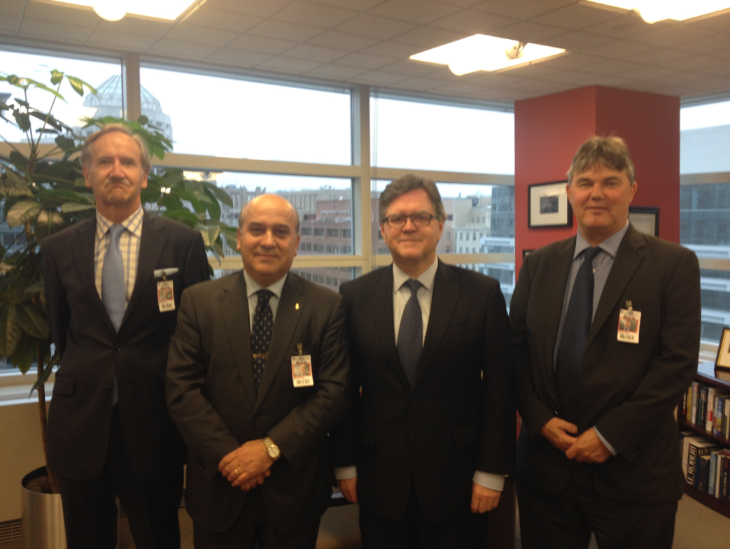
CB Programme (New vision)
World Bank, as a global funding institution, is one of the potential partners of the IHO for large scale Regional Hydrographic Projects.

Slide 23
CB Programme
Next step:
“Maritime Funding Seminar” at the World Bank,
in Washington DC, on 18 October 2017.
Regional Hydrographic Projects will be presented:
Caribbean (OECS Regional Hydrographic Project) )
S.West Pacific (Pacific Regional Navigation Initiative)
West Africa (HYDRO MOWCA Project– W. African Definition Study)

Slide 24
Report on the Overall Status of the IHO Work Programme
-As a result of the EIHC-5 discussion on Proposal 5 concerning the assessment of the IHO Work Programme, Conference Decision No. 3 reinforced the reporting requirements by introducing a six-monthly reporting regime for all IHO bodies.
-The outcome of the first three bi-annual assessments was submitted to Member States through IHO CL 17/2015, 66/2015 and 14/2016.
-Only six Regional Hydrographic Commissions (EAtHC, MACHC, NHC, NIOHC, NSHC, and SAIHC) did submit a status report.

Slide 25
Schedule for IHO Meetings
-The IHB, in liaison with the Chairs of IHO Committees and subordinate bodies, is seeking to establish a three-year rolling schedule of meetings (CL 96/2012 dated 15 November refers).
-The objective is to assist resource planning by the IHB and States, to encourage the diversification of venues, and decongest the late spring and autumn periods.
-The initiative has not been particularly successful so far. Relatively few dates or venues have been declared for IHO and RHC meetings in 2016 and 2017. Those IRCC bodies that have provided information have held to their traditional dates.

Slide 26
Action Requested of IRCC
IRCC is invited to:
Note this report.
Take any other actions as considered appropriate.

Slide 27
IRCC-8
IHB Report
Thank you.
Questions?

