Slide 1
MACHC report to 8th IRCC Abu Dhabi May 2016

Slide 2
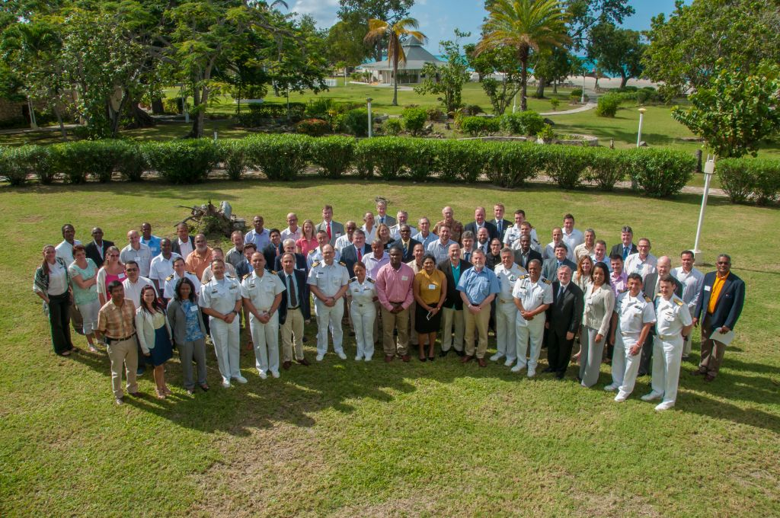
16th MACHC- St John’s, Antigua and Barbuda
12 of 13 MS
Interna-tional organisa-tions
7 of
13 AMS
Regional organisa-tions
6 Obser-ver nations
Industry
During Conference some 80 participants

Slide 3
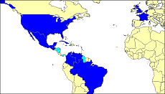
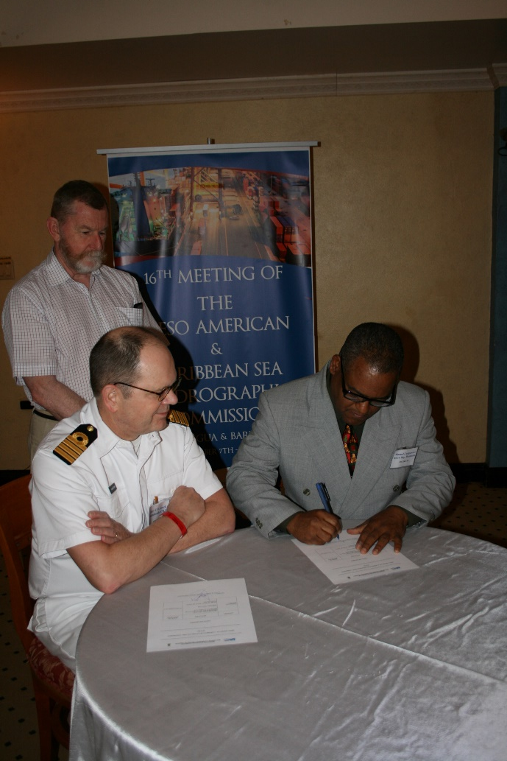
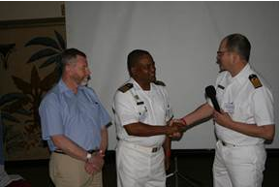
Memberschip
Dominican Republic Associate Member

Slide 4
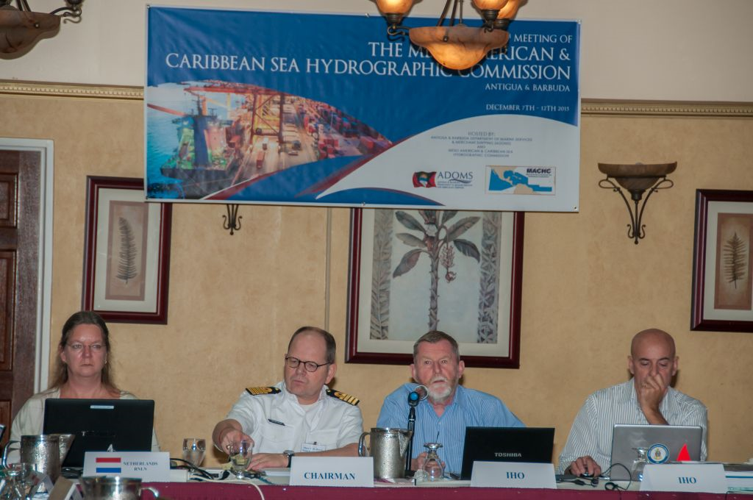
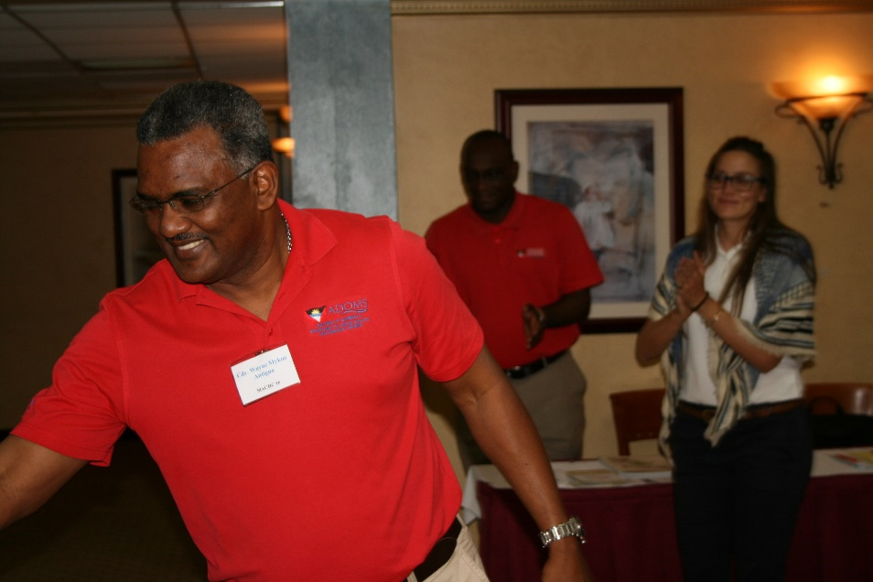
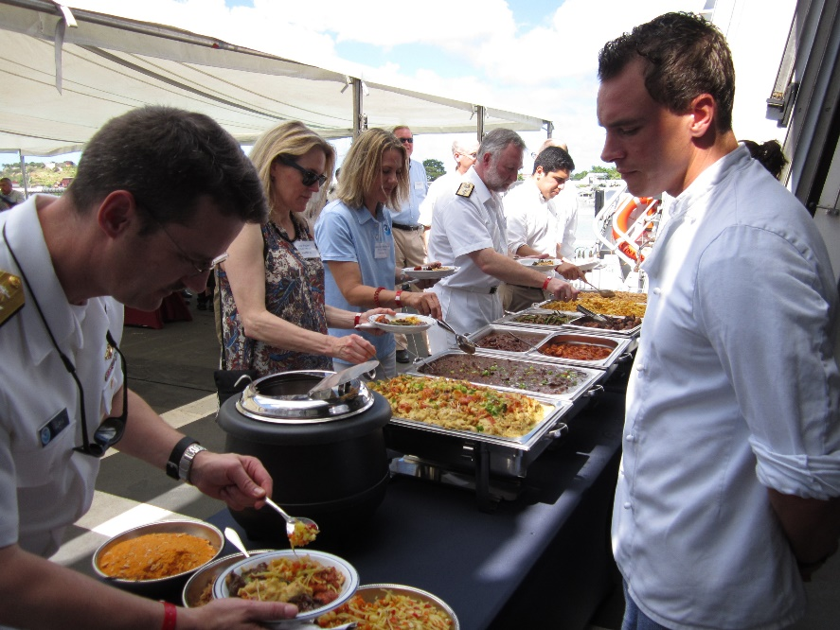
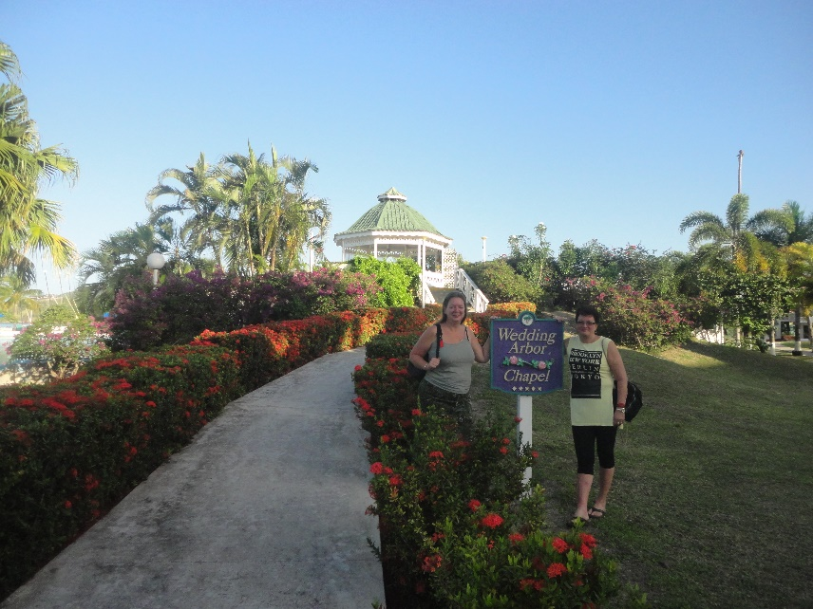
16th MACHC- St John’s, Antigua and Barbuda
Good discussions
Excellent Host
Excellent Visit to HNLMS Friesland
Enjoyable Location

Slide 5
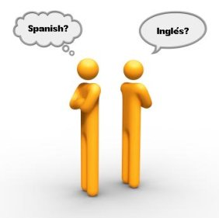
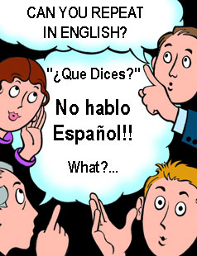
Spanish within the MACHC
Conlusions
IOT advance aims of MACHC the use of the Spanish language, wherever possible, would be beneficial.
Focus on working language, not official IHO-language.

Slide 6
Amended Statutes for Spanish: inclusiveness ⬄ budgetary constraints
ARTICLE 11: OF EXPENSES
d) In order to support Spanish speaking participants at meetings of the Commission (see Article 13), all participants are strongly encouraged to provide in-kind and/or financial support to enable continuous interpretation at the meetings.
ARTICLE 13: Of THE LANGUAGES OF THE COMMISION
a) The working language of the Commission shall be English, with continuous interpretation at meetings to and from Spanish being provided by the host country, with the support of other collaborating Member States or organizations if required (see Article 11d).

Slide 7
Remaining action item for Spanish: written translation services
No | Subject mater | Action | Responsible party | Due date
16.1.6 | Statutes | Member States to consider how to provide dual versions in Spanish and English of MACHC documents, for instance as a voluntary service by a Member State. | Member States | 17th MACHC Conference

Slide 8
IRCC actions : open items
Action identifier | IRCC action description | IRCC status | Actions taken by MACHC
IRCC7/19 | Encourage using risk assessments to establish survey priorities | permanent | Open. MACHC action 16.5.1 applies as a result of a dedicated Risk assessment meeting and the agenda cluster on ‘Survey and Risk’ during MACHC16.
IRCC7/28 | Implement procedure for new editions of INT Charts and report processes for review of first edition of first INT Chart of a new INT Chart Producer Nation |  | Open.
IRCC7/41 | Consider incorporating hydrography in more comprehensive maritime projects |  | Open. MACHC action 14.3.1 also applies (standing activity MICC).
IRCC7/43 | Provide access to IHB to CB promotional material | input expected | Open . At MACHC16 no feedback was given by MS or AMS.
IRCC7/56 | Provide comments on relevance of information overlay services | expected via Action WENDWG5/01 | Open. Action is paused as the issue is still under consideration of the WEND WG (Overlay services as AIO). See also decision 27 agreed at IRRC7.
IRCC7/62 | Consider providing IHO representatives at international meetings | input expected | Open.

Slide 9
Procedures to select representatives to the Council (IRCC7/26)
Issue. What does “representative” or selection imply?
MS are elected as MS of the IHO, but also elected by a specific group of MS in a region.
The following mechanism was decided upon.
Introduction of a standing agenda item for MACHC Conferences on IHO Council matters.
The elected Member States shall take into account the views of the Member States of the Commission.

Slide 10
Procedures to select representatives to the Council (IRCC7/26): Voting
When:
If the number of candidate MS is larger than the number of MACHC seats on the Council.
How:
A quorum is set at 50% of MS casting their vote. Representatives are then elected by simple majority.
If no quorum is achieved, the voting window is extended for two weeks and the missing MS are invited to vote.
If still no quorum has been achieved, the chair selects the representatives based on the votes cast.

Slide 11
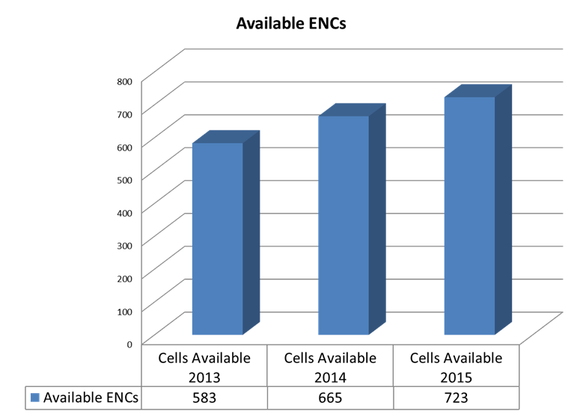
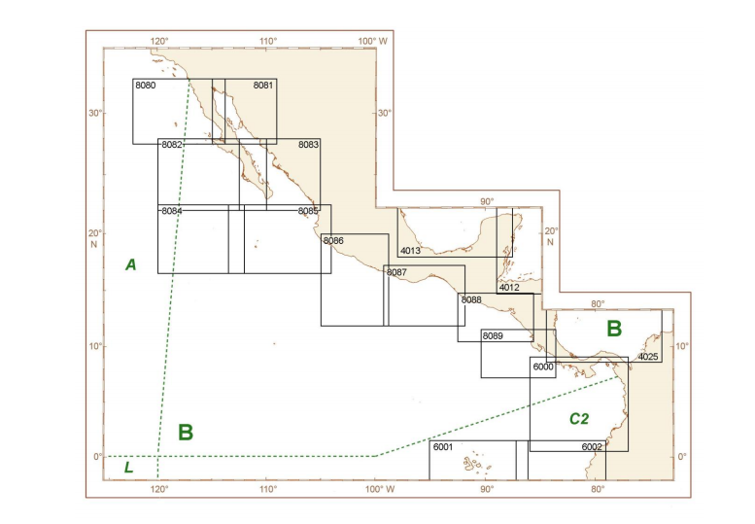
MACH Integrated Charting Committee (MICC)
S-11 update published
STEADY PROGRESS
47 new ENC’s

Slide 12
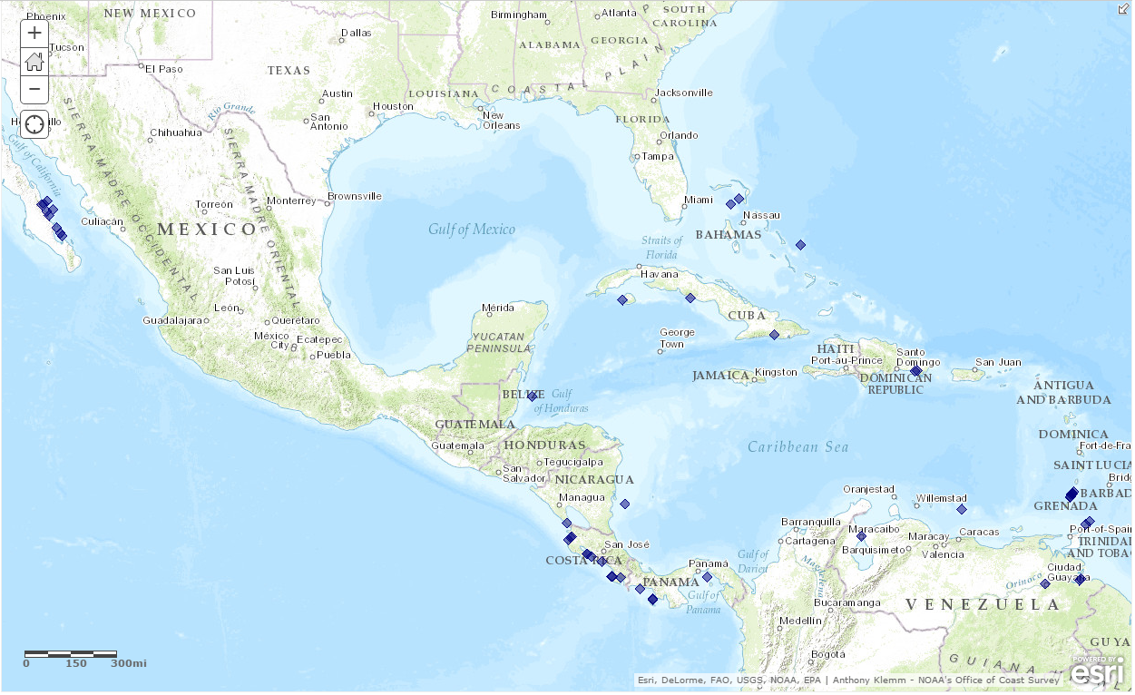
48 out of the 373 world-wide Cruise Ship Ports/ Anchorages not covered by Band 4, 5, or 6 ENCs are located in the MACHC
NOAA Port Analysis Evaluation – Gaps
Three have already been covered by new large scale ENCs

Slide 13
Risk Assessment meeting
Conducted first MACHC meeting on Risk Assessment.
Concluded that this initiative to explore risk assessment proved worthwhile.
Decided to organize a follow-on and longer meeting on Risk Assessment during next MACHC conference. Aims are:
Exchange information, learn and apply.
Clarify future objectives and attain consistency about terminology.
MS to provide their thinking during the year.

Slide 14
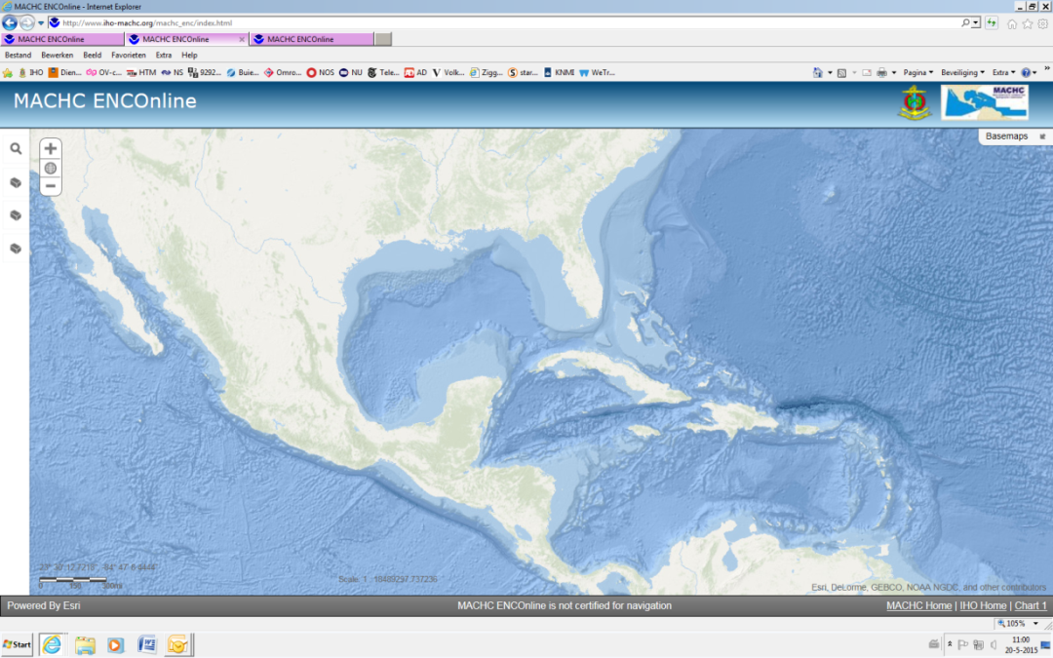
Marine Economic Infrastructure Programme (MEIP) WG
ENC Online viewer (WMS)
Remove password?
Yes. Showcase to spark interest IOT be used in other initiatives.
No. Chart data is a commodity that merits a return on investment.
CATALYST
IOT maintain momentum, NOAA offered to host two versions of the viewer: one under password and one without

Slide 15
Marine Economic Infrastructure Programme (MEIP) WG:
future viability of the MEIP-initiative
Way ahead (aim and scope)
Prepare a ‘think piece’ which lists potential options with the aim to facilitate decision making.
The ambition level is central to this piece: how and with what data to integrate and how to fit in with other complementary initiatives for SDI’s.
E.g. “Eye on the Earth” project of PAIGH
MS to share their thoughts on the future of the MEIP via correspondence/e-mail before next MACHC.

Slide 16

Capacity Building Committee
MSI & Hydro Governance Workshop
SDB Workshop
MSDI Workshop for Spanish Speakers
Seminar on Raising Awareness of Hydrography
MACHC
CB plan 2013-2017
2017
4 Proposed
ACTIVITIES
2014
4 Completed
2015
6 Completed
2016
4 Funded

Slide 17
Capacity Building Committee: challenges
Need for more courses in Spanish.
Complications in managing and coordinating MACHC CB activities in combination with a growing number of regional initiatives, e.g. FOCHIAMECA, OECS, PAIGH, US support to Haiti etc.
Need for a Vice Chair
Brazil was appointed as Vice Chair of the MACHC CBC

Slide 18
Capacity Building Committee and FOCHIAMECA
What:
A new multi-lateral initiative with the aim to reinforce the hydrographic capability in the region: “Proyecto de Fortalecimiento de Capacidades Hidrográficas en Mesoamérica y el Caribe”.
Issue:
Potential overlap with other CB activities and competition for scarce funding.
Action:
Mex to make their FOCAHIMECA program available to the CBC with the aim to harmonize.
If additional funding is sought from CB-funds, Mex to use the established CB mechanism’s.

Slide 19
Closing remarks
In line with the MoU IHO-OECS (IHB CL 15/2015), OECS was accepted as a permanent observer to the MACHC conferences.
The newly established Latin-American Chapter of the THSOA was introduced.
Some interesting presentations on IHO/MACHC-web
Challenges in surveying overseas territories (UK CEFAS)
Can Hydrographers rely on SDB? (France)
Managing hydrographic and oceanographic information in a MSDI (ICC)
GEBCO/DCDB/CSB Developments (CSB Chair)

Slide 20
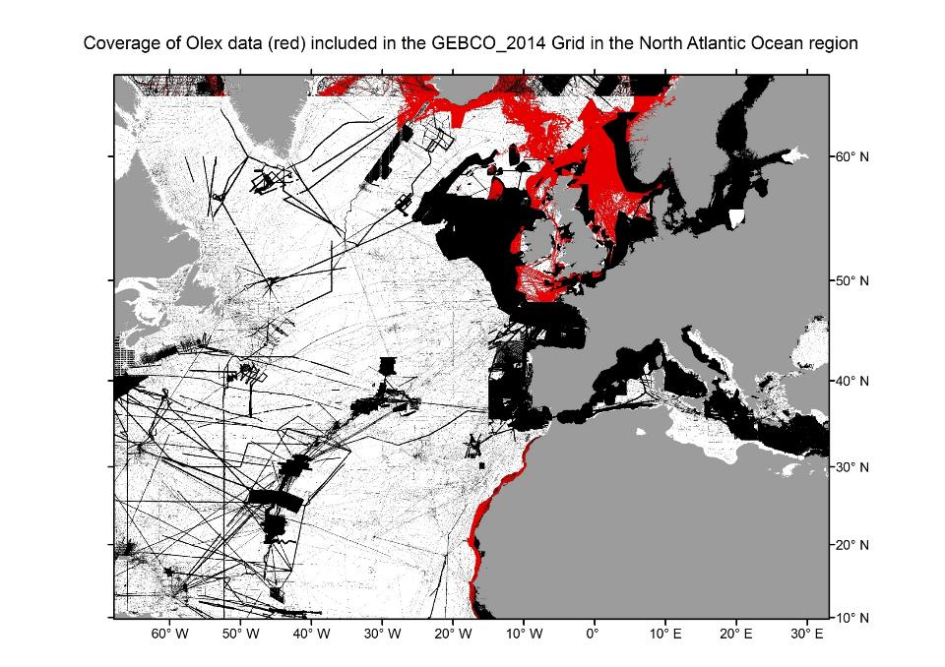
Notes:
This shows GEBCO data coverage with OLEX data in red.
Let’s look at a close up of the southern tip of Iceland <click> within this yellow box. <click>

Slide 21
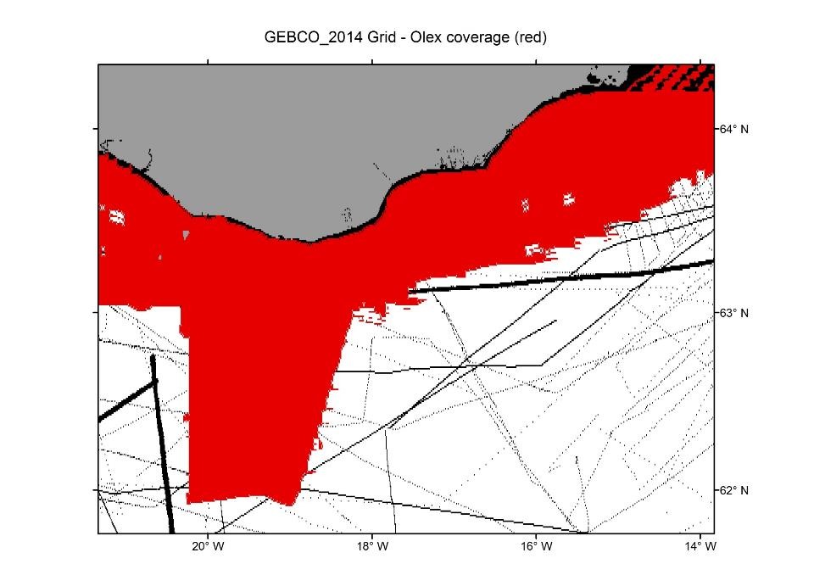
Notes:
You can see the how sparse the data coverage is before the addition of Olex data.

Slide 22
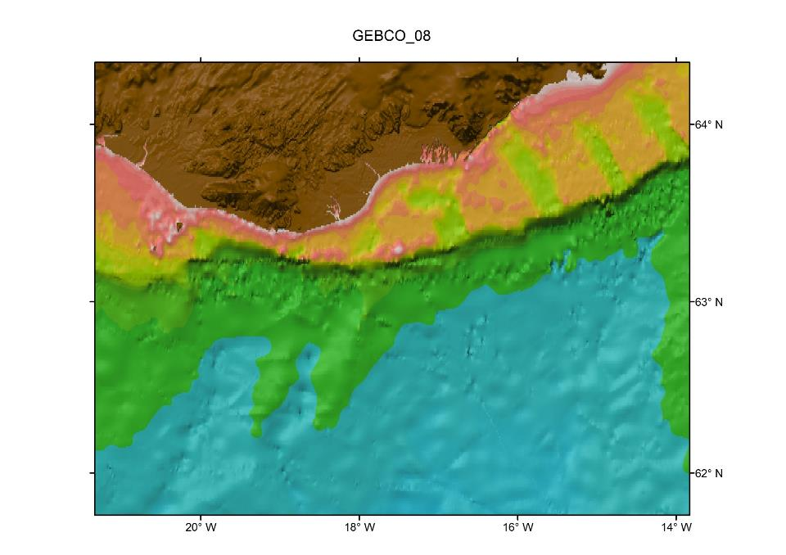
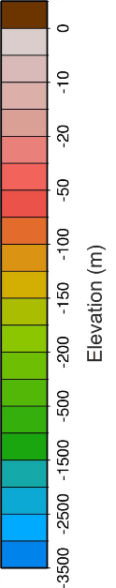
Notes:
This is GEBCO 08, the 2008 version of GEBCO for the same area<Click>

Slide 23
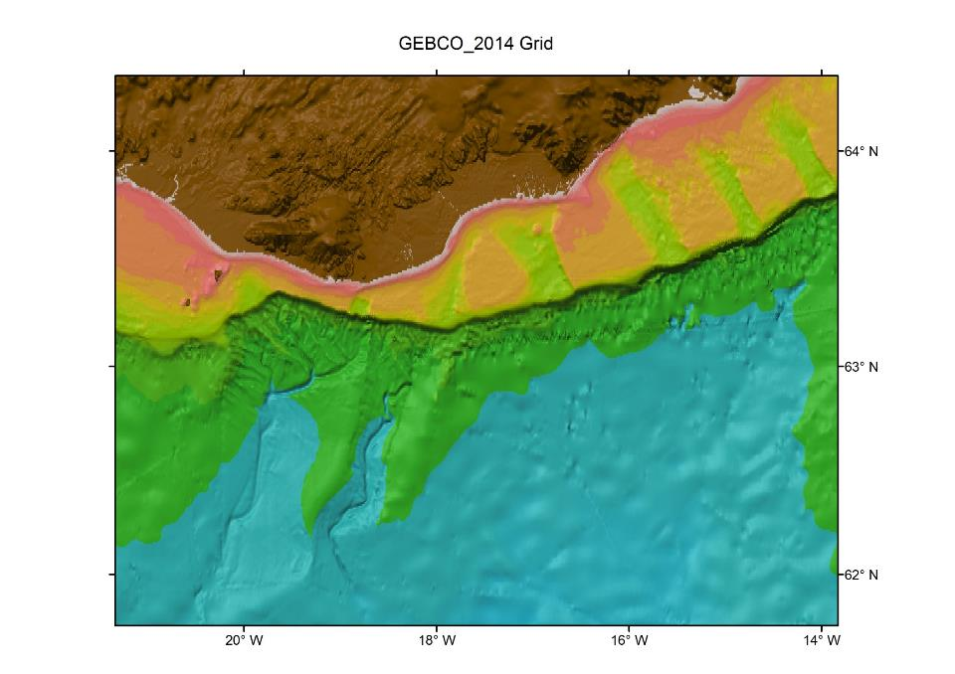
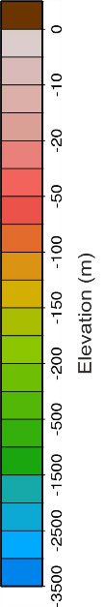
Notes:
This is a view of GEBCO14 after the addition of Olex data. These underwater canyons are now very well defined.

