Slide 1
IRCC-8
Agenda item 10
Update on the development of the IHO GIS
IHB

Slide 2
Contents
IHO Country Information Database
Regional Information Database
IHO ENC Catalogue
INToGIS
On-Line Registration Service for IHO Meetings
Action required of IRCC

Slide 3
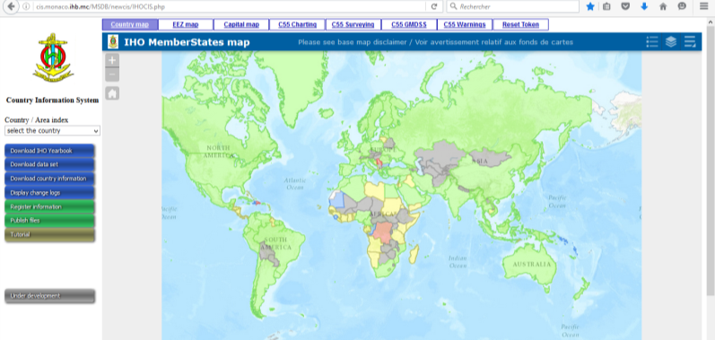

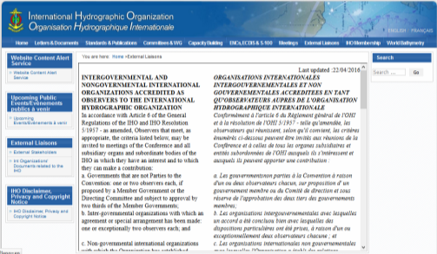
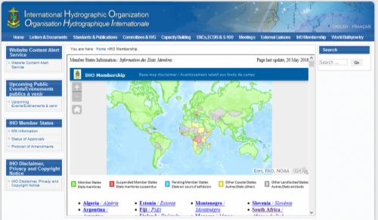
IHO Country Information Database
Upgrade of the database to include additional administrative information and facilitate the continuous update of the IHO Yearbook (P-5) and related lists posted on the IHO website

Slide 4
IHO Country Information Database
Currency of the information provided by Member States
Cyprus
DPRK
Jamaica
Latvia
New Zealand Serbia
Singapore
South Africa
UAE
China
Estonia Pakistan Suriname

Slide 5
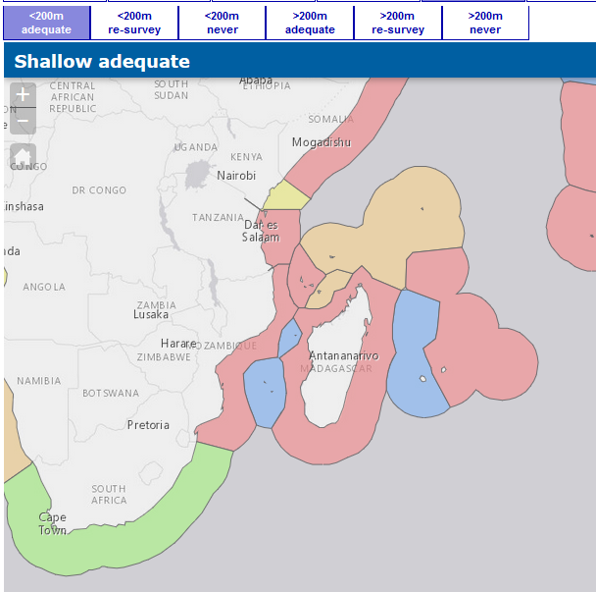
Regional Information Database
Implementation of an Esri-based GIS solution
  IHO ENC Catalogue (Home> ENCs, ECDIS & S-100> ENC Availability)
  IHO GIS for Antarctica (Home> Committees & WG> IRCC> HCA)
On-going development of
a GIS database application
to support C-55
Investigation of portrayal
options for CATZOC
information

Slide 6
Regional Information Database
Currency of the information available in C-55 (number of areas)

Slide 7
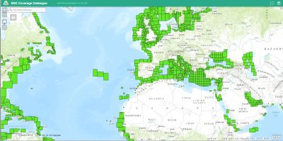
IHO ENC Catalogue
Home> ENCs, ECDIS & S-100> ENC Availability
Web-map service for each of the 6 ENC usage bands
Monthly update
Actions raised at WENDWG-6 in progress or under consideration

Slide 8
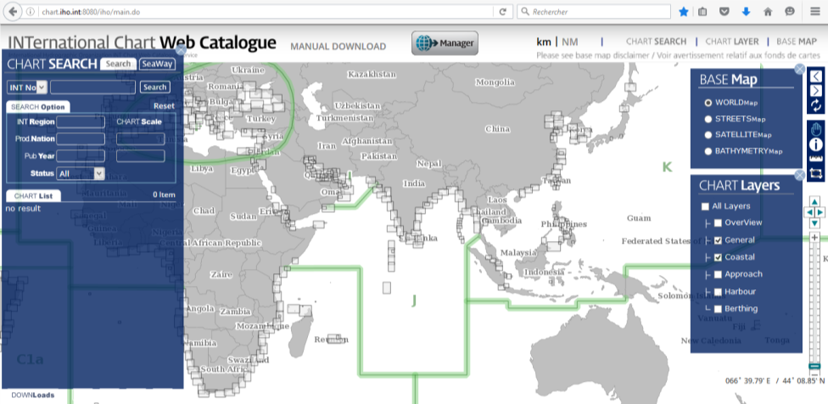
INToGIS
On-line web-based interactive version of IHO Publication S-11 Part B -Catalogue of INT Charts
Project supported by KHOA
Application made available in January 2016 (see IHO CL 89/2015)
Home> Standards & Publications> S-11> Part B (link)

Slide 9
INToGIS
Login identification requested by and provided to:
  All but 3 Regional Coordinators
  Only 15 Producer/Printer Nations
Workshop for Regional INT Chart / ENC Coordinators at the IHB on 25 April (immediately before NCWG-2)
  14 Coordinators present or represented
  Comprehensive demonstration of INToGIS management tools
  Review of the feedback and lessons learned
Request from one Coordinator to allow using the on-line interface to assess preliminary proposals prior to formal consideration and final decision by the relevant RHC

Slide 10
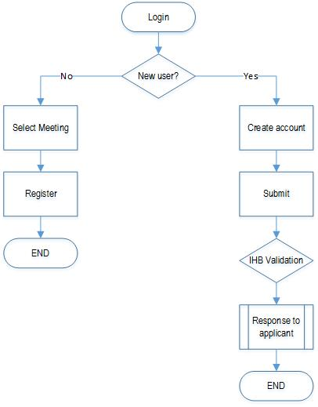
On-Line Registration Service for IHO Meetings
Development of an on-line registration service for IHC-19/A-1
The initial version will be self-contained with no direct connection to the Country Information System
Time-line:
  April: blank test at the IHB
  May: development and test of operation version
  15 June: on-line registration open for HSSC-8
  1 September: on-line registration open for IHC-19/A-1

Slide 11
Action required of IRCC
IRCC is invited to:
  Note the report
  Request RHCs to review entries related to their region in IHO C-55 and P-5 (Yearbook) at least annually;
  Provide guidance on further development of the IHO GIS that may be required to support its work;
  Take any other actions as appropriate

