Slide 1
South West Pacific Hydrographic Commission (SWPHC)
Report to IRCC 9 Paramaribo, Suriname – June 2017
Commodore B.K. Brace Chair SWPHC Hydrographer of Australia

Slide 2
Commission Membership
Members | Australia (Chair), Fiji (Vice Chair), France, New Zealand, Papua New Guinea, Kingdom of Tonga, United Kingdom, United States of America
Associate Members | Cook Islands, Kiribati, Niue, Palau, Samoa, Solomon Islands¹, Vanuatu²
Intergovernmental Observer Organization | Secretariat of the Pacific Community (SPC)
Observers | New Caledonia
IHO Representative | Secretary-General Robert Ward, Assistant Director Alberto Costa Neves
Notes | Solomon Islands is in the process of becoming an IHO Member. Vanuatu is an IHO Member and will become a SWPHC Member upon signing the Statutes

Slide 3
Meetings, Working Groups and Actions
The 14th SWPHC Meeting held in Noumea, New Caledonia from 30 November to 02 December 2016 was attended by more than 46 participants - representing all 8 Member States of the Commission, 6 Associate Members, Observer States, international/regional organisations, industry and the IHO Secretariat.
Since the last SWPHC meeting, there have been a number of teleconference and correspondence activities to review the CB Work Plan and to consider CB bids.
The next meeting (on the 18 month cycle) will be held in Kiribati in February/March 2018 and will be preceded by a 2-day technical workshop.
Actions – refer to full report for status of IRCC actions relevant to SWPHC

Slide 4
Capacity Building Activities
Activities completed since the last IRCC:
IHO CB Activities (CBWP)
Samoa Technical Assessment & Advice (CBWP- A-01) – report submitted
Tuvalu Technical Assessment & Advice (CBWP- A-03) – report submitted
Technical Workshop for PICTs (CBWP - P-08) – 31 participants
MSI Regional Workshop (CBWP – P-14) – 17 participants
Activities for 2017:
IHO CB Activities (CBWP)
SW Pacific Region Industry Survey Project (CBWP- P-09) – to be done
MBES Training in Fiji (CBWP- P-10) – to be done
Solomon Islands Nautical Cartographer Development (CBWP - P-25) – cancelled

Slide 5
Capacity Building Activities
Major Support Activities - Thankyou
Commonwealth Marine Economies Programme (CME)
CME Programme aims to support the sustainable growth of Commonwealth Small Island Developing States (SIDS) within the Caribbean, Pacific and Indian Ocean regions.
SWPHC SIDS are therefore ‘in scope’ for CME activities – details TBD
NZ Pacific Regional Navigation Initiative (PRNI)
NZ$5 Million over 5 years
Risk Assessments, CB to achieve Phase 1, establish MSI coordinator
PNG Maritime and Waterways Safety Project
ADB is helping PNG enhance maritime safety and efficiency. The project will upgrade the country’s navigational aids network, make maritime safety information more readily available, and help develop maritime safety communities of practice.
US$48.36 Million, includes US$41.50 Million ADB loan.

Slide 6
Capacity Building Activities
Achievements:
All PICTs have made progress on hydrographic activities – Fiji, PNG, Solomon Islands, Tonga and Vanuatu have made significant progress
3rd Pacific Regional Energy and Transport Ministers in Tonga in April 2017 endorsed the Regional Strategy on Safety of Navigation in the Pacific
Vanuatu established the Office of the Marine Regulator and became an IHO Member in 2017
Functions of Regulator include – controls over hydrographic surveys and dissemination of survey data, preparation and approval of charts and surveys for maritime purposes and the issue of notices to mariners
NZ Risk Assessment – Cook Islands, NZ, Niue, Tonga, Vanuatu
NZ PRNI – Risk Assessments, CB to achieve Phase 1, establish MSI coordinator

Slide 7
Capacity Building Activities
Achievements:
Cook Islands signed a bilateral agreement with NZ and approved establishment of a Hydrographic Service
Tonga and NZ progressing a bilateral agreement
Australia is working with UK for Australia to become PCA for Solomon Islands in August 2017
US is engaging with Palau for a Technical Visit
Nauru engaging with UKHO for charting support/PCA actitivities

Slide 8
Capacity Building Activities
Challenges
Capacity of the Capacity Builders
Support from the PCAs for CB activities in the SWPHC is under constant strain as the balance is maintained against other national priorities and resource management
Increased support from the IHO Secretariat is critical to the ongoing success of the IHO CBWP, not only merely for implementing the CBWP but also for its effectiveness, governance and due diligence to MS.
Establish a ‘CB Assistant’ in IHO Secretariat now.
More, potentially too much, is being asked of the RHCs and RHC Chairs; which then impacts delivery of their own and RHC-based activities.

Slide 9
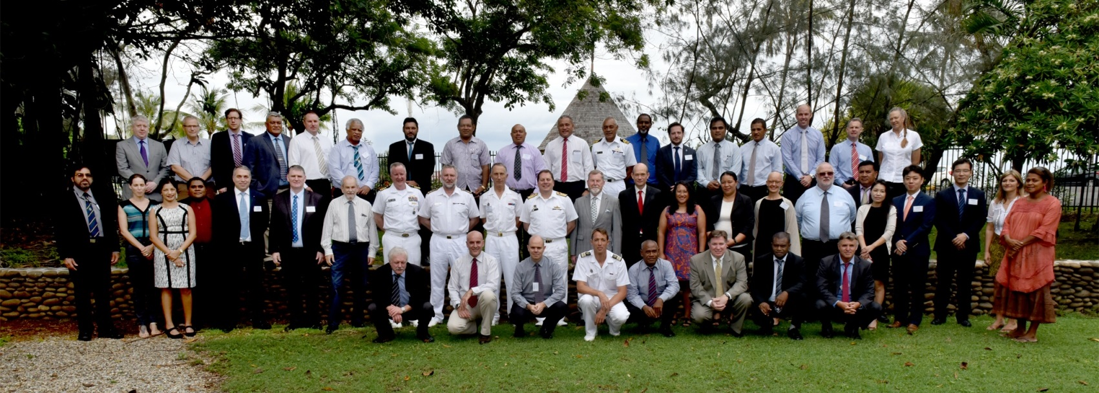
Actions required from IRCC
IRCC members are invited to:
note this report
note the value and effectiveness of preceding SWPHC meetings with a CB related workshop
SWPHC Meeting - Noumea, New Caledonia 30 Nov – 02 Dec 2016

