Slide 1
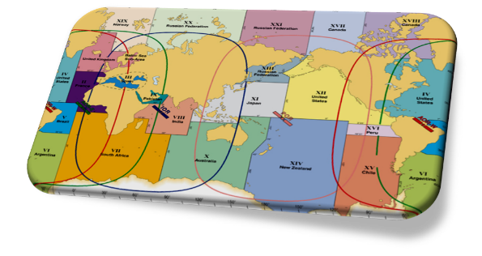
IMO/IHO World-Wide Navigational Warning Service
IRCC Update
June 2017

Slide 2
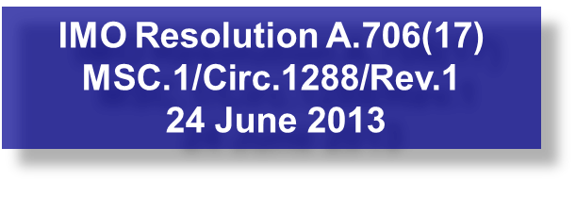
IMO/IHO World-Wide Navigational Warning Service (WWNWS)
International coordinated global service for promulgation of hazards to navigation by satellite affecting the safety of life at sea
Twenty One Navigation Areas (NAVAREAs), each with a Coordinator (Eighteen) responsible for the harmonization of navigational information in their area.

Slide 3
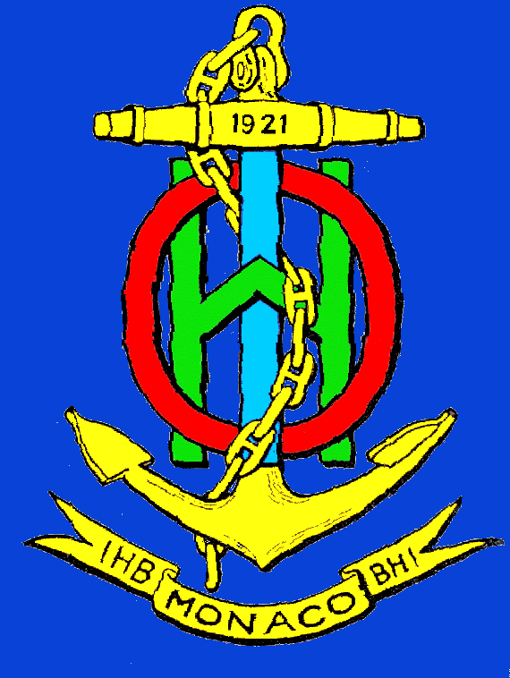
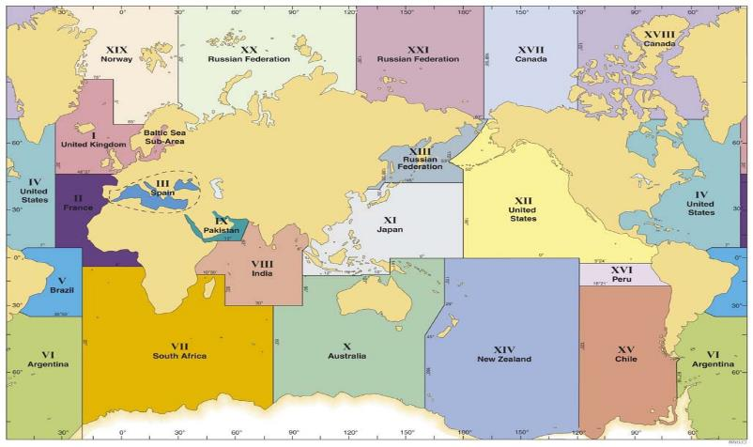
World-Wide Navigational Warning Service NAVAREAs

Slide 4
WWNWS-SC Members and Meetings
SC Members - 40 plus IHO Member States plus IMO,
WMO, IMSO, and Inmarsat
NAVAREA Coordinators: Argentina, Australia, Brazil, Canada, Chile, France, India, Japan, New Zealand, Norway, Pakistan, Peru, Russia, South Africa, Spain, Sweden, United Kingdom and United States
Last Meeting - September 12-16, Alesund, Norway.
38 Delegates in attendance: 18 – MS, IMO Sec, WMO Sec, IMSO Sec, Chairs of IMO NAVTEX and SafetyNET Panels, Inmarsat, Iridium, and IHO Secretariat. Including 16 NAVAREA Coordinator, one Sub-area Coordinator and three National Coordinators

Slide 5
Meeting Outcomes
15th Drafting Review Working Group IMO Resolutions:
A.705(17) Promulgation of Maritime Safety Information
A.706(17) World-Wide Navigation Warning Service
MSC.306(87) Revised performance standards for enhanced group call (EGC) equipment
All draft documents are available via the WWNWS page of the IHO web site
Members are encouraged to review and submit comments

Slide 6
GMDSS/MSI Briefs
MSI Self-assessment reports from all 21 NAVAREA Coordinators
IMO brief on activities of the Organization
Global Integrated Shipping Information System – will replace Annex 7 and 8 GMDSS Master Plan
SC noted comments for improvements
WMO brief on activities of the Organization
Noted increased cooperation between NAVAREA and METAREA Coordinators
IMSO brief on activities of the Organization
Update on technical assessment of Iridium as potential new GMDSS mobile satellite service provider
Inmarsat Update
SafetyNET II
Iridium Update
Status of their application
Live demo – included successful dissemination/receipt of “basic” nav warning

Slide 7
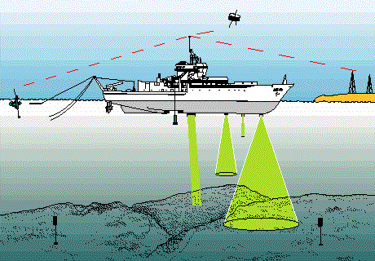
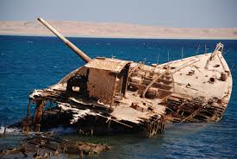
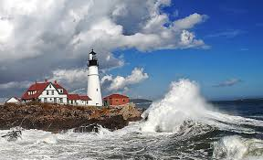
Maritime Safety Information Training
3 day comprehensive training course held with region
Led by WWNWS-SC
Sponsored by IHO CBC
Endeavour to be informed of all events that could significantly affect the safety of navigation within your region.

Slide 8
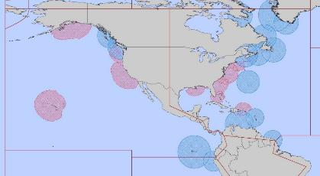
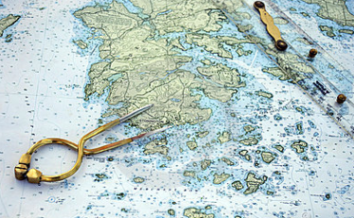
Maritime Safety Information Capacity Building Course Outcomes
Assess all information in the light of expert knowledge for relevance to navigation in the coastal region.
IV
XII

Slide 9
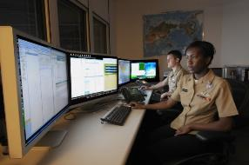
Maritime Safety Information Capacity Building Course Outcomes
Draft navigational warnings in accordance with the:
Joint IMO/IHO/WMO Manual on Maritime Safety Information
Pass NAVAREA warnings for further promulgation to the NAVAREA Co-ordinator

Slide 10
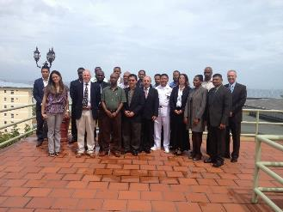
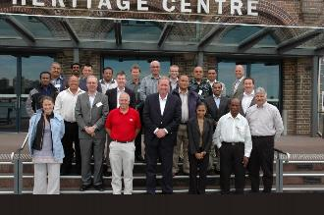
IHO MSI Training Courses (17)
2007 Jamaica (MACHC)
2007 Mozambique (SAIHC)
2008 Spain (MBSHC)
2009 Ghana (EAtHC)
2009 Oman (NIOHC / RSAHC)
2010 Namibia (SAIHC)
2010 Australia (SWPHC)
2011 Brazil (SWAtHC, SEPHC & MACHC)
2013 Trinidad (MACHC)
2013 South Africa (SAIHC)
2014 Oman (NIOHC / RSAHC)
2014 New Zealand (SWPHC)
2014 Ivory Coast (EAtHC)
2015 Japan (EAHC)
2015 Turkey (MBSHC)
2016 Saint Lucia (MACHC)
2016 New Zealand (SWPHC)
2017 3 courses planned
MACHC, NIOHC and SAIHC

Slide 11
MSI Training Course Metrics

Slide 12
Actions Requested of Committee
a. take note of the information provided in this report;
b. encourage the attendance of Member States and Observers at WWNWS-SC meetings;
c. highlight the use of the Joint Manual on MSI to ensure correct terminology and formats are used in MSI messages;
d. encourage closer engagement of the National MSI Coordinators of Member States with the relevant NAVAREA Coordinator(s);
Cuba provides NAVAREA IV first MSI – Survey operations
e. encourage closer coordination between WWNWS-SC and Regional CB Coordinators in planning and student selection for the CB MSI training course; and
f. take any other action it considers appropriate

