Slide 1

Proposal on MIO and AIO
NHC
IRCC9-07D4
Notes:
This topic has been well addressed by WENDWG6 and IRCC8.
NHC supports the outcome of the decisions on these meetings.
The reason for NHC to re-address this topic is that there seems to be different interpretations of the outcome.
Let us go back to the decision made at IRCC8

Slide 2
IRCC8 decision 14 (input från WENDWG)
IRCC9-07D4
“…to endorse the recommended actions from WENDWG concerning Marine Information Overlays (MIOs) as follows:
Taking into account the report of WENDWG6 concerning the situation where a Marine Information Overlay (MIO) is used to assist in drawing attention to any differences between a published paper chart and the corresponding ENC or to assist in displaying T&P notices for an ENC recommends:
a) All parties concerned with producing the respective MIO, paper chart and ENC should agree on the promulgation of the MIO for the relevant sea area concerned.
b) In such circumstances, and mindful of serving the best interests of the mariner, those producers of the MIO and related paper chart and/or ENC should work together bilaterally.
c) Production of the MIO should be carried out in close cooperation of producers of both the paper chart and the ENC”
Notes:
We would like to raise special attention to point a. above; that is that “all” or “both” parties concerned should agree. As such, it cannot be allowed that one actor can issue a MIO, which provides information on the quality of the ENC’s in the waters of another charting authority, unilaterally. It is only after agreement between “all” or “both” parties is in place that “all” or “both” parties are to solve the details bilaterally (point b.). The wording “bilaterally” must be read in the context of point a. being in place, hence point b. starts with the wording: “In such circumstances…”.
Back to one of our founding resolutions

Slide 3
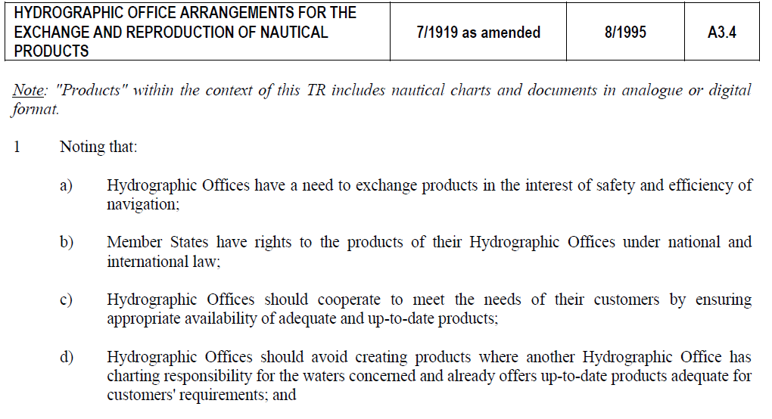
IHO resolution 7/1919 as amended 8/1995
IRCC9-07D4
Notes:
I would like to raise your attention to item 1d)
Paus
How does UKHO currently advertise for their AIO

Slide 4
AVCS current website as per 12 June 2017
The Admiralty Information Overlay is the only service available that overlays ENCs with worldwide Admiralty Temporary and Preliminary Notices to Mariners and new ENC Preliminary Notices to Mariners identifying navigationally significant differences between ENCs and existing paper charts. The Overlay is also the only service to include the results of the Admiralty Assurance Programme; an on-going comprehensive review of the world's ENCs undertaken by Admiralty in order to identify and resolve those differences.
Mariners the world over who have relied on Admiralty T&P NMs to manually update their paper charts, can continue to navigate safely using the Overlay which does this vital job digitally, displaying the same trusted information directly over the ENC to make passage planning significantly more efficient.
For further information on the AIO and compatible ECDIS systems, please see the AVCS page for more detail.
Notes:
Mariners NEED it to navigate safely

Slide 5
Conclusion
IRCC9-07D4
NHC does not question earlier decisions and statements by WENDWG and IRCC but experiences show that not all HO´s interpret the outcome of the discussions in the same way.
Since all attempts to stop the relevant producer of such MIO’s have failed (several official letters on behalf of some of the members of the NHC addressing this matter have been sent since 2009), the first precondition for such an MIO to be promulgated, is not in place.
Notes:
Läs innehållet

Slide 6
Proposal regarding MIO/AIO
IRCC9-07D4
Put MIO back on the agenda of the IRCC and WENDWG.
The IRCC is invited to:
a. endorse the proposal
b. agree on any necessary actions
Notes:
In order to prevent misconception, the NHC recommends IRCC to formulate an IHO policy statement with regards to the promulgation of MIO´s that address information on ENCs in the area of another charting authority.

