Slide 1
INSPIRE
Developing the “Marine Pilot” project:
Hugo.De-Groof@ec.europa.eu
Directorate-General Environment
Governance, Information & Reporting Unit
EC/EEA INSPIRE TEAM
EEA– DG Environment – Joint Research Centre

Slide 2





Marine Pilot
How the Marine Pilot is organized and current status
Paul Smits, Andrej Abramić, Vanda Nunes de Lima, Carmelo Attardo
European Commission
Joint Research Centre
Institute for Environment and Sustainability
Digital Earth and Reference Data Unit
www.jrc.ec.europa.eu
Serving society
Stimulating innovation
Supporting legislation

Slide 3
Aim of the Marine pilot
Obtain a common understanding the requirements of both Directives and to develop processes which accommodate their respective needs
Facilitate the implementation of INSPIRE requirements of the MSFD by sharing guidelines and practical experiences
Explore links with related data management initiatives (EMODNET, CISE)

Slide 4
Context and partners
The Marine Pilot under European Union Location Framework Action of the Commission-driven Interoperability Solutions for European Public Administrations Programme;
16 months project – started in September 2014
Member States
DG DIGIT
ISA programme :EULF action
EEA
EC/EEA INSPIRE team
INSPIRE MIG and Pool of experts
DG JRC
DG ENV.xDG MARE
Notes:
Sub-delegation to JRC; it is part of the I-EVOLV (INSPIRE Evolution) institutional Project
It explores practical links INSPIRE/MSFD/EMODnet
Marine and maritime sector

Slide 5
Marine Pilot Work Packages
Work Package 0- Management and communication
Work Package 1- Overview of MSFD requirements in relation of INSPIRE
Work Package 2- INSPIRE-based MSFD spatial data modelling
Work Package 3- Development of the data flow - MS to EEA using national (M)SDI
Work Package 4- EMODnet and INSPIRE
Work Package 5- Document and analyse the cost and benefit
Work Package 6- Training and capacity building
Notes:
Not consequent work packages

Slide 6
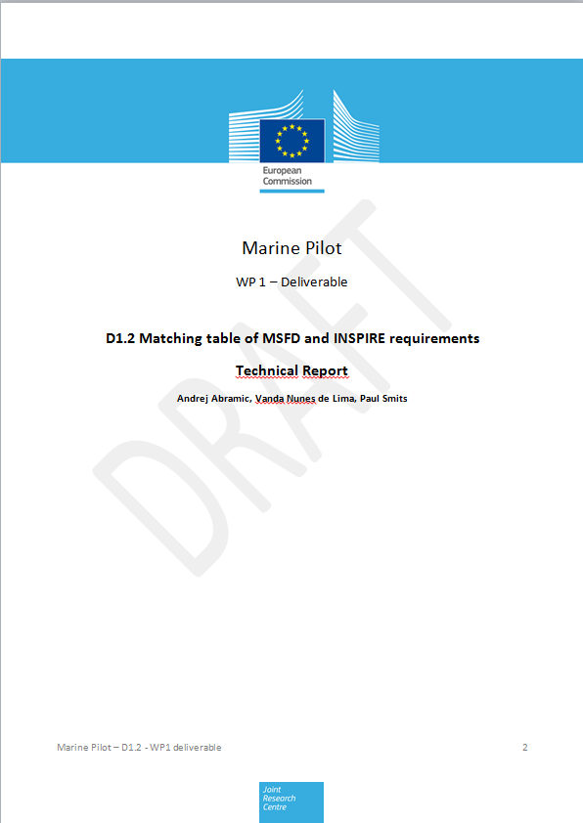
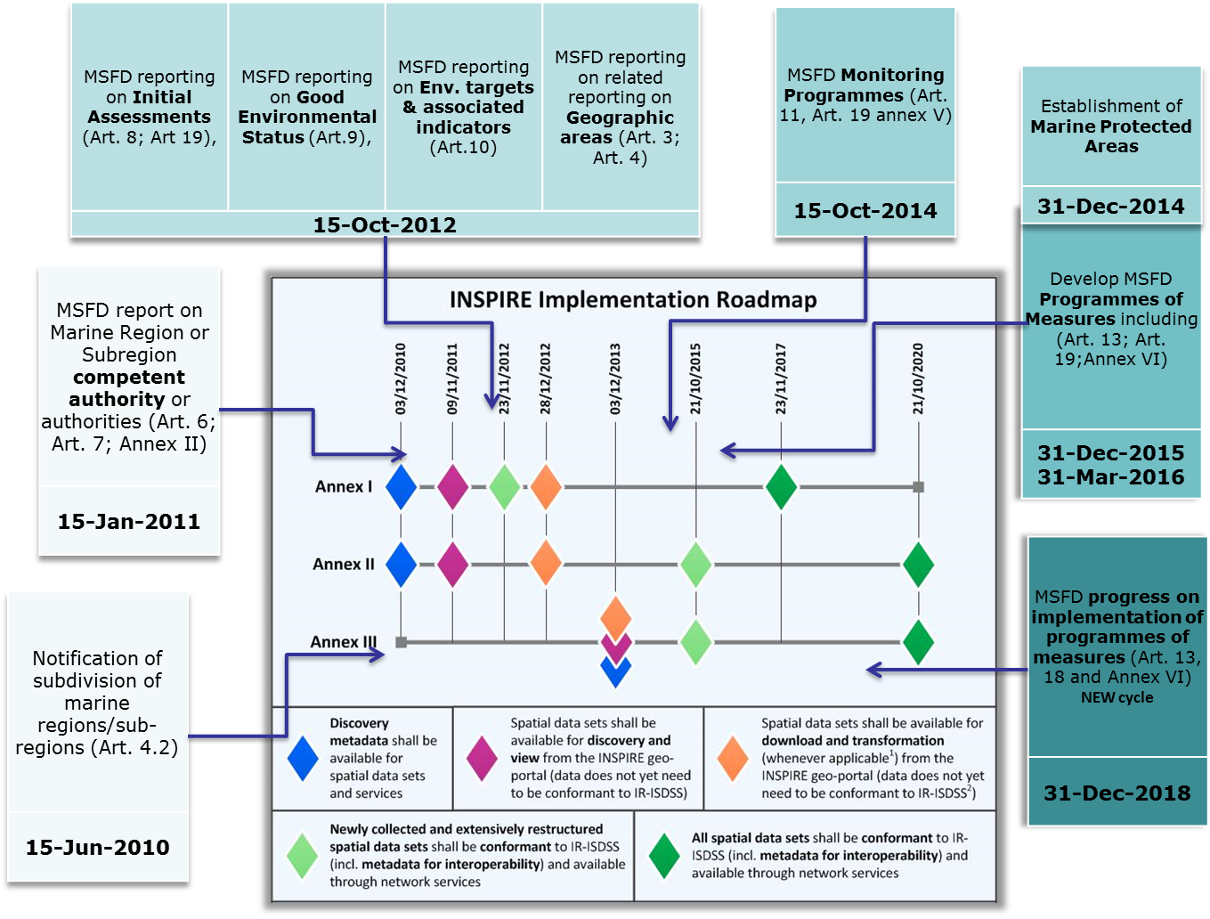
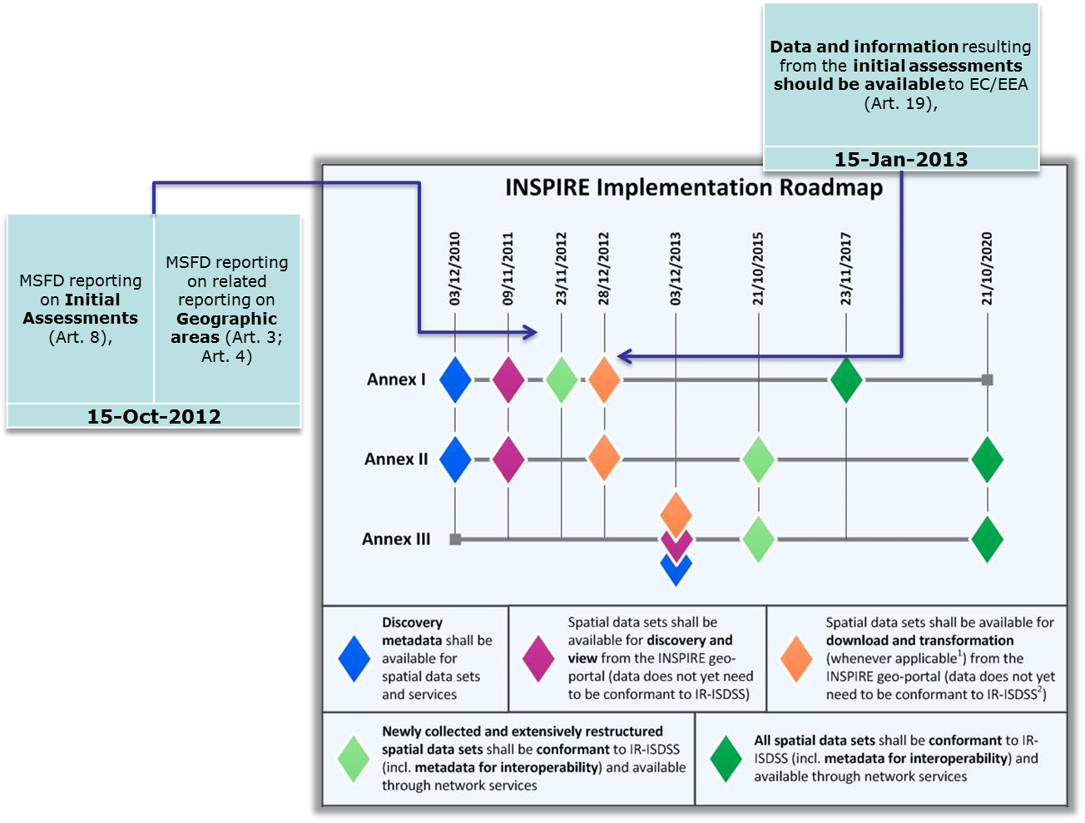
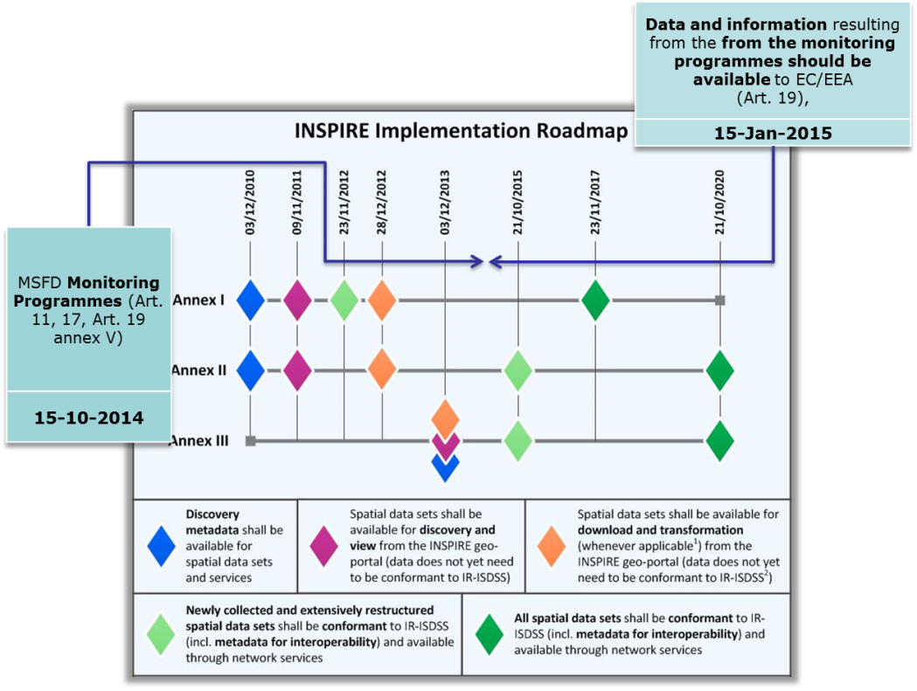
1st draft of WP 1 – Deliverable - initial analysis done by JRC
D1.2 Matching table of MSFD and INSPIRE requirements
Mapping between legally binding components of INSPIRE legislation and MSFD

Slide 7
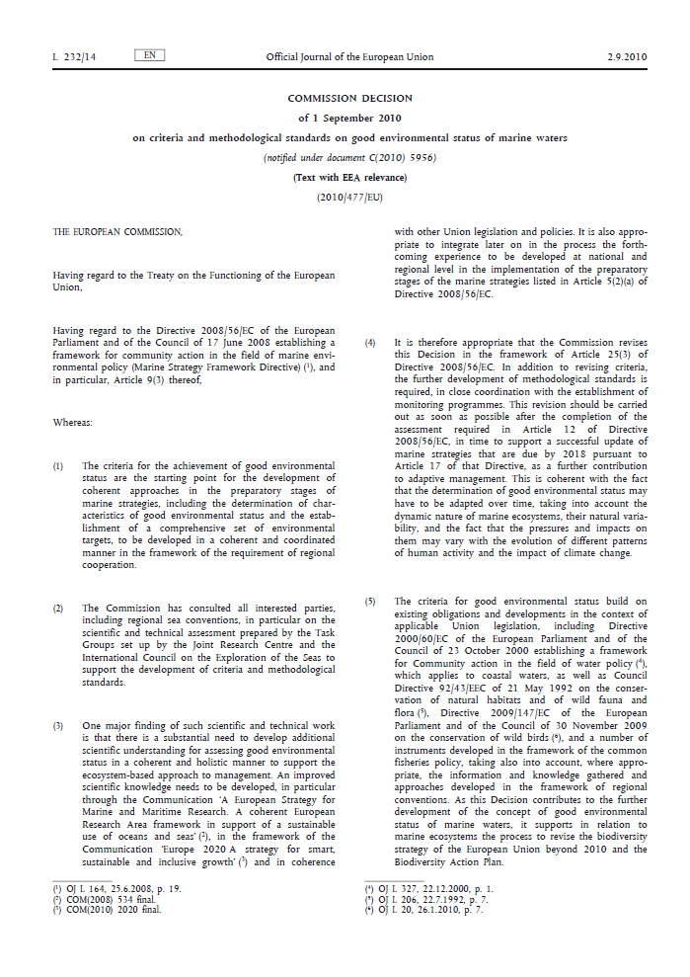
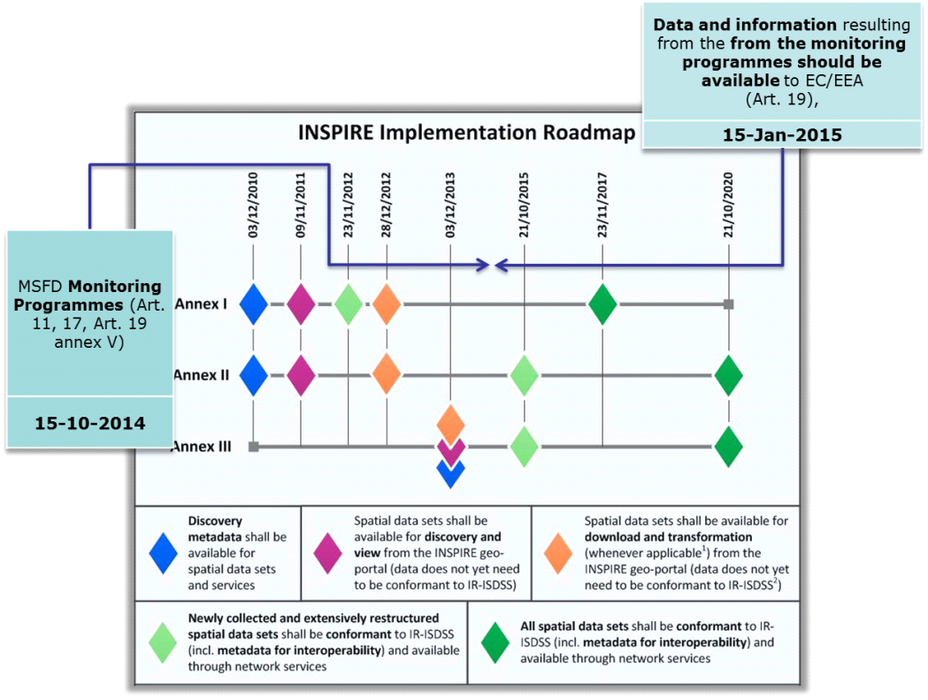
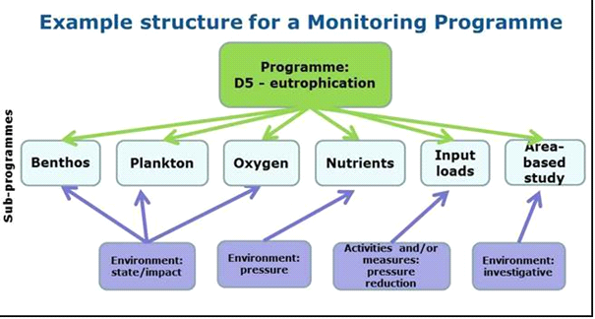
    Monitoring programmes & Article 19(3)

Slide 8
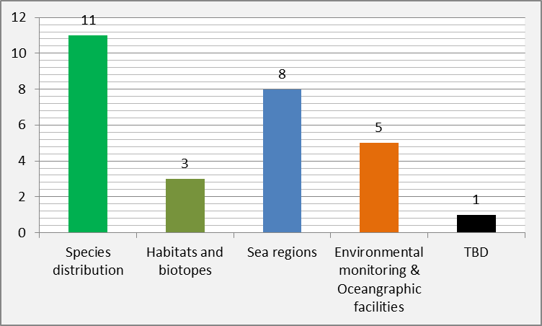
WP2 - INSPIRE-based MSFD spatial data modelling
information coming from the monitoring programmes could be divided in three classes:
Time series (e.g. concentrations of Chl a, nutrients, priority substances …)
Bio - data (e.g. invasive species distribution, affected habitats maps….)
Sea areas with common characteristics (e.g. seabed areas significantly affected maps…)

Slide 9
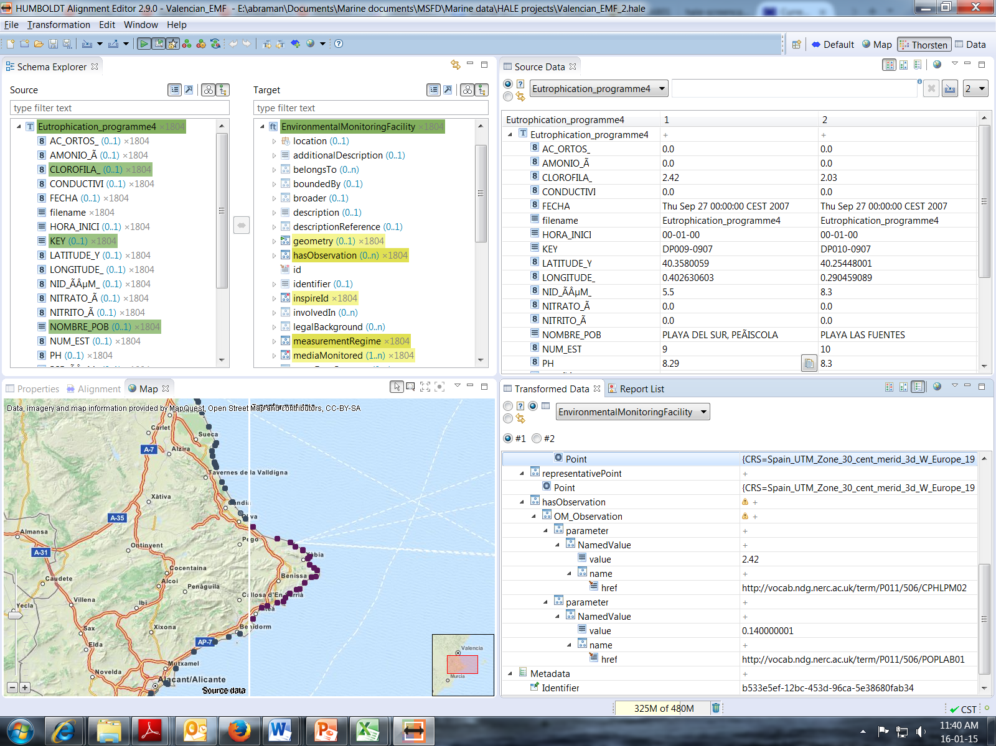
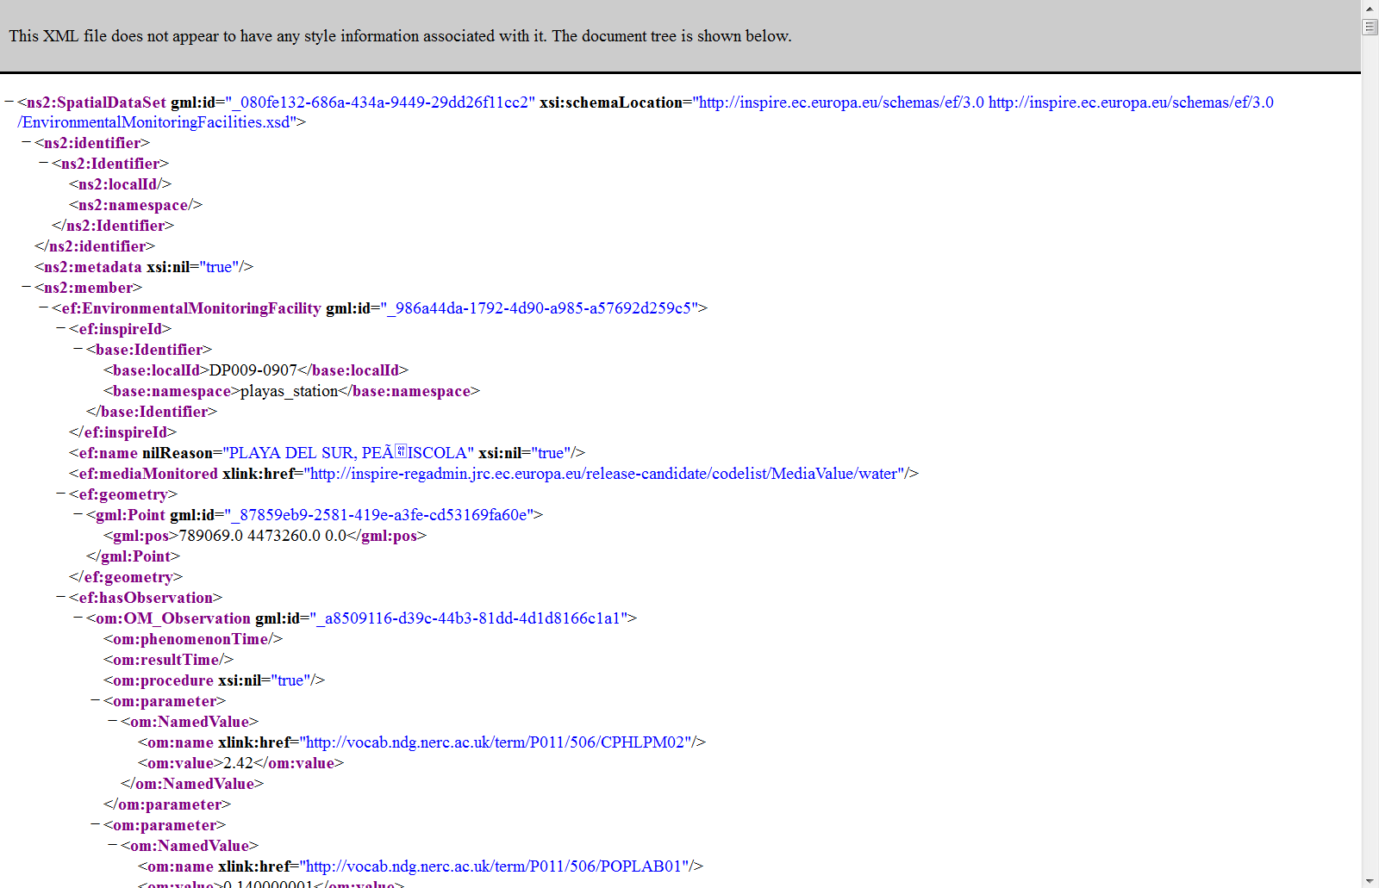
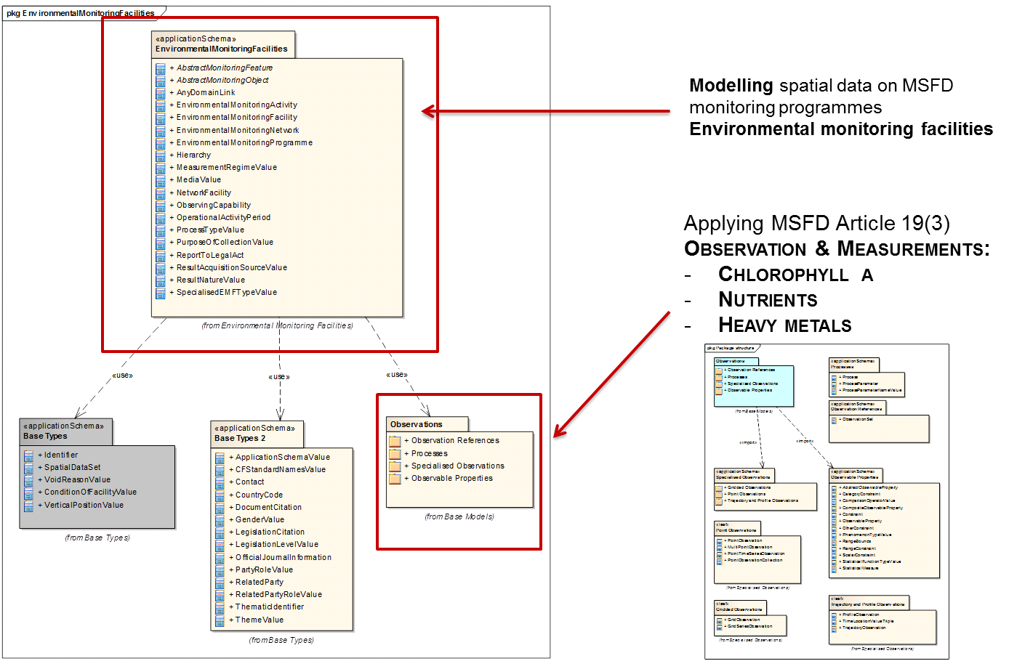
Time series – we develop INSPIRE GML with historical data (WFD coastal monitoring network SPAIN/Valencia)
NO NEED FOR EXTENSION
Environmental monitoring facilities model that includes Observation & Measurements model appropriate for time series.
Model of the EF is appropriate for modelling time series of two quality descriptors and related criteria:
Descriptor 5 - Human-induced eutrophication – nutrient levels; direct effects of nutrient enrichment (Chlorophyll a and water transparency data); indirect effects of nutrient enrichment (dissolved oxygen).
Descriptor 8 - Concentrations of contaminants (priority substances in water, sediment and biota)
Descriptor 9 - Contaminants in fish and other seafood/Levels, number and frequency of contaminants
Notes:
Maybe include explanation why not used Oceanographically features

Slide 10
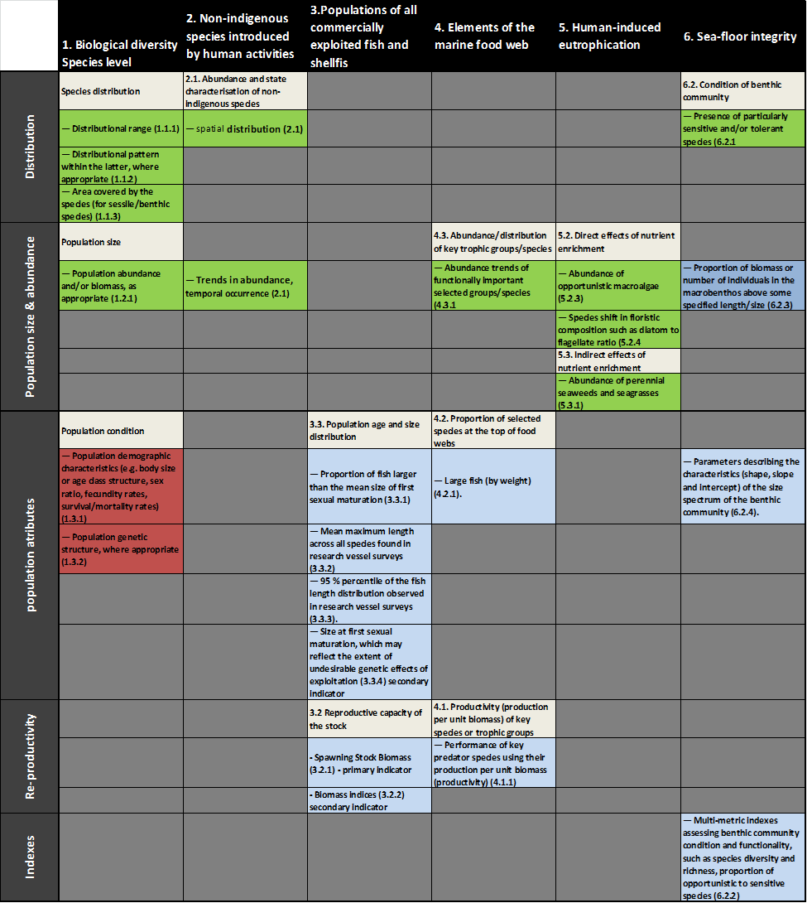
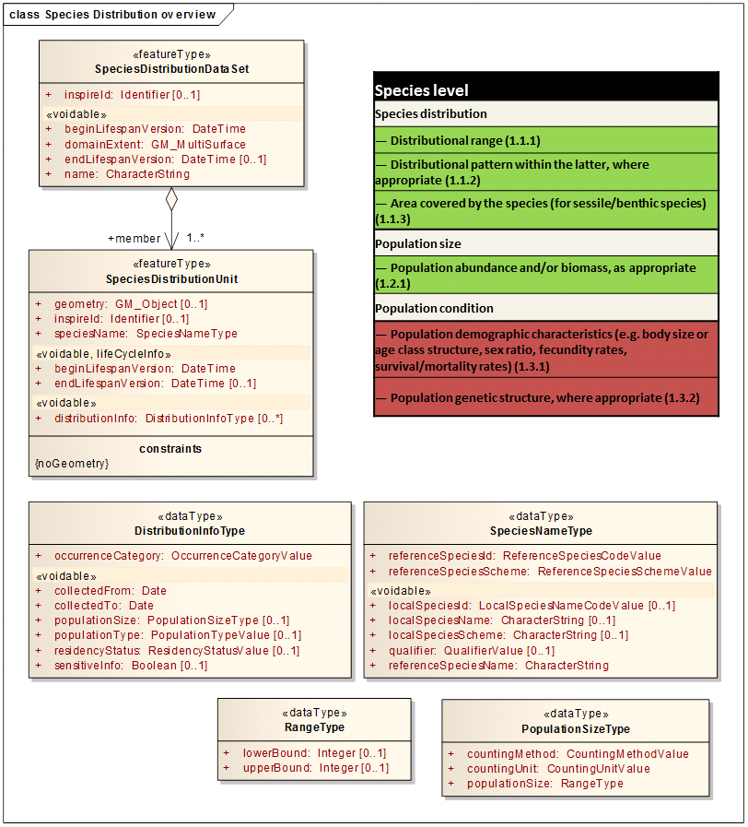
Biodiversity data SD & HB – needed extensions some test done by EMODnet data – W. Mediterranean habitats
Analyzing the requirements given by COM regarding the biodiversity quality descriptors and related criteria, for the needed INSPIRE models extension of SD and HB there are two approaches:
Extension on INSPIRE model (SD or HB) done for each quality descriptor separately (figure 6), extending on the criteria that is not covered by INSPIRE data model.
Extension of the INSPIRE data model that cover needs for all quality descriptors that are identified as should be modelled by SD or HB.
Biodiversity MSFD data model

Slide 11
Areas with common characteristics
Need to be developed an code list – for AbstractObservableProperty (empty code list that can be extended as needed by data provider)
NO NEED FOR EXTENSION
But MSFD code list needed

Slide 12
Covering the MSFD/Article 19 requirements (monitoring programmes part)
With models:
Environmental monitoring facilities (without extension)
Species distribution (extension needed)
Habitats and biotopes (extension needed)
Sea regions (development of MSFD code list)
We cover all data model requirements for all (10+1) quality descriptors 28+1 criteria given in Commission Decision on GEnS

Slide 13
WP3 - Development of the data flow - MS to EC/EEA using national (M)SDI
Develpoment with 3 countries, experience will be documneted
JRC is developing the Sand Box
Data from WFD coastal waters monitoring network, time series of the QD 5 and 8 (Chl a, nutrients, heavy metals, priority substances)
Data from EMODnet – habitats portal – W. Mediterranean data set on habitats
Protected sites – European data set on designated areas – form EEA

Slide 14
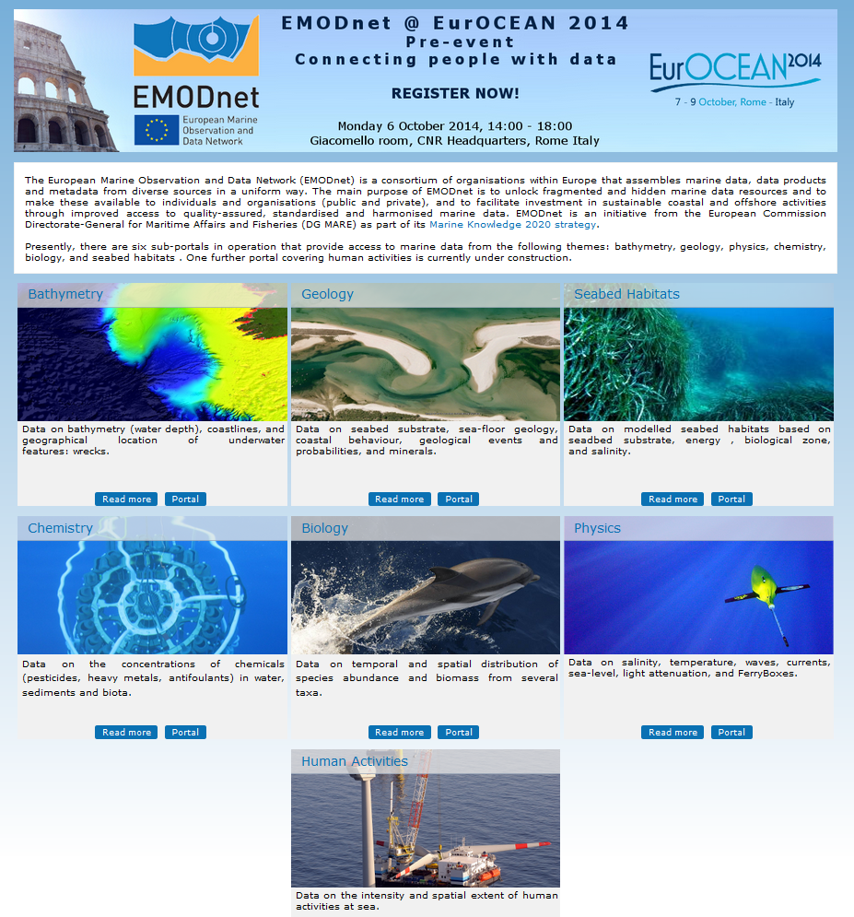
Work Package 4- EMODnet and INSPIRE
The relationship between INSPIRE, EMODnet, MSFD;
What implications INSPIRE has for EMODnet and for EMODnet data providers;
Recommendations for aligning EMODnet to INSPIRE in relation to MSFD.

Slide 15
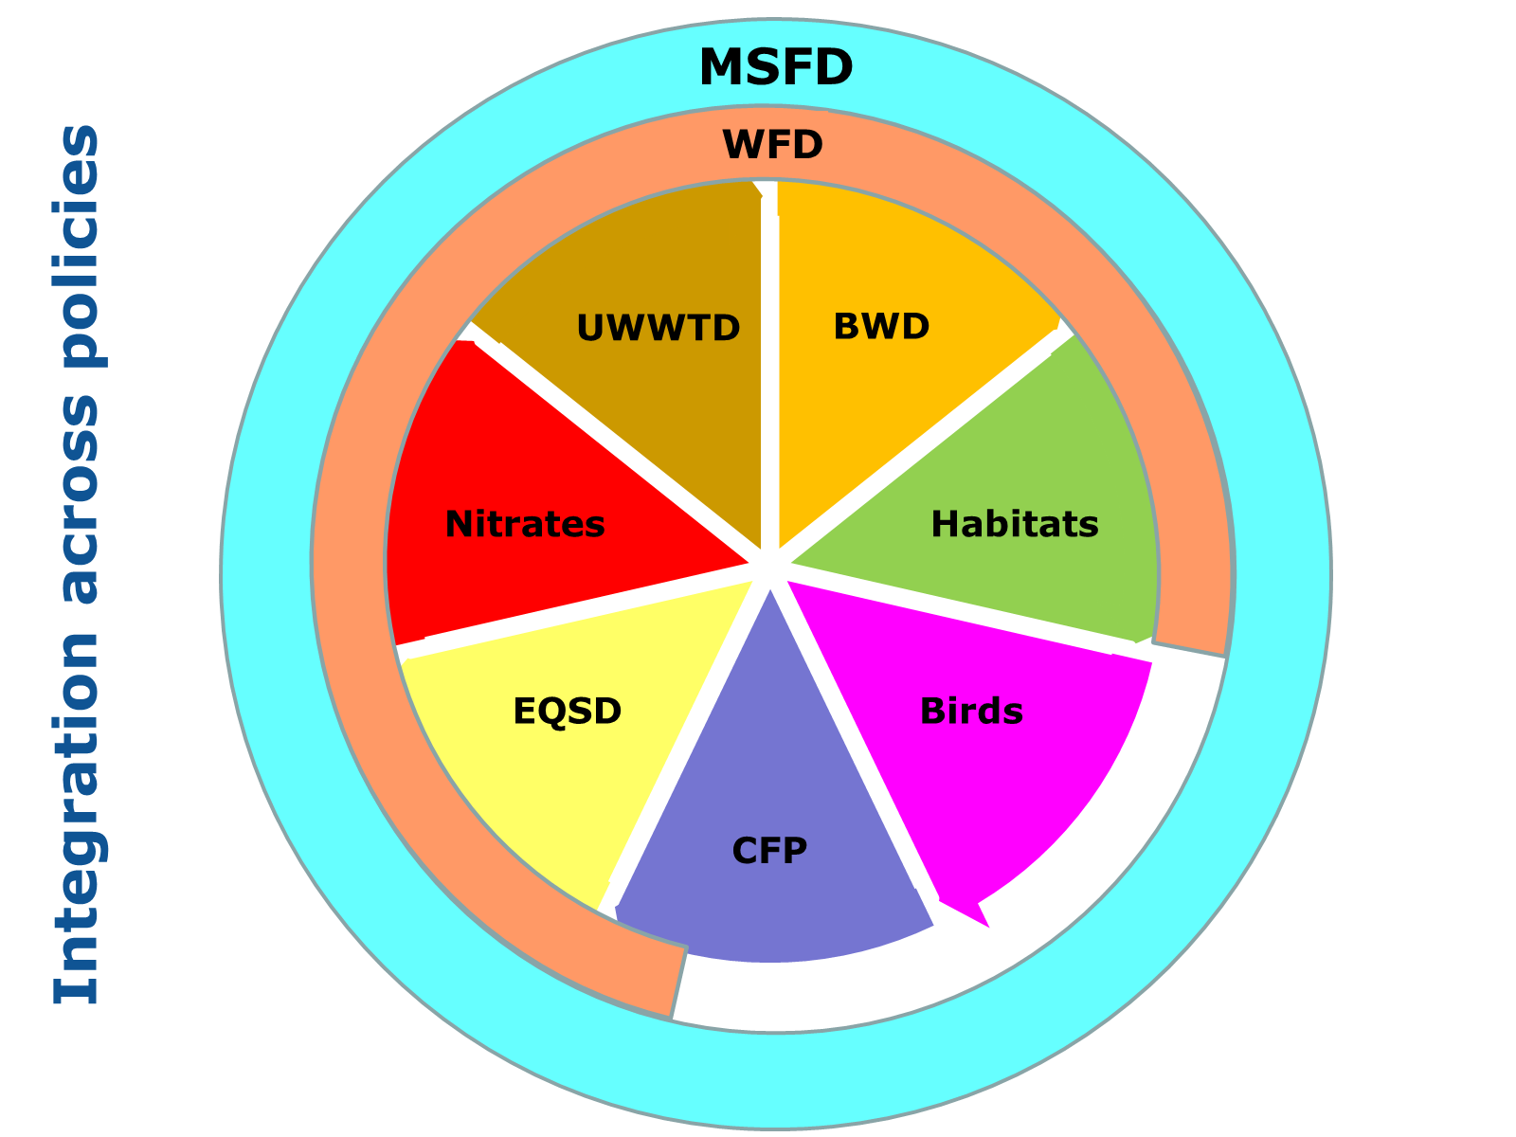
Work Package 5- Document and analyse the cost and benefit
Guidelines for collecting cost and benefit information are defined and distributed to the participating organizations.
    used for the Testing phase of the INSPIRE data specifications (v2.0)
Elements for the costs and benefits considerations will be collected
Possible reuse of the spatial data required by MSFD shared by INSPIRE network services in scope of implementation for other environmental policies
David Connor: Towards integrated marine environmental information

Slide 16
Work Package 6- Training and capacity building
(Workshop) Training of the pilot participants;
Proposed INSPIRE harmonization workshop -training session – development of the “water” cross-border layer
(Workshop) Training on re-use of marine pilot results.

Slide 17
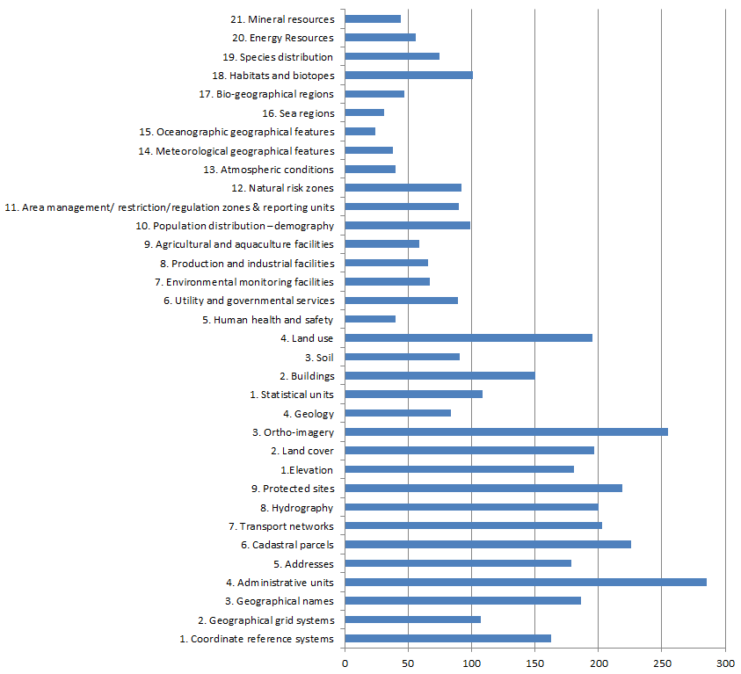
Public consultation response status
Disaster management
Urban Planning
Water Management Plans
Environmental Impact Assessment
Risk Management
Citizens Information
Public Inspections
…
Spatial data used
INSPIRE 34 Data Themes

Slide 18
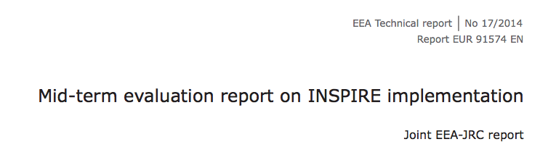
INSPIRE Policy Evaluation
https://www.google.be/webhp?sourceid=chrome-instant&ion=1&espv=2&ie=UTF-8#q=inspire%20policy%20evaluation%20report

Slide 19


Thank you for your attention

