Slide 1
Workshop for Regional INT Charts / ENC Coordinators
25 April
Agenda item 7: Preparation for the Future: ENCs and INT Charts
Is the IHO INT Chart Concept still valid ?
IHB

Slide 2
INT Chart Concept
IHO Work Programme
3.6 Coordination of Global Surveying and Charting
3.6.4 Maintain and coordinate INT Chart Schemes and improve the availability of the INT Chart Series

Slide 3
INT Chart Concept
Principal aims:
create a compact set of medium- and large-scale charts that are specifically designed for planning, landfall and coastal navigation and access to ports used by ships engaged in international trade.
avoid duplication of effort

Slide 4
INT Chart Concept
Recent new production:

Slide 5
INT Chart Concept
Progress towards completion of INT chart concept:
 | 2013 | 2014 | 2015
Total charts planned in INT schemes | 1980 | 2013 | 2009
INT charts published | 1514 | 1558 | 1588
% of the planned series | 76% | 77% | 79%

Slide 6
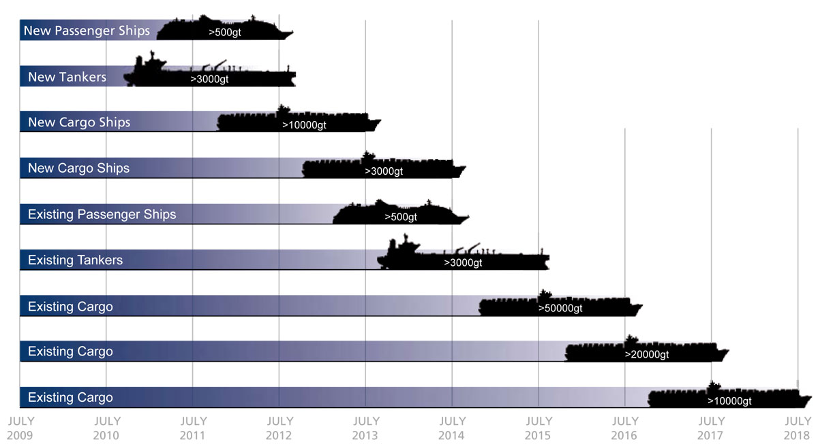
INT Chart Concept
Some considerations …
The requirement for paper charts may diminish over time
BUT
60% of the world’s cargo fleet < 10000 grt
ECDIS carriage requirement
>10,000 grt !

Slide 7
INT Chart Concept
Some more considerations …
…guidance in S-11 Part A
It is recommended that, for the sake of economy, national charts series are designed so that selected charts can be used for the International chart series …
is this recommendation still applicable / being implemented?
is this recommendation impacted by the switch from paper charts to ENC, as the primary driver for chart scheming and production?
are there significant additional costs associated with the scheming, management and production of INT charts?

Slide 8
INT Chart Concept
So, some questions to consider …
Is the IHO INT chart concept still justified ?
Is it sustainable? Are the resources available ?
If Yes,
Are there any immediate actions required to complete the schemes?
What actions ?
Should the INT concept be better aligned with global ENC coverage ?
How ?

Slide 9
Workshop for Regional INT Charts / ENC Coordinators
25 April
Agenda item 7: Preparation for the Future: ENCs and INT Charts
Is the IHO INT Chart Concept still valid ?
IHB

