Slide 1
Report of the / Proposal by the
DQWG
Hydrographic Services and Standards Committee
NCWG 4, The Hague, Netherlands, 6-9 Nov 2018

Slide 2
Top 3 work items of the DQWG
Develop and maintain a data quality checklist for product specification developers;
Provide guidance on data quality aspects to Hydrographic Offices, in particular to ensure harmonized implementation;
Periodically review S-100 based product specifications to ensure the data quality aspects have been taken into consideration and provide input papers for WGs and PTs consideration if deemed necessary.
NCWG 4, The Hague, Netherlands, 6-9 Nov 2018

Slide 3
Data Quality Checklist
Uses ISO standard 19152 as reference;
S-97 Guidance for Product Specification Developers - part C Data Quality;
Provides 10 recommendations;
Data quality measures can be divided into: completeness, logical consistency, positional accuracy, thematic accuracy, temporal quality, aggregation and usability.
NCWG 4, The Hague, Netherlands, 6-9 Nov 2018

Slide 4
Harmonization between S-1xx Product Specifications
 | S-101 | S-102 | S-104 | S-111 | S-112 | S-121 | S-122 | S-123 | S-125 | S-126 | S-127 | S-128 | S-129
S-101 | X
S-102 |  | X
S-104 |  |  | X
S-111 |  |  |  | X
S-112 |  |  |  |  | X
S-121 |  |  |  |  |  | X
S-122 |  |  |  |  |  |  | X
S-123 |  |  |  |  |  |  |  | X
S-125 |  |  |  |  |  |  |  |  | X
S-126 |  |  |  |  |  |  |  |  |  | X
S-127 |  |  |  |  |  |  |  |  |  |  | X
S-128 |  |  |  |  |  |  |  |  |  |  |  | X
S-129 |  |  |  |  |  |  |  |  |  |  |  |  | X
green = fully, yellow = partial, red = not (harmonized)
NCWG 4, The Hague, Netherlands, 6-9 Nov 2018

Slide 5
Guidance to Hydrographic Offices -> CATZOC
Stage 1: assessment (assessed / oceanic / unassessed)
Stage 2: temporal variation
Stage 3: features detected
Stage 4: full seafloor coverage
Stage 5: depth accuracy
Stage 6: horizontal accuracy
When HO’s follow this guideline, CATZOC values will become harmonized.
NCWG 4, The Hague, Netherlands, 6-9 Nov 2018

Slide 6
Problems or outstanding issues [1]
Dilemma between harmonized encoding of quality information and the allowable input into a datamodel.
HO’s use workarounds in current S-57 model.
Harmonized encoding is a joint HSSC-IRCC issue.
FUTURE
S-57, encoding is harmonized
S-101, encoding is harmonized
S-57, encoding not harmonized
S-101, encoding not harmonized
NOW
HSSC-10, Rostock-Warnemünde, Germany, 14-17 May 2018

Slide 7
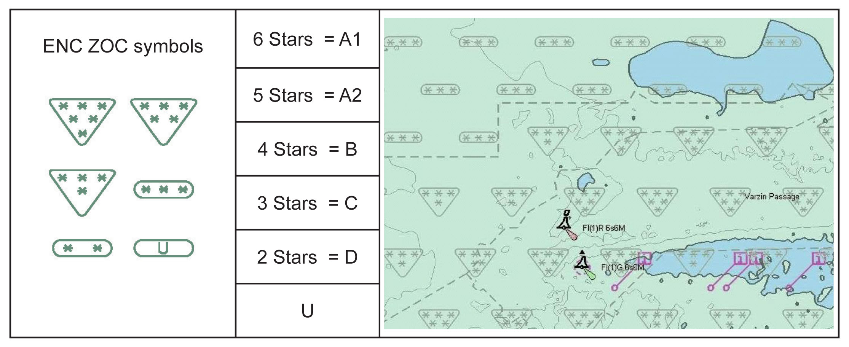
Problems or outstanding issues [2]
CATZOC symbol and display methodology fails its purpose
CATZOC symbol is not used during voyage
Maritime industry requests a safety cone around the vessel (UKC + XTD).
Visualisation of uncertainty of objects, lines and areas
NCWG 4, The Hague, Netherlands, 6-9 Nov 2018

Slide 8
Proposal to visualize uncertainty
Circle displays the 95% Confidence Interval
Area displays the 95% Confidence Interval
Only visible at large chart scales (uncertainty is usually < 100m).
Opacity = 20%, circle/area inherits same symbology type and color from parent symbol
When planning a route, the mariner can simply visualize the uncertainty, set his maximum cross track distance (XTD) and see if the XTD enters the circle/area.
Enroute uncertainty can be switched on in ECDIS when needed.
Isolated dangers (points) and depth contours (lines) most needed.
NCWG 4, The Hague, Netherlands, 6-9 Nov 2018

Slide 9
Action requested of NCWG
Join effort the change the current CATZOC symbol
Evaluate proposal for visualization of uncertainty
Provide any other feedback
NCWG 4, The Hague, Netherlands, 6-9 Nov 2018

