Slide 1
The Norwegian Pilot Guide – Sailing Directions
Anniken Puntervold The Norwegian Mapping Authority Hydrographic Service New Hampshire, May 2017
PHOTO: PORT OF STAVANGER

Slide 12
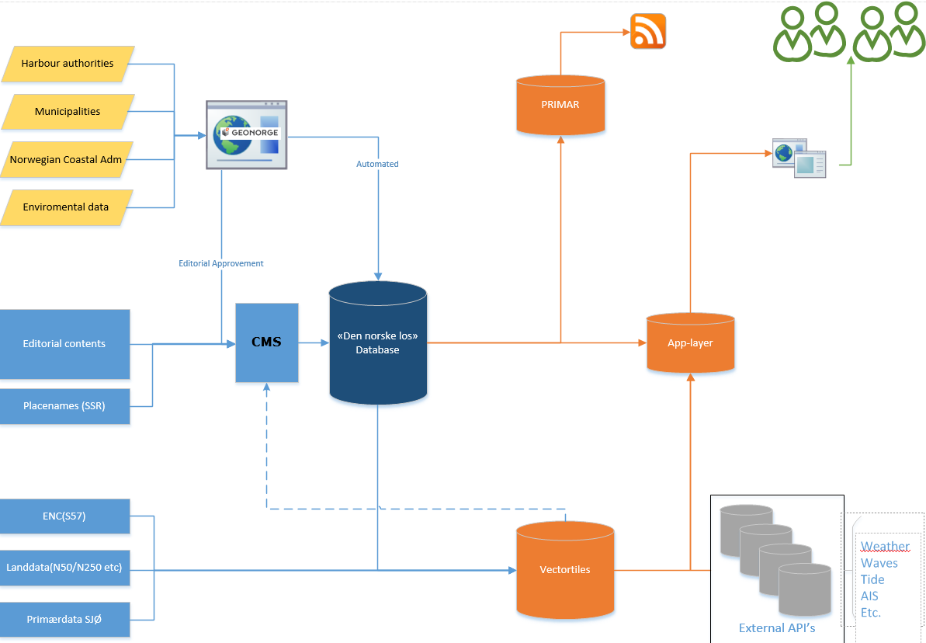
Dataflow

Slide 13
Place Names
Notes:
SSR – Register for spelling of place names database Sentral placename database
All placenames have a geographical position stored in SSR
Provides geotagging for all editorial input from the traditional books.
Updates of placenames is automated due to this link.
Option to add additional geometries(point.line,polygon) in CMS

Slide 14
Chart Sources
Notes:
Chart solution is based on vectortiles with misc sources
At this time, we will use Official S-57 data from NHS and of course S-100 data when its ready
We are using Landdata N50-N250 ( With Scale ranges from 1:50000-250k)
We are Investigating in implementing even higher resolution landdata (FKB, scale 1:5000) and NHS Primarydata, which is the source for all S-57 products, also apporx 1:5000 scale
The main challenge is to limit the total amount of data due to the need of an offline mode. The higher resolution on the sources the more storage they demand.

Slide 15
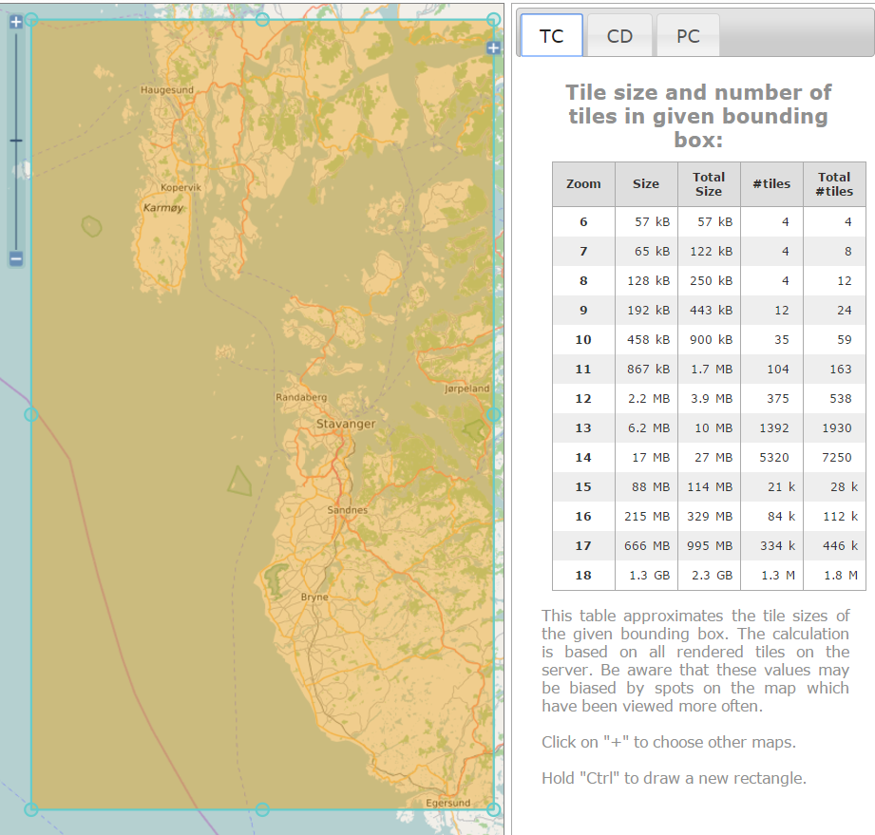
Chart Sources
The main challenge is to limit the total amount of data due to the need of an offline mode
http://tools.geofabrik.de/calc/
The higher resolution on the different sources, the more storage they demand
Find a balance between what to display and store

Slide 16
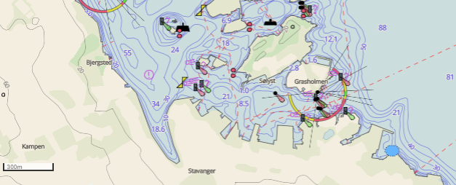
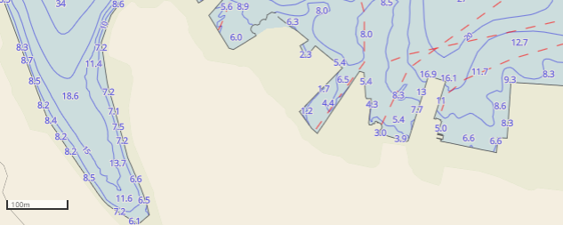
Chart Sources
Current data and detailing shown
The first screenshot shows bathymetry used in usage band 4, approach
On the second screenshot it is zoomed further in and usage band 5/6, harbor/berthing, appear
Notes:
Usage bands
4 = approach
5 = harbour
6 = berthing

Slide 17
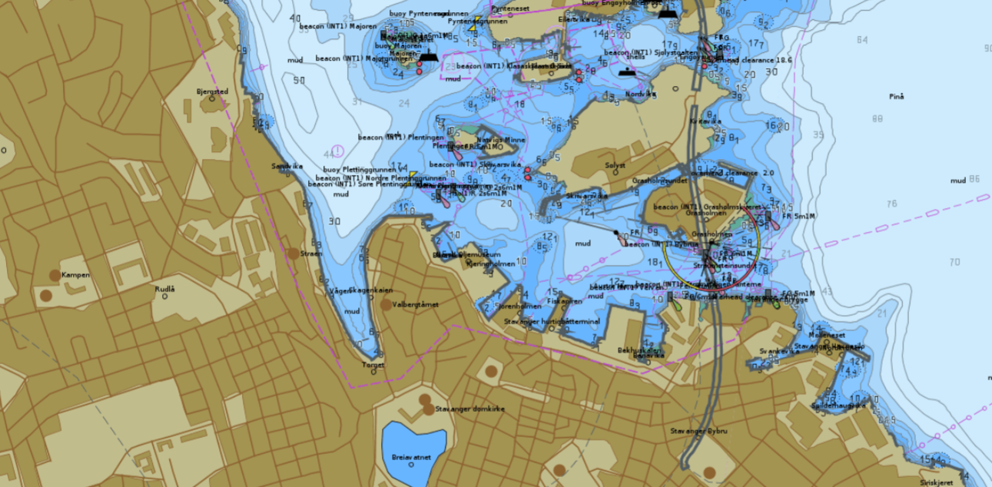
Chart Sources
Pure S-57 presentation – usage band NO4
Notes:
Usage band 4, approach

Slide 18
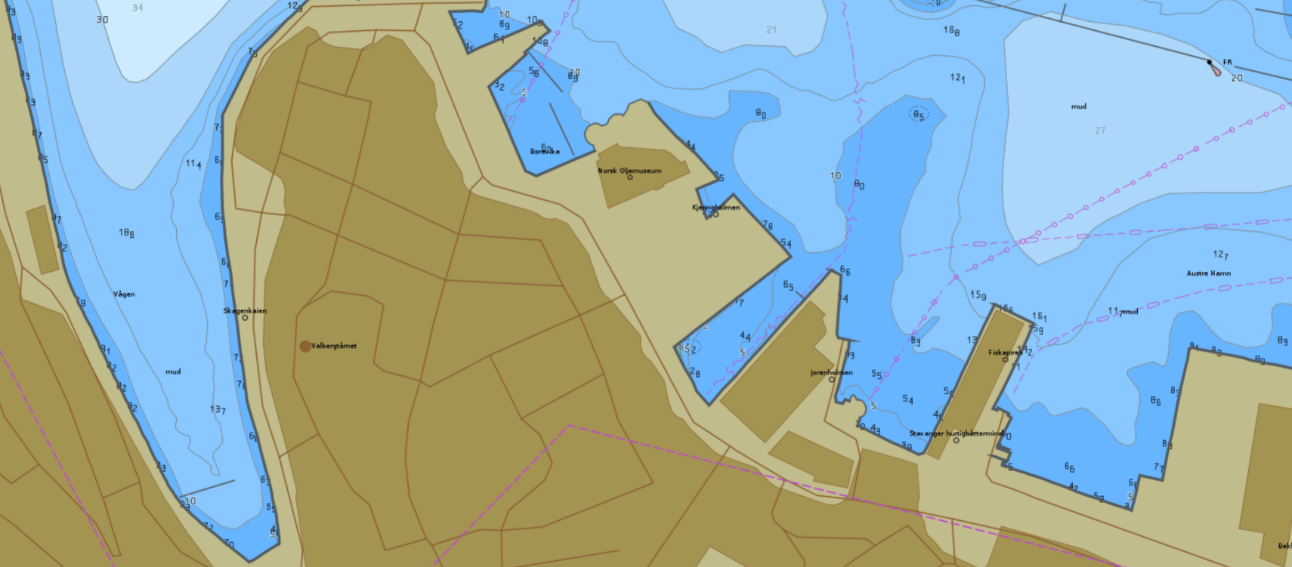
Chart Sources
Pure S-57 presentation – zoomed in to usage band NO5
Notes:
Usage band 5 – harbour.

Slide 19
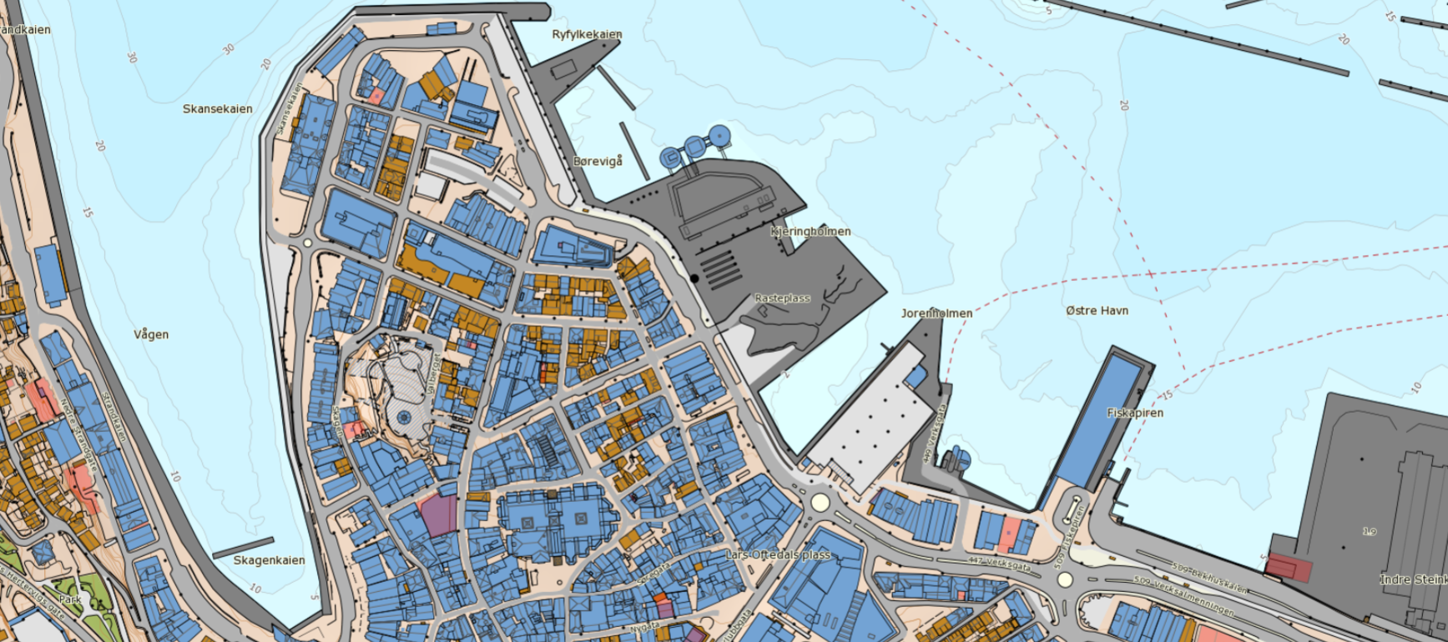
Chart Sources
Looking into the possibilities to implement even higher resolution land data (scale 1:5000) and NHS primary data, which is the source for all S-57 products, also approx. scale 1:5000.
This screenshot shows land data with scale 1:5000, and NHS primary data without soundings and underwater rocks:
Notes:
Soundings = SOUNDG
Underwater rocks = UWTROC

Slide 20
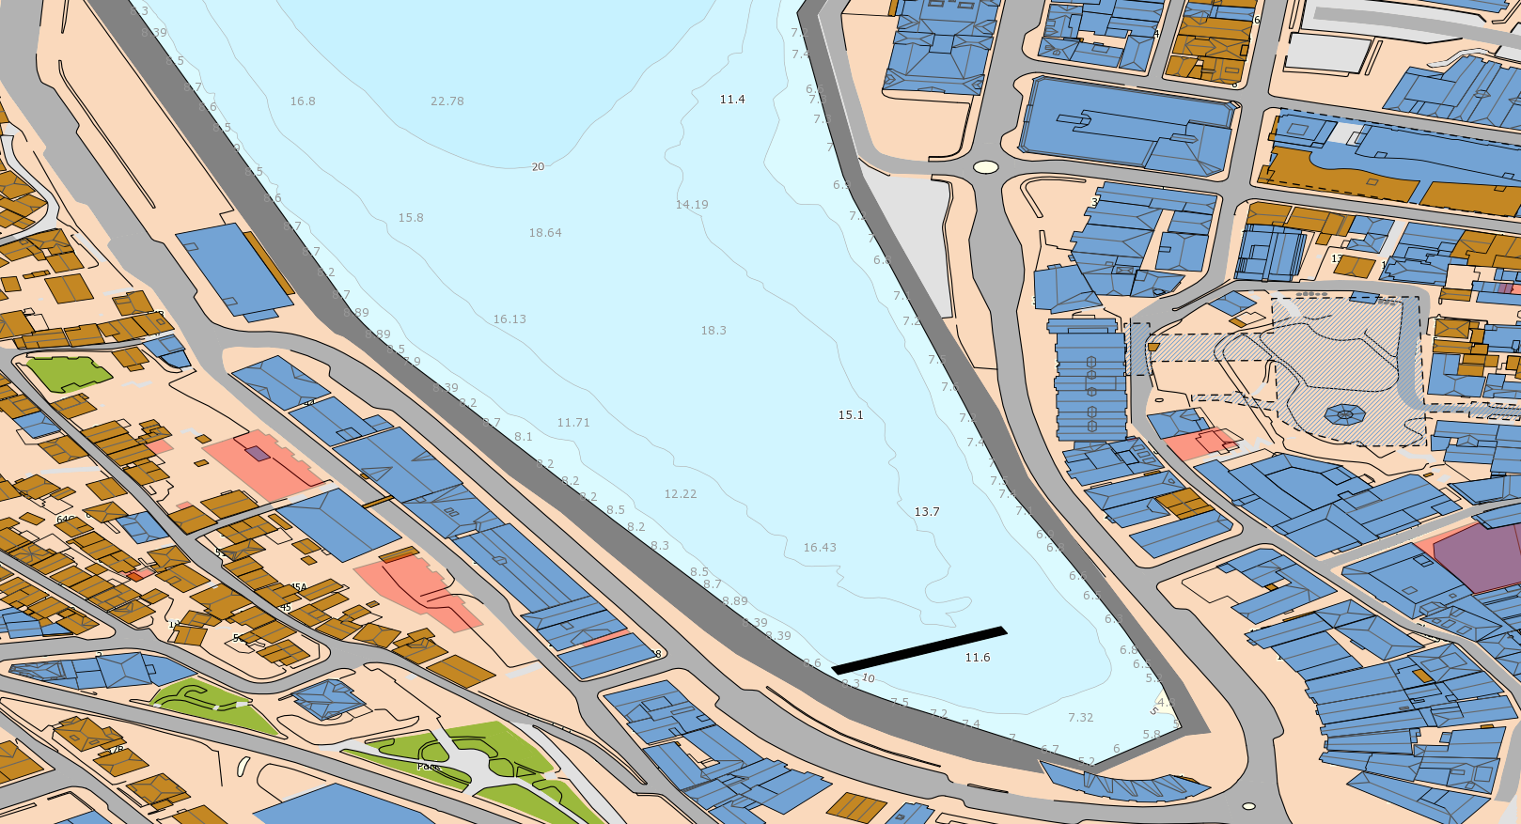
Chart Sources
Same area as the previous screenshot, zoomed in making soundings and underwater rocks appear.
Equal detailed information as in usage band 5/6.
Makes it possible to have the same details in areas where usage bands 5/6 not have been published.
Notes:
Den teknsike løsningen på pdb i dag for wms støtter wgs84 uten projeksjon (epsg:4326)

Slide 21
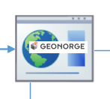
Geonorge – geonorge.no
A governmental co-op for overview and access of public geodata and services
All partners must make their data available according to specified models
Each data owner administers their data and services
Data could be:
Official chart data from the Norwegian Mapping Authority, including the NHS
Statistics Norway, www.ssb.no
Governmental departments etc.
Data is offered as services(i.e. WMS, WFS) or complete datasets

Slide 22
External Sources
Notes:
For the DNL there are several authorities that have contributing data
Working in progress on creating a national «Harbour-standard» to allow all Harbour autorities and Municipalities to deliver their data to Geonorge.
DNL will the harvest the data from here and implement it in the solution
The «harvesting» has focus on automated processes as far as possible,but a certain level of editorial approvment must exist.
Besides data from Geonorge, several API’s will be connected to directly via the app

Slide 23
Distribution
Notes:
PRIMAR/Geonorge - data from DNL-database exported as a dataset to be distributed through these channels.
For PRIMAR the datamodel and deliveries should comply with S-12x-model as they get established.
For Geonorge the datamodel and delivieries must comply with the national «Harbour-model» that is work-in-progress.
Nessecary mapping/re-mapping is done with FME.
For technical reasons the app will have an app-layer where the different data is compiled before it is distributed to the app itself.
Distribution to the app-layer is performed in several ways
Through CMS-API – read GeoJSON directly from DNL-DB
Data from DNL-db is integrated into the vectortiles-service
Additional layers as GeoJSON-files if needed.

Slide 24
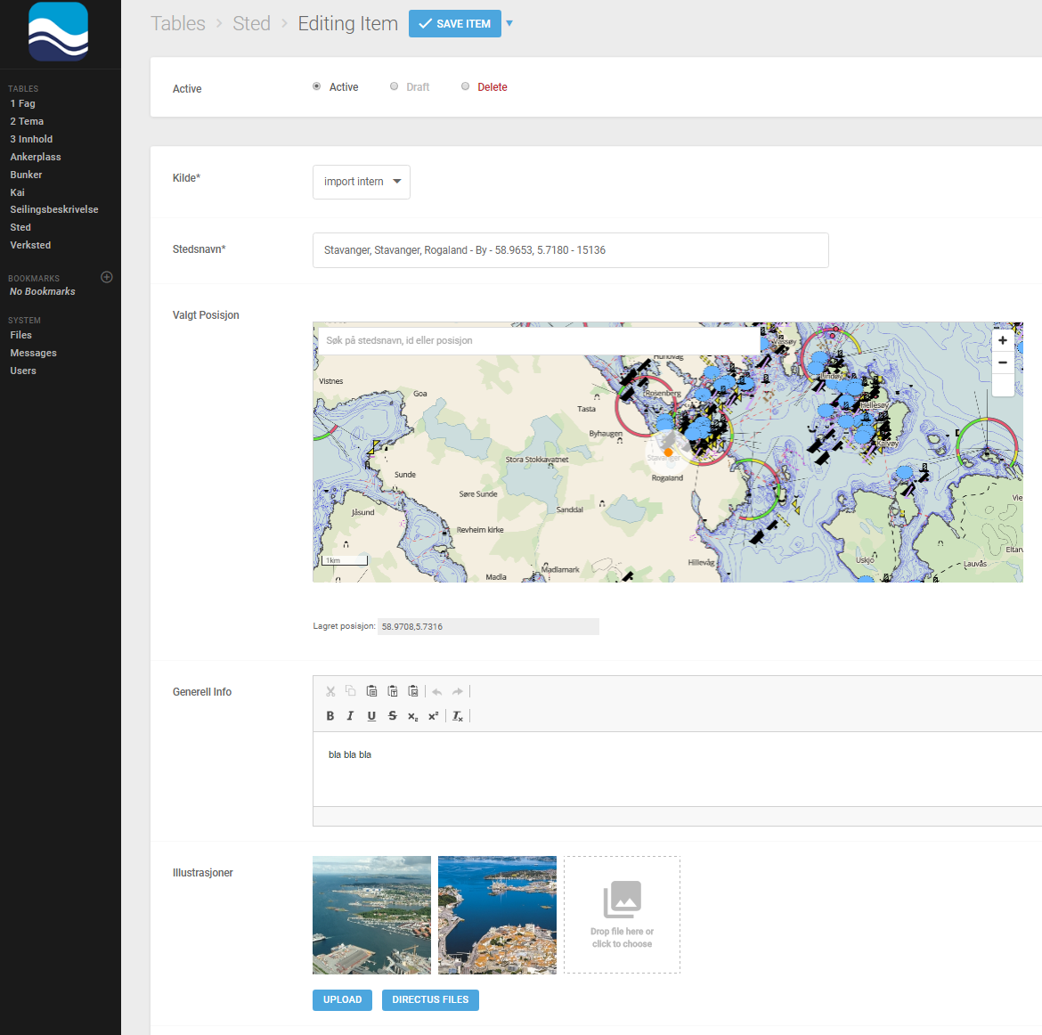
CMS
Notes:
Directus is an opensource headless Content Management System
A headless CMS has its front-end component (the head) removed, and what remains is a backend delivering content via an API
This makes the content independent of how it is displayed or used
Uses a MySQL database in bottom.
Highly configurable user interface
Supports users/roles
Logging of changes made
Has its own API that allows access to the content.
Will be used for managing all editorial content in DNL.
Can also be setup to allow external users to register and maintain their data

Slide 25
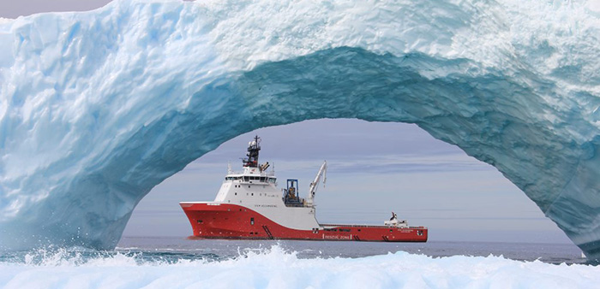
Approval – the Norwegian Mapping Authority
Notes:
We have established a good cooperation with the Norwegian Maritime Aurhority. We have received some guidelines about what we need to do, to get the contents approved for sailing. 1. How to get the application approved 2. What to be approved 3. Cooperation with NMA and NCA

Slide 26
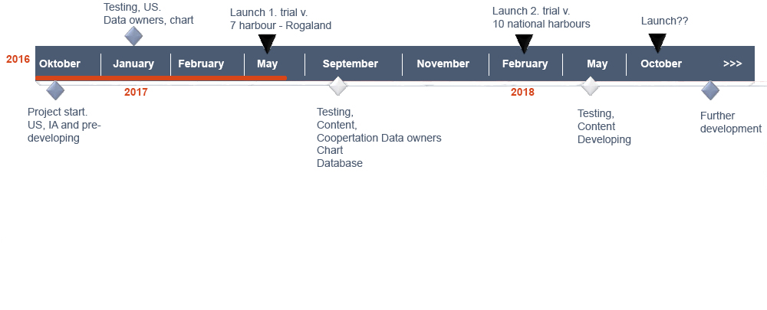
Tentative Timeline

Slide 27
Some Threat Scenarios
Notes:
And last but not least. Increasing digitalization also has a shadow side, such as cyber crime. However, in the future the digital maritime world will become less fragile against hacking. We can learn a lot from other sectors, such as financial and technological industries. We will continue our work on the secure use of digital systems, because there is only one way to go – and that is forward. The use of paper is the past.
But a secure digital future of maritime transport must be balanced and coordinated to avoid barriers and isolation between ships, distributors, port states and regions.
SSL / TLS certificates are a simple and fast way to ensure the transmission of information over the Internet
There have also been discovered weaknesses and errors in the Secure Sockets Layer (SSL) protocol, which has resulted in new versions and eventually renaming, Transport Layer Security (TLS)

Slide 28
Question to NIPWG and IHO
When we are digitizing the Norwegian pilot guide, we follow the guidelines from the IHO.
Do you know if there are any rules for digital presentation of data and textual content?
Are there any concerns about using an application as one of the medias?

Slide 29
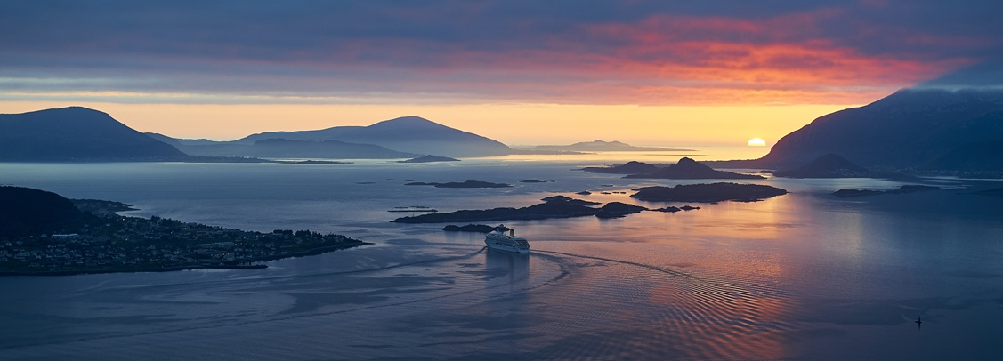
Thank you for your attention
kveann@kartverket.no www.kartverket.no

