Slide 1
Coast Survey Development Laboratory
Office of Coast Survey
National Ocean Service
National Oceanic and Atmospheric Administration
Update on S-104, Potential S-100 HDF5 Changes
Greg Seroka, on behalf of TWCWG

Slide 2
Progress in S-104: Overview
Progress since TSM6 in Sep 2018
TWCWG4: Changes to PS, from TSM6 feedback (Ed. 0.0.7 current)
Descoping Ed. 1.0.0
AIS removed until areas of influence are resolved
S-100 generic data transfer standard (real-time)
Development of HDF5 structure
Potential changes to S-100 HDF5 (TSM7-5.17 Paper)
In Progress/Next Steps
Continue testing proposed HDF5 formats
Submit S-100 Change Proposal
Integrate changes to S-104 PS
Notes:
-TWCWG not yet in agreement on tidal zones of influence; S-104 Ed. 1.0.0 will not include AIS delivery of real-time data until areas of influence are resolved in TWCWG. Maybe by Ed. 2.0.0.
-TWCWG has discussed framework for zones (GML), but it would be up to the HO to generate the zone data.
-S-104 Ed 1.0.0 will still have HDF5 (i.e. via internet)
In Progress/Next Steps:
-Get feedback on S-100 HDF5 changes
-Continue testing proposed HDF5 formats
-Submit S-100 Change Proposal
-Integrate changes to S-104 PS (Data Classification and Encoding Guide- waterLevelTime; enter F&A into IHO GI Registry; Feature Catalogue (XML); trend (0.2 m) discussion; portrayal discussion; Exchange Datasets; uncertainty+DQ)
S-112 Dynamic Water Level Data Transfer will be discontinued; functionality will be in S-104 and/or generic S-100 Data Transfer standard
Tides, Water Level and Currents (TWCWG) to HSSC9: “The HSSC is invited to consider development of a generic S-100 Data Transfer standard rather than continue development of S-112”
HSSC9/38 HSSC noted that development of S-112 is no longer required as the functionality will be in S-104 – Water Levels - and agreed to reassign the S-112 identifier to another product specification as appropriate

Slide 3
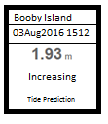
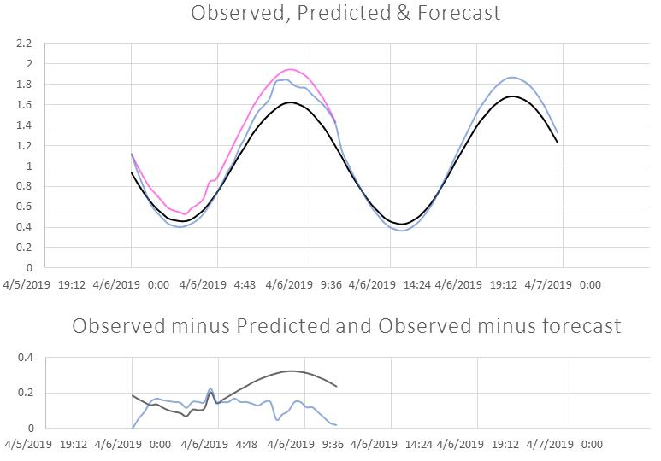
S-104 Use Cases for Time Series
After selection of station:
Use Case 1: Pick report
Use Case 2: Graphic plot of multiple time series
Time series may have different start/end
times, # records
Series have different types: prediction, etc.
Series may have variable time intervals
S-100 Ed. 4.0.0 Part 10c-6 mentions as a goal that the S-100 HDF5 profile must apply to “either static data or time series data (for any of the other kinds), with fixed or variable intervals.”
S-100 does not say how to support this type of data
Pick report
Graphic plot
Notes:
-focused on dataCodingFormat 1 as dataCodingFormat 2, 3 can be structured in ways similar to those described in S-111
-pick report: display of a graphic showing station name, valid date and time (local or UTC), water level height and trend, and type of water level data
-graphic plot: plots of multiple types of time series data over a specific time period. Type of data (observation, prediction, etc) represented by line colour
-In graphic plot, time series of different types of water level shown from one station (e.g. obs, pre, fcst)

Slide 4
Sample S-104 File: Fixed Time Series
S-104 HDF5 File
Feature Container: WaterLevel
Feature Instance: WaterLevel.01 (predictions only)
Values: Group_001=Data for Station No. 1
Values: Group_002=Data for Station No. 2
Feature Instance: WaterLevel.02 (observations only)
Values: Group_001=Data for Station No. 2
Feature Instance: WaterLevel.03 (forecasts only)
Values: Group_001=Data for Station No. 2
Notes:
We introduced the use cases in previous slide. Here is a sample S-104 HDF5 file for fixed time series that accommodates the use cases.
For pick report for Station 1, height and trend will come from only available series, the predictions.
For pick report for Station 2, height and trend will be available from one of three possible series.
For graphic plot for Station 1, the time series of predicted height values will be plotted; trend is not plotted.
For graphic plot for Station 2, all available (three) time series heights (but not trends) will be plotted, unless an option exists for deselection of some series. The colour and line type (solid, dashed, dotted, etc.) for each series is to be defined in the S-104 Product Specification.

Slide 5
Potential S-100 HDF5 Changes (TSM7-5.17 Paper)
TWCWG S-104 Project Team developed through consensus proposed S-100 HDF5 changes described here
Result includes all necessary water level, supplementary data in single HDF5 file in efficient, readable format for the 2 use cases
Team is testing, finalizing HDF5 structures
Seeking S-100 feedback before formally submitting S-100 Change Proposal
Changes to S-100 that may need S-100WG approval:
Non-uniform time intervals
Fixed-station Values Group structure change
Expansion of the Values Group metadata
Other changes we think are allowed in S-100

Slide 6
1. Non-uniform time intervals
 | Uniform Interval | Non-uniform Interval
i=1 | height, trend | height, trend, time
i=2 | height, trend | height, trend, time
etc. | etc. | etc.
 | time(i) from start time, interval
Are triply (or higher) compound values datasets allowed in S-100?
time required for each element in non-uniform interval series
New variable timeIntervalIndex:
(a) if > 0: uniform time interval (sec)
(b) if < 0: non-uniform intervals
Optional timeRecordInterval used only for gridded data.
Notes:
Currently, S-100 Ed. 4.0.0 details support for only uniform time interval series data.
S-100 Ed. 4.0.0 Part 10c-6 mentions as a goal that the S-100 HDF5 profile must apply to “either static data or time series data (for any of the other kinds), with fixed or variable intervals”.
As suggested by an S-104 Project Team member, observation time series may have variable time intervals.
S-100 Ed. 4.0.0 allows for doubly-compound arrays
e.g. S-111 surfaceCurrentSpeed, surfaceCurrentDirection
Not clear if triply (or higher) compound values datasets allowed:
e.g. S-104 waterLevelHeight, waterLevelTrend, waterLevelTime
waterLevelTime optional S-104 Feature Attribute, required for non-uniform interval time series
Table 10c-17 states for fixed stations that the HDF5 dataset is comprised of a compound array, “one component for each attribute specified in the corresponding feature information dataset in the Feature Information group (Table 10c-8)”.

Slide 7
2. Fixed-station Values Group structure change
For fixed stations, S-100 before and after proposed change:
Before: | After:
Group_001=Data at Time No. 1 values across all stations | Group_001=Data at Station No. 1 values across all times
Group_002=Data at Time No. 2 values across all stations | Group_002=Data at Station No. 2 values across all times
etc. | Etc.
S-100 Ed. 4.0.0: for all coverage types except moving platforms, each Values Group represents one time record.
For fixed stations, propose:
1 Values Group = 1 station
Values Group length = number of times, not number of stations
Proposal consistent with S-111 Ed. 1.0.1.
Notes:
TSM7-5.17 paper provides suggested wording changes:
The first paragraph below Table 10c-18 should now read “Time series data for all except the fixed station and moving platforms format (dataEncodingFormat = 1, 4) are encoded in successive groups contained within the instance group.”
The third paragraph below Table 10c-18 should now read “For all coverage types except fixed stations and moving platforms, the number of Groups is the number of time records.”
And add “For fixed stations, the number of Groups is the number of stations”.
Also, Table 10c-17, second row, should be revised from ‘values: 1-dimensional Array, length = numberOfStations’ to ‘values: 1-dimensional Array, length = numberOfTimes’.
Table 10c-18, second row, should also be revised to reflect this change. Please see Item 3 (Expansion of the Values Group metadata) below for specific revisions to Table 10c-18.

Slide 8
3. Expansion of the Values Group metadata
S-100 Ed. 4.0.0 only includes timepoint in Values Group metadata (Table 10c-18). Each Values Group (each station) needs additional metadata:
Values: Group_001=Data for Station No. 1
Values: Group_002=Data for Station No. 2
N | Name | Camel case | Mult. | Data Type | Remarks and/or Units
dataCodingFormat = 1
1 | Name of the station | stationName | 0..1 | Character
2 | Station identification number | stationNumber | 0..1 | Integer
3 | Number of time records | numberOfTimes | 1 | Integer
4 | Index for time interval | timeIntervalIndex | 1 | Integer | Positive value denotes timeRecordInterval (sec). Negative value denotes non-uniform time interval.
5 | Valid time of earliest value | startDateTime | 1 | Character | DateTime format
6 | Valid time of latest value | endDateTime | 1 | Character | DateTime format
dataCodingFormat = 2 or 3
1 | Time stamp | timePoint | 1 | Character | DateTime, gridded data
for station ID
for non-uniform intervals
may differ between series
Notes:
Note that additional variables such as Marine Resource Names (MRN) and station category (e.g., high or long-term, medium, or low) could be added here.
TSM7 5.17 paper provides suggested changes to Table 10c-18 row 2.

Slide 9
4. Other changes we think are allowed in S-100
Migrated optional S-100 variable numberOfTimes from Instance level to Values Group level
Added product-specific metadata pickPriorityType to Feature metadata
Default priority of typeOfWaterLevel shown in pick report, e.g. pickPriorityType = “2, 1, 5”
Prediction first, then observation if prediction unavailable, then forecast if previous two unavailable
Pick report
Notes:
-Still need to discuss whether end user can change pickPriorityType, as part of S-104 portrayal specification discussion.

Slide 10
In Progress/Next steps for S-104
Gather feedback from TSM7 on S-100 HDF5 changes
Continue testing proposed HDF5 formats
Submit S-100 Change Proposal
Integrate changes to S-104 PS
Notes:
-Get feedback on S-100 HDF5 changes
-Above proposed changes should benefit other S-XXX HDF5 time series data, such as S-111
-Are changes implementable by OEMs in ECDIS? Are they implementable in S-100?
-Continue testing proposed HDF5 formats
-Submit S-100 Change Proposal
-Integrate changes to S-104 PS (Data Classification and Encoding Guide- waterLevelTime; enter F&A into IHO GI Registry; Feature Catalogue (XML); trend (0.2 m) discussion; portrayal discussion; Exchange Datasets; uncertainty+DQ)

Slide 11
Supplementary Slides

Slide 12
Present status of the S-104 Product Specification
COMPONENTS OF THE S-104 PRODUCT SPECIFICATION
Main Document (ver. 0.0.7)
Data Classification and Encoding Guide
Establish Feature(s) and Attributes (F&A) (Draft Annex A, add waterLevelTime)
Enter F&A into the IHO GI Registry
3. Feature Catalogue (XML)
4. Portrayal Catalogue
Establish Symbol
Convert Symbol into SVG Files
Portrayal rules – plain text
Portrayal Rules (XSL)
Enter symbol into Portrayal Register
Exchange Format
S-104 EXCHANGE FILE CREATION
S-100 Dataset (HDF5) (under development/testing)
Catalogue File (XML)
Notes:
Descoped S-104; generic S-100 Data Transfer standard:
S-112 Dynamic Water Level Data Transfer will be discontinued; functionality will be in S-104 and/or generic S-100 Data Transfer standard
Tides, Water Level and Currents (TWCWG) to HSSC9: “The HSSC is invited to consider development of a generic S-100 Data Transfer standard rather than continue development of S-112”
HSSC9/38 HSSC noted that development of S-112 is no longer required as the functionality will be in S-104 – Water Levels - and agreed to reassign the S-112 identifier to another product specification as appropriate
-need to re-draft data classification and encoding guide with waterLevelTime, make sure no gridded hydroid for now
-need to enter F&A into IHO GI Registry
-Feature Catalogue (XML) for Ed. 1.0.0 will follow
-So will Portrayal Catalogue, Exchange Datasets, uncertainty, data quality
Other items are all in paper+Appendix A
-waterLevelTrend 0.2m: As for the trend categories and the critical value (i.e., 0.2 m), there are good arguments on both sides. Having a single value for all HOs will produce uniformity. On the other hand, allowing each HO to set values will be flexible enough to include low tide-range areas (the Baltic Sea) or even high tide-range areas (Bay of Fundy). I'd like to hear more from Zarina and other PT members about this issue, and I've added Thomas Hammarklint, who questioned the 0.2 m value at TWCWG4, to the distribution list.
-Finally, we can postpone discussion about the pick report and graphic plot portrayal until later, since the data to support all the options will be included in the HDF5 file. (deselect time series on graphic plot, portrayal of vertical datum on pick report, change default priority of pick report, etc).

