Slide 1
CARTOGRAPHIC BOUNDARY DEFINITION PROPOSAL
by National Hydrographic Centre
Malaysia

Slide 2
SCOPE
ISSUE
FACTOR CONTRIBUTING TO THE ISSUE
CHALLENGES
MITIGATING THE CHALLENGES
IMMEDIATE BENEFIT
SAMPLE
CONCLUSION

Slide 3
ISSUE
DISHARMONISATION OF ENC LEADING TO
UN-SEAMLESSNESS COVERAGE
TRANSBOUNDARY OVERLAPPING CELL

Slide 4
FACTOR CONTRIBUTING TO THE ISSUE
ENC SOURCE
PAPER CHART
OVERLAPPING CELL

Slide 5
CHALLENGES
TO HARMONISE ENC
CHALLENGES
UPDATING
DATA CONSISTENCY
CLIPPING
POLITICAL BOUNDARY
NON POLITICAL BOUNDARY

Slide 6
MITIGATING THE CHALLENGES BY… DEFINING A CARTOGRAPHIC BOUNDARY BY WAY OF DEFINITION
CARTOGRAPHIC BOUNDARY
“Cartographic Boundary can be defined as the limit to clip of an overlapping ENC between two neighbouring countries and later shall not be signified or regarded as a political or jurisdictional boundary. It should be as simple as possible so the user will be provided with most coherent service possible”

Slide 7
IMMEDIATE BENEFIT FROM THE DEFINITION
To give the liberty to HO’s in choosing political boundary or cartographic boundary.

Slide 8
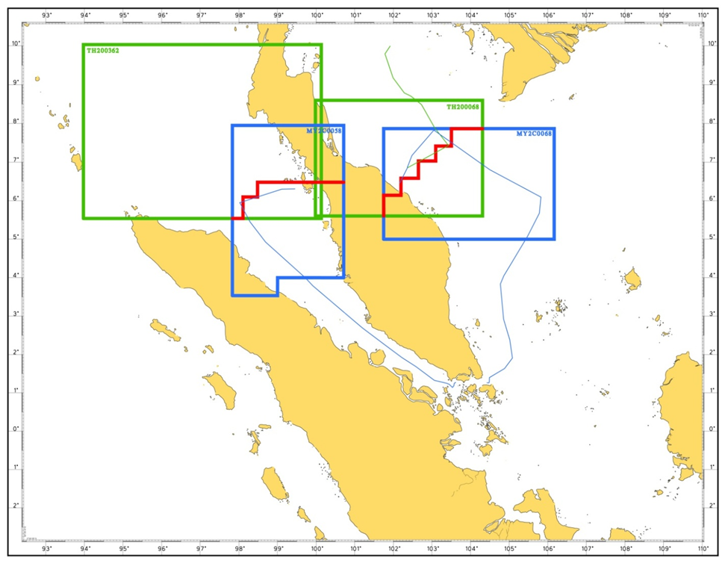
SAMPLE IN CONDUCT OF A CARTOGRAPHIC BOUNDARY BETWEEN MALAYSIA AND THAILAND
ZIG ZAG CONCEPT BETWEEN MALAYSIA AND THAILAND

Slide 9
CONCLUSION
Recommending WEND WG to
a. Endorse the definition of “Cartographic Boundary”
b. Forward the proposal to Hydrographic Dictionary WG
c. Consider the possibility of producing the “Limits of Cartographic Boundaries” Publication.

Slide 10
THANK YOU

Slide 11
Continue..
NHC proposed the zig zag line concept as the approach to define cartographic boundary without imposing on political or jurisdictional boundaries.
Cartographic boundary with zig zag line concept will offer one of the best solutions to achieve seamless ENC between adjacent cells.

