Slide 1
The Data Aspects of future navigation: What Industry is looking for when talking e-Navigation
Michael Bergmann MBA AFNI - The Nautical Institute AFRIN - The Royal Institute of Navigation
Director Maritime Industry Jeppesen
President CIRM
Presented at WENDWG6, Stavanger Norway, 8 March 2016

Slide 2
ENC Overlaps
Bonus slides as of 8 March 2016
IHO DB | Total Sq.Km | Total Gap Sq.Km | % of Overlap
Band 1 | 497,054,117 | 33,138,627 | 6.7%
Band 2 | 158,124,282 | 2,347,561 | 1.5%
Band 3 | 35,905,140 | 256,693 | 0.7%
Band 4 | 7,715,851 | 8,185 | 0.1%
Band 5 | 923,050 | 2,653 | 0.3%
Band 6 | 28,533 | 1 | 0.004%
Total | 699,750,973 | 35,753,718 | 9.3%

Slide 3
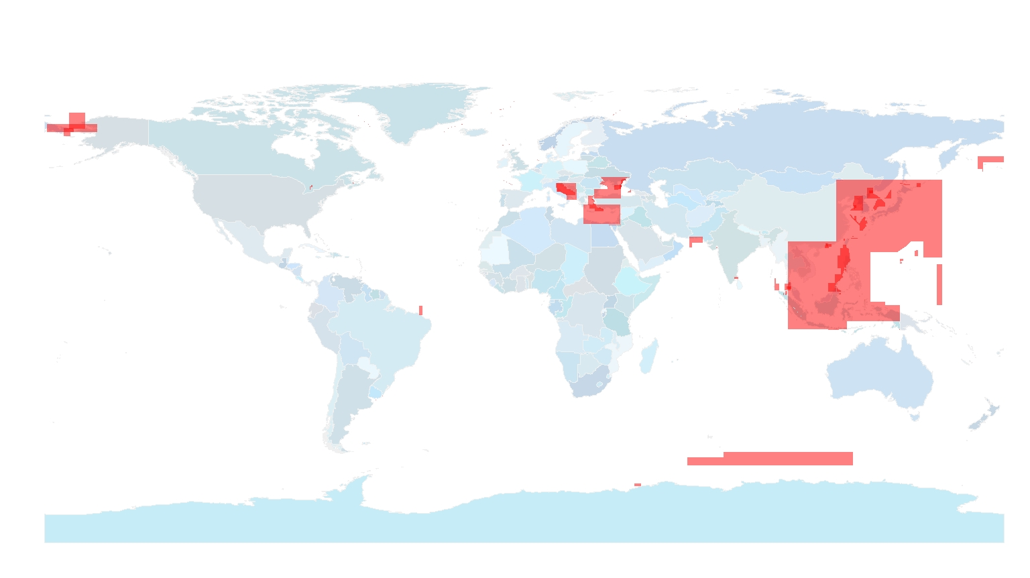
ENC Overlaps Bonus Slide….

Slide 4
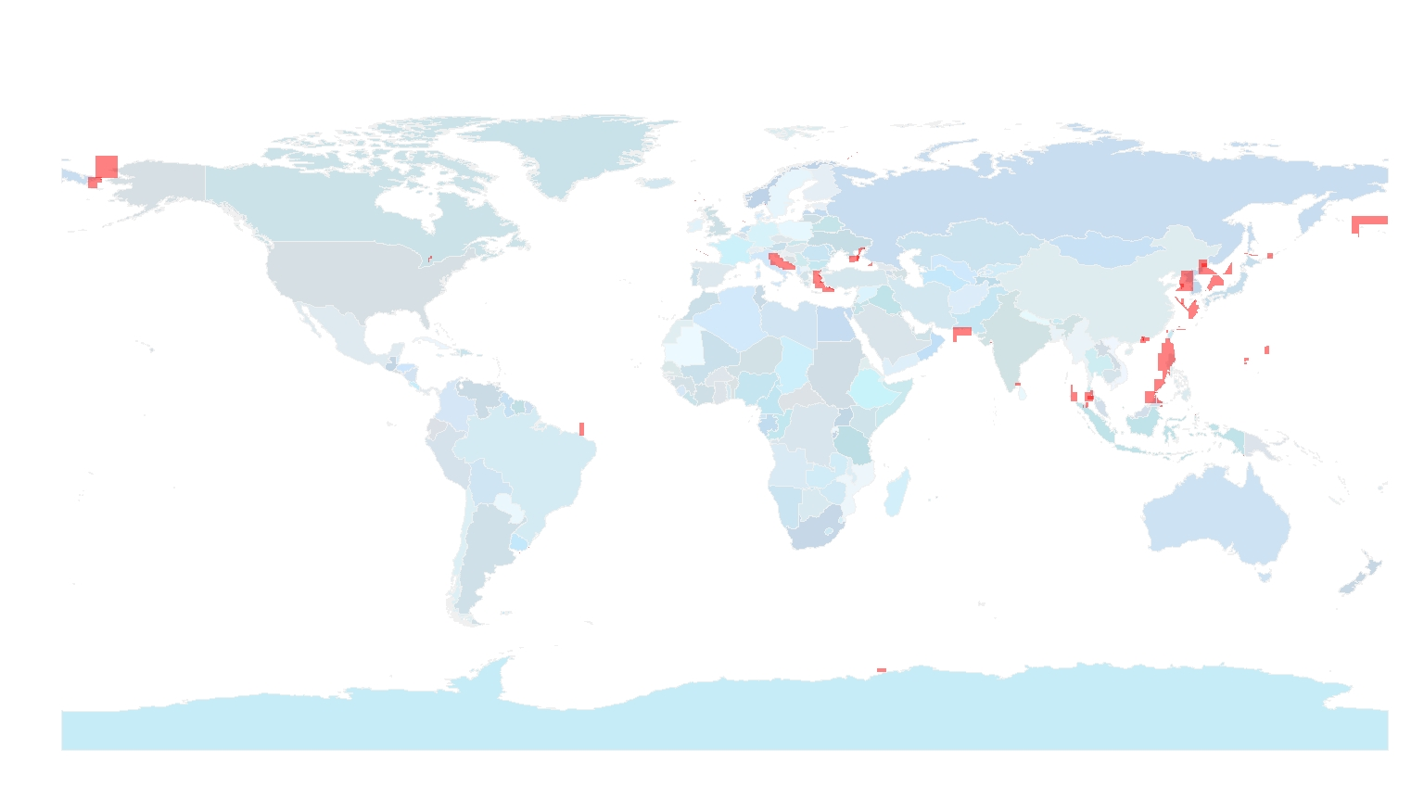
ENC Overlaps Bonus Slide….

Slide 5
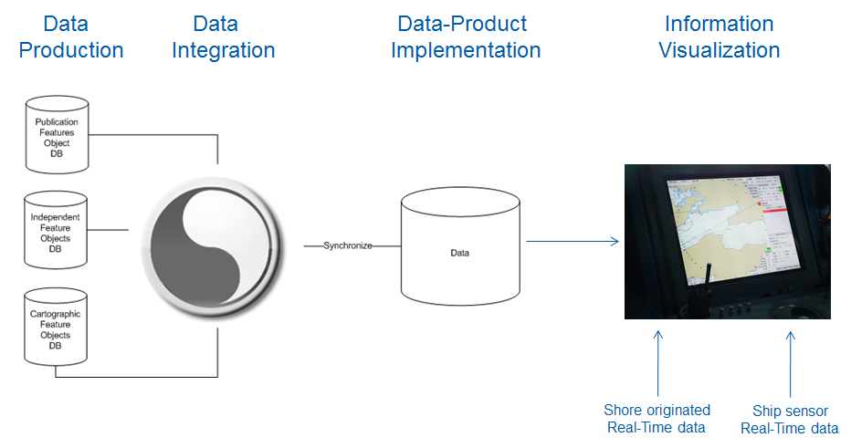
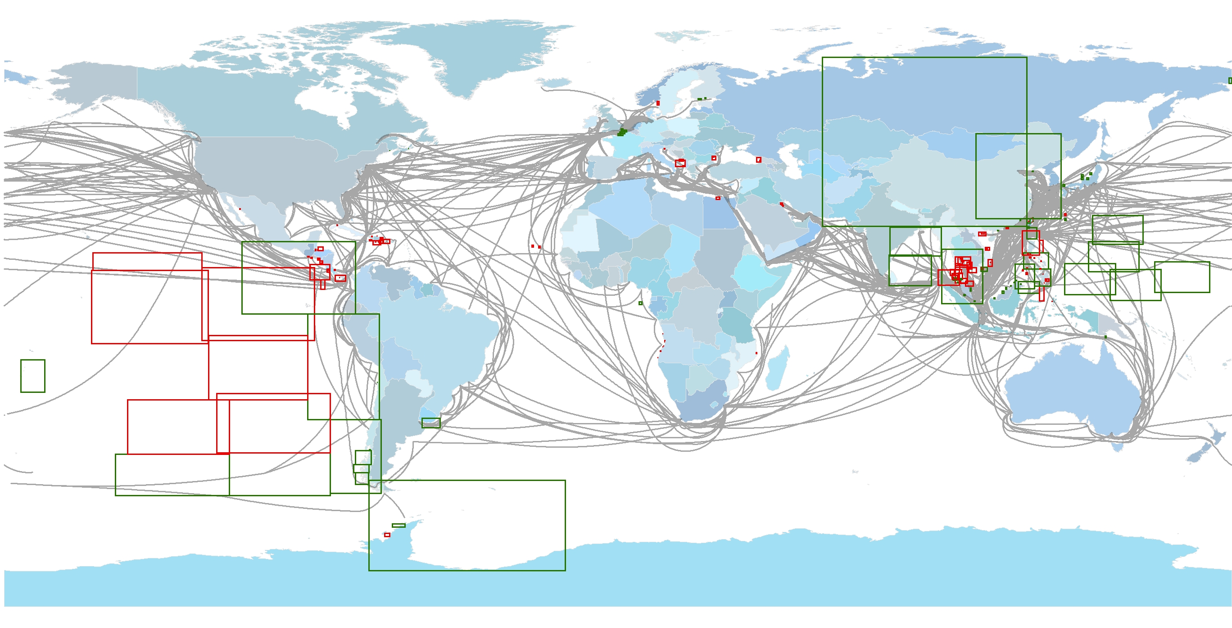
Agenda
Basic
SD
Sensor Error Budget
Data
Error Budget
Voyage
Centric
Extension
Data Quality Definition
Data Supply Chain Certification
Data Accessibility
© Michael Bergmann, 2016

Slide 6
1. Data Quality Definition
Basic
SD
Sensor Error Budget
Data
Error Budget
Voyage
Centric
Extension
© Michael Bergmann, 2016

Slide 7
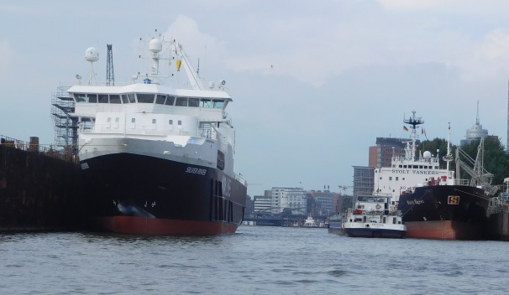
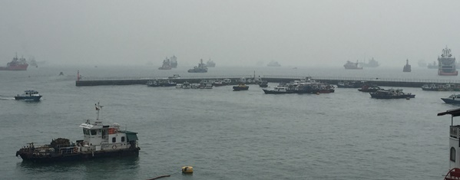
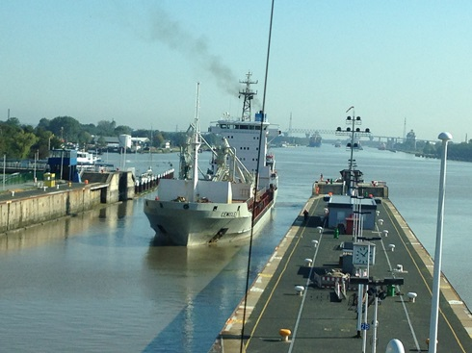
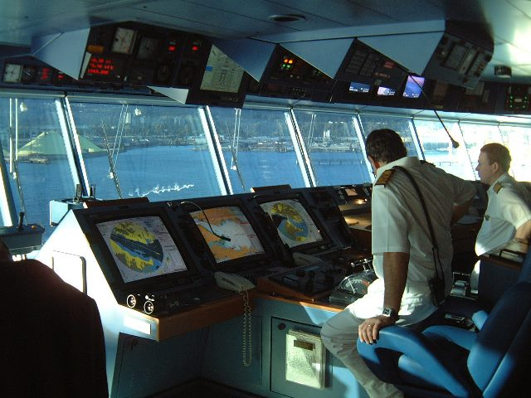
Situational Awareness Safeguarding needs enhanced Support
Increasing complexity of nautical task
Higher traffic volume and densities
Reduction of navigable space
Larger ship size
Reduction of bridge teams
Economical and ecological pressure
Increasing data volumn
Higher number of situation relevant data types
More data sources (sensors, other ships, shore…)
Higher resolution of data provision (spatial, temporal)
Necessity to prepare information
Selecting and linking of relevant data
Evaluation and refinement of data
Human Centric Approach for presentation of information

Slide 8
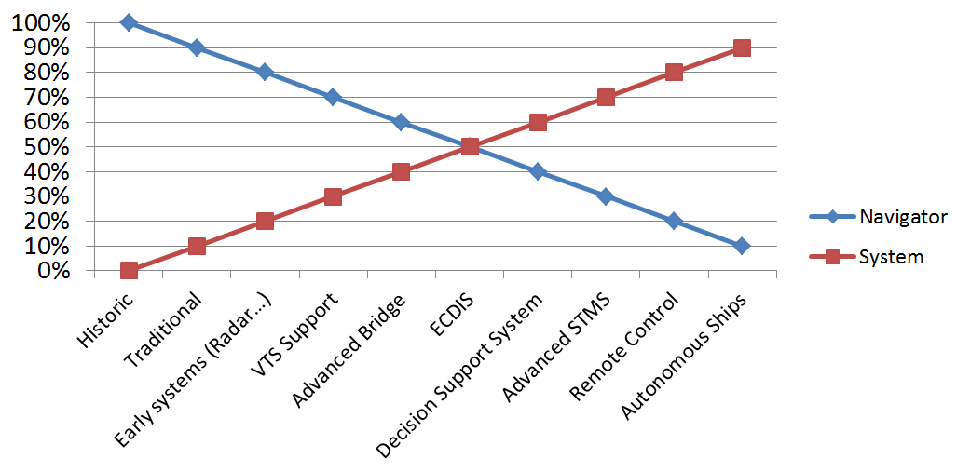
Reliance of Ship’s Navigation Navigator vs System
e-Navigation
Michael Bergmann, HSSC7, 12 Nov 2015
8

Slide 9
Avoidance of Collision& Grounding dCPA/tCPA, Ship Domain (SD), and Ship Arena (SA)
Open Sea Conditions
dCPA/tCPA are usual identifiers of collision risk between ships
(distance/time to Closest Point of Approach)
SD is the safety area around a ship not to be violated (ships and obstacles)
Diversity of SD models result from determination & considered impacts (object of research)
SA describes the area around a ship to be monitored for SD protection (taking into account the needed time for collision avoidance actions)
© DLR 2016 (P. Banys)
Restricted Waters, Port Entries, Narrow Fairways,….
dCPA/tCPA approach unusable due to restricted navigation area
Special SD taking into account specific conditions & maneuvers (navigational area and maneuver possibilities)

Slide 10
Dimension of Ship Domain Influencing Factors
Ship Centric factors
Voyage Centric Factors
System Centric Factors
Ship size (length, width)
Ship’s static characteristics (wind susceptibility)
Ship’s dynamic characteristics (maneuverability…)
Cargo: dangerous goods
Passenger
Speed
Human factors (navigator education, experience…)
Ship Sensor error budget
Data error budget (data quality indicator, CATZOC…)
Data Supply Chain error budget
Example of error budget:
HPE of GPS SPS
HPE: Horizontal Positioning Error
GPS: Global Positioning System
SPS: Standard Positioning Service
© DLR 2016 (FAA GPS Performance Analysis Report - Report #86 - 2014)

Slide 11
Determining the dimension of the individual Ship Domain
(1) Ship’s size & characteristics define the dimension of the basic domain.
(2) Voyage centric factors are increasing the basic risk and require an extension.
Data
Error Budget
Residual error budget in data supply chain (static and dynamic) have to be determined & monitored
Basic
SD
Sensor Error Budget
Voyage
Centric
Extension
© Michael Bergmann, 2016
(3) Each component used for decision support (Radar, ARPA, Compass, ENCs…) contributes to SD’s confidence.
(4) In integrated systems (ECDIS, INS) the data error budget may be accumulative.

Slide 12
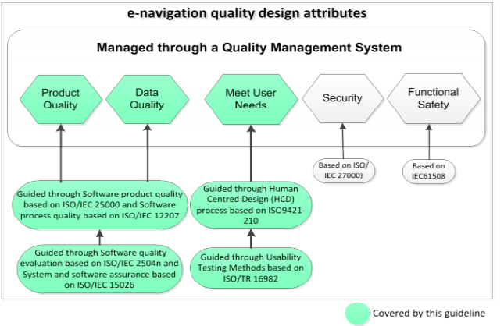
HCD and SQA Guidelines Reducing system error budget
HCD (Human Centered Design) and SQA (Software Quality Assurance) Guideline recommends standards for system quality to reduce system error budget
IMO Guidelines on Human Centred Design and Software quality assurance (SQA) in e-navigation
It addresses need on data quality but doesn’t specify data quality standards

Slide 13
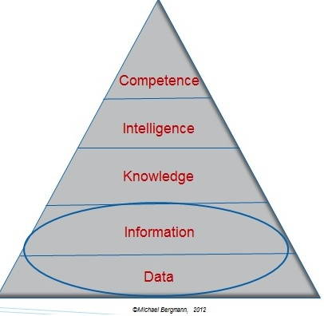
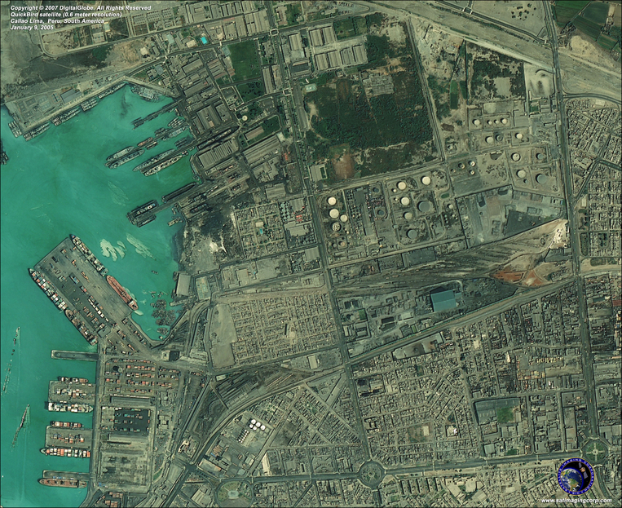
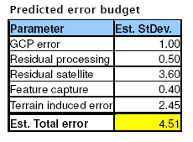
Situation Awareness Data are the key element !
Data needs to be converted into information.
Human Centered Design (HCD) intents to present information in digestible way.
High error budgets in database cannot be rectified by the best systems.
Data quality needs to be a prime focus area.
http://www.satimagingcorp.com/gallery
(meters)
Example
QuickBird is a high resolution satellite owned and operated by DigitalGlobe
© Jeppesen, 2005: Data Validation Project
Lima, Peru

Slide 14
2. Data Certification End-to-End

Slide 15
Data Quality at e-Navigation Systems Part of the Guideline
3. Definitions
3.1 Data Quality: The degree to which quality characteristics of data have the intrinsic potential to satisfy stated and implied needs when data is used under specified conditions. It also refers to the degree to which data quality is reached and preserved within a computer system when data is used under specified conditions.
3.2 Data Quality Assurance (DQA): A set of processes, that ensures that shore and shipboard based data used by e-Navigation systems meets and complies with required quality specifications. It is recommended that DQA is performed using a quality management system such as ISO/IEC 90003:2014 or relevant standards.
Source: IMO Guidelines on Human Centred Design and Software quality assurance (SQA) in e-navigation

Slide 16
IMOs position on data Producers:
5.9 Producers of input data should have lifecycle management practices in place to handle possible data format changes during the lifecycle. These lifecycle management practices should include timely announcements to software producers and end users about such changes. As part of the DQA producers of input data should test all data in service for conformance with relevant international standards.

Slide 17
Further IMO Specifications:
Software quality is also dependent on the quality of input data, which should conform to relevant international standards. ... (i.e. .. . IHO standards for nautical information including Electronic Navigation Charts (ENC))…
A systematic approach to ensure data quality is recommended, and can include:
defining and evaluating data quality requirements in data production, acquisition and integration processes;

Slide 18
Data Supply Chain Certification Reducing data supply error budget
From data quality standards for data creation…..
….. to Data Supply Chain Certification covering the full supply chain and reducing overall data error budget.
S-57 Files
Validation
Encryption
Distribution
ENC Files
Type Approval
ISO Certification
ISO Certification
Data product standards
Process Documentation)
Focus:
process within segment
SENC Certification
Extendable
Data Supply Chain Certification
(Data Quality, Integrity and Interoperability)
Focus: data across entire supply chain
The Data Supply Chain Certification proposed to IHO is built on the experience of the aviation industry.
DO-200A is defining the maximum accumulative error rate (10⁻⁸ for critical data) throughout the supply chain.

Slide 19
Maritime Data Quality Aspects Based on RTCA DO-200A in Aviation
Accuracy
Resolution
Assurance Level
Traceability
Timeliness
Completeness
Format
Data Integrity throughout the Supply Chain
DSCC addition
Notes:
Accuracy Accuracy is the degree of conformity of a measured or calculated quantity to its actual (true) value.
Resolution Image resolution describes the detail an image holds. Higher resolution means more image detail. Image resolution can be measured in various ways. Basically, resolution quantifies how close lines can be to each other and still be visibly resolved.
Assurance Level Critical Catastrophic: Failure conditions that would prevent continued safe voyage. Hazardous: Failure conditions that would reduce the capability of the ship or the ability of the crew to cope with adverse operating conditions to the extent that there would be: (1) a large reduction in safety margins or functional capabilities, (2) physical distress or higher workload such that the crew could not be relied on to perform their tasks accurately or completely, or (3) adverse effects on occupants including serious or potentially fatal injuries to a small number of those occupants. Essential Major: Failure conditions that would reduce the capability of the ship or the ability of the crew to cope with adverse operating conditions to the extent that there would be, for example, a significant reduction in safety margins or functional capabilities, a significant increase in crew workload or in conditions impairing crew efficiency, or discomfort to occupants, possibly including injuries Minor: Failure conditions that would not significantly reduce ship safety, and that would involve crew actions that are well within their capabilities. Minor failure conditions may include, for example, a slight reduction in safety margins or functional capabilities, a slight increase in crew workload, such as routine voyage plan changes, or some inconvenience to occupants. Routine Failure conditions that do not affect the operational capability of the ship or increase crew workload.
Traceability Traceability refers to the completeness of the information about every step in a process chain. It is ability to chronologically interrelate the uniquely identifiable entities in a way that is verifiable. It is the ability to verify the history, location, or application of an item by means of documented recorded identification.
Timeliness Done at the proper time. Happening or appearing at the proper time.
Completeness Having all necessary parts, elements, components, or steps.
Format -> A computer program accepts data as input in a certain format, processes it, and provides it as output in the same or another format. Generically, data formats tend to fall into bitmaps that describe images and/or sound patterns, text formats, and numeric data formats. -> A content format is a system of converting data to information. Content formats are used in recording and transmission to prepare data for observation or interpretation. Observable data is often known as raw data, or raw content. In addition to converting data to information, a content format may include the encryption and/or scrambling of that information.

Slide 20
DSCC in Integrated Systems e-Navigation implementation
Spanning full supply chain:
Data Producers -> End Users

Slide 21
A reminder: Data Supply Chain Certification at IHO
Presented at WEND 11, 2008
Presented at CHRIS 20, 2008
Both invited members to participate in a correspondence group
HSSC1 invited further work from the DSCC-CG and invited it. (HSSC2 Action 2)
The DSCC-CG had 36 members from HOs, IHO-WGs, related organizations and experts
A draft of a Marine version of DO-200A has been developed and distributed to the DSCC-CG

Slide 22
Suggestion from an Industry viewpoint:
A coordinated approach to DQA under the leadership of IHO in partnership with Industry and other key stakeholders
Utilizing the work of the CG-DSCC
Taking into account:
Data quality aspect
Data security aspect
Supplementary data aspect

Slide 23
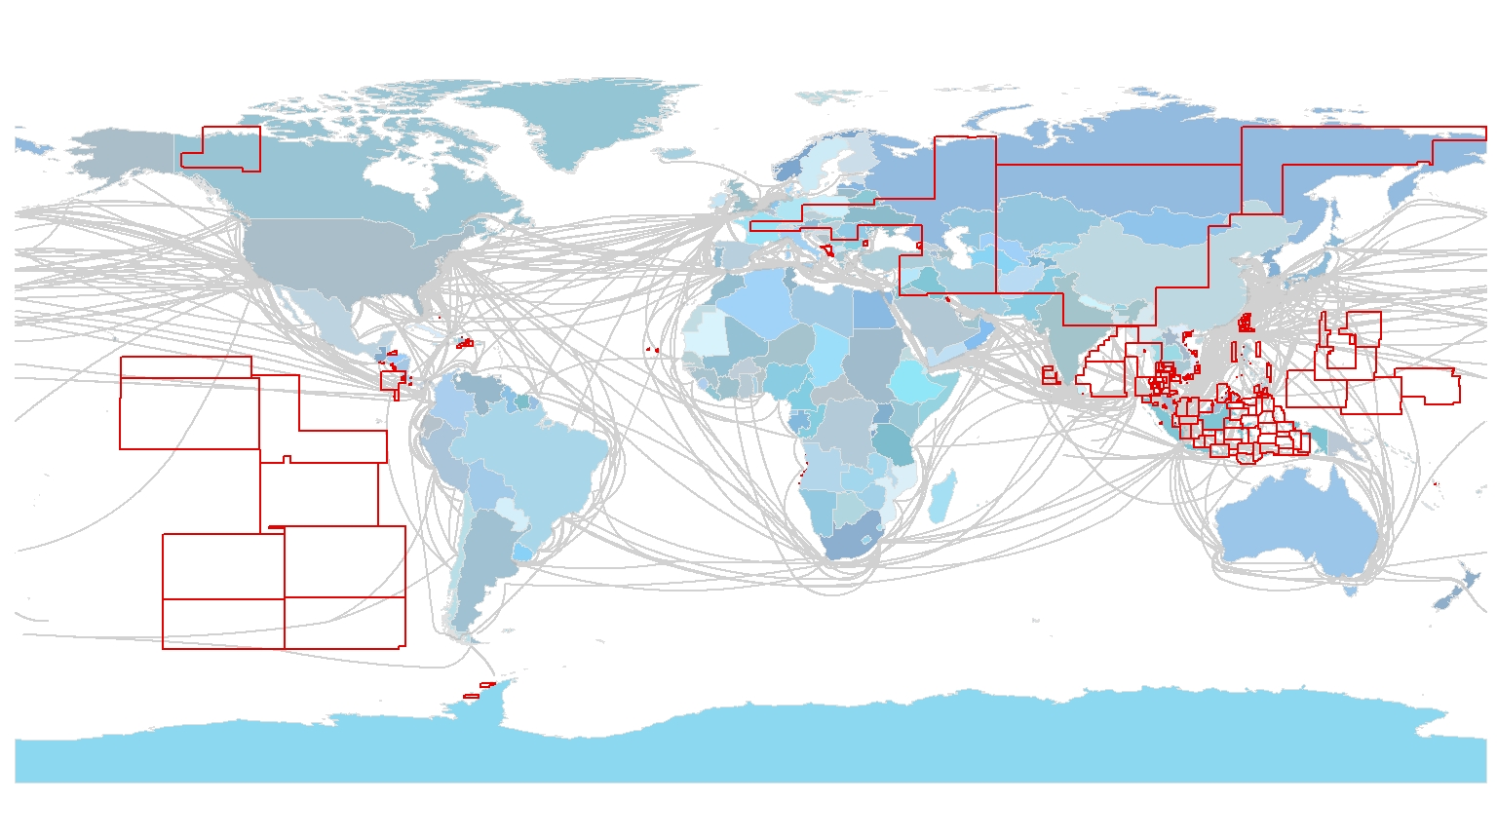
3. Accessibility of Data

Slide 24
Data accessibility is paramount
Industry can only build solutions if data is accessible
Fair conditions for data access are accepted (i.e. Level Playing Field)
Access conditions should be conceptually harmonized
Data access restrictions or exclusive use of non-classified data is counter productive
WEND Principles support equal access to data (e.g. PRO 7)
ICAO has mandated data access from CAAs
Civil Aviation Authorities to provide data to all civil aviation stakeholders if requested
The Maritime Safety Information (MSI) “open access” policies (e.g. INSPIRE…) is requesting accessibility of MSI data layers.

Slide 25
Example: ENC cells currently not available through RENC distribution
Source: IHO ENC Catalogue and Coverage Analysis Database 2016

Slide 26
ENC Coverage Analysis – Gaps
Note:
Although the ENC gap is proportionally small, its correlation and impact on available cells is rather large
Source: IHO ENC Database and Coverage Analysis Database 2015

Slide 27
Data shouldn’t be an issue!
ENCs and other HO data should fully comply with data standards
Access to coverage shouldn’t be an issue following US contribution to PRO 7: While great progress has been made in achieving adequate coverage of ENCs, proactively eliminating gaps and overlaps between Member States and through RHC collaboration, it is appropriate to look now at the current accessibility and distribution of ENCs. (IHC 5, 2014: CONF.EX5/G/03)
Confusion of mariners, ship owners and masters on ENC availability versus accessibility should be eliminated

Slide 28
Recommended next steps: An Industry Vision for the Future
To support future development:
Improve Data Quality Definitions as currently worked on by IHO DQWG
Implement a Data Supply Chain Certification to ensure End-to-End data quality throughout integrated systems
Improve accessibility to unclassified HO data

Slide 29
THANK YOU !
Michael Bergmann MBA AFNI AFRIN
michael.bergmann@jeppesen.com

