Slide 1
Report of the representative of the USCHC on the implementation of ENC Schemes
WORLDWIDE ENC DATABASE WORKING GROUP (WENDWG)

Slide 2
Status of the ENC Scheme USCHC Coverage

Slide 3
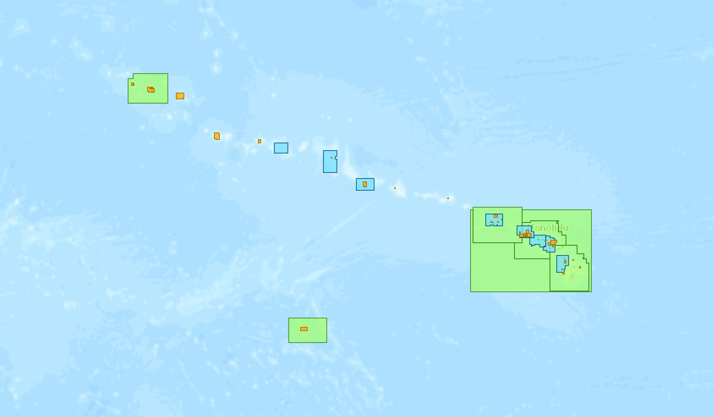
Status of the ENC Scheme USCHC Coverage

Slide 4
Renewed Focus
Meeting Next Monday in Victoria, BC – updating Terms of Reference
Rescheming ENCS into a grid format – making sure that they work together in the future
S-100 based products – surface currents, distribution of S-100 products, etc.

Slide 5
Existence of overlapping ENCs that may have a possible impact on safe navigation
Overlaps are generally caused by the release of new cells
Not usually controversial and are fixed quickly

Slide 6
Actions requested of WENDWG/IRCC
WENDWG is invited to note the report from USCHC

