Slide 1
Provision of Data Beyond Charts WEND’s S-100 Future
Challenges
^{Office of Coast Survey}
National Oceanic and Atmospheric Administration

Slide 2
Council 2 Actions
C2/30 - IRCC to instruct and provide guidance to the WENDWG in order to investigate the applicability of the WEND-like Principles to the production and dissemination of S-101 ENCs and the first generation of S-100 based products and to report back at C-3
C2/31 - Council, HSSC, IRCC Chairs and SecGen to draft an implementation strategy/roadmap for a transition plan aiming to the regular and harmonized production and dissemination of S-100 based products for further discussion at A-2 and for the preparation of the 2021-2023 IHO Work Programme
^{Office of Coast Survey}
National Oceanic and Atmospheric Administration

Slide 3
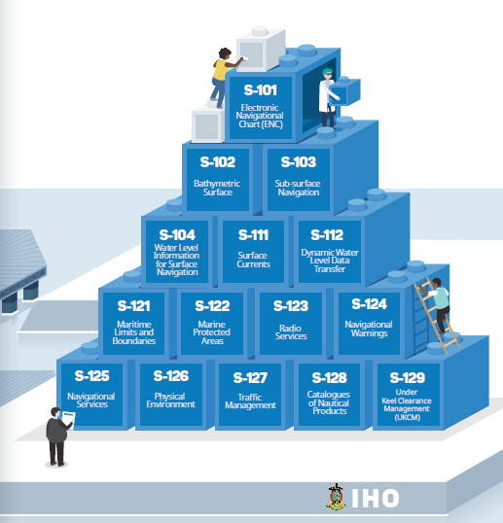
S-100 Product Development
^{Office of Coast Survey}
National Oceanic and Atmospheric Administration
Notes:
S-101 Nautical Charts
S-102 High Resolution Bathy
S-111 Surface Currents
S-412 Ocean Forecasts

Slide 4
Challenges
Distribution Model – should we use a central distribution model (as we do with RENCs) or should data be hosted by national hydrographic offices via national portals? Could there be a hybrid approach?
Distribution frequency – weekly, daily, hourly, more?
System integration – how to include all of this in ECDIS and beyond
^{Office of Coast Survey}
National Oceanic and Atmospheric Administration

Slide 5
Challenges
How will the RENCs be involved? Quality control? Encryption? Etc.
How will we approach new data schemes?
WEND Principles to be adjusted?
Other considerations?
^{Office of Coast Survey}
National Oceanic and Atmospheric Administration

Slide 6
Council 2 Actions
C2/30 - IRCC to instruct and provide guidance to the WENDWG in order to investigate the applicability of the WEND-like Principles to the production and dissemination of S-101 ENCs and the first generation of S-100 based products and to report back at C-3
C2/31 - Council, HSSC, IRCC Chairs and SecGen to draft an implementation strategy/roadmap for a transition plan aiming to the regular and harmonized production and dissemination of S-100 based products for further discussion at A-2 and for the preparation of the 2021-2023 IHO Work Programme
^{Office of Coast Survey}
National Oceanic and Atmospheric Administration

Slide 7
Thank You
^{Office of Coast Survey}
National Oceanic and Atmospheric Administration

Slide 8
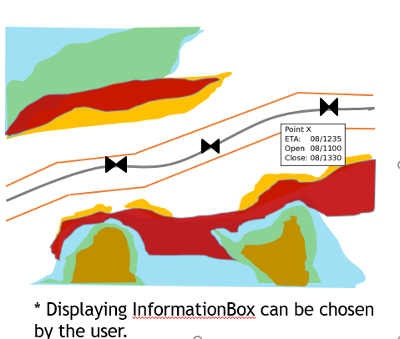
On the horizon
S-104 Water Level
Predicted and Real Time?
Currently under development by the IHO
S-129 Underkeel Clearance Management
Depicts go/no go areas based on inputs in UKC systems from bathymetry, surface currents and water levels
S-121 Maritime Boundaries
^{Office of Coast Survey}
National Oceanic and Atmospheric Administration

Slide 9
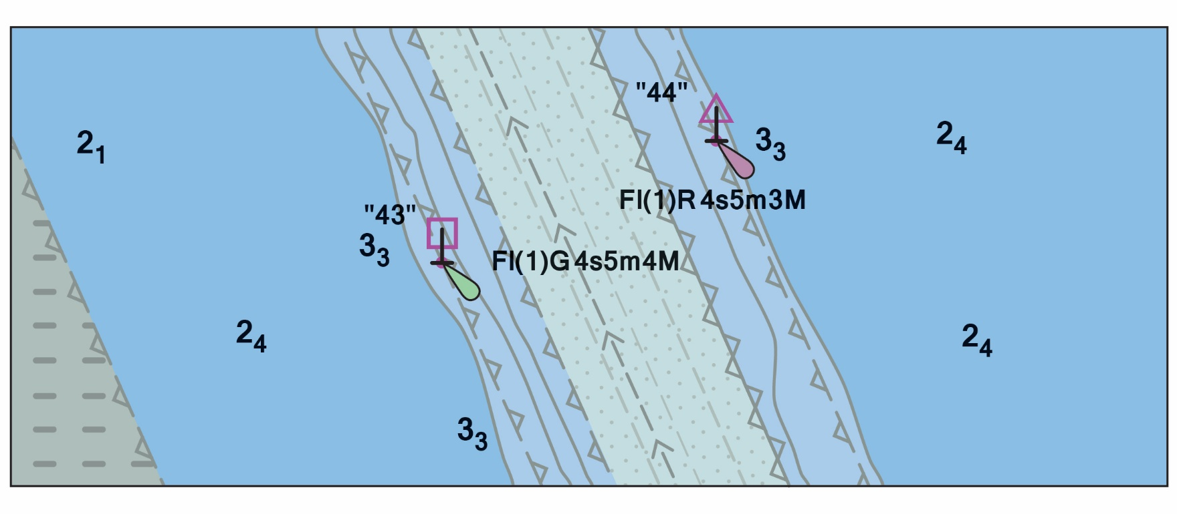
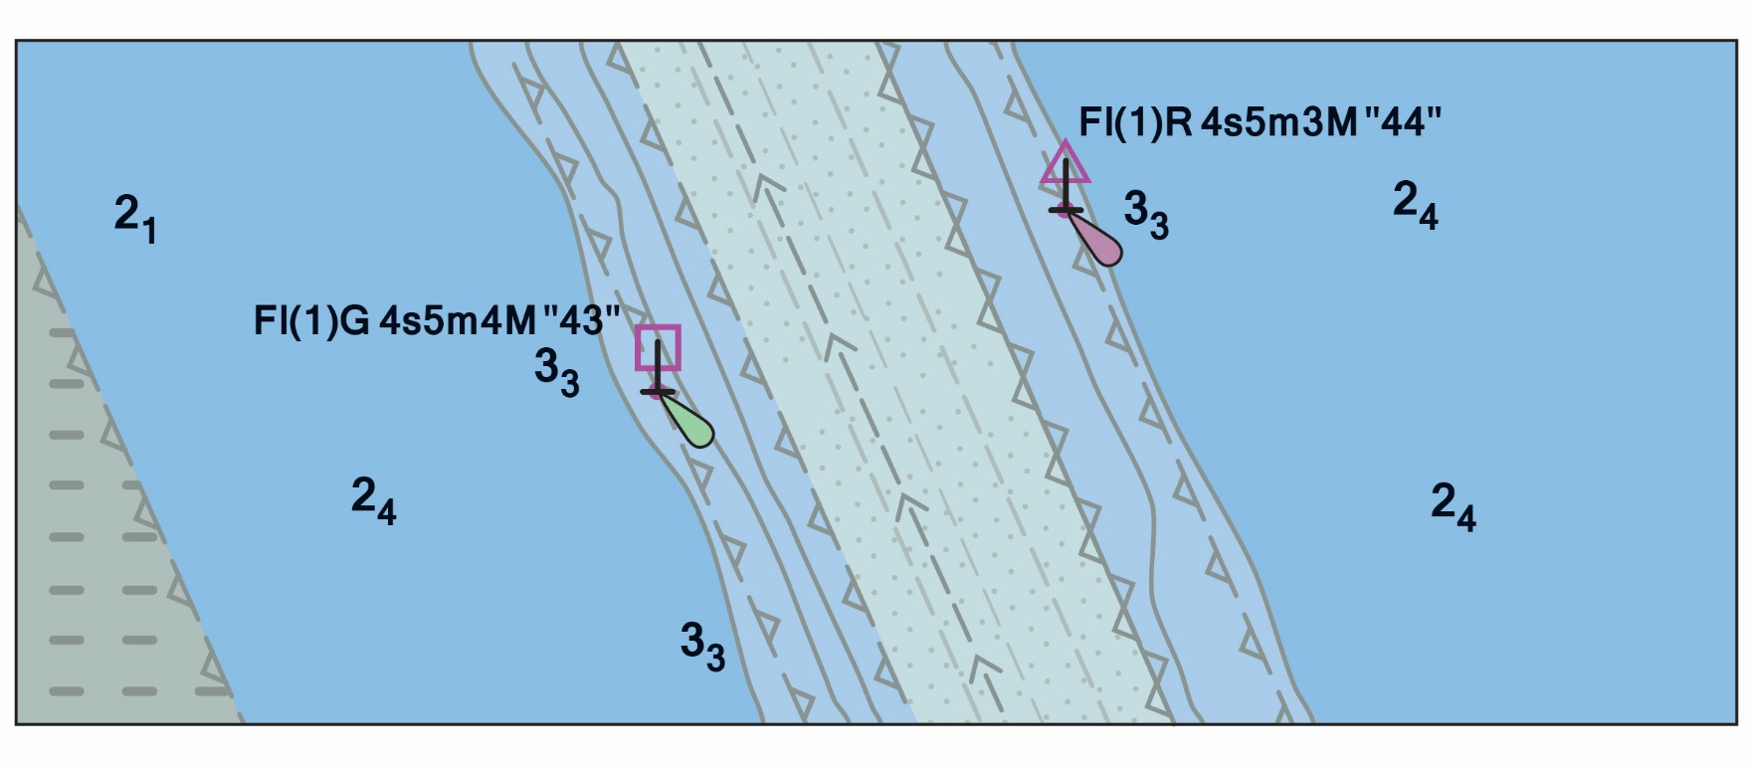
S-101 Electronic Navigational Charts
Improved Data Modeling
Machine readable catalogues
NOAA and ESRI developed an S-57 to S-101 Convertor
S-101 Edition 1.0.0 scheduled for December 2018
Testing Edition for system implementers
New Feature to control text placement on the ECDIS
^{Office of Coast Survey}
National Oceanic and Atmospheric Administration

Slide 10
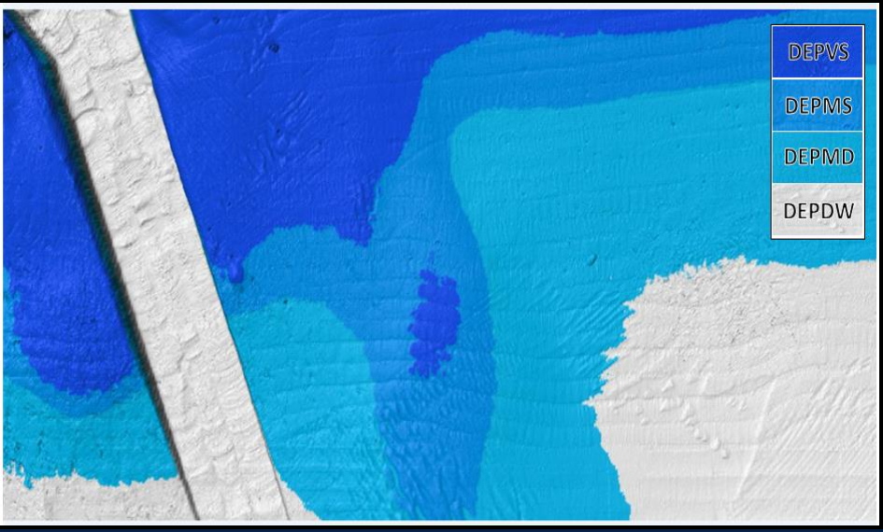
S-102 High Resolution Bathymetry for Navigation Systems
Utilizes S-100 HDF encoding
US Naval Oceanographic Office developed a BAG to S-100 HDF convertor for test data
NOAA is upgrading the convertor to work on Windows and prototype test data for precision navigation
^{Office of Coast Survey}
National Oceanic and Atmospheric Administration

Slide 11
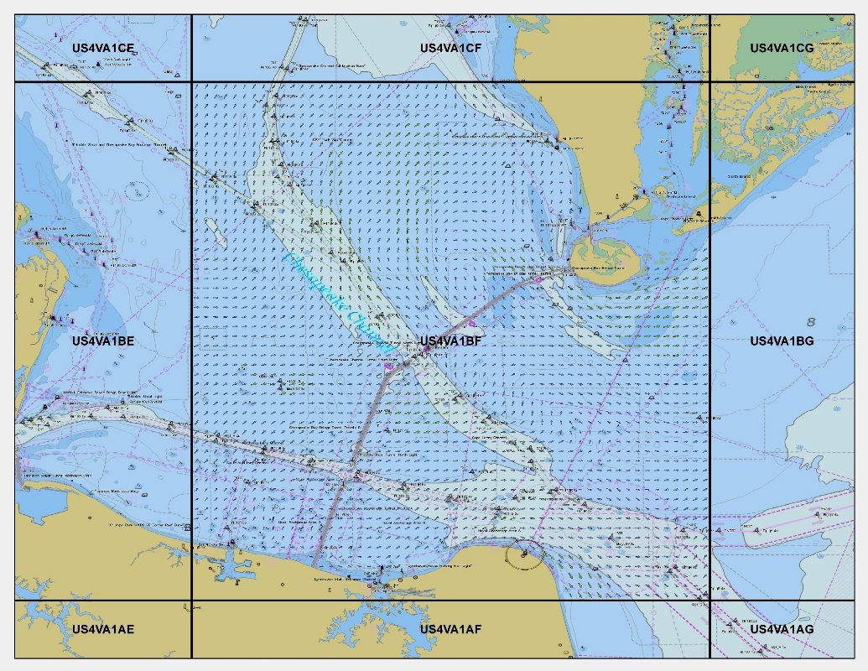
S-111 Surface Currents at NOAA
Utilizes S-100 HDF encoding
S-111 product bounds follow the same scheme as the new NOAA ENCs
500 meter resolution with 48 hour forecasts in 1 hour increments
Chesapeake and Delaware Bay initial test area
Working on the Data Discovery
ftp://ocsftp.ncd.noaa.gov/OFS_Data/
^{Office of Coast Survey}
National Oceanic and Atmospheric Administration

Slide 12
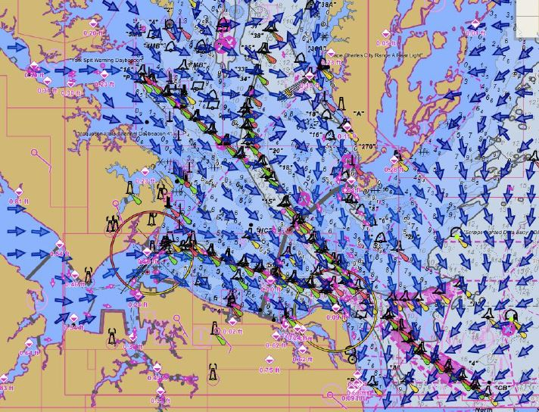
S-111 Surface Currents at NOAA
Surface currents in Chesapeake bay using Rose Point software
^{Office of Coast Survey}
National Oceanic and Atmospheric Administration

Slide 13
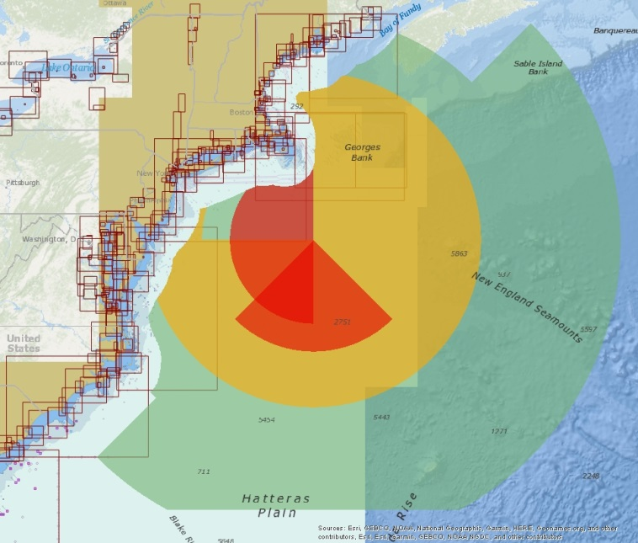
S-412 Ocean Forecasts
Weather and Wave Hazards
S-100 GML
Weather Messages
Weather message
Tropical cyclone messages
Thunderstorm message
High wind message
Freezing spray message
Reduced visibility message
Large seas message
Precipitation message
Temperature message
Future Specifications include
Weather and Wave Conditions
Weather and Wave Observations
Weather Systems
Tropical cyclone
Low
Convergent Boundary
Front
Ridge
Squall
Thunderstorm
Cyclone Track
Cone of Uncertainty
^{Office of Coast Survey}
National Oceanic and Atmospheric Administration

