Slide 1
Arctic Regional Hydrographic Commission
6th Conference – Iqaluit, Nunavut (Canada)
3 & 6 October 2016
WENDWG Matters
Yves Guillam (as WENDWG Secretary)

Slide 2
WENDWG Matters
Objectives, Membership
Main Issues
Actions from WENDWG-6, March 2016
Since IRCC8…
Actions requested of ARHC

Slide 3
Objectives, Membership
“to advise IRCC [ RHCs ] and to assist in facilitating a world-wide consistent level of high-quality, updated official ENCs through integrated services that support chart carriage requirements of SOLAS Chapter V, and the requirements of the IMO Performance Standards for ECDIS.”
WEND Principles (IHO Resolution 1/1997)
Guidelines for the Implementation of the WEND Principles

Slide 4
Objectives, Membership
Chair: Jamie McMichael-Phillips, UK
ARHC, USCHC: Laurent Tardiff, CA
BSHC: Jarmo Mäkinen, FI
MACHC: John Nyberg, US
NHC: Evert Flier
…
DK: Jens Peter Hartmann
US: Julia Powell, John Lowell
…
RENCs: IC-ENC, PRIMAR

Slide 5
Main Issues
Overlapping ENCs
RENC Harmonization and Distribution
ENC Coverage (Risk Assessment)
Full Implementation of the WEND Principles
Admiralty Information Overlays (T&Ps, …)
WENDWG6/06: RHCs to define and adopt ENC Schemes (as it is done for INT Charts Schemes) and provide basic metadata to the IHB and IHB to consider including a layer of “Approved” ENC Schemes to the IHO ENC Catalogue or as an extension of the INT Web Chart Catalogue.

Slide 6
Since IRCC8…
IRCC8/13: RHCs to reduce overlaps by applying the
WEND Principles in defining approved ENC schemes
IRCC8/14: WENDWG to draft an IHO Resolution to address the overlapping issues and report to the IRCC
Decision ICC8/14: …on Marine Information Overlays, T&Ps

Slide 7
Since IRCC8…
www.iho.int > WENDWG > WENDWG Repository
The US-Canada Case Study
Risk Assessment Methodologies
ENC Data Flow Producers→RENCs→Distributors
ENC Coverage for Cruise Ships in Med
…

Slide 8
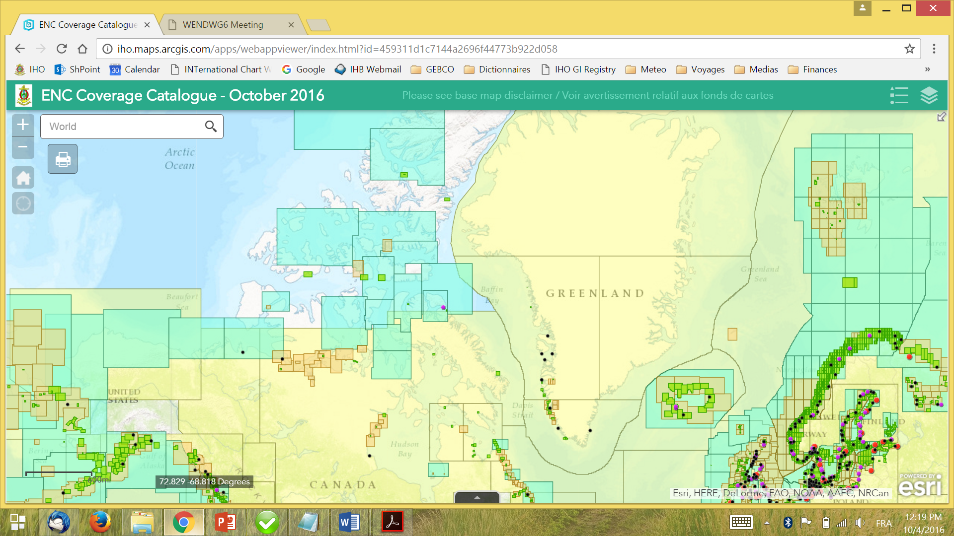

Slide 9
Action requested of ARHC
→ ARHC Members to review WENDWG Membership and instruct your ARHC Representative prior to WENDWG-7 (31 Jan. – 2 Feb, Washington DC, US)
→ ARHC INT Chart / ENC Coordinator for Region N to define an ENC Scheme for UB1, UB2, UB3, in liaison with INT Chart and ENC Producers
→ ARHC Rep. to report to the WENDWG Chair/Sec. by end of Nov. 2016 on ENC coverage issues (gaps, overlaps, inconsistencies) vs maritime shipping routes, user requirements (in preparation of the IHO report to NCSR – Action WENDWG6/12)
→ Take any other action as considered appropriate

Slide 10
Any questions ? - Secretariat Contact
info@iho.int

