Slide 1
BSHC-22
Outcomes from the IRCC-9
Dr Mathias JONAS
Secretary-General, IHO

Slide 2
Inter-Regional Coordination Committee
(IRCC-9)
Paramaribo, Suriname, 12-14 June 2017
15 Regional Hydrographic Commissions (RHCs)
IRCC subordinate bodies
15 observers
Total of 35 participants

Slide 3
IRCC-9
Reviewed the reports and activities of the RHCs and its subordinate bodies,
Considered the outcomes of the 1st Session of the IHO Assembly (A-1),
Acknowledged the accomplishments and challenges of the Capacity Building programme and IBSC activities,
Examined the developments on Crowd-Sourced Bathymetry and maximizing the use of hydrographic data and
Considered issues related to the Worldwide ENC Database (WEND).

Slide 4
IRCC-9
The meeting considered at the regional level the key achievements and developments on the status of surveys and charting, on the harmonization of depth data and its presentation in ENCs, the provision of the joint regional bathymetric databases, on the implementation of harmonized chart datum, on the parallel processing of all ENC and paper chart issues, on the progress of Marine Spatial Data Infrastructures and on the broad aspects related to the use of official S-57 data in the leisure craft market.
The Committee noted with satisfaction that some regions had made significant progress in eliminating overlaps, properly assessing CATZOCs and addressing gaps in a consistent way and that regional geoportals with ENC data had been established to facilitate harmonization of charts and risk assessment.

Slide 5
IRCC-9
The Committee received reports on the progress made in all the Pacific Island Countries and Territories (PICTs) with respect to governance of hydrographic activities.
Reports presented additional contributions from Member States to regional projects from Mexico to the Meso-America and Caribbean Sea area providing training through its FOCAHIMECA Project, from France to the Western and Central Africa Definition Study, from the United Kingdom with the Commonwealth Marine Economies Programme, with the Overseas Territories Seabed Mapping Programme and with the Scoping Study in the Organisation of the Eastern Caribbean States (OECS).

Slide 6
IRCC-9
The meeting identified the importance of the Crowd-Sourced Bathymetry Working Group, the Nippon Foundation support to the GEBCO Seabed 2030 Project and the need for additional engagement on data gathering in several forums.
The Committee received reports on the development of an IHO Satellite-Derived Bathymetry assessment and charting programme for uncharted or poorly charted areas, on matters related to the future of the paper chart, to the implementation of S-100 product specifications, to the increasing need for improved data and navigational products (through e-navigation and marine services portfolios - MSPs) to support the effective and sustainable use of maritime spaces and their natural resources.

Slide 7
IRCC-9
The meeting reviewed progress towards the full implementation of the WEND Principles, the guidance for the preparation and maintenance of INT Chart and ENC Schemes, the need to implement ENC scheming at the regional level, the challenges for coordinating INT Chart schemes and improving ENC coverage, in particular the establishment of consistent INT schemes in semi-closed basins.
The Committee urged Regional Hydrographic Commissions to seek to resolve ENCs overlaps in small scale usage bands which pose significant risks to navigation and endorsed a proposed draft IHO Resolution for eliminating overlapping ENCs.
The importance of providing CATZOC information in all ENCs was considered, in particular to support the work of the RHCs in risk analysis.

Slide 8
IRCC-9
The Committee commended both Regional ENC Coordinating Centres (RENCs) on the work undertaken hitherto to reach maturity and stability and for the support provided to hydrographic offices and end-user service providers, and the IHO Secretariat on the improvements made to the IHO ENC catalogue and other aspects of the infrastructure.
The meeting considered the need for the RHCs to encourage the Member States in each region to consider making all ENC data available through the RENCs and to release bathymetric datasets or subsets into the public domain via the IHO DCDB.
The meeting endorsed a revised statement on the use of Marine Information Overlay (MIO) to assist in drawing attention to any differences between a published paper chart and the corresponding ENC or to assist in displaying Temporary &Preliminary notices for an ENC.

Slide 9
IRCC-9
The IRCC noted the establishment of the Open Geospatial Consortium (OGC) Marine Domain Working Group (Marine DWG), a group of experts that advises OGC on the way forward in relation to the Marine Domain, identifying gaps in the current OGC baseline regarding marine geospatial data and ocean mapping.
The cooperation with OGC ensures that the evolving IHO standards are brought to the attention of the OGC, that best practices are used and the latest technical approaches considered. The meeting was also informed on the development of the Concept Development Initiative - Defining the Future of Marine Spatial Data Infrastructure (MSDI), developed by OGC at the request of the MSDIWG and a newly prepared White Paper on MSDI.

Slide 10
IRCC-9
The meeting was informed of the achievements through the Capacity Building Programme, the recent technical visits, the raising awareness workshops, the Maritime Safety Information trainings and courses in Hydrography and Nautical Cartography.
The meeting acknowledged the role of the generous support from the Republic of Korea and from the Nippon Foundation of Japan, the in-kind support from Member States and industry stakeholders and the work of the RHC CB Coordinators and Project Leaders in these achievements.

Slide 11
IRCC-9
The Regional Hydrographic Commissions expressed concerns on the main difficulties and challenges posed by the reduced resources that have restricted surveying capability, and the maintenance of staff members and their ability to contribute to the IHO Work Programme.
The meeting noted in particular the restrictions imposed on developing the capacity of the Capacity Builders and on the support needed from the primary charting authorities for capacity building activities.

Slide 12
IRCC-9
Increased support from the IHO Secretariat was seen as critical to the ongoing success of the Capacity Building Programme, not only for implementing the programme as such but also for its effectiveness, governance and due diligence for the benefit of the Member States.
The Committee agreed that a major challenge to the successful operation and further enhancement of the Capacity Building Programme is the need for additional Capacity Building assistance in the Secretariat due to the significant increase in the level of CB activities and other competing IHO requirements/priorities.

Slide 13
IRCC-9
The meeting was briefed on recent progress in the Arctic with the development of Hydrographic Risk Assessment, the work of the Arctic International Charting Coordination Working Group, the establishment of the Arctic Regional Marine Spatial Data Infrastructure Working Group, the Arctic Voyage Planning Guide for mariners and the investigation on the potential of remote sensing and satellite-derived bathymetry and of crowd-sourced bathymetry for use within the Arctic community.

Slide 14
IRCC-9
The Committee was informed on the progress made with publications under its responsibilities and acknowledged the work done by the MSDIWG on the draft New Edition 2.0.0 of the IHO Publication C-17 Spatial Data Infrastructures: "The Marine Dimension" - Guidance for Hydrographic Offices and by the IBSC on the draft New Editions 1.0.0 of the IHO Publications S-8A and S-8B Standards of Competence for Category "A" and Category "B" Nautical Cartographers.
The three publications were endorsed and the Committee will seek their approval by the Member States according to the process agreed by the IHO Assembly.

Slide 15
IRCC-9
The IRCC considered the outcomes of the 1st Session of the IHO Assembly including those related to the establishment of the IHO Council and its membership, the revision of IHO Resolutions, the 2018-2020 IHO Work Programme and the IHO Strategic Plan.
The meeting decided to establish a Drafting Group to review the IHO Resolution 2/1997 as amended Establishment of Regional Hydrographic Commissions – RHC and tasked the East Asia Hydrographic Commission to provide input to the IHO Resolution 1/2005 IHO Responses to Disaster.

Slide 16
IRCC-9
The meeting encouraged RHCs to consider using satellite derived bathymetry and risk assessment methodologies in uncharted or poorly charted areas in their respective regions as a way of developing survey priority areas as part of attracting donor funding.

Slide 17
IRCC-9
The meeting considered the outcomes of HSSC, in particular those related to chart quality and indicators and the need for IHO Member States to populate ENCs with assessed CATZOC values in particular for Usage Bands 3, 4, 5 and 6, noting that the concept of CATZOC values is expected to remain valid for future S-101 ENCs and the key aspects handled by the Data Quality Working Group.

Slide 18
IRCC-9
The meeting invited the RHCs to encourage Member States to support the establishment of a Working Group on Marine Geospatial Information (WG-MGI) by the United Nations Committee of Experts on Global Geospatial Information Management (UN-GGIM) and to promote the use of the UN-GGIM Shared Guiding Principles for Geospatial Information Management to align the S-100 framework for marine geospatial data and regional implementations of Marine Spatial Data Infrastructures

Slide 19
IRCC-9
The meeting considered the benefits of having solid infrastructure in the IHO Secretariat to support and inform decisions of its Member States and the subordinate bodies, and the developments in databases, online services and IHO Geographic Information System (GIS) tools.
The meeting considered the positive developments on the management, review and monitoring of new INT Charts and endorsed the amendment to Section 100 of IHO Publication S-11 - Part A Ed. 3.0.0 - Guidance for the Preparation and Maintenance of International (INT) Chart Schemes.

Slide 20
IRCC-9
The meeting re-elected Dr Parry Oei (Singapore) as the IRCC Chair and elected Mr Thomas Dehling (Germany) as the Vice-Chair for the period of 2017-2020.
The next meeting of the IRCC is planned to be held in Goa, India, from 4 to 6 June 2018, preceded by the 16th meeting of the Capacity Building Sub-Committee (CBSC16) from 30 May to 1 June 2017.

Slide 21
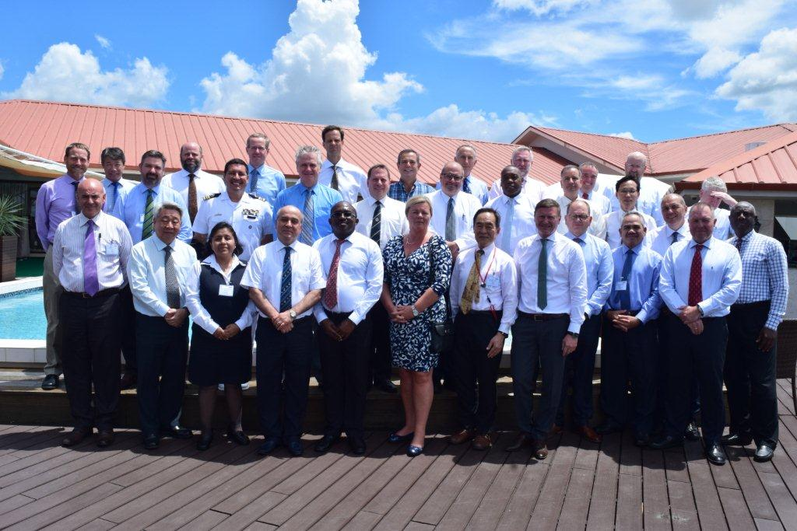
IRCC-9 Participants

