Slide 1
National Report by
France
IHO Hydrographic Commission on Antarctica (HCA)

Slide 2
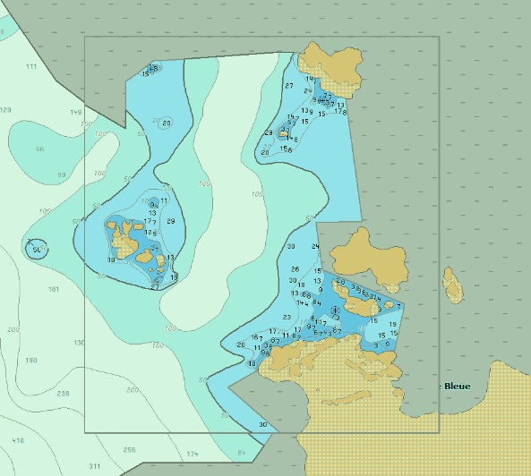
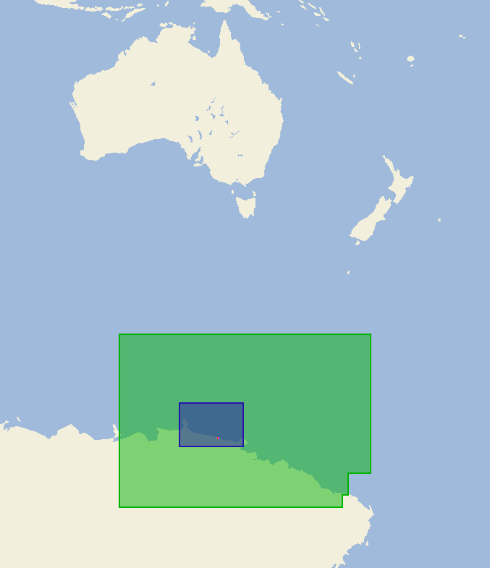
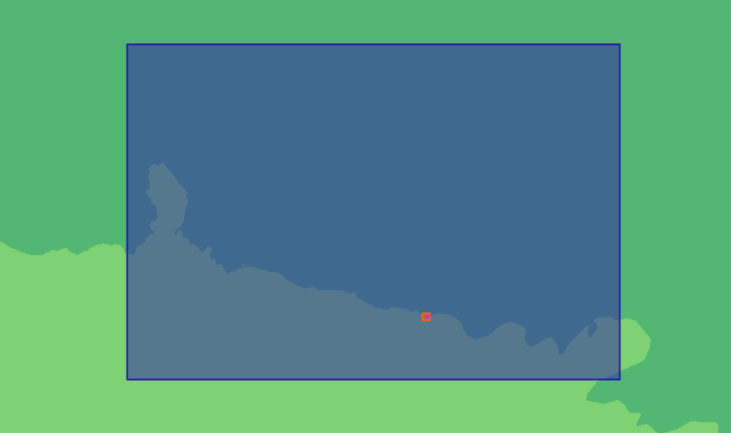
Survey and charting progress in Antarctica since HCA-14 (June 2016)
new charts produced (INT, national, ENC)
4 new ENC cells
FR275910 : Cape Goodenough to Balleny Islands
FR375920 : Glacier Dibble Tongue to Mertz Glacier Tongue
FR57594B : Max Douguet Archipelago
FR67594A : Max Douguet Archipelago – Martin harbour
FR67594A
FR375920
FR275910
FR67594A
FR57594B
Source : Primar Chart Catalogue

Slide 3
Survey and charting progress in Antarctica since HCA-14 (June 2016)
New publications
NTR
Areas surveyed
NTR
Risk assessment studies
NTR
Impact of Polar Code on your activities
NTR

Slide 4
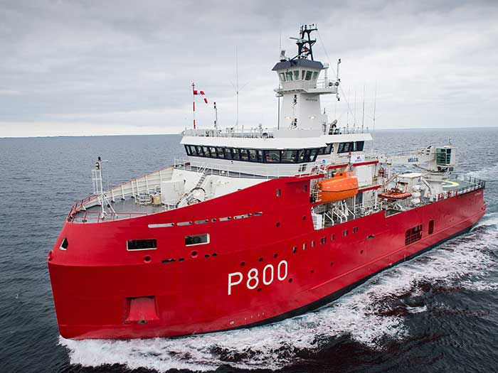
Status of Relations with Other Organizations
New Polar Logistic and Patrol Vessel L’Astrolabe
72 m long, 16m large, 60 PX, IB5 Class
TAAF, IPEV & MinArm partnership
Operated by French Navy
Replaces both NS Albatros and supply vessel Astrolabe (IPEV).
Not fitted with hydrographic sensors
Adaptation of the METOC support needed for ice navigation

Slide 5
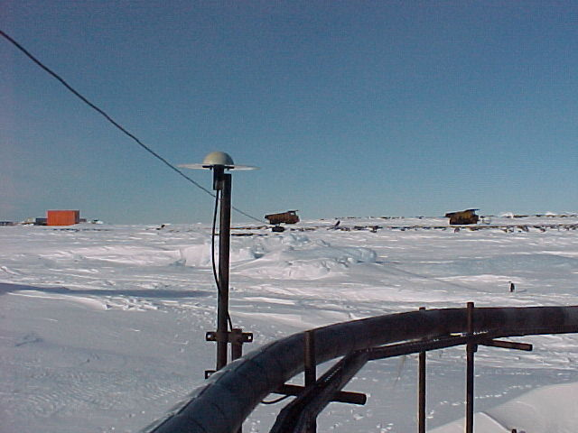
Status of Relations with Other Organizations
FR Tide gauge in Antarctica - Dumont d’Urville observatory
ROSAME network
http://www.legos.obs-mip.fr/fr/share/soa/cgi/getobs/v0.2a/index.pl.cgi?contexte=ROSAME&donnees=MRG&suivi=TPS-REEL&env=COTIER
http://refmar.shom.fr/en/partenaires/producteurs-de-donnees/reseau-maregraphique-rosame
ARGOS real-time transmission

Slide 6
Status of Relations with Other Organizations
Hydrographic data received from other organizations
NTR
Hydrographic data provided to other primary charting authorities and/or GEBCO
Shom hydrographic data (soundings, DTM) are available under open data licences on Shom portals :
data.shom.fr & diffusion.shom.fr
(not yet available however in this region)

Slide 7
Planned Activities for 2018-19
New charts, new publications
NTR.
ENC coverage “achieved” (at least regarding the survey coverage)
New surveys
Survey campaign requested in 2019-2020 but difficult to plan due to the lack of suitable nautical assets

Slide 8
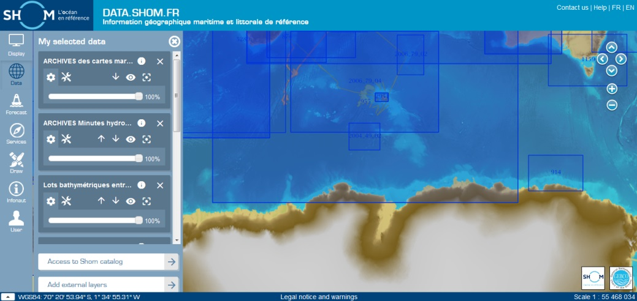
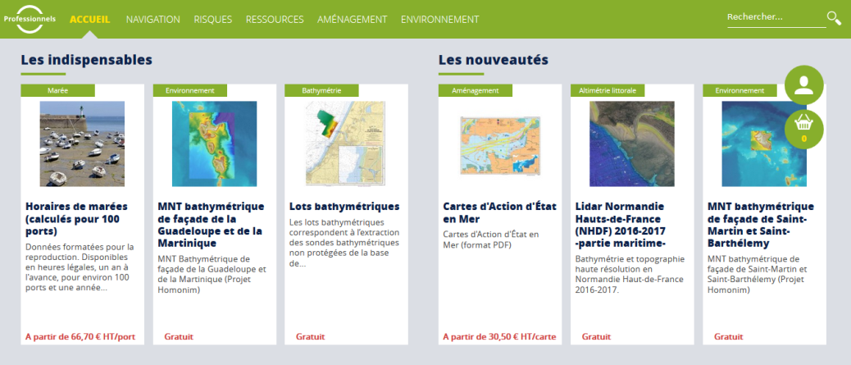
Marine Spatial Data Infrastructure
Shom’s maritime and coastal geographic information portal :
data.shom.fr
Online distribution space :
diffusion.shom.fr

Slide 9
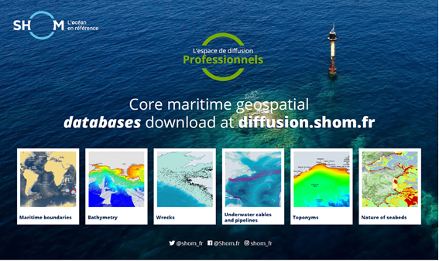
Marine Spatial Data Infrastructure
Shom’s portals updated regularly
Since December 3rd 2017, in accordance with France open data policy, Shom has widely opened up access to its core data

Slide 10
Particular Issues that may require HCA Consideration
MSs wishing to exchange with the Shom on METOC support for ice navigation, are kindly invited to contact :
hom-cfud-d@shom.fr & dmi-rex-d@shom.fr
Take note of that report

