Slide 1
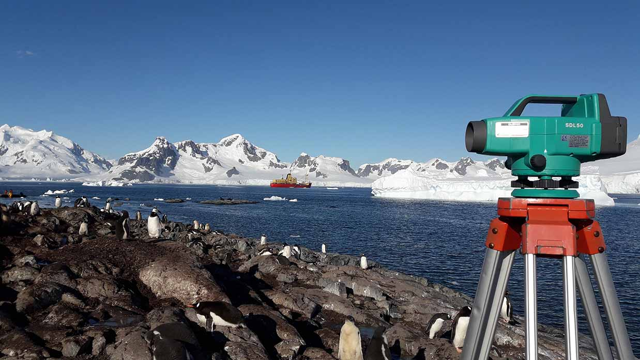
National Report by CHILE
IHO Hydrographic Commission on Antarctica (HCA)

Slide 2
Survey and charting progress in Antarctica since HCA-14 (June 2016)
TABLE OF CONTENTS
New charts produced (INT, national, ENC)
Areas surveyed
Risk assessment studies
Impact of Polar Code on your activities

Slide 3
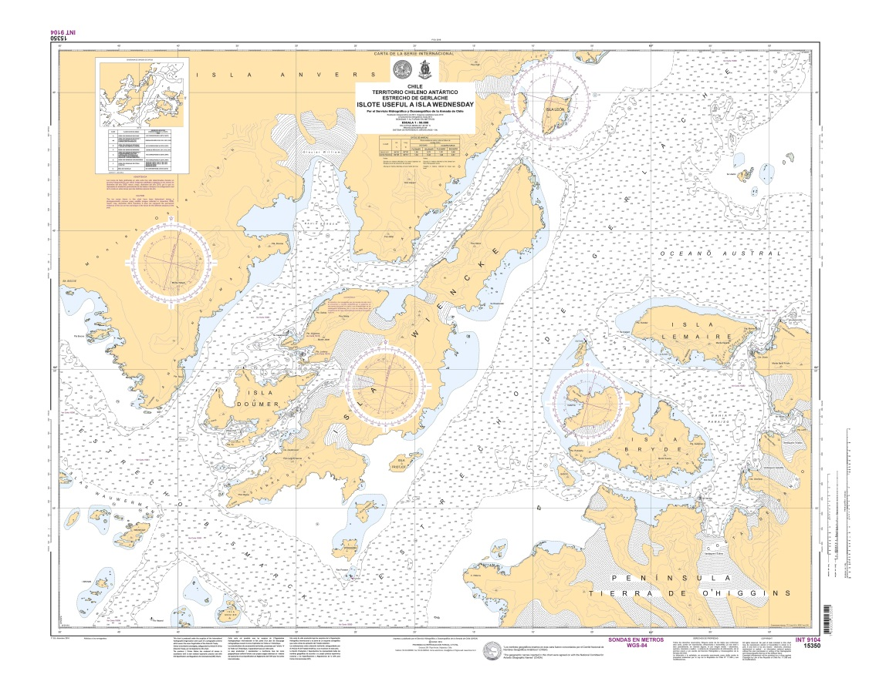
Survey and charting progress in Antarctica since HCA-14 (June 2016)
New charts produced (INT, national, ENC)
-New INT Paper Chart 15350 (INT 9104) “Estrecho De Gerlache, Islote Useful a Isla Wednesday” (scale 1:50.000) was published in 2016.

Slide 4
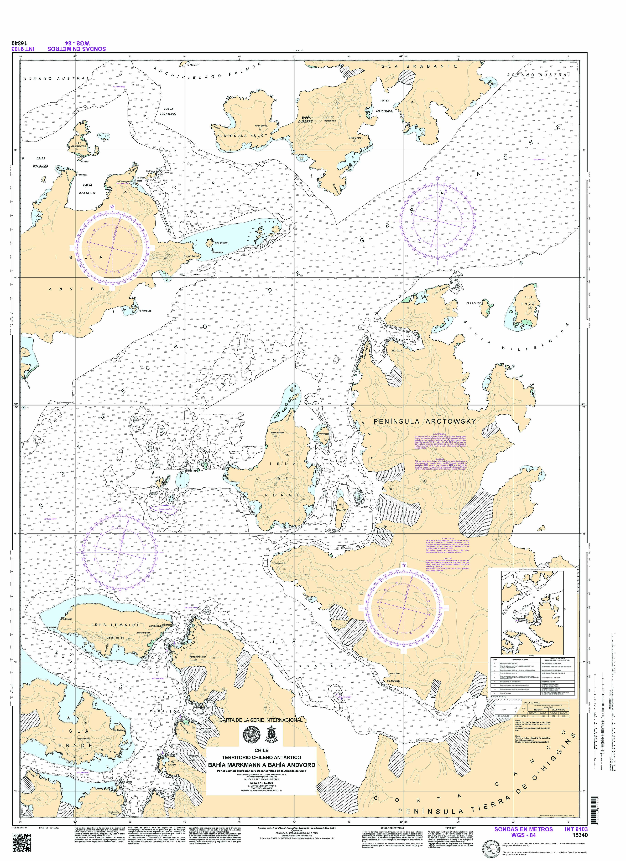
Survey and charting progress in Antarctica since HCA-14 (June 2016)
New charts produced (INT, national, ENC)
-New INT Paper Chart 15340 (INT 9103) “Bahía Markmann a Bahía Andvord” (scale 1:50.000) was published in 2017

Slide 5
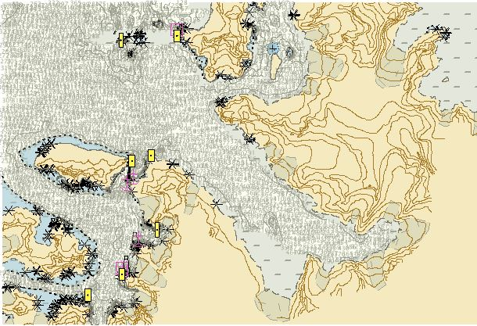
Survey and charting progress in Antarctica since HCA-14 (June 2016)
New charts produced (INT, national, ENC)
-The Electronic Nautical Chart CL4MA956 and CL4MA957 were published in 2018.

Slide 6
Survey and charting progress in Antarctica since HCA-14 (June 2016)
Areas surveyed
In January 2017, SHOA carried out hydrographic surveys of the Rey Jorge Island in Almirantazgo Bay. The survey took place between January 19th and March 02th, planned to obtain the data for the National Paper Charts 14200 (INT-9151) “Rey Jorge Island – Livingston Island”, scale 1:200.000.
The hydrographic survey was executed to by the Chilean ATF “Lautaro”.

Slide 7
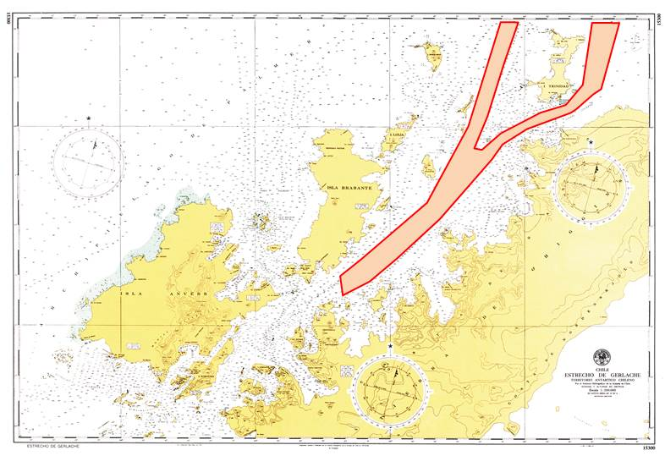
Survey and charting progress in Antarctica since HCA-14 (June 2016)
Areas surveyed
In February 2018, SHOA carried out hydrographic surveys of the Gerlache Straight. The survey took place between February 13th and February 28th, and corresponds to the first campaign planned to complete the data for the National Paper Charts 15300 (INT-9157) “Gerlache Straight”, scale 1:200.000.
The hydrographic survey was executed to by the Chilean Ice breaker AP “Oscar Viel”, using a multibeam echosounder.
CHART 15300 (INT 9157)

Slide 8
Survey and charting progress in Antarctica since HCA-14 (June 2016)
Areas surveyed
OCEANOGRAPHIC ACTIVITIES:
Permanent Activities:
- Tide gauge maintenance in Puerto Soberanía.
- Tide gauge maintenance in Rada Covadonga.
Activities during last Antarctic Campaign 2017/2018:
- Tide gauge installation in Cabo Sterneck.
- Tide gauge installation in Base Gabriel González Videla.
These Tide Gauges were only installed for the survey period.

Slide 9
Survey and charting progress in Antarctica since HCA-14 (June 2016)
Risk assessment studies: None
Impact of Polar Code on your activities: None

Slide 10
Status of Relations with Other Organizations
Scientific and polar institutes
Cruise vessels
Hydrographic data received from other organizations
Hydrographic data provided to other primary charting authorities and/or GEBCO

Slide 11
Status of Relations with Other Organizations
Scientific and polar institutes
The National Committee of Antarctic Geographic Names:
The National Committee of Antarctic Geographic Names is the organization in charge of studying the historical background and the collection of information required to assign any name give to a geoform used in the Chilean Antarctic Cartography.
This Committee gathers several Chilean governmental institutions.
This year first meeting of the National Committee of Antarctic Geographic Names, was hold on April 2nd, at which the final draft of the Procedures for the study of geographical names in Antarctica was presented.

Slide 12
Status of Relations with Other Organizations
Hydrographic data received from other organizations:
From UKHO on 2012 for the Nautical Charts 15340 (INT 9103), 15350 (INT 9104), 15351 (INT 9134) and 15352 (INT 9135).
From SHOM on 2014 for the Nautical Charts 15340 (INT 9103), 15350 (INT 9104) and 15351 (INT 9134).
From CIOH on 2015 for the Nautical Charts 15340 (INT 9103) and 15350 (INT 9104).

Slide 13
Status of Relations with Other Organizations
Hydrographic data provided to other primary charting authorities and/or GEBCO: None

Slide 14
Planned Activities for 2018-19
New charts
New surveys

Slide 15
Planned Activities for 2018-19
New charts
-2018 SHOA is currently updating (INT 9104) Nautical Paper Chart 15350 “Islote Useful
a Isla Wednesday” (scale 1:50.000).
-2019 SHOA will publish National Nautical Paper
Chart 14213 “Ensenadas Mackellar y Martel”
(scale 1:15.000)

Slide 16
Planned Activities for 2018-19
New surveys
2019 SHOA will carry out hydrographic surveys
of the Gerlache Straight. The survey corresponds to the second campaign
planned to complete the data for the National Paper Charts 15300 (INT 9157) “Gerlache Straight”, scale 1:200.000.
The hydrographic survey will execute to by the Chilean
Ice breaker AP “Oscar Viel”.

Slide 17
Any other matters of relevance to HCA
MARITIME SAFETY INFORMATION (MSI)
Chile has an infrastructure in accordance with the assigned area of responsibility NAVAREA XV. This area considers the Antarctic area of the Chilean responsibility. Transmissions are made through NAVTEX and SafetyNet INMARSAT “C” according to pre-established schedule. Additionally, the Meteorological Service of the Navy broadcasts through NAVTEX and SafetyNet the navigational warnings about ice edges and plotting of drifting icebergs.
The Chilean Maritime Authority, through “Fildes Port” (port authority), issues Antarctic weather forecast for Zone IX and Presidente Eduardo Frei Montalva Antarctic Meteorological Center, issues weather forecast for the Drake Passage and Bellingshausen Maritime Region.

Slide 18
Chilean National Report HCA-15
Valparaíso, CHILE June 2018

