Slide 1
National Report by
UNITED KINGDOM

Slide 2
Survey and charting progress in Antarctica since last meeting (June 2016)
New charts produced (INT, National, ENC)
UK have published 5 INT charts and corresponding ENCs since HCA14
Areas surveyed
UK have surveyed in numerous areas since HCA14
Risk assessment studies
Impact of Polar Code on your activities

Slide 3
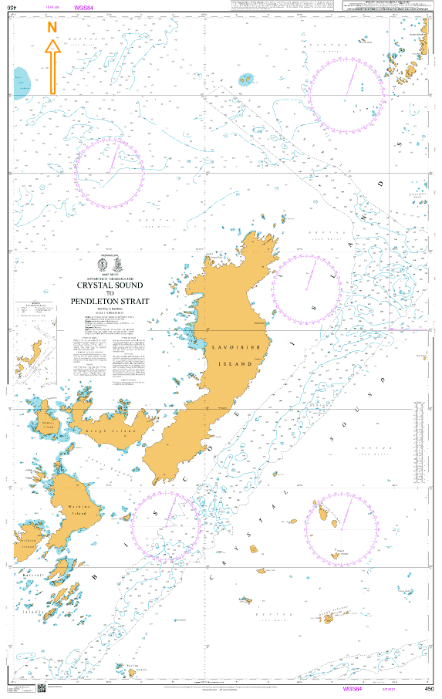
New Charts & ENCs published by the UK since HCA14
INT9131(BA450 & GB400450)
Crystal Sound to Pendleton Strait
December 2017

Slide 4
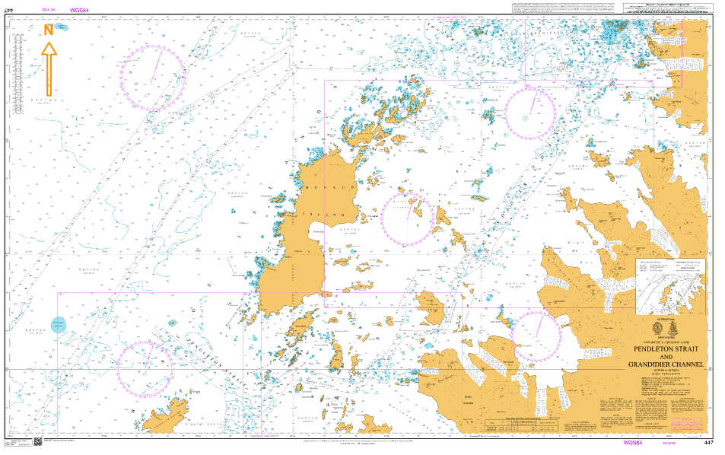
INT9159 (BA447 & GB300447) Pendleton Strait and Grandidier Channel - March 2018

Slide 5
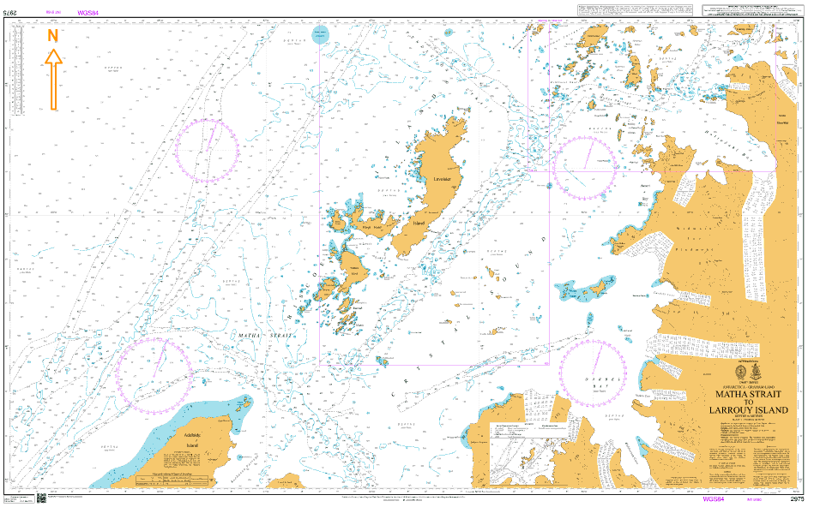
INT9160 (BA2975 & GB302975) Matha Strait to Larrouy Island – March 2018

Slide 6
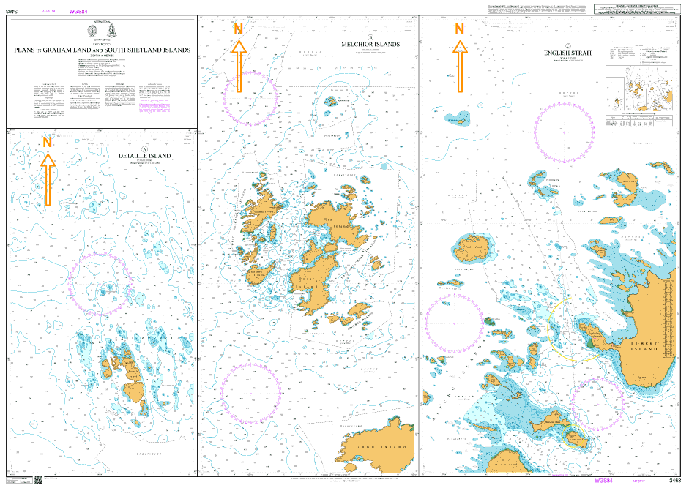
INT9117 (BA3463 & GB43463A, GB43463B & GB53463C) Plans in Graham Land and South Shetland Islands – December 2017

Slide 7
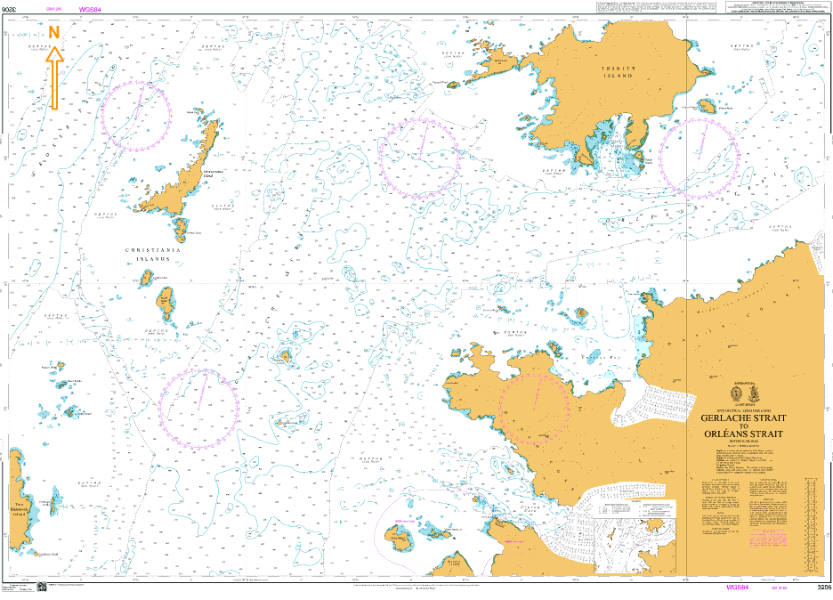
INT9165 (BA3206 & GB403206) Gerlache Strait to Orleans Strait – May 2018

Slide 8
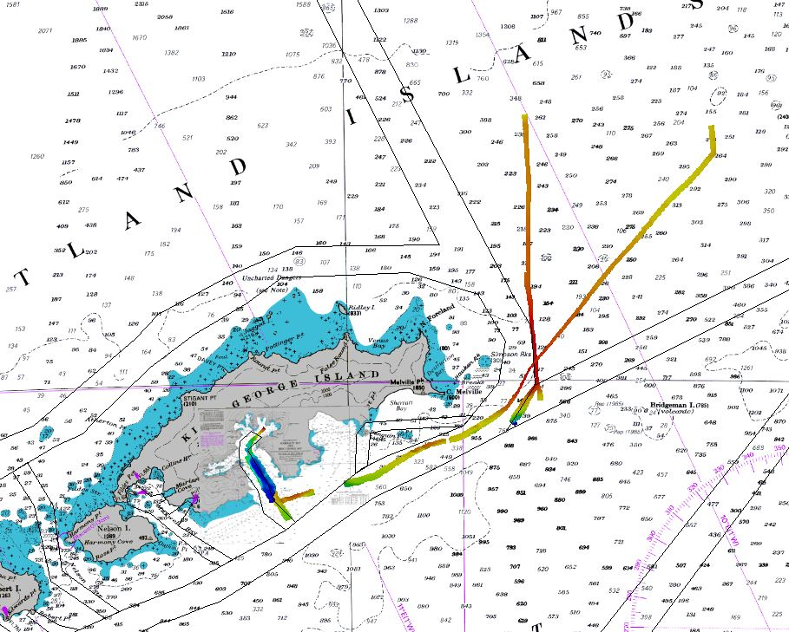
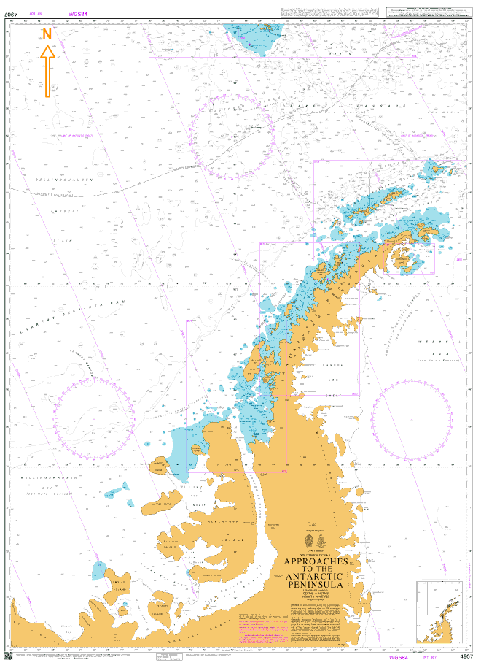
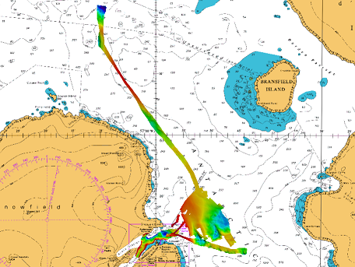
Areas surveyed since HCA14 by HMS PROTECTOR (2016/17 coverage)

Slide 9
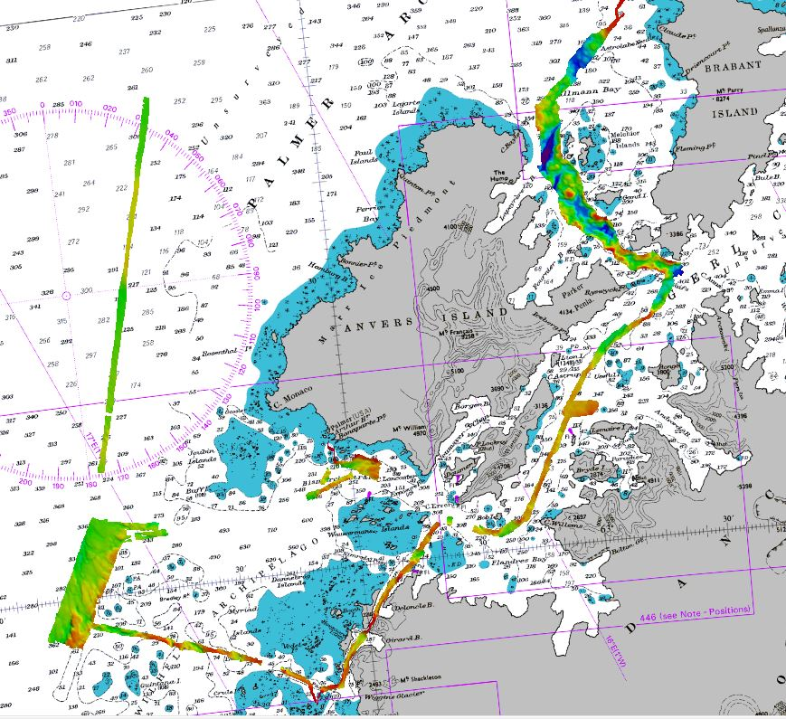
Areas surveyed since HCA14 by HMS PROTECTOR (2016/17 coverage)

Slide 10
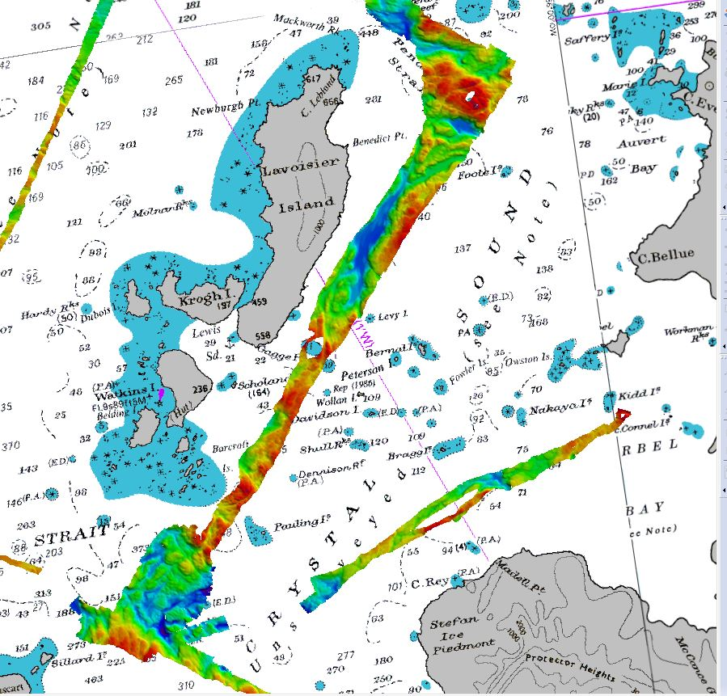
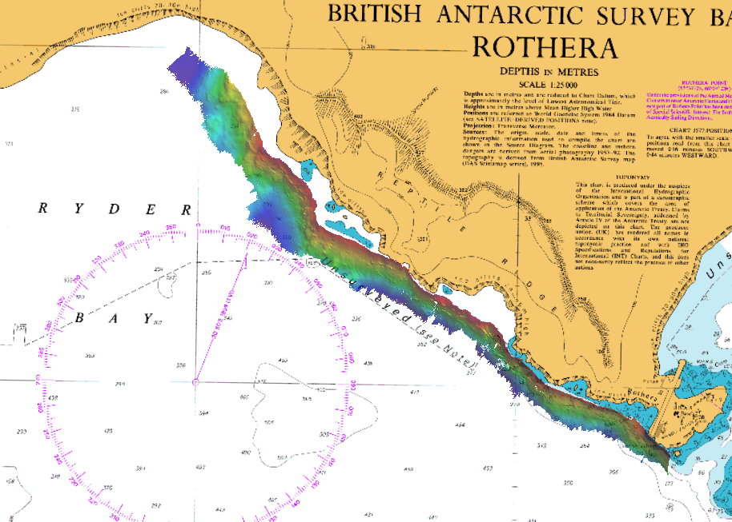
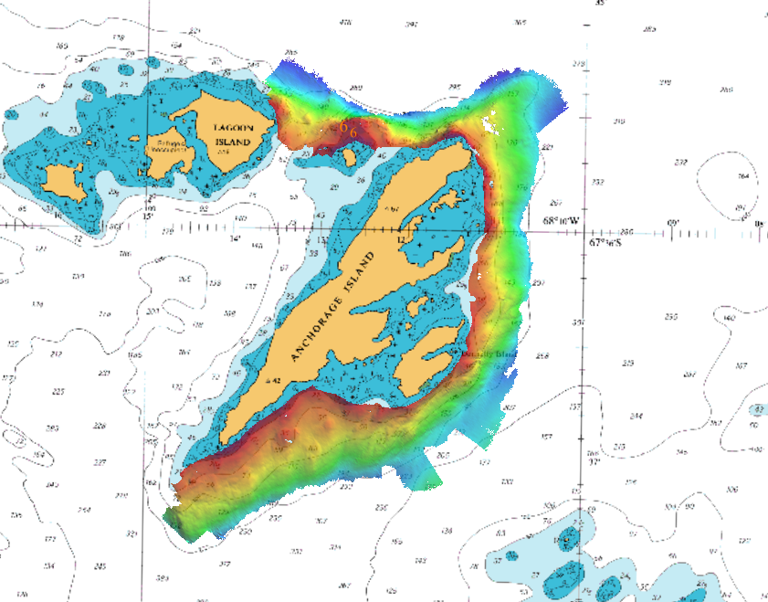
Areas surveyed since HCA14 by HMS PROTECTOR (2016/17 coverage)

Slide 11
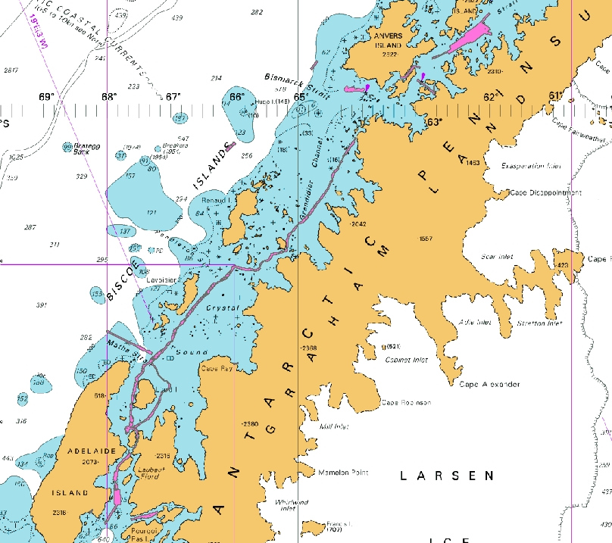
Areas surveyed since HCA14 by HMS PROTECTOR (2017/18 coverage)

Slide 12
Risk assessment studies since HCA14 - The UK has not carried out any in depth studies. However, regular monitoring of Tourist vessel statistics and traffic density provide evidence to support existing INT charting and highlight the need for further coverage.
There has been no impact of the Polar Code on our activities

Slide 13
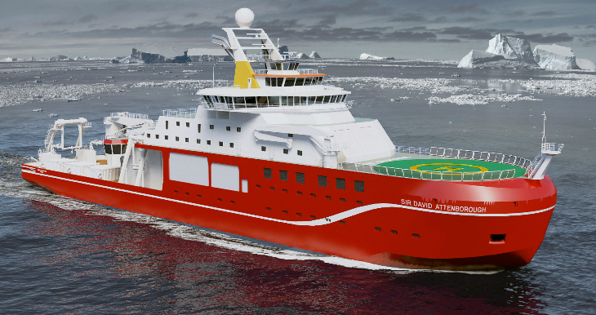
Status of Relations with Other Organizations
Scientific and Polar Institutes – Regular liaison maintained with British Antarctic Survey (BAS), exchanging data and coordinating scientific and surveying requirements. New BAS Polar research vessel to be completed in 2019

Slide 14
Cruise vessels – Regular contact maintained with IAATO, providing data to vessels and receiving access to AIS vessel movements to monitor navigational “hotspots”. This contributes to the understanding of vessel destinations and charting requirements. IAATO keen to task their vessels to provide confirmation of the existence of navigational aids in the Antarctic Peninsula.

Slide 15
Hydrographic data received from other organizations:
Survey data received from Colombia (DIMAR)
Survey data received from Alfred Wegener Institute (DE)
Survey data received from Chile (SHOA)
Hydrographic data provided to other primary charting authorities:
New Zealand/US (LINZ/NGA) – Multibeam survey data
Spain (IHM) – Imagery to be supplied in support of the preparation of new INT charts
Argentina (SHN) – supply of S57 Data for INT9140

Slide 16
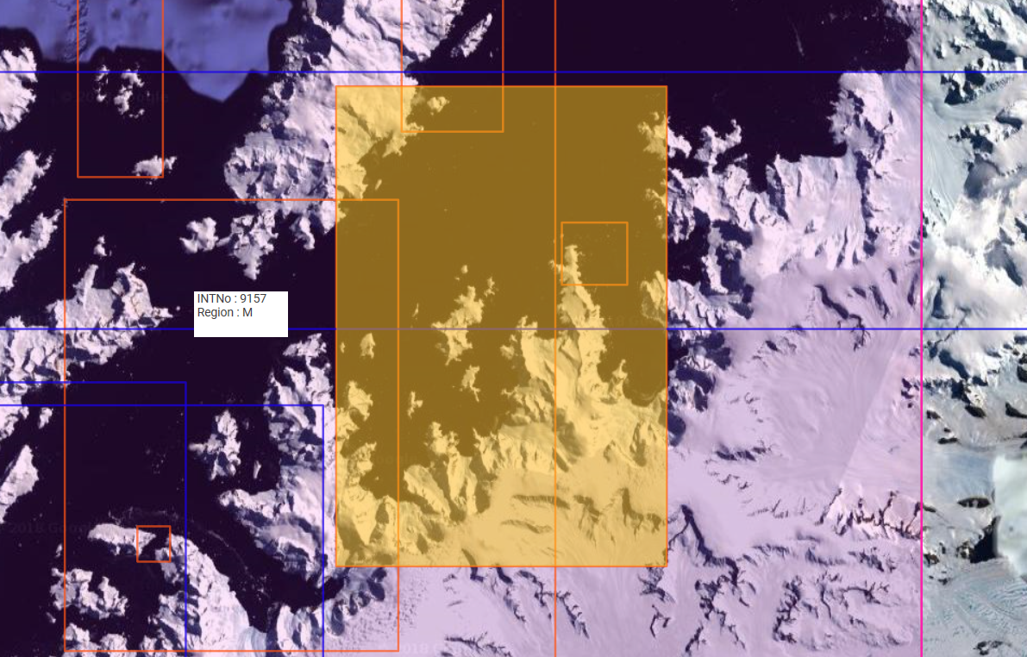
Charts and ENCs in preparation – UK have 3 INT charts in preparation with corresponding ENCs.
INT9166 (BA3207) Wilhelmina Bay – 2018/19

Slide 17
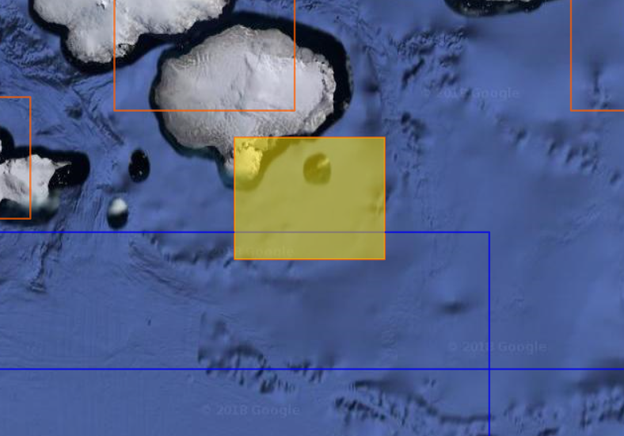
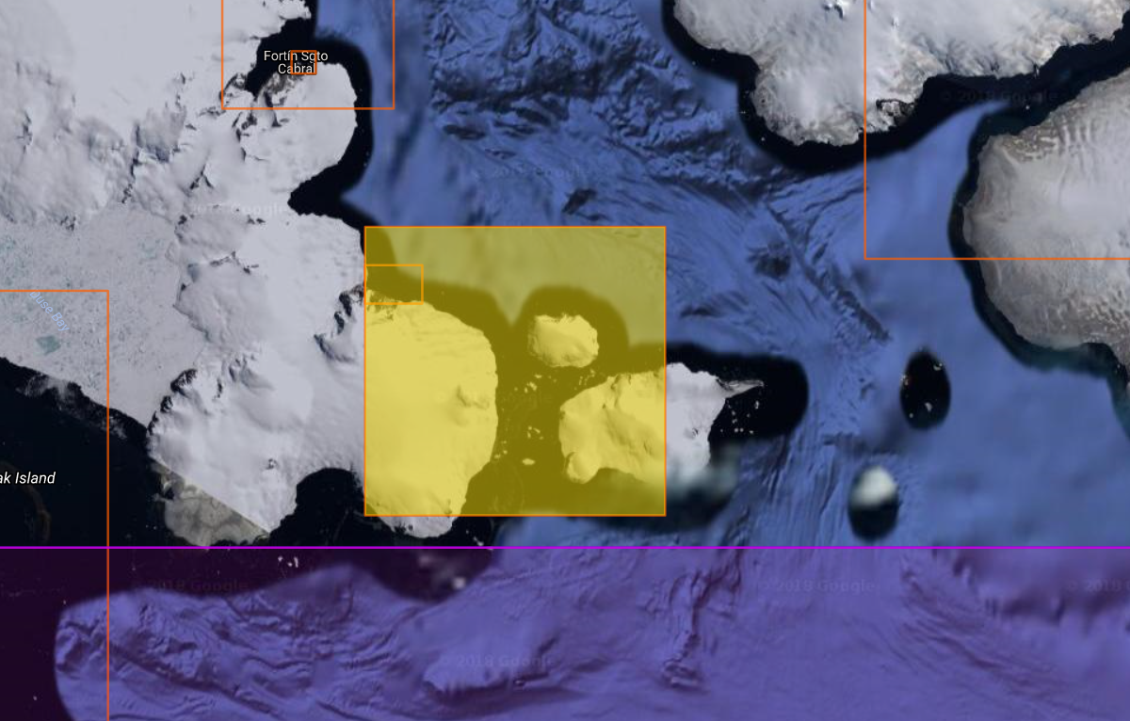
INT9114* (BA3208) Plans in Antarctic Sound – 2018/19
(*Change to INT scheme – to
be discussed)

Slide 18
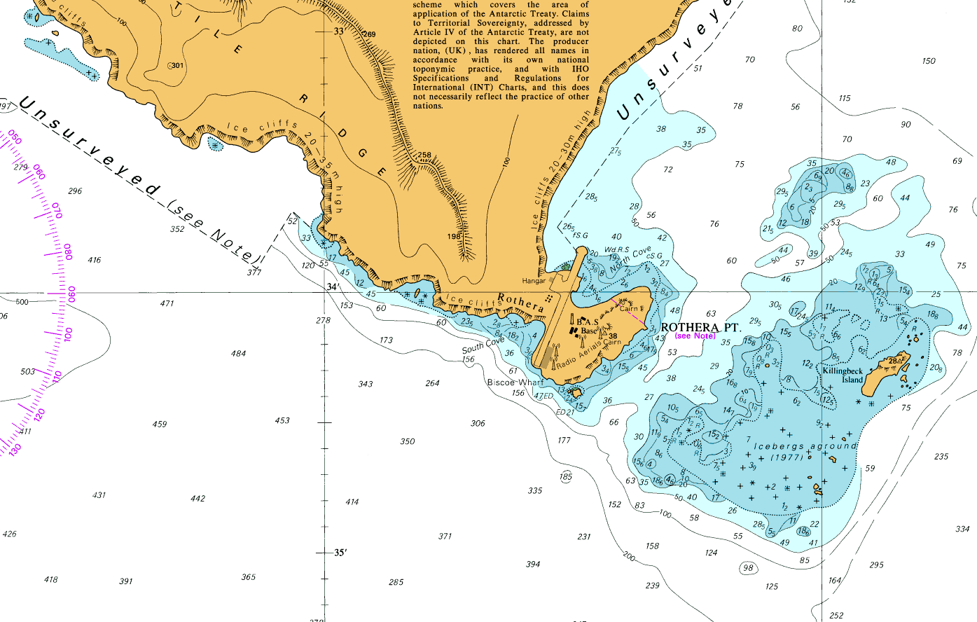
INT9113* (BA3461) Biscoe Wharf, Rothera and Horseshoe Island – 2018/19 (*Change to INT scheme – to be discussed)

Slide 19
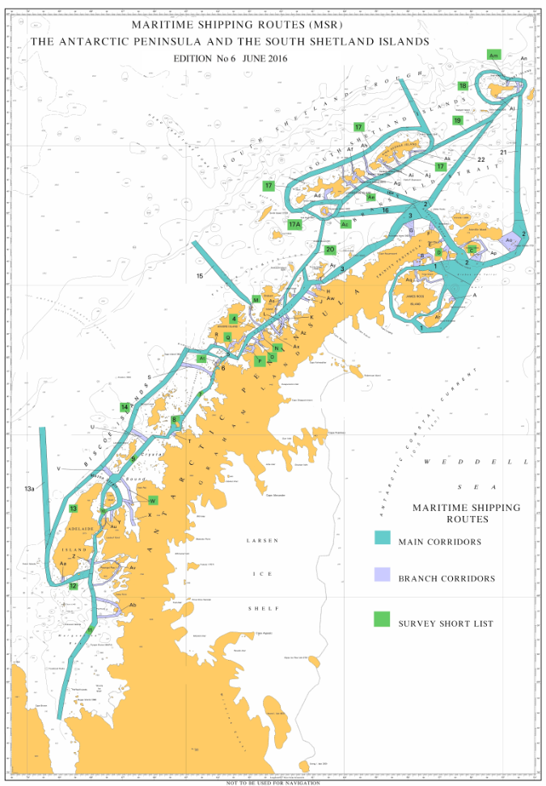
New surveys – HMS PROTECTOR will continue to have priority tasking to survey areas within UK INT chart responsibility. This falls within the remit of the IHO HCA Prioritised Survey Plan.

Slide 20
Any other matters of relevance to HCA
Since HCA14, the UKHO has maintained the updating of the Antarctic Pilot (NP9) following publication of the latest INT charts
Particular Issues that may require HCA Consideration :

