Slide 1
IHO Hydrographic Commission on Antarctica (HCA)
National Report by
South Africa

Slide 2
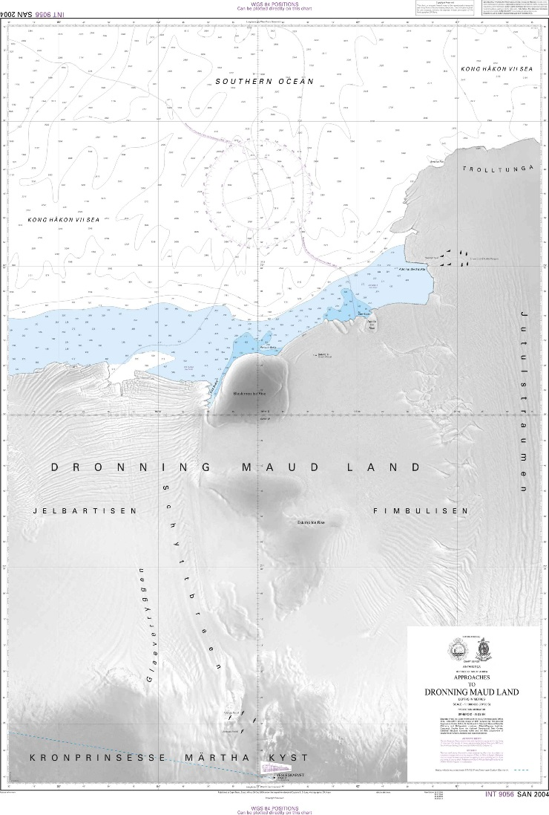
Survey and charting progress in Antarctica since HCA-15
No new INT, national, ENC charts were produced in the reporting period
The SA Navy did not conduct any Antarctic surveys in the reporting period
No risk assessment studies were conducted
New Technologies And /Or Equipment: There is currently a project underway for the replacement of the SAS PROTEA as well as the survey launches. She will be able to assist in scientific and hydrographic missions to Antarctica and the Islands as she will also be strengthened for summer ice conditions. She will also be a platform to be used by other government departments should the need arise.

Slide 3
Status of Relations with Other Organizations
SA’s polar issues are mainly administered through Department of International Relations & Cooperation (DIRCO), Department of Environmental Affairs (DEA) and Department of Science & Technology (DST). The SANHO and the DEA recognizes the need to actively develop and maintain a working relationship for the mutual benefit of both organisations for the furtherance of maritime safety in the Antarctic and South African Islands, in the spirit of cooperative governance.
This relationship has been further strengthened during talks between the two departments with Terms of Reference drafted.
The DEA also indicated there is currently a draft search and rescue/emergency plan between them and the South African Maritime Safety Authority (SAMSA), represented here by the Maritime rescue Coordination Centre (MRCC).

Slide 4
Status of Relations with Other Organizations
Offer of And/Or Demand For Capacity Building. The bathymetric data within the area of the approaches to Dronning Maud Land is based on satellite derived altimetry and bathymetric contours from the Alfred-Wegener Institute, Germany and trackline bathymetric cruise data from the US National Geophysical Data Centre, Boulder, Colorado, USA (GEODAS) and the South African Department of Environment Affairs Directorate (DEA): Antarctica and Islands, Cape Town.
South Africa welcomes any additional survey data including satellite imagery (geo-referenced) within their charting area from neighbouring countries to update chart SAN 2004 (INT 9056) and ENC ZA300300.
Training Received, Needed, Offered. The Terms of Reference between the SANHO and the DEA makes provision for capacity building initiatives for the benefit of staff and personnel between the SANHO and DEA.

Slide 5
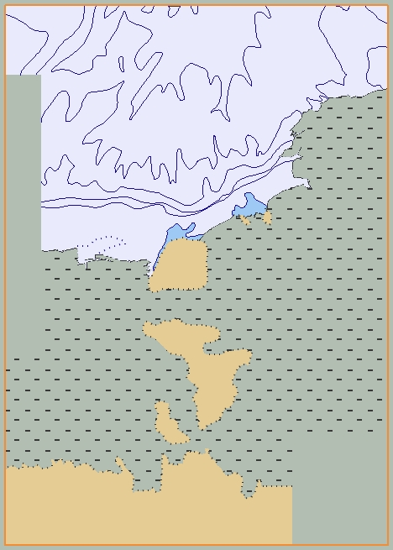
Planned Activities for 2019/20
No new charts are planned for 2019/20
No new SA Navy surveys are planned for 2019/20

Slide 6
Any other matters of relevance to HCA
Disaster Prevention. South Africa is a signatory to the Antarctic Treat Consultative Meeting (ATCM), and as such, provides input regarding vessel traffic in the Antarctic region. The SA Agulhas II is viewed by the Hydrographer a source of AIS data while deployed in the Antarctic, and requested whether the Department of Environment Affairs Directorate (DEA) would be willing to share any AIS data for submission to the ATCM.
The DEA also indicated there is currently a draft search and rescue/emergency plan between them and the South African Maritime Safety Authority (SAMSA), represented here by the Maritime rescue Coordination Centre (MRCC).
Environmental Protection. SANAE IV was recently inspected by Norway and was found generally compliant, but need to address energy efficiency and renewable energy, and reduce hazards resulting from current upgrading work, etc.

Slide 7
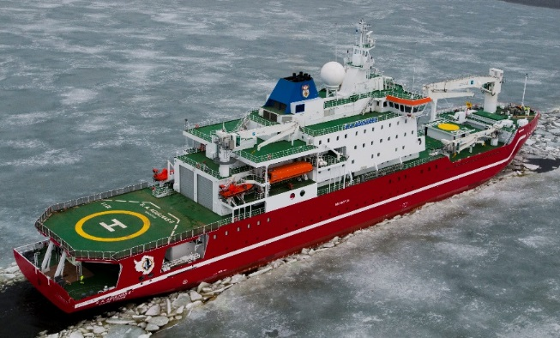
Conclusion
Particular Issues that may require HCA Consideration:
Invited to take note of the report and the information provided.
Invited to take any appropriate action deemed necessary.
Thank you!

