Slide 1
e-Navigation
Overview
Stephen Bennett
Vice Dean of the IALA World-Wide Academy

Slide 2
Changing Maritime Environment
Sea
Shore
Density and mix of shipping increasing
Globalisation of shipping industry
Larger and faster ships
Increased offshore activity
ECDIS carriage
Reduced manning
Dilution of competency
Cluttered bridge design
Greater regulation
Security concerns
Increasing paperwork
Optimisation of logistic chain
Deepwater berth availability
Public intolerance of accidents
Harbour hassle
Public demand for internet access

Slide 3

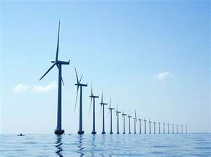
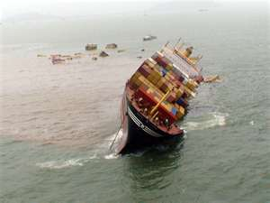
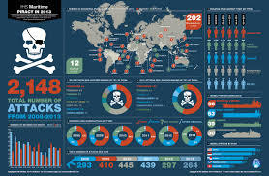
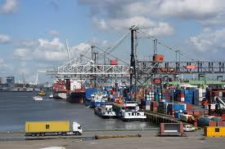
Increasing Pressures

Slide 4
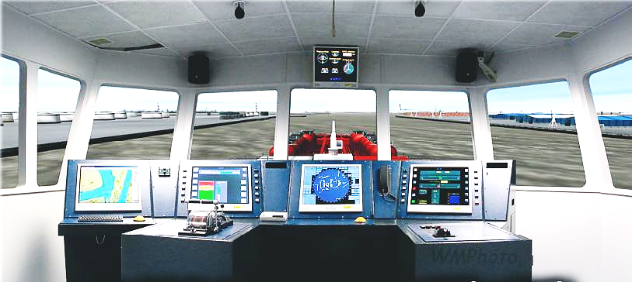
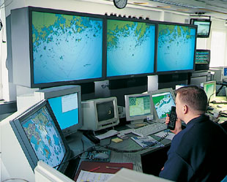
Vision and Strategy
VTS
SRS
GNSS
COM
GMDSS
INS
IBS
CM
DS
STRATEGY
IVEF
VISION
ECDIS
ENC
AIS
LRIT
VTM
AtoN
…

Slide 5
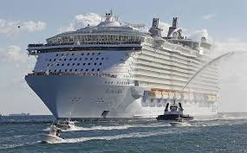
Vision for e-Navigation
Integration of information on the ship
Coordinated management of VTS and related services (SAR) ashore
Provide seamless communication ship to ship; ship to shore and all shore authorities
Resilient navigation
Guard zones, recommended routes, no-go areas – Sea Traffic Management
World-wide ENC coverage

Slide 6
Definition of e-Navigation
The harmonised………
  Collection
  Integration
  Exchange
  Presentation
  Analysis………..
…..of maritime information onboard and ashore by electronic means to enhance:
  berth to berth navigation and related services (VTS)
  safety and security at sea
  protection of the marine environment
“CIEPA”

Slide 7
Aims of e-Navigation
PROMTE
WORLDWIDE STANDARDISATION, UNIFORMITY AND INTEROPERABILITY
SUPPORT
SAFE / SECURE NAVIGATION
CONTRIBUTE
EFFICIENT MARITIME TRANSPORT AND LOGISTICS
SYSTEM INTEGRATION
DEVELOP
VESSEL TRAFFIC MANAGEMENT AND MONITORING
COMMUNICATION AND DATA EXCHANGE
EFFECTIVE SEARCH-AND-RESCUE, DISASTER AND INCIDENTS RESPONSE
REQUIREMENTS WITH RESPECT TO TRAINING AND EDUCATION
FAMILIARISATION WITH PROCESSES, PROCEDURES, SERVICE PROVISION, APPLICATIONS, SYSTEMS

Slide 8
Main Components
PNT
Resilient Navigation
IALA WW Radionavigation Plan
Comms
Uninterrupted communications
IALA Maritime Radio Communications Plan
ENCs
Population of ECDIS
Adequate Electronic Navigational Charts

Slide 9








Multi-Organisation Project
IMO
IAIN
IHO
CIRM
IEC
ICS
ITU
IALA
IMPA

Slide 10
e-Navigation Time-line
2004
IMO MSC considered the issue
2006
Proposed Development led by IALA
2014
Strategic Implementation Plan
2008
MSC 85 Approved Strategy

Slide 11
e-Navigation Architecture
“The Seven Pillars”
Human | Ship | MSPs | Comm | PNT | Shore | CMDS
Human Factors | Shipboard Equipment | Maritime Service Portfolios | Communication Services | Resilient PNT | Shore-based Infrastructure | Common Maritime Data Structure

Slide 12
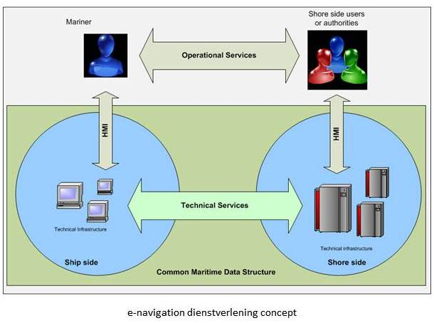
Maritime Service Portfolios
MSP = Combination of a Operational + a Technical Service

Slide 13
Strategic Implementation Plan – First 5 Priorities – Nov 2014
S1: improved, harmonized and user-friendly bridge design;
S2: means for standardized and automated reporting;
S3: improved reliability, resilience and integrity of bridge equipment and navigation information;
S4: integration and presentation of available information in graphical displays received via communication equipment; and
S9: improved Communication of VTS Service Portfolio (not limited to VTS stations).

Slide 14
e-Navigation Development based on 7 Risk Control Options
IMO (MSC)
IALA (ENAV Committee)
Resilient PNT (RCO5)
In cooperation with other international organizations
(ITU, IEC, CIRM, ICS etc.) develop functional, technical and performance standards for communications, navigation systems, portrayal, data exchange etc.
IHO leads on S-100
Lead Organization and Coordinator
Focus on prioritised ship components
GMDSS modernization

Slide 15
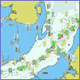

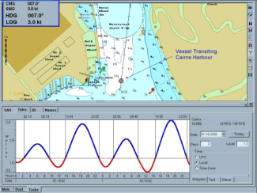
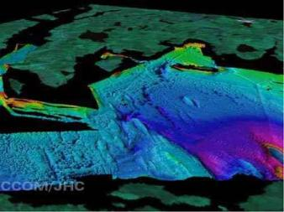

S-100 and Product Specifications
S-101 ENC
… contains all
the components
to make different
product specifications
for all types of
hydrographic data
S-100
S-102 ??
S-103 ??
S-104 ??
???????????????????????????????? ... S-10?…
12/12/2014
15
Notes:
15

Slide 16
S-100 - overview
IHO Universal Hydrographic Data Model
Extends the principles of the original intent of S-57
S-100 describes the overarching model for data definition, transfer and combination
Product Specification Register - a list of S-100 based Product Specifications created by recognized organizations such as IALA (e.g. S-201 to S-299 for AtoN) describing the content, purpose, version, location and availability of those Product Specifications

Slide 17
5 Registers in the Registry
S-100 GI Registry
Feature Concept Dictionary
Portrayal
Domains
Registers
Metadata
Product Specification
Data Producer Code
12/12/2014
IALA WWA – Introduction to e-Navigation
17

Slide 18
Summary
IMO will address ship side issues
IALA will address Resilient PNT and Comms issues
IHO will address ENCs to populate ECDIS
e-Navigation will use S-100 with Product Specifications
The Morse key to the mobile phone took just 25 years
e-Navigation test beds already being used
IHO and IALA leading the way

Slide 19
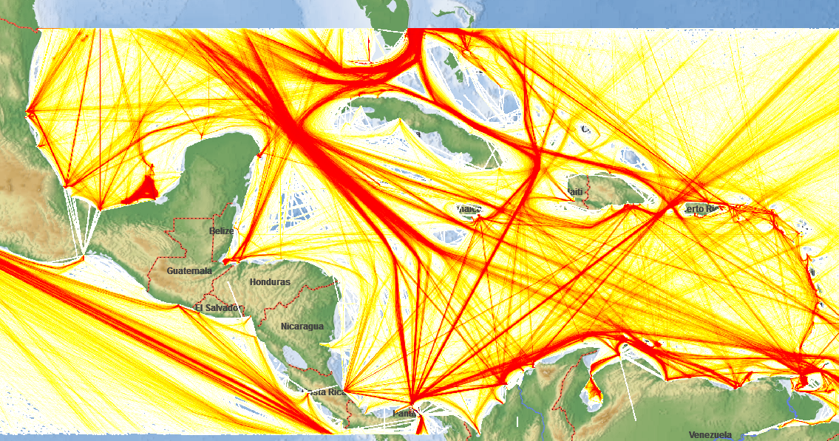
Questions?

