Slide 1
Meso-American & Caribbean Sea Hydrographic Commission IALA and its Academy Update
Stephen Bennett; Vice-Dean IALA WWA

Slide 2
IALA-AISM
is an International
Technical Organization,
created in 1957
Membership
National
Associate
Industrial
Honorary
Competency : All types of AtoN
Notes:
IALA is an NGO, and works for the benefit of its members.
Stress that it is not-for-profit, secular and non-political.
Provide a forum to share expertise and experiences
Safety and protection of the marine environment is the prime concern.

Slide 3
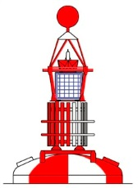
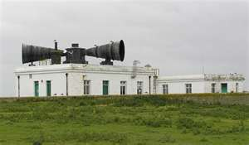
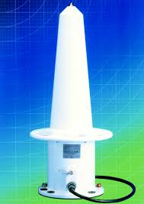
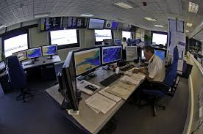
Types of AtoN
Visual and Physical AtoN
Fixed AtoN
Floating AtoN
Audible Signals
Radionavigation AtoN
Vessel Traffic Services

Slide 4
IALA Activity 2013 - 2014
Enhancement of Committee Structure
18th Conference in A Coruña, Spain – May 2014
Assembly approval for IGO status
Reinforcement of IMO and IHO relationship – “Delivering as One”
New Secretary General – Francis Zachariae (Feb 2015)

Slide 5
The IALA World-Wide Academy “The Academy”
“The IALA World-Wide Academy is the vehicle by which IALA delivers training and capacity building”
Independently funded by donations and support
Success 2012-2014 exceeded expectations
International demand for an expanding training and capacity building programme
New full time staff member from 1 March 2015

Slide 6
Capacity Building Regions 2012 - 2014
Region | Target States
East Asia | 5
North Indian Ocean | 11
Eastern Atlantic | 18
Southern Africa and Islands | 8
Meso-America and Caribbean – largest number | 19
South-west Pacific | 12
ROPME Region | 5
Total Target States | 78

Slide 7
Capacity Building – Master Plan
Success 2012 – 2014 resulted in removal of 9 States from 2012 target list
Demand for Stage 2 visits training increasing
Increased demand required new Master Plan 2015 – 2018 (on website)
Review of target States based on least developed and developing nations resulted in new total of 69 target States

Slide 8
Target States 2015 - 2019
Region | Target States
Africa Anglophone | 12
Africa Francophone | 8
Near East | 13
Far East | 5
South West Pacific | 12
Meso America and Caribbean | 19
Total States | 69

Slide 9
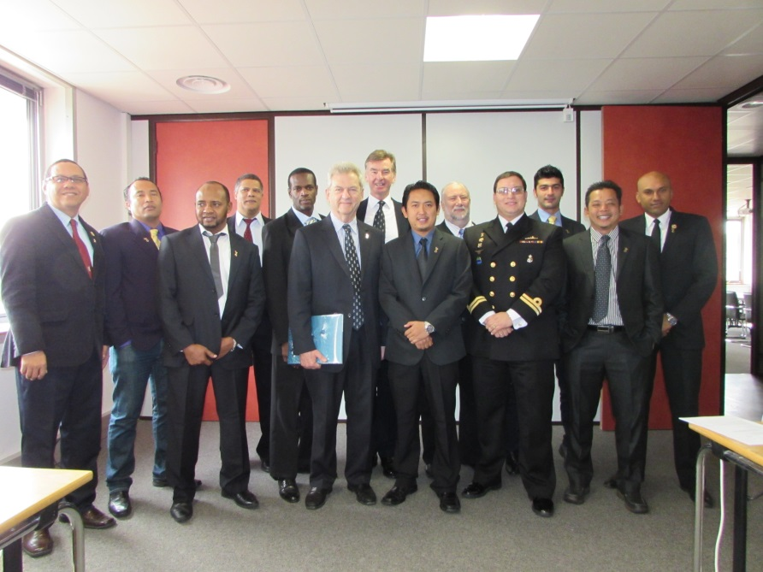
Academy Deliverable A
Training

Slide 10
Human Resource Responsibilities IALA Recommendation E-141.2.1
The National Competent Authority should:
Ensure that the AtoN Authority is provided with sufficient staff, appropriately qualified, suitably trained and capable of performing the tasks required, taking into consideration the type of AtoN and the level of services to be provided

Slide 11
Academy Training Deliverables
VTS Training
AtoN Training
IALA Rec V-103
V103-1 – operators
V103-2 – supervisors
V103-3 – OJT
V103-4 – OJT instructor
Delivered only by ATOs
(list on Academy webpage)
IALA Rec E-141
AtoN Manager Syllabi:
E141/1 – Level 1 AtoN Managers
Risk Management Workshops (IALA WWA.L1.3)
Introduction to e-Navigation (IALA WWA.L1.4)
Historic Lighthouses (IALA WWA.L1.5)
AtoN Technician Syllabi:
IALA WWA.L2.0 – 33 model courses

Slide 12
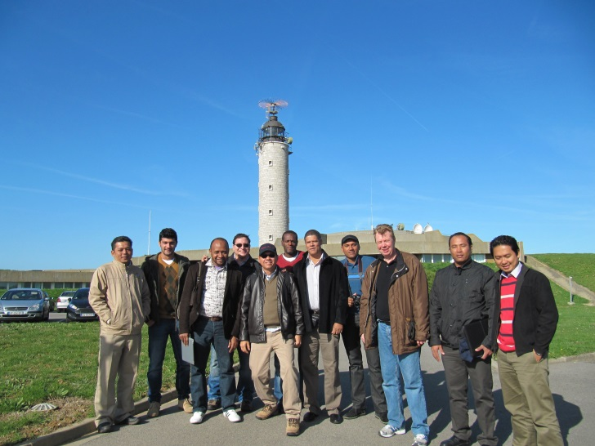
AtoN Training Update
Event | Location | Date
L1 AtoN Manager | IALA HQ | March 2014
L1 AtoN Manager | Brest; IALA HQ | Sep 2014
Risk Management | Istanbul | Sep 14
e-Nav intro | IALA HQ | Nov 14
L1 AtoN Manager | IALA HQ | July 2015
L1 AtoN Manager | Wenzhou China | Sep 2015
L1 AtoN Manager | Brest; IALA HQ | Sep 2015
Risk Management | Singapore | Oct 15

Slide 13
Future Possible Training Hubs
Strategy is to have at least one Accredited Training Organization in each Target Region
Some ATOs to develop as regional training hubs
IALA WWA to facilitate where requested through MOUs
Region | VTS | AtoN
Africa (A) Africa (F) | Abidjan | S. Africa
Near East | Abu Dhabi | Oman
Far East | Malaysia Singapore Japan | Malaysia China
SW Pacific | Australia | Fiji (SPC)
MAC | ? | ?

Slide 14
CB Strategy and Achievements
Joint IHO/IALA capacity building strategy
Stage 1: Raising AWARENESS through targeted “Level 1+” seminars
2012 delivered to 74 delegates from 12 target States
2013 delivered to 345 delegates from 40 target States
2014 delivered to 524 delegates from 49 target States
2015 – Meso-American and Caribbean Sea Region – host nation being investigated
Stage 2: Request by newly aware States for ASSESSMENT of needs
Delivered by Academy Staff and IALA experts

Slide 15
Stage 2 Technical Visits
Request from Competent Authority
5 - 8 day visit by 2 IALA experts
Confidential report with recommendations
Free of charge!

Slide 16
Capacity Building Deliverables – 2013-15
 | Category | 2013 | 2014 | 2015
Stage 1 | Awareness | Mauritania Myanmar Riyadh Mombasa Indonesia - VTS Bangkok Singapore Vanuatu St Maarten | Abu Dhabi Qatar Kandla, India Bangkok Ghana Mozambique Indonesia Japan Malaysia Mexico | Cook Is Panama West Africa Timor Leste Meso-America and Caribbean Sea region
Stage 2 | Needs assessment technical visits | Mauritius Cameroon | Fiji Comoros Vietnam (S) | Vietnam (N) Trinidad Brunei Myanmar Maldives Ivory Coast Congo Madagascar Sri Lanka

Slide 17
Summary & future planning
2012 – 2014: IALA WWA original aims and objectives either achieved or exceeded
Final Stage 1 Awareness programme to be held (hopefully) in the MACHC Region
Targeted Stage 1 missions/high level visits to individual key States – e.g. Panama
Stage 2 technical needs Assessment missions ramping up
Regional Training hubs being established in each Target Area

Slide 18
IALA WWA
Questions?

