Slide 1
Satellite Derived Bathymetry GEBCO Cookbook
Derrick R. Peyton

Slide 2
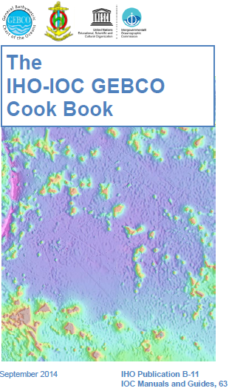
Overview
Principles
6 Steps to SDB
Canadian case study
Future work

Slide 3
Principles

Slide 4
Principles / Pretty
LIDAR
Atmospheric attenuation
Bottom return
IR
Sun glint
Blue Green
IR/Red: do not penetrate through water - reflected
Attenuation through water is proportional to depth
Green and Blue are attenuated in different proportions
Seabed scattering
Notes:
Contains animation on click

Slide 5
Principle / Text
Spectral range penetrating seawater typically between 350nm (UV) and 700nm (red) with following characteristic:
Exponential attenuation of radiance is a function of depth and wavelength
This principle is the base for depth estimation
To simplify, depth can be determined with an equation where M, N and L are empirically determined
$D=M×{\left(\frac{\ln\left(blue obs.\right)}{\ln\left(green obs.\right)}\right)}^{2}+N×\left(\frac{\ln\left(blue obs.\right)}{\ln\left(green obs.\right)}\right)+L$

Slide 6
Required Data
Multispectral sensor
Landsat 8 (free at http://earthexplorer.usgs.gov/), 30m resolution
World view (Digital Globe), 1.85m multispectral resolution
Spot (CNES), 6m multispectral resolution
Colour bands required:
Blue
Green
Infra Red
Benchmark Data: existing bathymetry to be used to determine the M and N factors = Vertical Referencing

Slide 7
Steps 1-6
Step 1 Acquire Satellite Imagery
Step 2 Satellite Image Processing
Step 3 Raster Calculator = V_{sat} = { ln(blue) / ln(green) }
Step 4 Benchmark using mbes or lidar or existing chart
determine M, N and L using least squares
Step 5 Raster Calculator to calculate SDB Depths
Step 6 Check

Slide 8
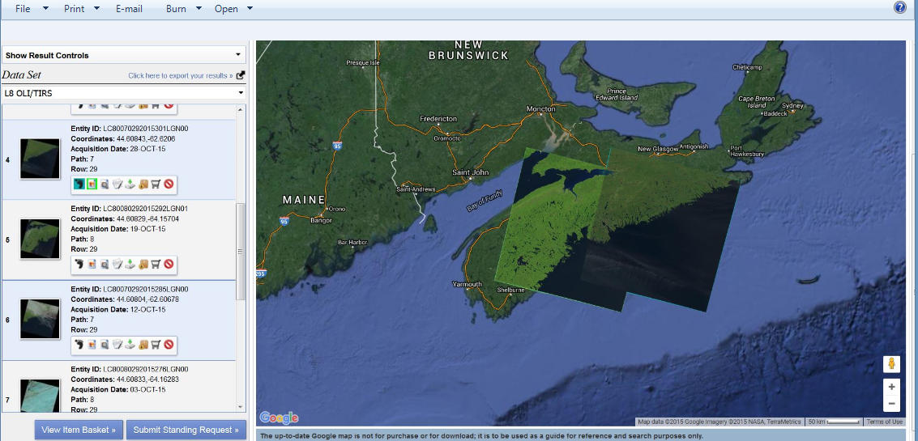
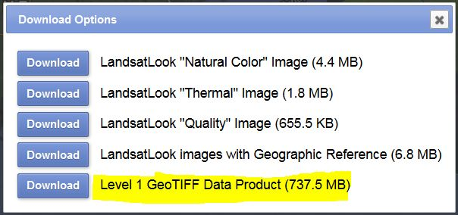
Steps 1 Acquire Satellite Imagery

Slide 9
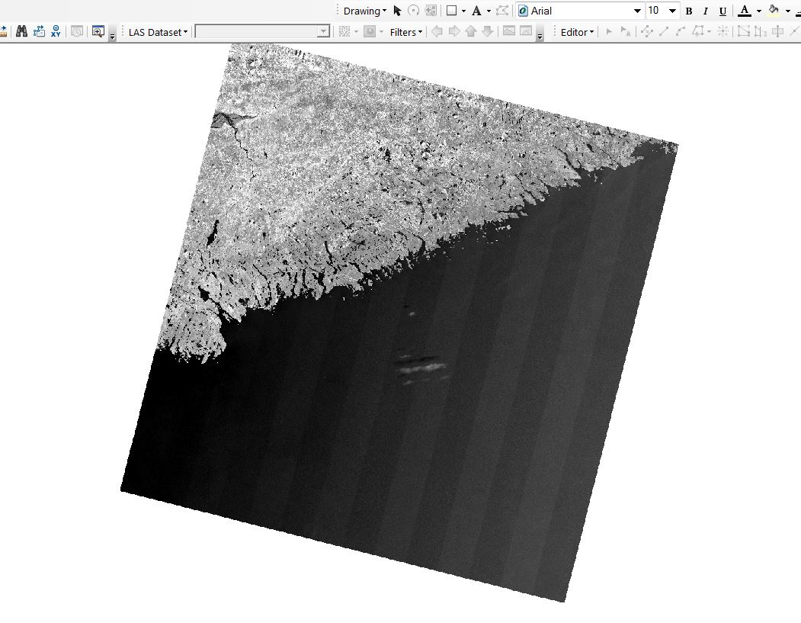
Step 2 Satellite Image Processing
“Bad” scan lines
9

Slide 10
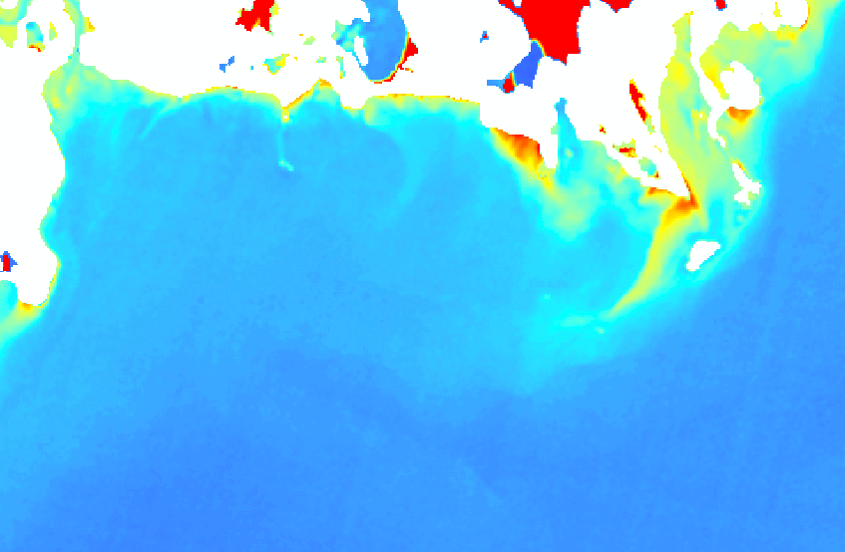
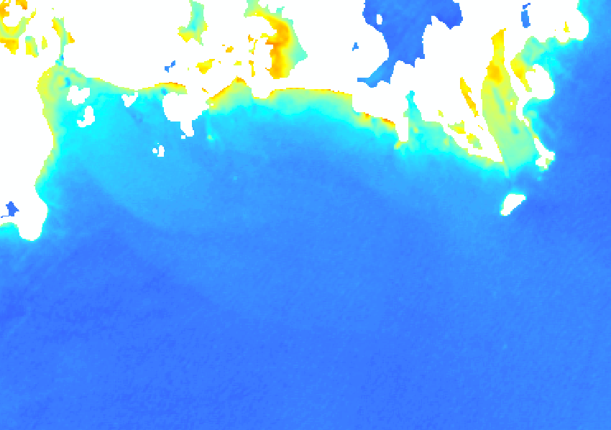
Step 2 Satellite Image Processing
Example: April vs. May image (2015)
>> Turbidity
>> Cloud Cover
Real feature
Visible on both images
Cloud cover
Biological growth
10

Slide 11
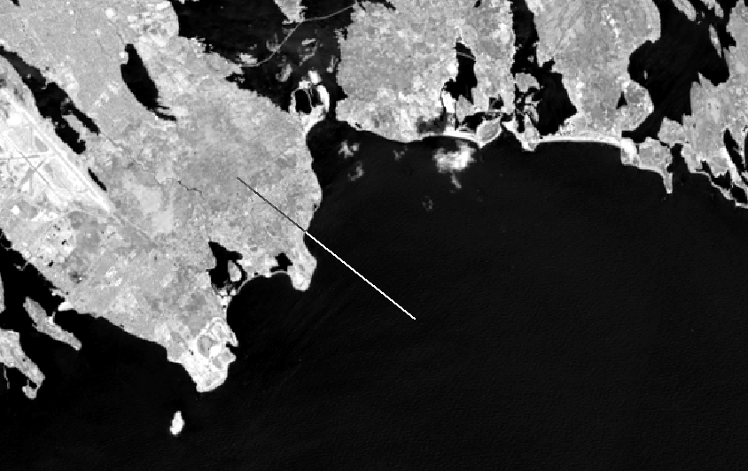
Water Separation
Step 2 Satellite Image Processing
Using the Infra Red band, determine the threshold value for the land/water separation
Tool: ArcMap > 3D Analyst Tool bar
Interpolate Line crossing from land into water
Display histogram

Slide 12
Filtering
Step 2 Satellite Image Processing
Apply low pass filter to each image band to remove random noise
Spatial Analyst: convert to float
Low pass filter
Crop to water areas only using the IR layer and determined water separation threshold value
Optional (generally not of use if good image)
Glint/cloud correction
In practice does not make a difference with images free of cloud cover

Slide 13
Apply Bathymetry Algorithm
Step 3 Raster Calculator
Compute a new raster
Find a subset area within the benchmark data where computed raster and existing bathy are matching (= free of “fake” depths due to turbidities etc.)
Compute the M, N and L coefficients by statistical analysis.
Raster Value$=Vsat=\frac{Ln(filtered blue)}{Ln (filtered green)}$

Slide 14
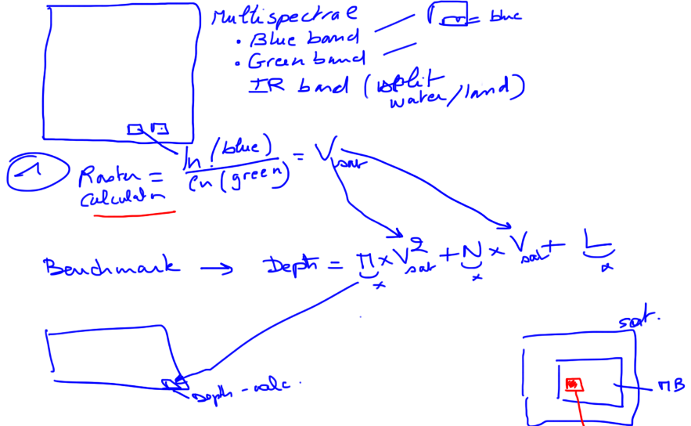
Step 4 Benchmarking

Slide 15
Step 5 Calculate SDB Depths
$DSDB=M×{\left(\frac{\ln\left(blue obs.\right)}{\ln\left(green obs.\right)}\right)}^{2}+N×\left(\frac{\ln\left(blue obs.\right)}{\ln\left(green obs.\right)}\right)+L$

Slide 16
Step 6 Check
Key Notes….
Make a plan
Know your data
QC

Slide 17
Example of result – Nova SCOTIA

Slide 18
Step 1 & 2 Acquire Satellite Imagery
18

Slide 19
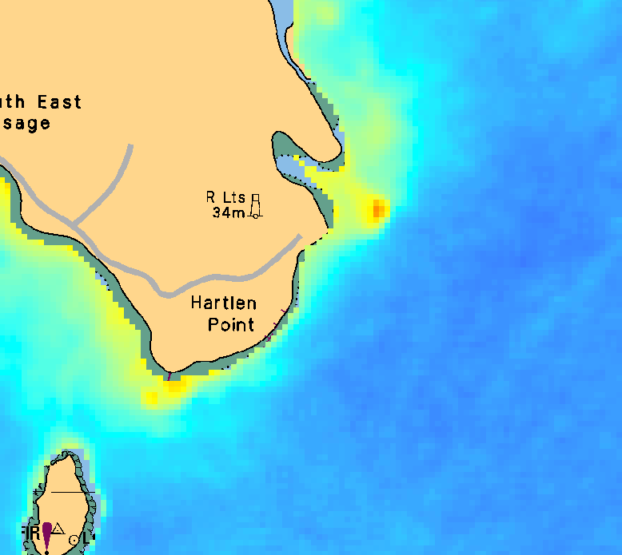
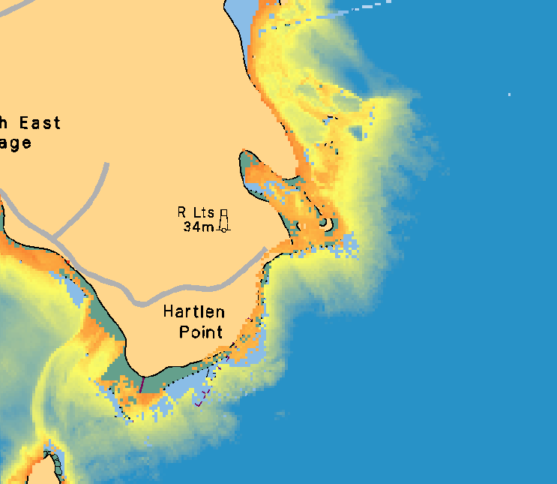
Step 1 & 2 Acquire Satellite Imagery
Looking for an area with good match between the known bathy and image
Use subset to compute coefficients
Satellite Extracted
Reference bathy
Notes:
Reference bathy is LIDAR data (Hawkeye II)

Slide 20
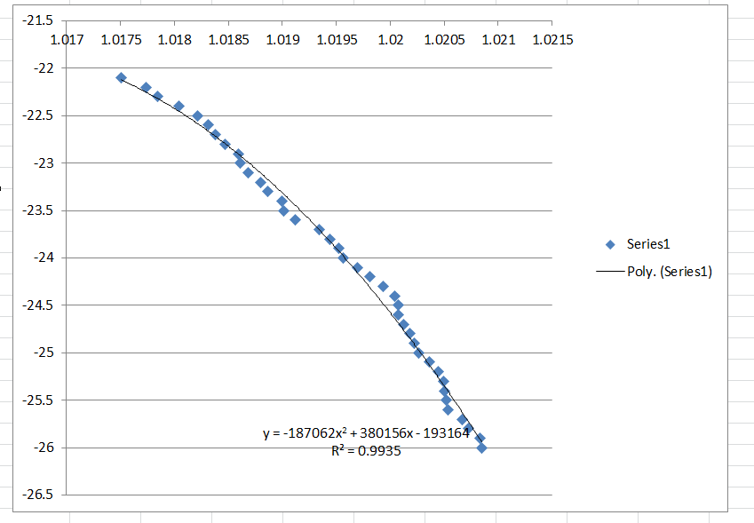
Step 3 & 4 Raster Calculator
Formula: using Trendline, 2 degress polynomial.
Use raster calculated with same coefficient

Slide 21
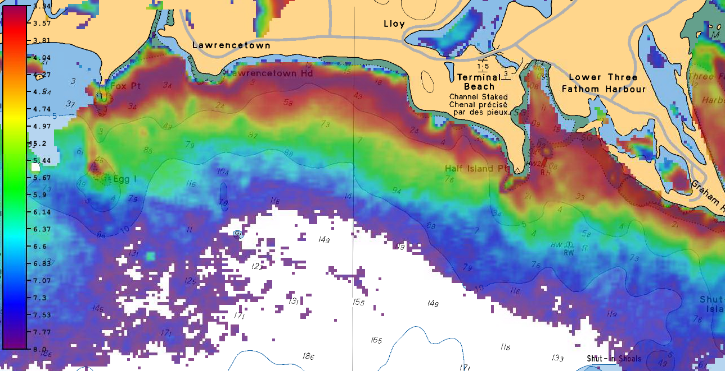
Step 5 Calculate SDB Depths
Chart comparison

Slide 22
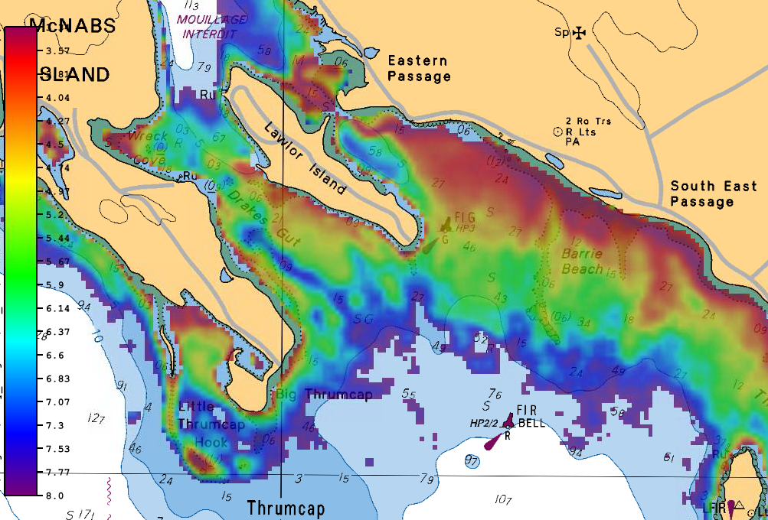
Preliminary Results
Chart Comparison

Slide 23
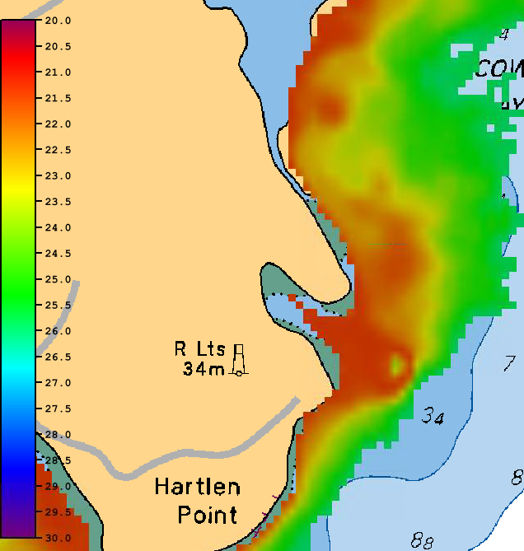
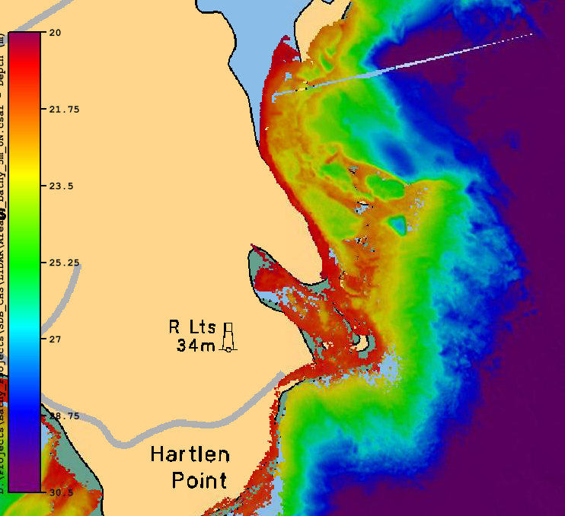
Preliminary Results
Comparison with LIDAR
30m vs. 5m resolution
2 to 3m standard deviation in depth values
Notes:
There is not more detailed comparison – ideally would need a third multibeam survey to make a full comparison
Cannot compare with charted depths since depths from satellite are relative to ellipsoid – pending getting a chart datum separation model from CHS.

Slide 24
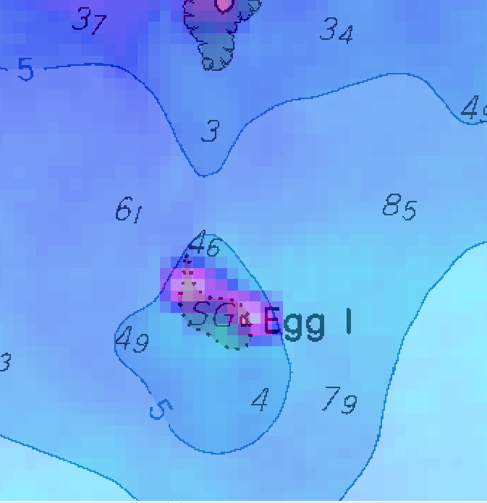
Visible feature
Overlay with chart 4237

Slide 25
Summary
Recap,
We took the GEBCO Cookbook approach to SDB
The process can be accomplished with little cost
There are primarily 6 steps to follow
Preliminary results from Canadian data is promising
Way forward,
Statistical comparison of SDB and Observed
Total Propagated Uncertainty to be developed (UNH)

Slide 26
Thanks for Listening

