Slide 1
Belize Port Authority , National Hydrographic Report 2016
Organization: Belize Port Authority
Ports Commissioner: Mrs. Merlene Martinez
Submitted by: Michael Jenkins
Chief Safety and Security Manager
Hydrographic Department
mjenkins@portauthority.bz
bzportauth@btl.net

Slide 2
Survey areas of interest Belize City Harbor

Slide 3
Big Creek and Harvest Caye Approaches

Slide 4
New Surveys
The Belize Port Authority has not conducted any of its own hydrographic surveys but has received new data from NAVO, Fugro and Oceanside Solutions . These independent organizations conducted bathymetric surveys mainly in the south where the new cruise ship port facility is located, Harvest Caye and in the area of the Lighthouse Reef Atoll.

Slide 5
On July 13th 2016 the Belize Port Authority welcomed the visit from Mr. Chris Thorne and Mr. David Parker from the UKHO office.
It was confirmed that bathymetric surveys has been done by other governmental departments in the country.
We met with Coastal Zone Management and with the Fisheries Department. It was discussed that survey interest be communicated to BPA so that the limited resources are not overlapped in hydrographic data gathering.
Both confirm to have Hydrographic data.

Slide 6
Mr. Parker also conducted an assessment of our Hydrographic suite of equipments and with two days of trouble shooting we were unable to get all equipments working and synchronized to the Hypack software.
It was concluded that full suite be sent for maintenance to Survey Equipment Services in Katy Texas , USA

Slide 7
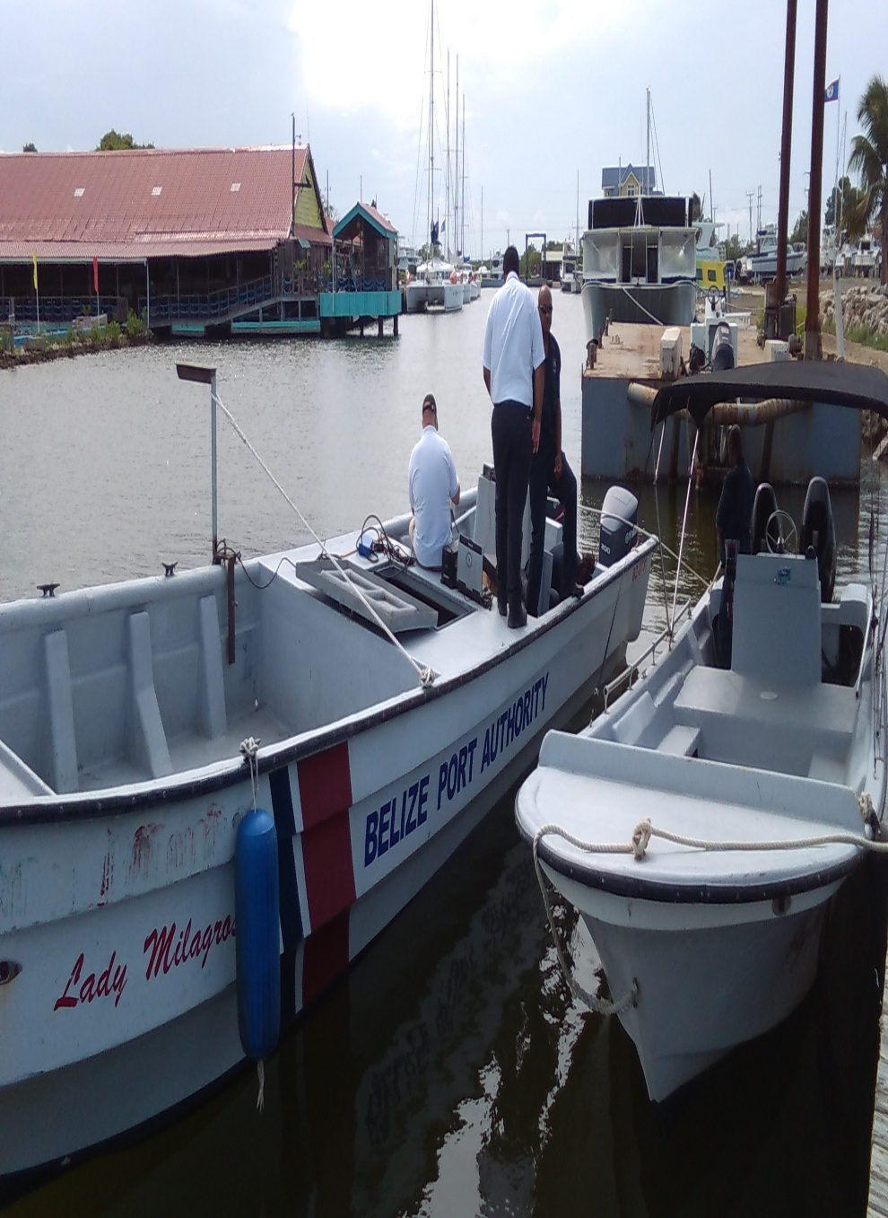

Slide 8
Favorable results from meetings with other governmental agencies was the submission of lidar surveys conducted by NAVO.
The data submitted covered the southern approaches to and included the inner channel and the entire Lighthouse Reef Atoll

Slide 9
Lidar survey areas

Slide 14
The Belize Port Authority recognizes the importance in receiving hydrographic data for the overall development of the country of Belize.
Such development can be seen from the newly established cruise ship port in the south of the country.
On the 17th November 2016 Norwegian Dawn made its first call to the Harvest Caye cruise port.

Slide 15
Considerable amount of Hydrographic surveys where carried out for the safe navigation of these cruise ships to the new port.
NCL captains have confirmed that the soundings and navigation to the new cruise port to be precise and accurate to industry standards.
The full data set for these surveys has not yet been had. Updates to the NP82 is forth coming and to Admiralty chart # 1573 Gulf of Honduras.

Slide 17
Notes:
Update to NP82, addition new pilot station and navigational markers.

Slide 19
Demarcations of new navigational route

Slide 20
Surveys conducted by Fugro were not completed due to Governmental and environmental clearances. Discussions are ongoing for the completion and also to benefit from the airborne bathymetric Lidar surveys that will be conducted for the Caribbean region.
Data collected by Oceanside Solutions and Fugro has not yet been officially given to the Authority but immediately after receiving, it will be submitted to UKHO office for verification and update to charts.

Slide 21
The Belize Port Authority encountered some delays in getting the Hydrographic equipment (Gulf of Honduras Project) to the intended service provider due to the financial constraints brought upon by hurricane Earl. a lot of our navigational aids were lost due to the storm and had to be replaced.
All Hydrographic equipments will be shipped to service provider by early January 2017.

Slide 22
Recognizing that our country may once again have a working set of survey equipment by the middle of next year 2017 it is requested that the Commission takes special interest in Belize for the continuous training in data gathering and processing.

Slide 23
The Belize Port Authority is fully committed to the objectives of this Commission and the overall development of the Hydrographic services in Belize.
Our mandate to provide updated Hydrographic information is becoming extremely critical as the maritime domain becomes more congested with larger vessels and the impacts caused by ship accidents along with climate change is severely taking a toll on the maritime environment.

Slide 24
The Belize Port Authority continues to prioritize its resources in the area of Hydrographic data gathering
The Authority is cognizant of the fact that without updated survey data that the economy and the marine environment will be severely impacted.

