Slide 1
‘Smart Telemetry’ Developments in Environmental Data Sharing and Publishing (for Ports, Harbours and Coastal Authorities)
John Pepper
OceanWise Ltd
Notes:
Abstract:
Transmitting environmental monitoring data reliably from marine and coastal based stations remains problematic despite improvements in land and satellite based methods of communication. Often this results in interrupted real time data flows, data losses that cannot be recovered, or excessive costs as a result of having to keep network channels open or lengthy negotiation. The ip.buffer range was developed by Scannex for the telecommunication sector and has recently been adapted to work in harsh and low power environments with the help of OceanWise.
Advantages of this new ‘Smart Telemetry’ system include an extensive range of data delivery options using industry standard Internet TCP/IP protocols. A large non-volatile flash memory enables the ip.buffer to reliably store, monitor and manage data transmitted from a wide range of oceanographic and other sensors. Bi-directional communication, encryption and user authentication provide a safe method for remote device administration facilitated by OceanWise’s recommended Mobile to Mobile Virtual Private Networks.
This presentation describes the new developments incorporated into the ip.buffer in detail. It then presents a number of case studies where the ip.buffer has been used with different sensors and OceanWise’s environmental data sharing and publishing system, Port-Log, for a variety of applications. Several installations in the UK, Europe and Middle East are provided as worked examples.

Slide 2
What is telemetry?
The word is derived from Greek roots: tele = remote, and metron = measure
An automated communications process by which measurements are made
Data is collected at remote or inaccessible points and transmitted to receiving equipment for monitoring

Slide 3
Why is it important?
It allows you to access extremely high capacity and volumes of data collected which can overwhelm simple monitoring systems.
It greatly reduces operational costs, lets you avoid unsafe places.
Enables you to get information in almost “real time” without having to go visit sites to collect the data.
Lets you “look in” on processes and events remotely, as they are happening and can alert you immediately if something changes.
Wireless telemetry can save resources for your company (and the planet!)
Time and travel costs are saved - manual measurement replaced with automated electronic processes.
It can substantially improve the efficiency of many processes.

Slide 4
Key Requirements for “Smart” Telemetry
Protocols – Handshaking
Error Correction
Power Management
Local Alarms / Alerts
Status Messages – Battery Levels, Signal Strengths
Multi-Channel Communications
Implement newer/faster Internet Protocols
Notes:
Protocols – Handshaking
Error Correction
Power Management
Local Alarms / Alerts
Status Messages – Battery Levels, Signal Strengths
Multi-Channel Communications
Implement newer/faster Internet Protocols

Slide 5
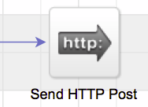
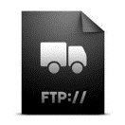
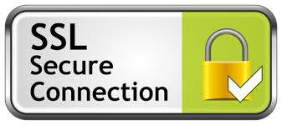
Reliable Data Transfer
Multiple Protocols:
HTTP Post – quickest, most reliable!
Direct TCP Server / Client
FTP / sFTP Server / Client
Email / POP3 / SMTP
ZIP Data compression
Reduces data costs
SSH/SSL Encryption
Data Security
IT Departments like it !
Notes:
Multiple Protocols:
HTTP Post – quickest, most reliable!
Direct TCP Server / Client
FTP / sFTP Server / Client
Email / POP3 / SMTP
ZIP Data compression
Reduces data costs
SSH/SSL Encryption
Data Security
IT Departments like it !

Slide 6
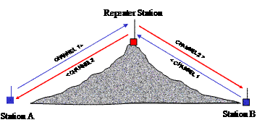
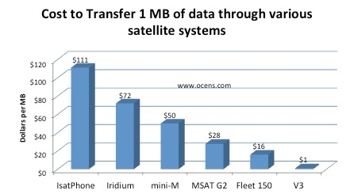
Typical Challenges of Telemetry
Power Consumption
Base Stations
Physical Obstructions
Interference
Band Width
Running Costs
Single Channel
IT Departments!
Notes:
Typical Challenges of any Telemetry System:
Power Consumption – as always. A polled system is always On!!
Base Stations – where to locate them
Physical Obstructions – buildings / mountains.
Interference – other operators within an area.
Band Width – typically 19,200 for UHF – 9600 for dialup GSM.
Running Costs – UHF Free – Satellite not so free!
Single Channel – more than one instrument – you need to multiplex
IT Departments – I say no more!

Slide 7
What do we mean by “Real Time”?
Instant <10 secs
Power Generation Industry define “Real Time” as less than 3 seconds to respond to an event
(we don’t see these sorts of requirements in Oceanography too often!)
Operational 30 secs to a few minutes.
Maritime Operations (e.g. VTS Operators, Dredgers, etc.)
Typically are only interested in readings taken in the last few minutes.
More concerned about the numbers changing and recent trends.
May need to respond to alerts and thresholds
Monitoring 30mins to several hours
Medium / Long-term Projects (e.g. Surveyors, Analysts)
Emphasis on reliability and data delivery
Often as a backup to service intervals
Monitoring battery / memory levels etc.
Notes:
We need to define “RealTime” - it means different things to different people!
Power Generation Industry define “RealTime” as less than 3 seconds to respond to an event
Presumably that’s the time between the adverts starting, and the kettle going on – luckily we don’t get many of those constraints.
The quicker you want it – the more power and technology you need to throw at the problem!
Clients always want it on the nail – but normally we can agree on a “60 second to 5 minute” level of response – things don’t change that quickly in the marine environment!
For the long-term stuff – hourly uploads are perfectly acceptable – but the longer the time interval, the longer it takes you to realise there is a problem – so we recommend “at least hourly” for a web-based system.

Slide 8
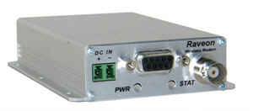
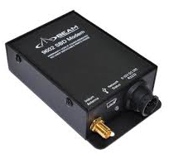
Real Time Telemetry is not new
UHF/VHF/HF Transceivers
Satellite Comms/ Small Burst Data
GSM Modems
Direct TCP Connections
Proprietary / Bespoke Systems
Polled / SCADA / SDI12 Systems
Notes:
There are plenty of systems out there – many bespoke / proprietary – locked down to particular installations and instrument suites.
We don’t have that luxury – we have to accept anything from anywhere by whatever means.
We vehemently protect out instrument independence.
As Time goes on, instrumentation is getting more and more intelligent - what let’s them down is what they are connected to.
Out there we’ve got a plethora of technologies:
UHF/VHF/HF Transceivers
Satellite Comms / Small Burst Data
GSM Modems
Direct TCP Connections
Proprietary / Bespoke Systems: Datawell, Loggernet
Polled / SCADA / SDI12 Systems
Some good – some bad – some in desperate need of retirement!

Slide 9
OceanWise approach
Port-Log.net
Ocean Database
Port-Log System
Design and Installations
We are instrument and transmission independent!

Slide 10
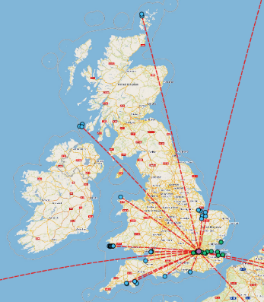
Port-Log.net – OceanWise Real Time Subscription Services
Now in over 100 locations globally
Notes:
Oceanwise now has many Real Time monitoring sites around the UK and Overseas, which we manage for different customers for different reasons. 103 at the last count!
They comprise of a multitude of different sensors and instrument suites collecting things like Tidal Elevation, Waves, CTD, WQ, Meteorology – as well as ancillary installation parameters such as battery levels, signal strengths and charge currents that enable us to monitor the out-stations.

Slide 11
Port-Log.net
Cloud based management and publishing of environmental data…
Reliable on-line hosted service
Redundancy inherent in the service
Secure data storage
Doesn’t need the purchase of new server hardware

Slide 12
Accessible On-Line
Notes:
We provide a Data Management service that enables our clients (and their clients!)
Ensuring that the data arrives in good time – and is readily accessible – all-be-it behind a secure login.
What’s the phrase at the moment – ‘OnLine, OnTablet, OnPhone’ – why not ‘OnVessel’
I appreciate this is not 100% about “Marine Measurement” – but there’s no point making the measurements if no-one is going to see the data – so ensuring it is managed in the right place will hopefully ensure it doesn’t disappear into someone’s bottom drawer!

Slide 13
Features of Port-Log.net (1)
Quick, easy and cost effective to set-up
Central upgrades to the system – no need for customers to receive and install them!
Can be “public” or “private” facing with secure log-in’s
Web-based for ease of access to multiple users
Customers can have own dedicated site

Slide 14
Features of Port-Log.net (2)
Flexible access levels (e.g. view only, view & download; view, edit & download)
Can work with almost any instrument for environmental monitoring – tide, wave, met, currents, temperature & density (CTD), Water Quality, AIS.
Works with existing installed instruments
…and we haven’t knowingly lost a data record since Port-Log.net went live in Oct 2010!

Slide 15
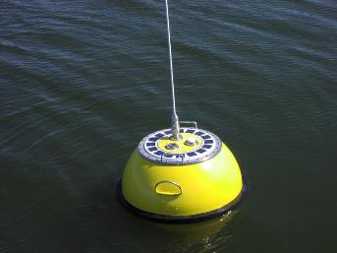
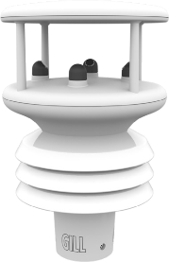
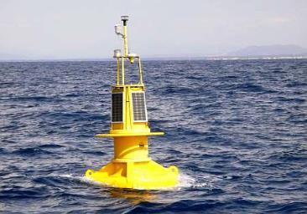
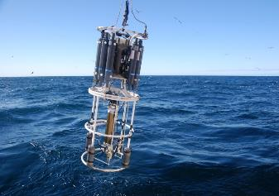
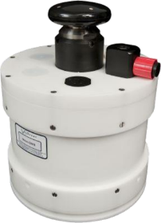
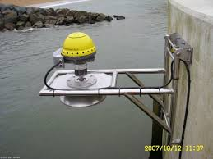
Environmental Sensors

Slide 16
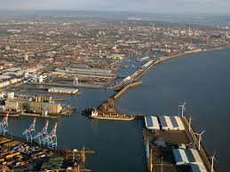
Case Study 1
Real Time Meteorological Data for Peel Ports – Liverpool

Slide 17
About the Project (1)
Peel had sensors in place but unreliable display mechanism
Smart telemetry installed feeding data to Port-Log in the cloud.
Customer now has access to live data:
For VTS purposes
Downloadable data for hydrographic survey tidal corrections
Historic data for long-term harmonic analysis (for more accurate tidal predictions)

Slide 18
About the Project (2)
Sensors are the major cost associated with a new system
Not having to replace them significantly reduced the cost of fixing their system
No requirement to install, connect and set-up a server
Subscription model reduced the cost of the project significantly

Slide 19
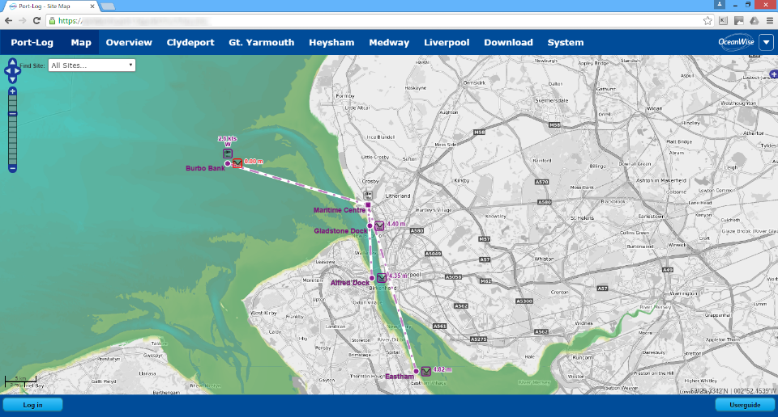
The Project Area

Slide 20
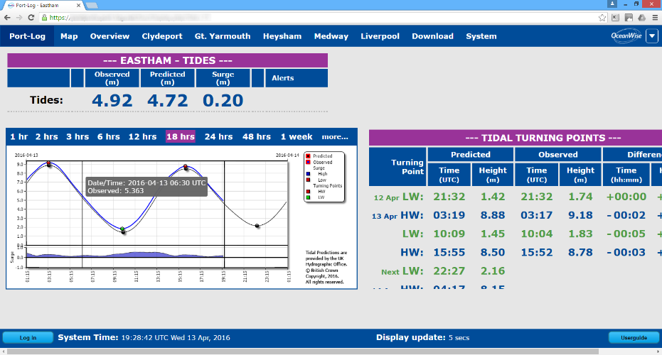
Port-Log Tides

Slide 21
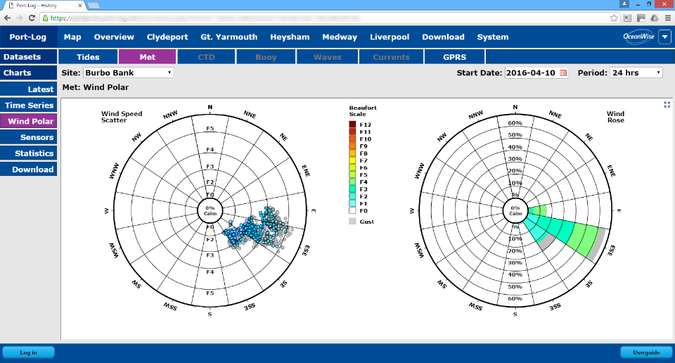
Port-Log Meteorology

Slide 22
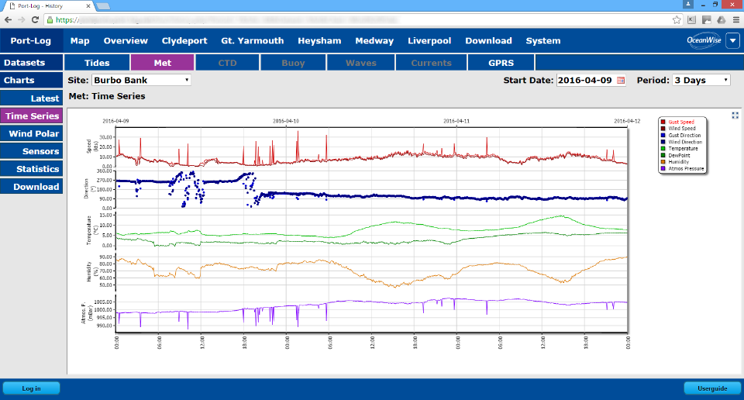
Port-Log Meteorology (historical)

Slide 23
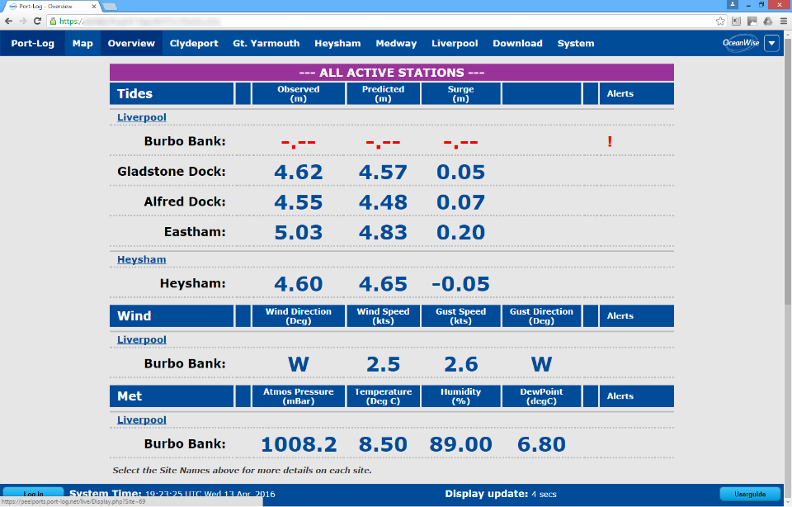
Port Log - Overview

Slide 24
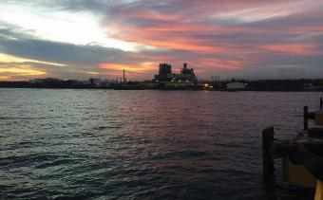
Case Study 2
Itabo Coal Terminal
Dominican Republic

Slide 25
About Itabo
Itabo Coal Terminal and Power Station provides electrical power to the Dominican Republic.
Region susceptible to hurricanes so monitoring winds, waves and water level at the terminal is critical to the movement and berthing of vessels unloading coal.
When wave height or wind speed exceeds set levels vessels are unable to berth.
Local engineering company, Geomedicion, Instrumentos y Sistemas, S.R.L. (G.I.S.), requested by AES (the terminal and power station operator) to source a solution comprising sensors, data telemetry, management and display.

Slide 26
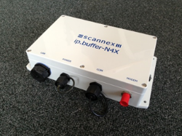
Methodology (1)
System design incorporated “best in class” sensors - Met Station (Gill Instruments) and Water Level Radar and seabed mounted Directional Wave Recorder (Valeport).
Data collected and transmitted via GPRS using OceanWise Smart Telemetry modem - which stores data in case of interrupted transmission transmits when reconnected.
Bi-directional communication allows status of sensors, battery levels and solar panel power output to be monitored.
Data transmitted to Port-Log.net. cloud based
data management and display system.

Slide 27
Methodology (2)
Cloud based subscription service provides economical and fast data access to many end users, including those on the vessels using the port via the web based display.
Port-Log.net provides loading and storage of the data in an installation of Ocean Database and delivers a variety of displays for all the required data.
Data can be viewed in real time or historically at any location with access to the Internet including :
the Coal Terminal Control Room
AES personnel’s smart phones or tablets.
Data held securely and, in this case, only accessible to authorised users by entering a username and password.

Slide 28
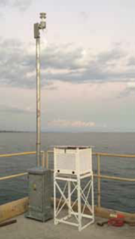
Benefits to AES
Combines data from best in class sensors into a single system
Cost effective, quick and easy secure cloud based data storage and publishing
Calibration, configuration and monitoring of equipment via web interface
Real-time data available for fast response to changing conditions

Slide 29
Port-Log Waves

Slide 30
Port-Log Meteorology

Slide 31
Summary
Port-Log.net answers problems encountered by ports and harbours that have a mixture of environmental sensors in their areas of operations by:
Providing instrument independent telemetry services
Networking instruments monitoring very different parameters.
Providing to cost effective cost effective on-line service.
Reducing dependence on specific telemetry provision from different instrument providers sources.

Slide 32
where your data matters Thank you www.demo.port-log.net www.oceanwise.eu

