Slide 1
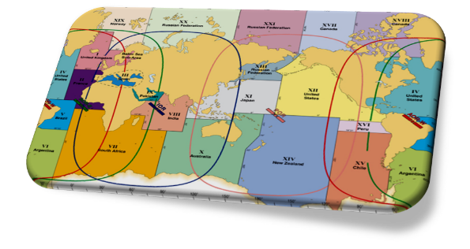
IMO/IHO World-Wide Navigational Warning Service
NAVAREA IV / XII
30 November 2017

Slide 2
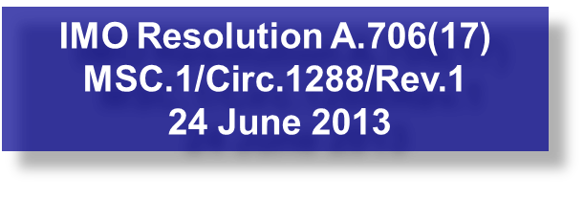
IMO/IHO World-Wide Navigational Warning Service (WWNWS)
International coordinated global service for promulgation of hazards to navigation by satellite affecting the safety of life at sea
Twenty One Navigation Areas (NAVAREAs), each with a Coordinator (Eighteen) responsible for the harmonization of navigational information in their area.

Slide 3
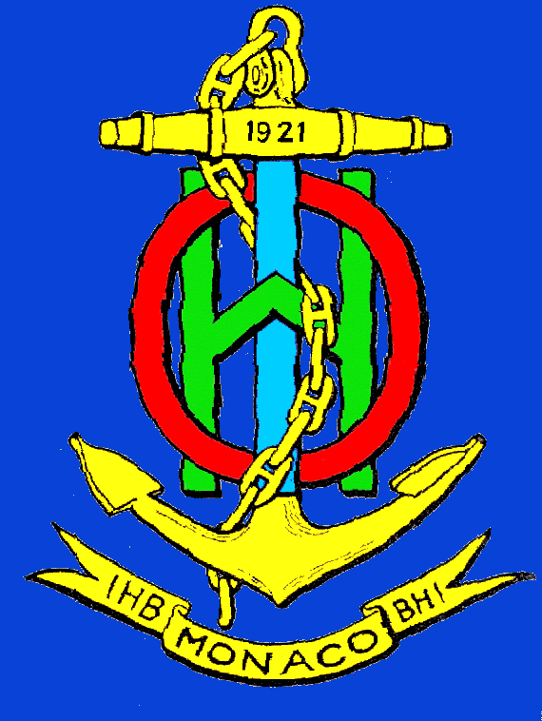
WWNWS-SC
Established 1973
Monitors and guides the WWNWS
Provides guidance to IHO Member States to further evolution of WWNWS
International cooperation with IMO, WMO, IMSO, IALA
Chairman represents IHO for relevant IMO Committees.
Capacity Building Assistance
Rep Regional Hydrographic Commission Conferences
MSI Training
Commission Membership – 40 plus IHO Member States plus IMO, WMO, IMSO and Inmarsat

Slide 4
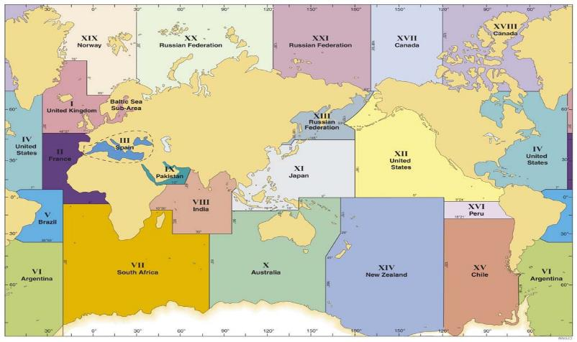
World-Wide Navigational Warning Service NAVAREAs

Slide 5
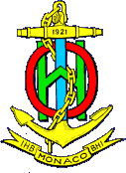
Definitions
NAVAREA: A geographical sea area established for the purpose of coordinating the broadcast of navigational warnings
NAVAREA COORDINATOR: The authority charged with coordinating, collating and issuing navigational warnings for a designated NAVAREA
NATIONAL COORDINATOR: The national authority charged with collating and issuing coastal warnings
within a

Slide 6
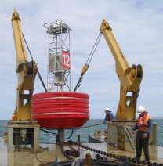
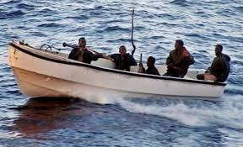
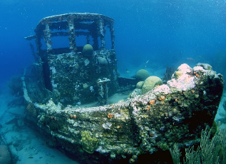
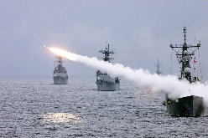
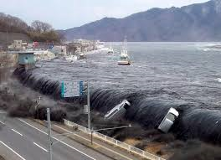
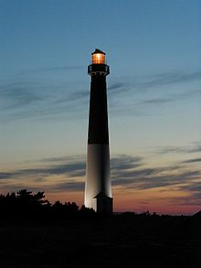
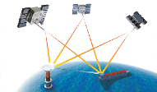
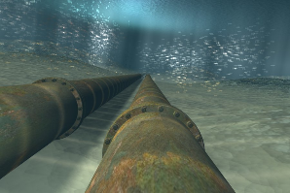
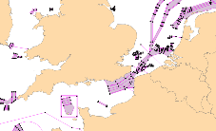
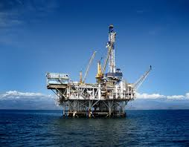
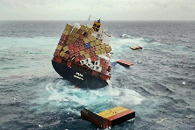
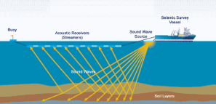
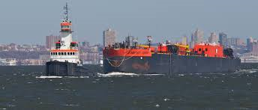
Navigational Warnings

Slide 7
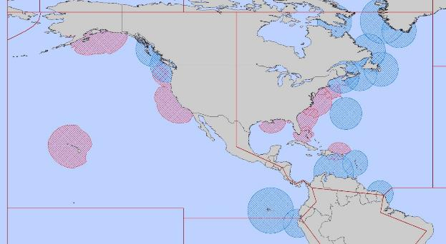
NAVAREA IV/XII Coordinator
Endeavour to be informed of all events that could significantly affect the safety of
navigation within the NAVAREA
IV
XII
IMO Resolution A.706(17) MSC.1/Circ.1288/Rev.1 24 June 2013

Slide 8
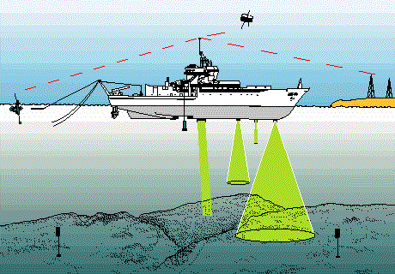
NAVAREA IV/XII Coordinator (cont.)
Assess all information immediately upon receipt in the light of expert knowledge for
relevance to navigation in the NAVAREA;
Select information for broadcast

Slide 9
National Coordinator
Endeavour to be informed of all events that could significantly affect the safety of
navigation within your national waters
IV
XII
IMO Resolution A.706(17) MSC.1/Circ.1288/Rev.1 24 June 2013

Slide 10
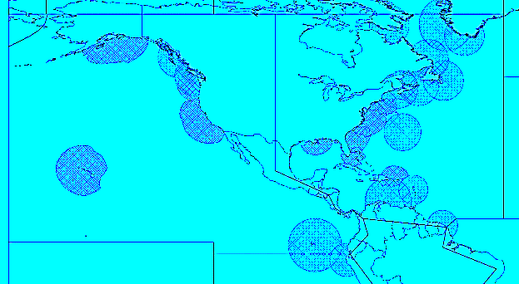
National Coordinators in the MACHC
Anguilla(UK) | Guyana
Antigua and Barbuda | Haiti
Aruba (Kingdom of the Netherlands) | Honduras
Bahamas | Jamaica
Barbados | Martinique (France)
Belize | Mexico
Bermuda | Montserrat (UK)
British Virgin Islands (UK) | Nicaragua
Caribbean Netherlands (Kingdom of the Netherlands) | Panama
Cayman Islands (UK) | Puerto Rico (US)
Colombia | Saint Barthélemy (France)
Costa Rica Cuba | Saint Kitts and Nevis
Curaçao (Kingdom of the Netherlands) | Saint Lucia
Dominica | Saint Martin (France)
Dominican Republic | Saint Vincent and the Grenadines
Ecuador | Saint Maarten (Kingdom of the Netherlands)
El Salvador | Suriname
French Guiana | Trinidad and Tobago
Grenada | Turks and Caicos Islands (UK)
Guadeloupe (France) | United States Virgin Islands (US)
Guatemala | Venezuela
IV
XII

Slide 11
IHO Capacity Building
The first phase of capacity building is the collection and circulation of nautical information
Allows for real time integration of your national maritime safety information to be part of the World-Wide Navigational Warning Service (WWNWS)
Understand your roles and responsibilities
Establish links with NAVAREA Coordinator

Slide 12
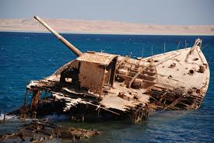
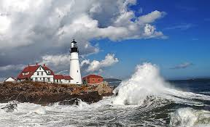
Maritime Safety Information Training
3 day comprehensive training course held with region
Led by WWNWS-SC
Sponsored by IHO CBC
Endeavour to be informed of all events that could significantly affect the safety of navigation within your coastal region.

Slide 13
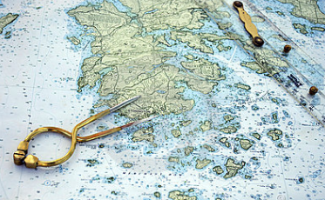
Maritime Safety Information Capacity Building Course Outcomes
Assess all information in the light of expert knowledge for relevance to navigation in the coastal region.
IV
XII

Slide 14
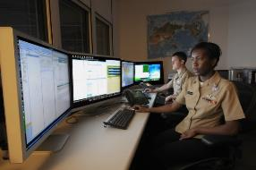
Maritime Safety Information Capacity Building Course Outcomes
Draft navigational warnings in accordance with the
Joint IMO/IHO/WMO Manual on Maritime Safety Information
Pass NAVAREA warnings for further promulgation to the NAVAREA Co-ordinator

Slide 15
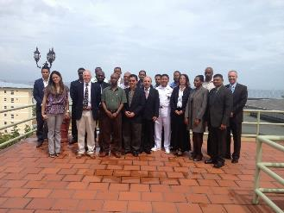
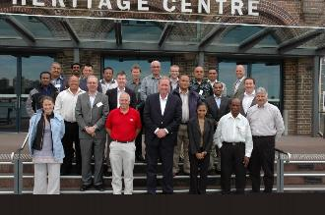
IHO MSI Training Courses (19)
2007 Jamaica (MACHC)
2007 Mozambique (SAIHC)
2008 Spain (MBSHC)
2009 Ghana (EAtHC)
2009 Oman (NIOHC / RSAHC)
2010 Namibia (SAIHC)
2010 Australia (SWPHC)
2011 Brazil (SWAtHC, SEPHC & MACHC)
2013 Trinidad (MACHC)
2013 South Africa (SAIHC)
2014 Oman (NIOHC / RSAHC)
2014 New Zealand (SWPHC)
2014 Ivory Coast (EAtHC)
2015 Japan (EAHC)
2015 Turkey (MBSHC)
2016 Saint Lucia (MACHC)
2016 New Zealand (SWPHC)
2017 Barbados (MACHC)
2017 South Africa (SAIHC)
* Red indicates MACHC Training

Slide 16
MSI Training Course Data

Slide 17
MSI Training Course MACHC Data
85 students trained from 31 countries
Countries in Blue have provided MSI for 2017
Anguilla
Antigua and Barbuda
Barbados
Belize
Bermuda
British Virgin Islands
Cayman Islands
Colombia
Costa Rica Cuba
Curacao
Dominica
Dominican Republic
Ecuador
El Salvador Grenada
Guatemala
Guyana
Haiti
Honduras
Jamaica Martinique Mexico
Montserrat
Nicaragua
Panama
Saint Kitts
Saint Lucia
Saint Vincent and the Grenadines
Suriname
Trinidad & Tobago
Turks and Caicos French Guiana Venezuela

Slide 18
Country Information Country specific MSI reporting in the following slides are from December 2016 to October 2017

Slide 19
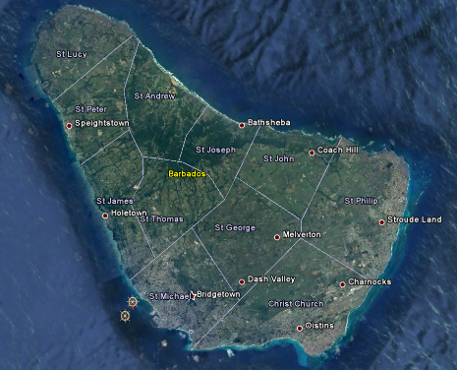
Barbados
Sent 2 MSI reports to navsafety@nga.mil
Promulgated 2 NAVAREA warnings
1 warning currently in force

Slide 20
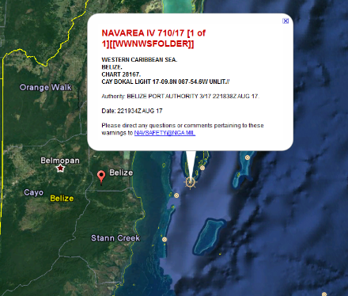
Belize
Sent 4 MSI reports to navsafety@nga.mil
Promulgated 2 NAVAREA warnings
1 warning currently in force

Slide 21
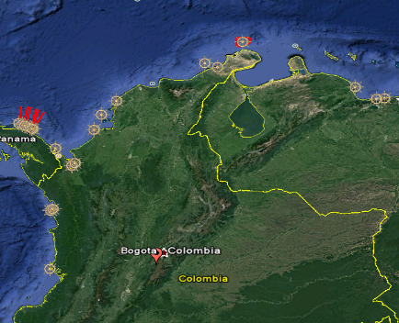
Colombia
Sent 249 MSI reports to navsafety@nga.mil
Promulgated 48 NAVAREA warnings
11 warnings currently in force

Slide 22
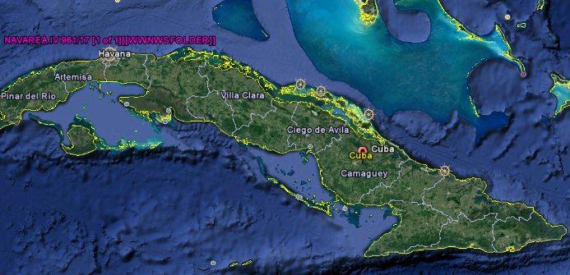
Cuba
Sent 10 MSI reports to navsafety@nga.mil
Promulgated 10 NAVAREA warnings
3 warnings currently in force

Slide 23
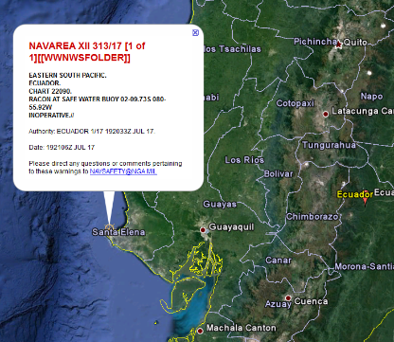
Ecuador
Sent 2 MSI reports to navsafety@nga.mil
Promulgated 1 NAVAREA warning
1 warning currently in force

Slide 24
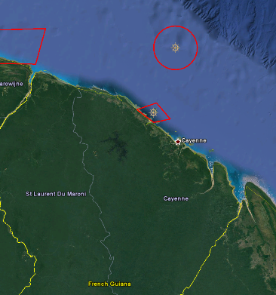
French Guiana
Sent 18 MSI reports to navsafety@nga.mil
Promulgated 17 NAVAREA warnings
1 warning currently in force

Slide 25
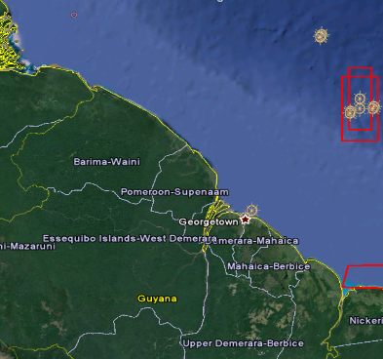
Guyana
Sent 17 MSI reports to navsafety@nga.mil
Promulgated 6 NAVAREA warnings
2 warnings currently in force

Slide 26
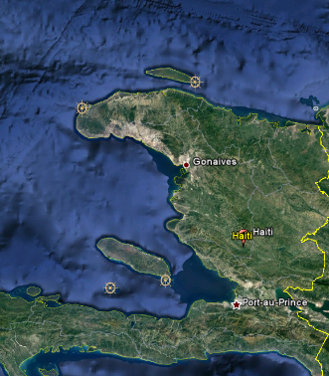
Haiti
Sent 4 MSI reports to navsafety@nga.mil
Promulgated 4 NAVAREA warnings
4 warnings currently in force

Slide 27
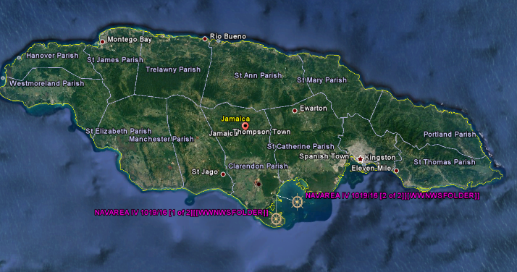
Jamaica
Sent 3 MSI reports to navsafety@nga.mil
Promulgated 1 NAVAREA warning
1 warning currently in force

Slide 28
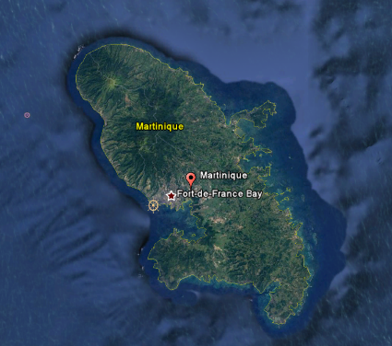
Martinique
Sent 34 MSI reports to navsafety@nga.mil
Promulgated 18 NAVAREA warnings
3 warnings currently in force

Slide 29
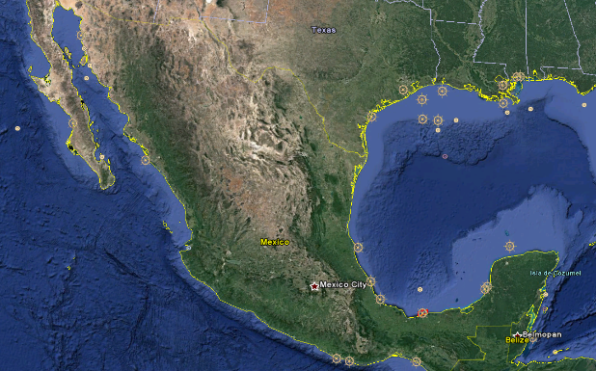
Mexico
Sent 172 MSI reports to navsafety@nga.mil
Promulgated 91 NAVAREA warnings
11 warnings currently in force

Slide 30
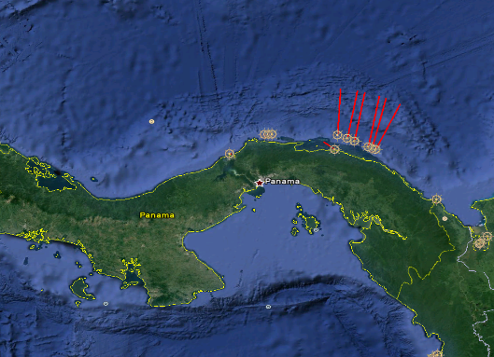
Panama
Sent 35 MSI reports to navsafety@nga.mil
Promulgated 35 NAVAREA warnings
3 warnings currently in force

Slide 31
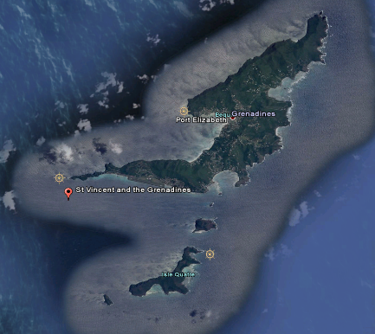
Saint Vincent and the Grenadines
Sent 1 MSI reports to navsafety@nga.mil
Promulgated 1 NAVAREA warning
1 warning currently in force

Slide 32
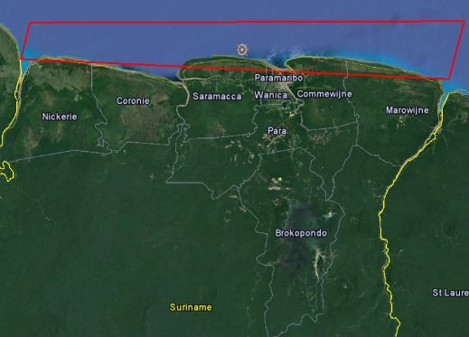
Suriname
Sent 12 MSI reports to navsafety@nga.mil
Promulgated 10 NAVAREA warnings
2 warnings currently in force

Slide 33
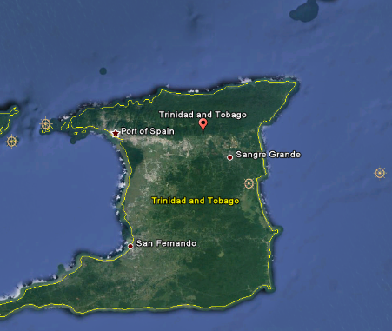
Trinidad and Tobago
Sent 73 MSI reports to navsafety@nga.mil
Promulgated 29 NAVAREA warnings
6 warnings currently in force

Slide 34
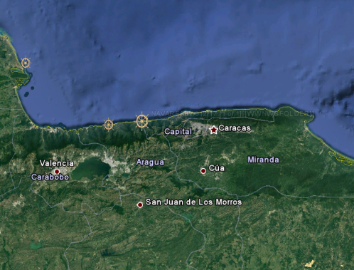
Venezuela
Sent 38 MSI reports to navsafety@nga.mil
Promulgated 13 NAVAREA warnings
7 warnings currently in force

Slide 35
National Coordinators in NAVAREA IV and XII
Send MSI to NAVAREA IV/XII and we will disseminate a navigational warning for your waters….
AT NO COST TO YOU !!
Mariners will be able download your warning as a text file or as a Google Earth KMZ from the Maritime Safety Information website!
http://msi.nga.mil/NGAPortal/MSI.portal
Select the Broadcast Warnings link
navsafety@nga.mil

Slide 36
NAVAREA IV/XII Thank you for your support!!
IV
XII

