Slide 1

Dominican Republic
NationalReport
Meeting of the MACHC 18th
Varadero, Cuba 2017
Manuel Bolívar Arias Campusano
Captain, ARD., (DEMN)
In Representation of the Hydrographic Service of the Navy of Dominican Republic (SHARD)
dir.hidrografico@academianaval.edu.do
marca63@Gmail.com

Slide 2
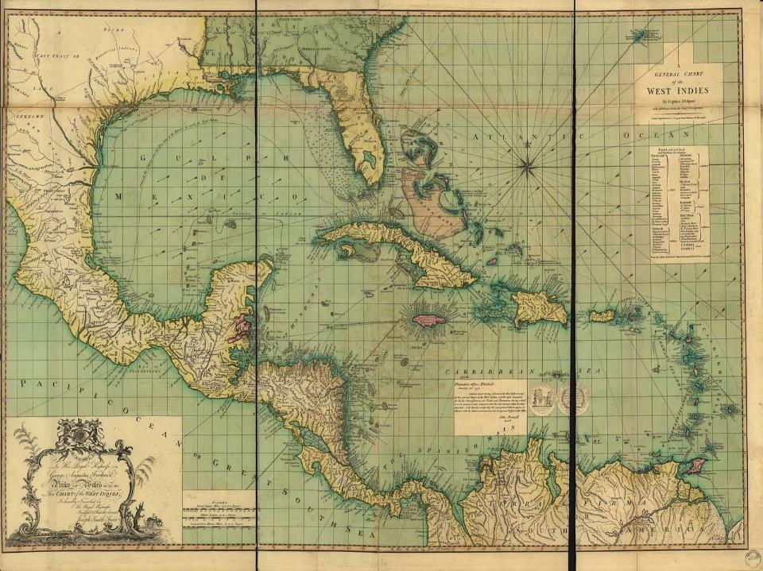

Slide 3
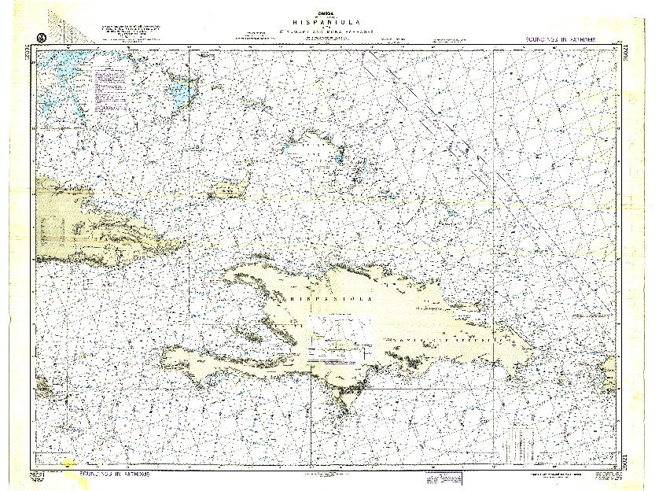
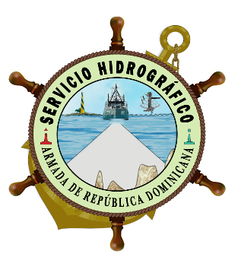
DOMINICAN REPUBLIC NATIONAL REPORT
CONTENT
I.- INTRODUCTION
SHARD
II.- ACTIVITIES PERFORMED
A- TRAINING PROCESS
B- NATIONAL AND INTERNATIONAL RELATIONSHIPS
C- TECHNICAL PROCESS
D- OTHER ACTIVITIES
III.- CONCLUSION

Slide 4
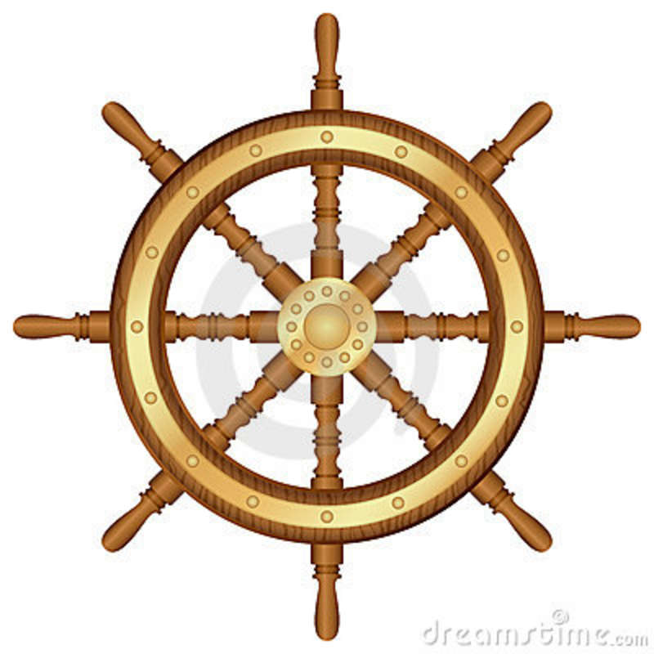
INTRODUCTION
The SHARD reactivated four (04) more headlights, reducing the deficiency that we have been facing for years, making our waters safer, we continued with the training process of our personnel, in another order, at the beginning of the year, the Dominican Navy approved, the signing of the cooperation agreement between the (UKHO) and the (SHARD) for the Electronic Nautical Charters (ENC) of our country, as well as the payment of the debt that the country had been carrying since 1982 with the IHO.
"In Navigable Sea, Sustainable Development".

Slide 5
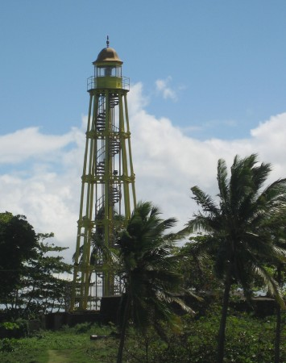
A.- ACTIVATION OF LIGHTS
ACTIVITIES PERFORMED
In this year (04) lights were activated, thus reducing the deficiency we had, they are:
Punta Laguna Light (Isla Saona).
Cabo Engaño Light (Prov. Altagracia).
Punta Balandra Light (Prov. Samaná).
Luperón Light (Luperón Bay).

Slide 6
B.- TRAINING PROCESS
"Course of Hydrography and Nautical Cartography", in Veracruz, Mexico, year 2017-2018, through the FOCAHIMECA Project.
"Course on Marine Fund Research Techniques", at the Iberoamerican University (UNIBE) in Santo Domingo, Dominican Republic, from November 8 to 18, 2017.
"Basic Course on Hydrography", at the Naval Institute of Higher Studies, Sto. Dgo., Dominican Republic, from November 13 to 24, 2017.

Slide 7

B.- NATIONAL AND INTERNATIONAL RELATIONSHIPS
At the national level, SHARD is still in process with cooperation and collaboration agreements with national public entities.
At the international level, At the beginning of the year, the Dominican Navy approved the signing of the Cooperation Agreement between SHARD and the (UKHO), on the preparation of the Electronic Nautical Charts (ENC) of our country.

Slide 8
C.- TECHNICAL PROCESS
It is in the process of adapting the SHARD with the necessary equipment and the evaluation to enable one of our vessels in oceanography.
D.- OTHER ACTIVITIES
The Dominican Navy assumed the payment of the debt with the IHO, which had been in the country since 1982, starting in July and ending in December, in order to place ourselves as ACTIVE MEMBER.

Slide 9
CONCLUSION
We take specific steps for the benefit of the nation, due to the enormous lethargy that the country has been in hydrographic matters for many years, in that order, we are applying an impulsive educational reengineering for SHARD, as well as reinserting ourselves as an Active Member to the IHO, This is very important for our organization, and continue to advance in this great community, which is a spearhead for the development of marine sciences.
“Let's encourage a safer world through HYDROGRAPHY”.

Slide 10
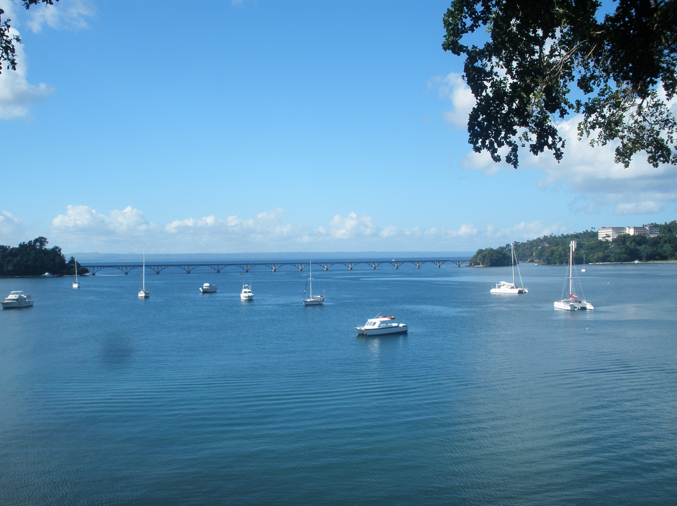


THANKS FOR YOUR ATTENTION
IN NAVIGABLE SEA, SUSTAINABLE DEVELOPMENT

Slide 11


