Slide 1
19th Meeting of the Meso America – Caribbean Sea Hydrographic Commission National Report by
United States of America

Slide 2
U.S. Hydrographic Leadership
NOAA
U.S. National Hydrographer & Director, Office of Coast Survey
Rear Admiral Shep Smith
Deputy Director, Office of Coast Survey
Katie Ries
NGA
Senior GEOINT Authority-Maritime
John Lowell
Director, Maritime Office
Captain Richard Kennedy (replaced Brian Connon, August 2018)
Navy
Commander Naval Meteorological and Oceanography Command (CNMOC) Oceanographer of the Navy, Hydrographer of the Navy, and Navigator of the Navy
Rear Admiral John Okon
Deputy Hydrographer of the Navy
Stanley Harvey
Notes:
Note:
Rear Admiral John Okon has replaced Admiral Tim Gallaudet this past year. Admiral Gallaudet is now the Acting Under Secretary of Commerce for Oceans and Atmosphere within NOAA.

Slide 3
Main Achievements 2018
TRAINING
New NGA & NOAA CAT B Courses in Cartography
4th annual NOAA Chart Adequacy Workshop—>
CHARTING
New ENC coverage in Haiti, continuing in 2019
Beginning chart re-scheming for U.S. national waters, new ENCs already being issued.
ENC First—faster updates, more detail on ENCs
Gradual reduction in paper and raster service
SURVEYING
Colombia
Honduras
Suriname
Puerto Rico
Gulf Coast USA
Notes:
NGA CAT B Course in Cartography
*The pilot session started in June 2017 and consists of 10 students.
*The second session started in January 2018, also with 10 students
NOAA CAT B Course in Cartography
*Eleven students graduated from the first class
*Second class began in August 2018 with 12 students
NOAA Chart Adequacy Workshop
*Three-day long workshop on nautical chart adequacy assessment
New cells area all in Haiti (Eric Li). Supporting graphics in google docs, MACHC folder, National Report.

Slide 4
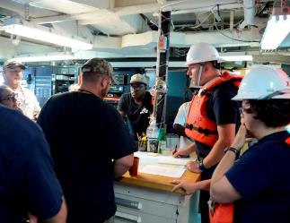
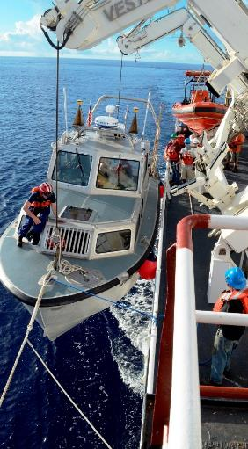
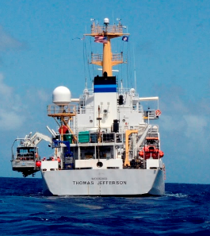
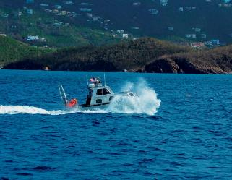
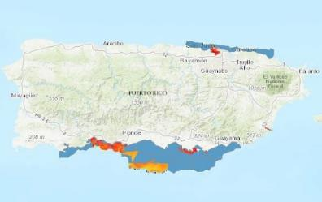
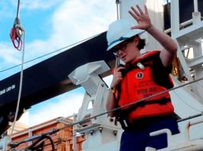
Hurricane Maria Response: Sept 2017 and Aug-Nov 2018
Notes:
Most hydrographic acquisition was conducted by survey launches 2903 and 2904.
For 20 days the ship sustained the crew and support staff and provided facilities for planning and processing data independent from local infrastructure.
2017 storm response summary from https://www.nauticalcharts.noaa.gov/updates/?p=171448
Excerpt: Following the storm, Thomas Jefferson deployed in September 2017 for hydrographic hurricane response work in Puerto Rico and the U.S. Virgin Islands (PR/USVI). The ship and crew surveyed 18 individual port facilities to ensure safety of navigation and help re-open the region for maritime commerce.
Planned project dates: 8/13/18 - 11/5/18
Planned days at sea: 83
Area: 250 Square Nautical Miles
Link to the 2018 story book summary: https://noaa.maps.arcgis.com/apps/MapJournal/index.html?appid=549d6452fd594615affbddc0f540388a
The economy for the 3.3 million Americans in the territory of Puerto Rico is largely ocean dependent. Approximately 7% of the jobs in Puerto Rico are directly involved in ocean related services accounting for over $920 million in wages.1 The island also imports 85% of its foodstuffs and virtually all of its energy products.2 Currently, only a small percentage of its coasts and critical harbors have been surveyed with modern, high-resolution sounding or hydrographic LiDAR devices. In 2017 the island was damaged by two major hurricanes; in response, the NOAA ship Thomas Jefferson conducted emergency sidescan and multibeam surveys of seven port facilities to locate storm related obstructions and damage to the channels. A follow up to some of these ports and pilot areas, combined with a survey of the surrounding coastline, is necessary to verify that dangerous obstructions have been removed prior to updating nautical charts.

Slide 5
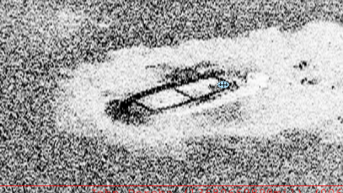
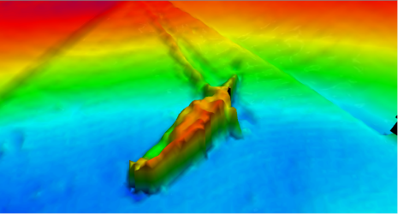
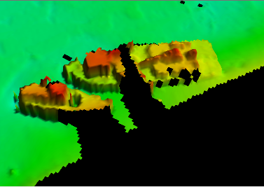
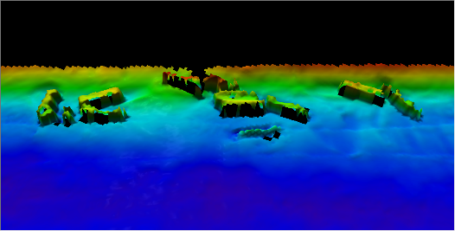
Hurricane Maria Response
Wreck, Charlotte Amalie, St Thomas, USVI
Wrecks, Charlotte Amalie,
St Thomas, USVI
Containers, Limetree Bay, St Croix
Notes:
Some Obstructions found in the multibeam and sidescan sonar data.

Slide 6
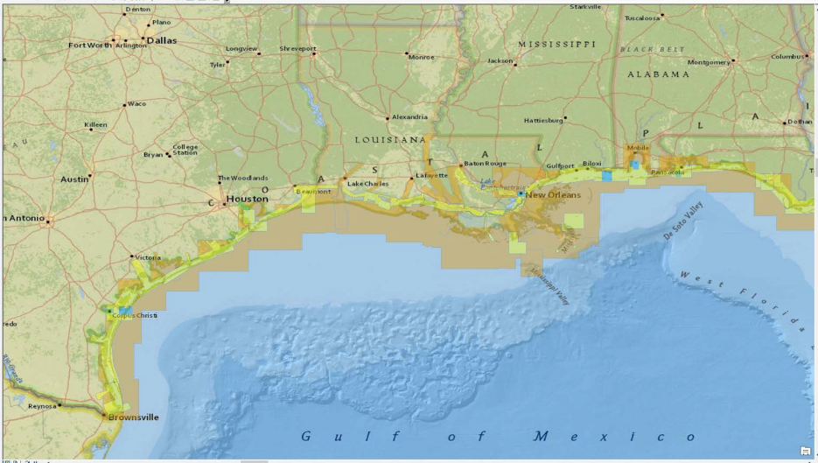
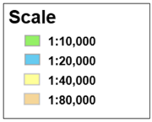
Current Gulf of Mexico (US coast) ENC suite

Slide 7
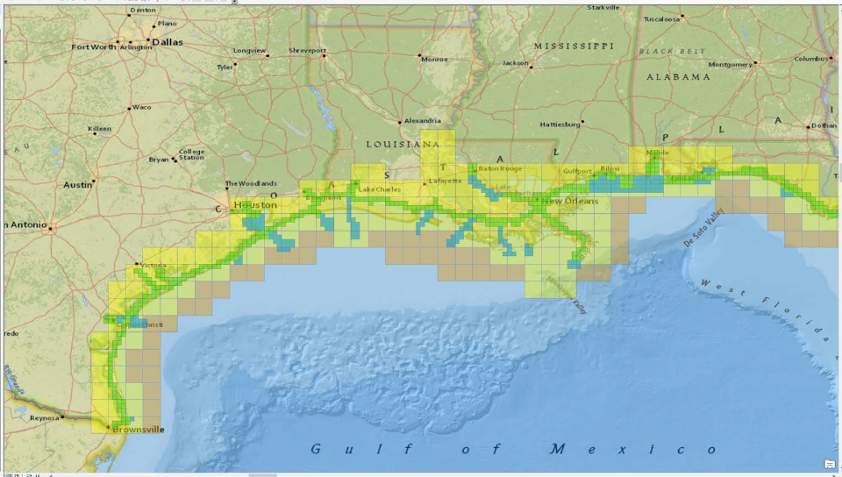
Gulf of Mexico (US Coast) ENC Re-scheme Proposal (draft)

Slide 8
Progress on MSDI
U.S. Open Data Policy
Principles: Discoverable, Accessible, Described, Reusable, Complete, Timely, Managed Post Release (ie, point of contact)
Subject to any partner (international, commercial) restrictions.
Marine Spatial Data Infrastructure - Concept Development Study
Supporting non-traditional users of nautical chart information—ENC Direct to GIS
ENC-derived theme layers are distributed via OGC compliant Web Services
https://nauticalcharts.noaa.gov/data/gis-data-and-services.html
Notes:
The first MSDI-CDS workshops took place in October to gather information and help focus the effort for the future. The knowledge gained from the CDS will be captured in a technical report that will provide the foundation for development of a potential future pilot that will in turn advance the state of Spatial Data Infrastructures (SDIs) that support marine data across the globe.
Theme Layers are developed taking into account suggestions from the IHO MSDIWG on core MSDI data layers. This application and the applicable Theme Layers are being redeveloped in 2018-2019 in order to ensure consistency across products, and increase application stability. For more information
Data is a valuable national resource and a strategic asset to the U.S. Government, its partners, and the public. Managing this data as an asset and making it available, discoverable, and usable – in a word, open – not only strengthens our democracy and promotes efficiency and effectiveness in government, but also has the potential to create economic opportunity and improve citizens’ quality of life.
For example, when the U.S. Government released weather and GPS data to the public, it fueled an industry that today is valued at tens of billions of dollars per year. Now, weather and mapping tools are ubiquitous and help everyday Americans navigate their lives.
The ultimate value of data can often not be predicted. That’s why the U.S. Government released a policy that instructs agencies to manage their data, and information more generally, as an asset from the start and, wherever possible, release it to the public in a way that makes it open, discoverable, and usable.
The White House developed Project Open Data – this collection of code, tools, and case studies – to help agencies adopt the Open Data Policy and unlock the potential of government data. Project Open Data will evolve over time as a community resource to facilitate broader adoption of open data practices in government. Anyone – government employees, contractors, developers, the general public – can view and contribute. Learn more about Project Open Data Governance and dive right in and help to build a better world through the power of open data.
Principles are each briefly described at https://project-open-data.cio.gov/principles/

Slide 9
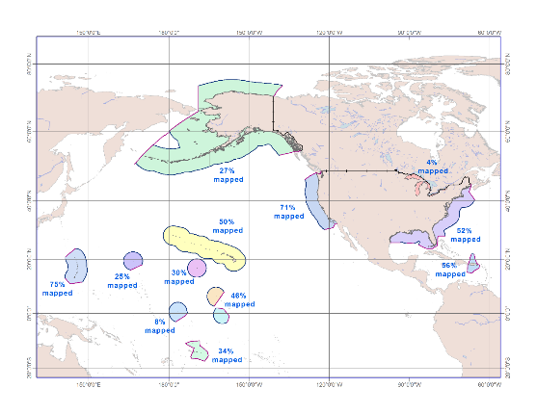
US Waters that have been “mapped”
Total US waters
42% mapped
with at least 1 sounding per 100 m grid cell
Zones | % Mapped | Area mapped (sq nm) with modern surveys (>1960) | Total Area (sq nm)
EEZ | 43% | 1,472,500 | 3,438,000
Coastal Waters* | 32% | 49,400 | 154,000
Total US waters | 42% | 1,521,900 | 3,592,000
* Includes Great Lakes
Notes:
Note this correspondence between Meredith and Andy regarding the GOM specicialy:
From: Meredith Westington - NOAA Federal
Wed, Nov 21, 2:31 PM (5 days ago)
to Andy, me
P.S. The GOM EEZ is 47% mapped. 85,900 sq nm out of 182,800 sq nm is considered "minimally mapped."
On Wed, Nov 21, 2018 at 12:29 PM Meredith Westington - NOAA Federal <meredith.westington@noaa.gov> wrote:
I have the stats split in a way that is awkward to just pull out GOM. I have GOM EEZ and combined Atlantic/GOM coastal waters. When I made the decision to combine both GOM and Atlantic regions for coastal waters stats, it was because there wasn't a clear place to divide in the Florida Keys. Do you want the GOM EEZ stats?
Meredith
On Wed, Nov 21, 2018 at 12:23 PM Andy Armstrong - NOAA Federal <andy.armstrong@noaa.gov> wrote:
Hi Meredith,
Looks good. Did we have "mapped values" for the Gulf of Mexico, specifically? Looks like the value shown here is lumped with Atlantic.
Best,
Andy

Slide 10
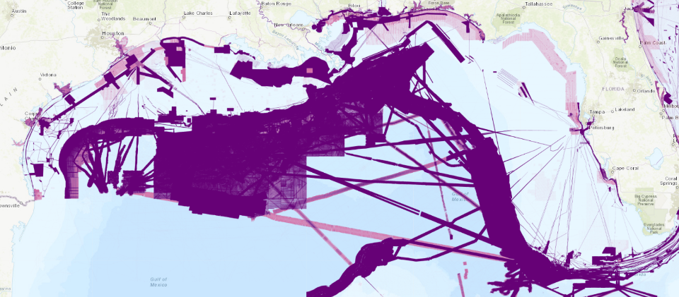
Analysis of U.S. holdings for U.S. Gulf of Mexico waters
Pink: 1-2 soundings per cell
Purple: 3 or more soundings per cell
Notes:
These are points copied from a slide in the back up slides which helped set the context of the SB 2030 criterion
*Use Seabed 2030 100-m resolution goal
*Use all soundings since 1960 archived at NCEI
*Irrespective of source or perceived quality
*Basic criterion: At least 1 sounding in the cell
*Enhanced criterion: 3 or more soundings in the cell
NOTE: (These may not be the variable criteria that Graham Allison introduced regrading number of soundings based on depth- Justi)

Slide 11
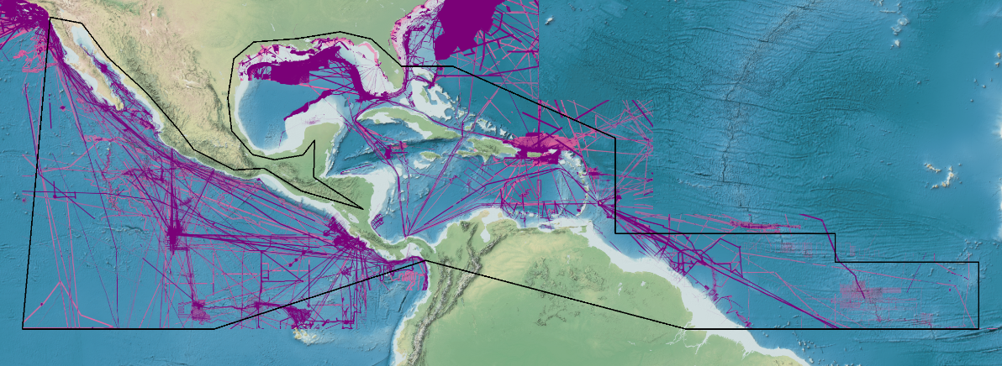
IHO DCDB Holdings for MACHC Region
Pink: 1-2 soundings per cell
Purple: 3 or more soundings per cell
Notes:
*Uses Seabed 2030 100-m resolution goal
*Use all soundings since 1960 archived at NCEI
*Irrespective of source or perceived quality
*Basic criterion: At least 1 sounding in the cell
*Enhanced criterion: 3 or more soundings in the cell
NOTE:--In this case many areas, especially in national waters, appear empty—this is likely because most of the data in Non-US regions is from scientific cruises in deeper water.
NOTE: (These are not be the variable criteria that Graham Allison introduced regrading number of soundings based on depth; All the US analysis for both coastal waters and EEZ uses the 100-m cell resolution standard- Justi)

Slide 12
U.S. Navy Hydrographic Plans in the MACHC region
“CAT A” and “CAT B” S-5 Training
Subject Matter Expert Exchange visits
hydrography, oceanography, and meteorology
Combined hydrographic surveys
TAGS, Airborne Coastal Survey (ACS) LIDAR System, and the Fleet Survey Team
Promoting use of new technologies (i.e. Autonomous Surface Vessel, Ocean Sensors)
Surveys Planned in 2019
Belize, Haiti, Honduras
Point of contact: Eric.Villalobos@navy.mil
Notes:
International Hydrographic Management and Engineering Program (IHMEP) International Hydrographic Organization (IHO)
International Hydrographic Science Applications Program (IHSAP) International Hydrographic Organization (IHO)

Slide 13
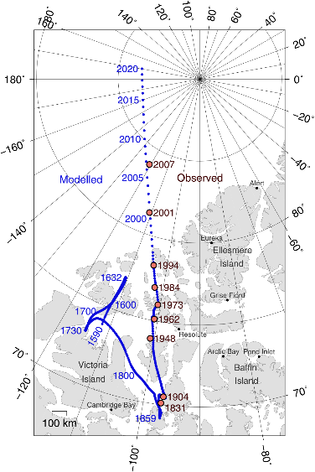
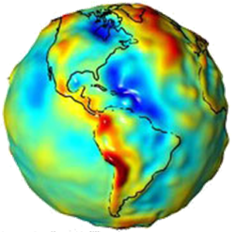
Plans that affect the region
New Earth Gravity Model (EGM)
in 2020, important for MSL and WGS
New World Magnetic Model (WMM)
in 2020 and out-of-cycle update in 2019 for the northern latitudes
Notes:
New World Magnetic Model (WMM) in 2020 which defines the difference between True North and Magnetic North. There is also an out-of-cycle update in 2019 for the northern latitudes.

Slide 14
2019 Training and Exchanges
NOAA CAT B Training for Nautical Cartography
51 week training at NOAA
to be announced in early 2019
5th Chart Adequacy Workshop
scheduled July-August 2019
3 days duration at NOAA
Shachak.Peeri@noaa.gov
US Hydro Conference
Biloxi, Mississippi March 19-21, 2019
Registration now open!
https://thsoa.org/US-Hydro-2019

Slide 15
Hydrography comes to Social Media!
NOAA OCS Blog: www.nauticalcharts.noaa.gov/updates/
Subscribe to the Coast Survey Biweekly newsletter: www.nauticalcharts.noaa.gov (click the newspaper icon in the footer)
Join LinkedIn and connect to IHO: www.linkedin.com/company/international-hydrographic-organization/
Old-fashioned Email—love to hear from you directly
Shep.Smith@noaa.gov
John.E.Lowell@nga.mil
Stanley.B.Harvey@navy.mil

