Slide 1
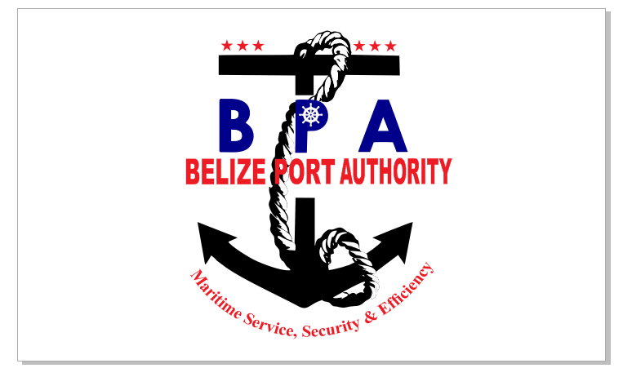
National Report Belize 2018
Meso American and Caribbean Sea 19th
Hydrographic Commission
28th November- 2nd December, 2018
Cartagena, Colombia

Slide 2
MACHC 19 Belize Report
The Belize Port Authority is a statutory body falling under the Ministry of Transportation and National Emergency Management. It is administered by a board comprising of a Chairman ( representing the Minister), two ex-officio members ( Financial Secretary & CEO) and seven other members nominated by the Minister for a period of two years.

Slide 3
Hydrographic Office
Organization: Belize Port Authority
Ports Commissioner: Mrs. Merlene Martinez
Submitted by: Michael Jenkins
Chief Safety and Security Manager
Hydrographic Department(Safety and Security)
mjenkins@portauthority.bz
bzportauth@btl.net

Slide 4
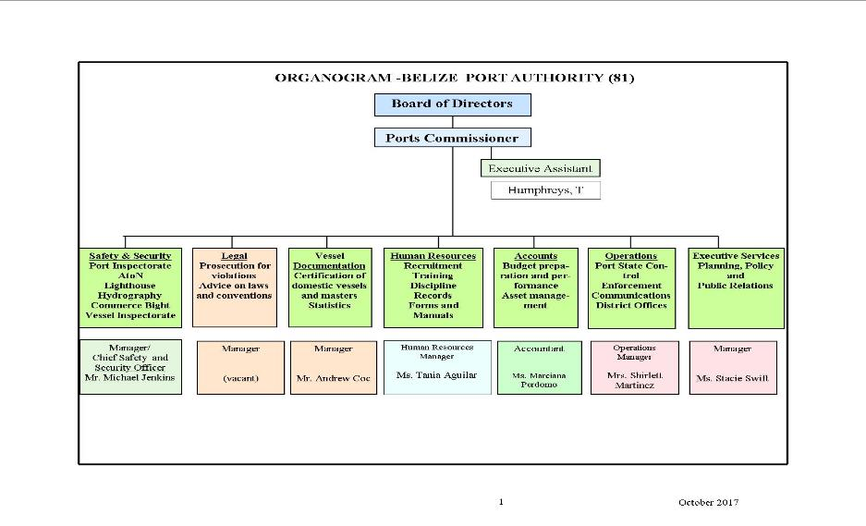
The Belize Port Authority is staffed by 79 employees including the Ports Commissioner

Slide 5
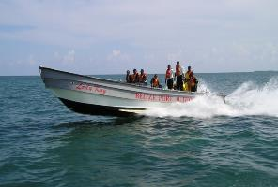
TASKS
Patrol all waters to ensure boating and navigation safety;
Respond to and broadcasting all relevant information relating to search and rescue and evacuation operations;
Disseminate accurate and updated information relevant to the mariners in an efficient manner;

Slide 6

ASSIGNED TASK
Security - ISPS Code
- Company Assets
Inspections & Licensing of local vessels
Licensing for Boat Masters
Conduct casualty & other marine related investigations
Maintenance of Navigational Aids
Hydrographic survey
Port State Control

Slide 7
To carry out the duties of the authority two new vessels has been added into service.
One vessel is presently dry docked and has completed full refurbishment and the installation of twin 200hp outboard engines.
To fulfill the mandate of the Authority and our day to day operations in 2018 total expenditure amounted to $3,568,467.74 Bz.

Slide 8
Since the start of 2018 to present the Belize Port Authority has inspected 6,011 vessels for registration and licensing.
Total imports 648,536 metric tons
Total export 634,302 metric tons
Total cargo through put 1,282,536 metric tons

Slide 9
New Surveys
In 2018 the BPA was please to facilitate surveys through the Commonwealth Marine Economies program. Surveys were concentrated in areas of Belize City Harbor, English Caye Channel entrance, Commerce Bight pier development and the Big Creek Placencia Harbor.

Slide 11
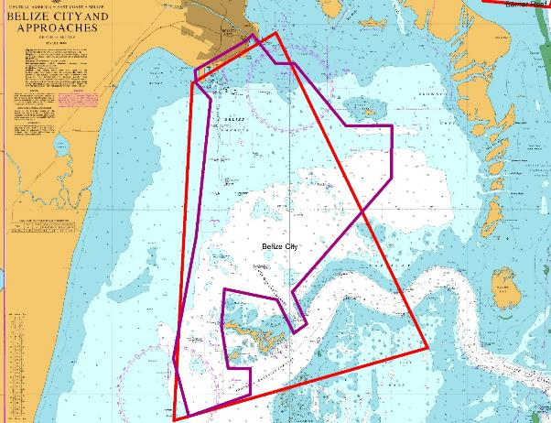
Belize City Harbor

Slide 12
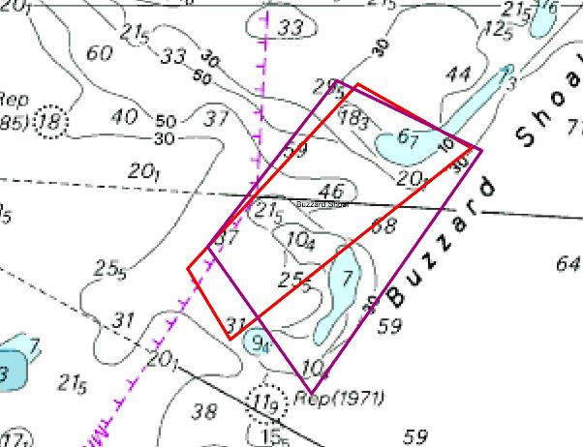
English Caye Channel entrance

Slide 13
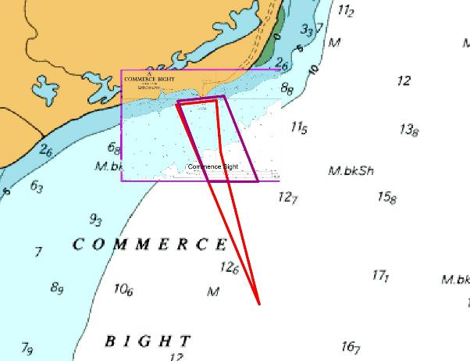
Commerce Bight Port

Slide 14
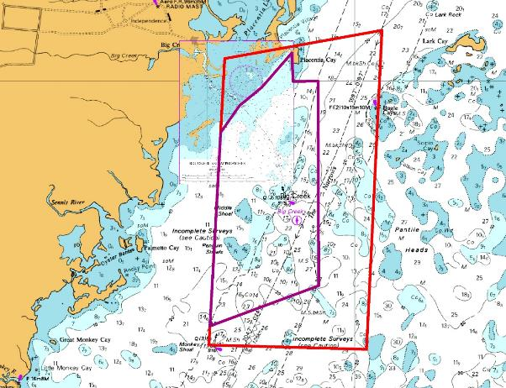
Big Creek/ Harvest Caye Port approaches

Slide 15
New Chart.

Slide 16
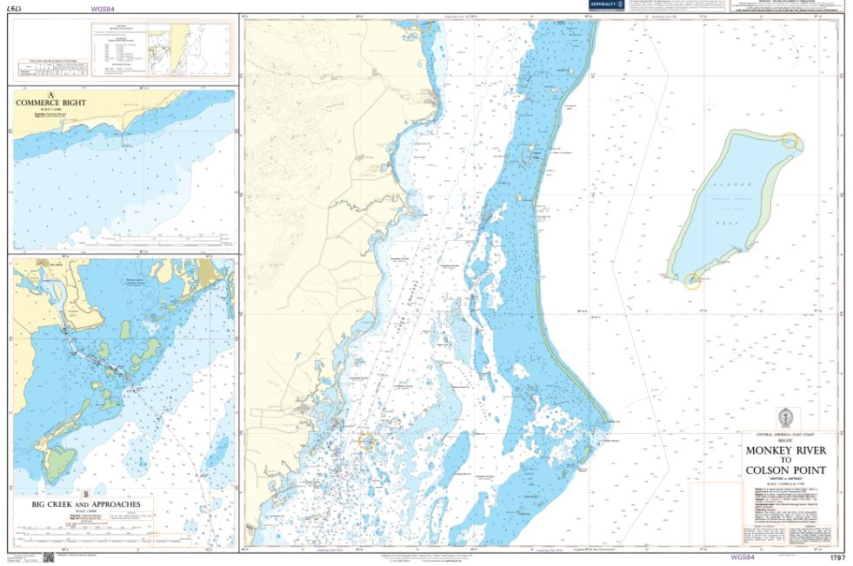

Slide 17
New Charts and Publications
Admiralty paper chart #522 available December 2018.
Admiralty paper chart #1797 will be available January 2019
Band 4 ENC GB400522 edition 6 already in use
The Authority is presently compiling a national list of Aids to Navigation and mooring locations. This will be completed by early 2019.

Slide 18
Future
Through the CME program Belize was able to secure commitments to have surveys be conducted in the Northern part of the country.
Priority areas were identified by both the Belize Port Authority and Coastal Zone Management.

Slide 19
Initial confirmation from UKHO was that financial funding was only available for surveys to be conducted in Block 1 and 2 out of 10 blocks.
Additional finances has been allocated and UKHO has now finalized that all 10 blocks will be surveyed.

Slide 20
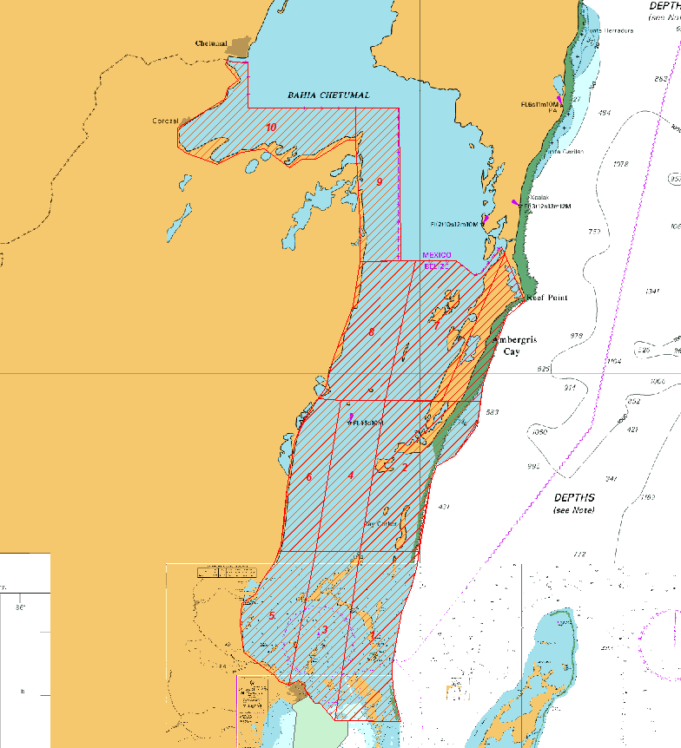

Slide 21
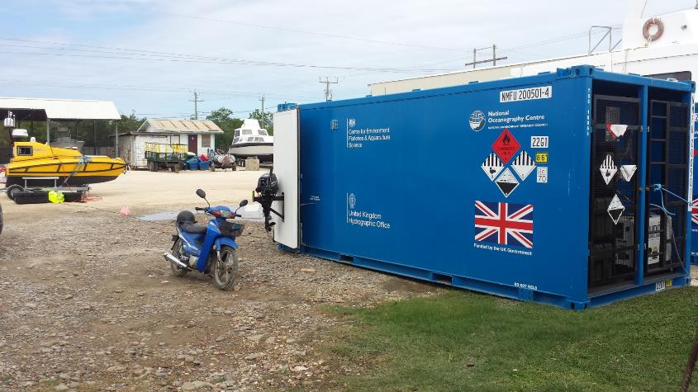
The Belize Port Authority has not invested in new survey equipments but is committed to do its part to fulfill its mandate to carry out hydrographic surveys. The Authority continues to partner with groups such as the National Oceanography Centre from the United Kingdom.

Slide 22
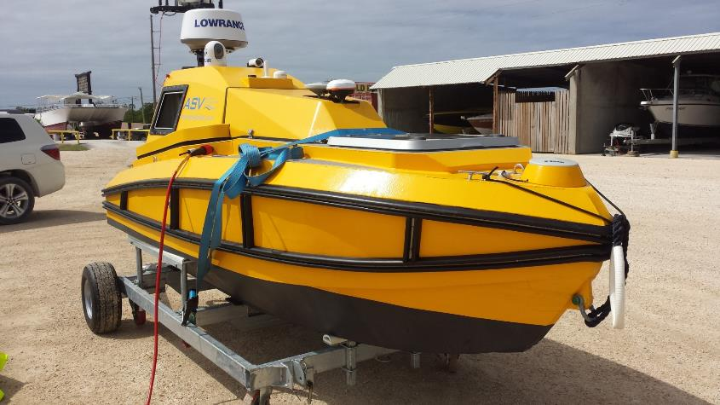
This autonomous boat is a scientific survey vessel with sensor payloads such as multi beam echo sounder, side scan sonar and a range of other sensors such as fluorometer, ph meter etc. The ASV will conduct much needed oceanographic sampling and research.

Slide 24
MACHC 18 a resolution was passed to utilize survey equipments from the Gulf Of Honduras Project as spare parts in other countries.
Navisound Echosounder/N210 ( may be used by commission for spare parts)
Ser#95524
Cable connection broken
Yellowfin Sidescan/ 4618 (may be used by commission for spare parts)
Ser#872-000-150
Needs repairs.
Valeport Tide Gauge/ 740006 ( may be used by commission for spare parts)
Ser#4765
Needs Calibration

Slide 25
Maritime Safety Information
In 2018 there was one reported grounding of a sailing vessel namely “ TROTAMUNDOS”
The said vessel is a USA registered vessel and on Amy 1st , 2018 it ran aground in the area of English Caye.
Investigation revealed that all navigational lights in the area was working and that captain made a navigational error that caused incident.

Slide 26
The Belize Port Authority made two (2) marine notices to NAVSAFETYIV for this year 2018.
On Feb. 2nd #8 and #12 buoy in the turning basin was reported missing. This notice was not released since the aids were considered minor and NAVarea believed that the local port authority had the situation under control.

Slide 27
On October 19th, 2018 the Authority sent out an MSI in regards to North Of English Caye Buoy missing.
At the MACHC 18 it was mandated that all non functioning aids must be reported to NAVAREAIV but it has been noted that minor aids do not need to be reported.

Slide 28
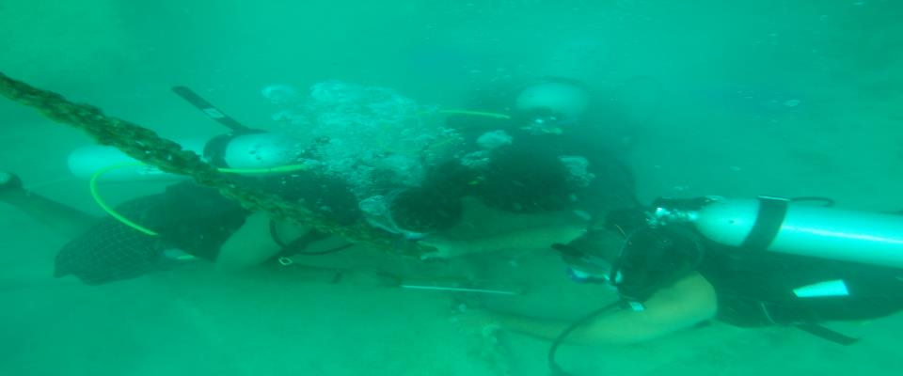
hl
The BPA has a dedicated dive team that conducts all aids to navigation maintenance and marine casualty investigations.

Slide 29
Capacity building
There was no hydrographic training conducted during 2018.
Correspondence was sent to the embassy of Mexico here in Belize in regards to Mexico conducting some surveys which would have been mutually beneficial.
No reply was had but the Port Authority is still hopeful that this effort can still be actualized in 2019 and at the same time some much needed training can be given to the Belize authority by the Mexican survey team.

Slide 30
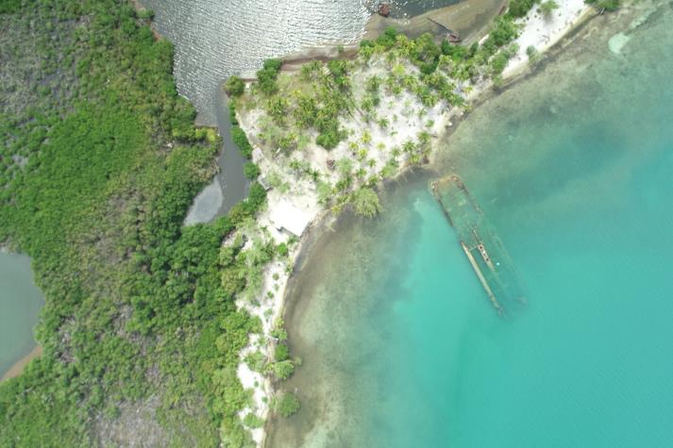
Collaborative efforts has been had with Coastal Zone Management in conducting aerial photography of coastal islands.

Slide 31
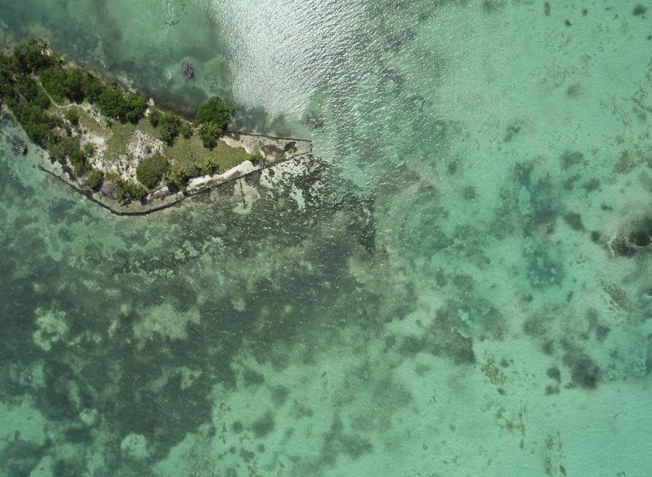

Slide 32
Challenges
GMDSS Area A1 coverage is still a challenge.
Collaborative efforts through signed MOU with the National Coast Guard and other NGO’s allows for effective communication to be had from areas where VHF channel 16 signal is weak.
Acquisition of new survey equipments and upgrade to a multibeam system and the subsequent training needed for proper husbandry and use of equipments.( replacement of those that may be used as spare parts)
They are three (3) major lighthouses that requires immediate structural repairs. The structures historical and navigational importance places the repairs on high priority. Sourcing of material for repairs and funding which was estimated at half million Belize dollars is a challenge. This is high priority for the Authority.

Slide 33
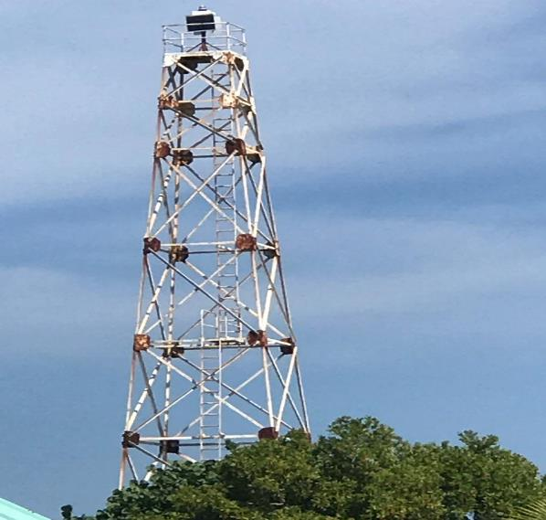
Deterioration of lighthouse structure

Slide 34
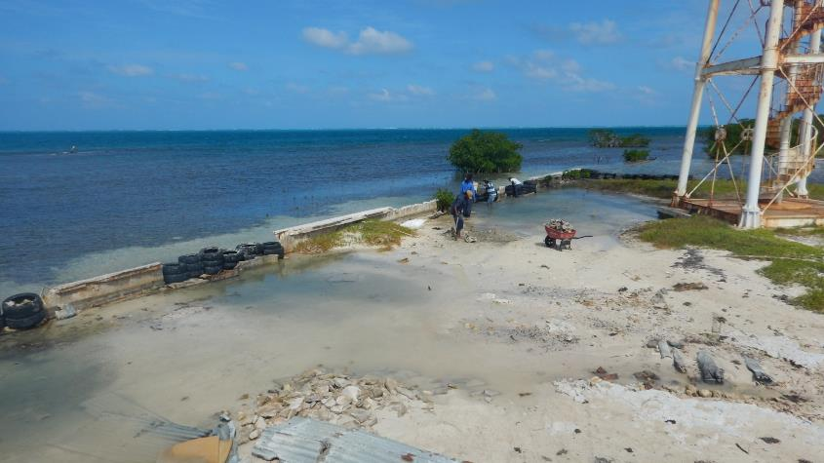
Erosion causing the lighthouse to be compromised

Slide 35
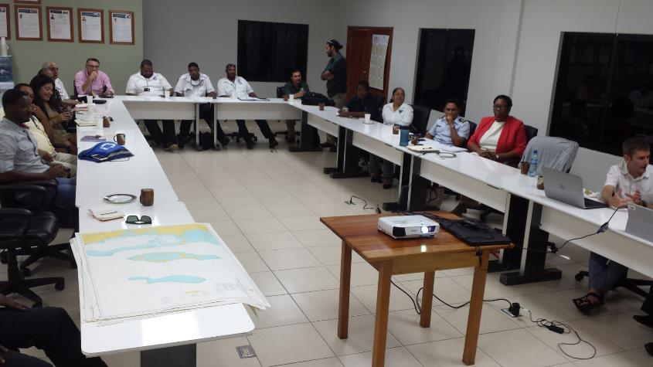
Stakeholders planetary meeting where Government agencies and NGO’s discussed future hydrographic needs and use of data, held on the 21st November, 2018

Slide 36
THE END
Thank You!!

