Slide 2
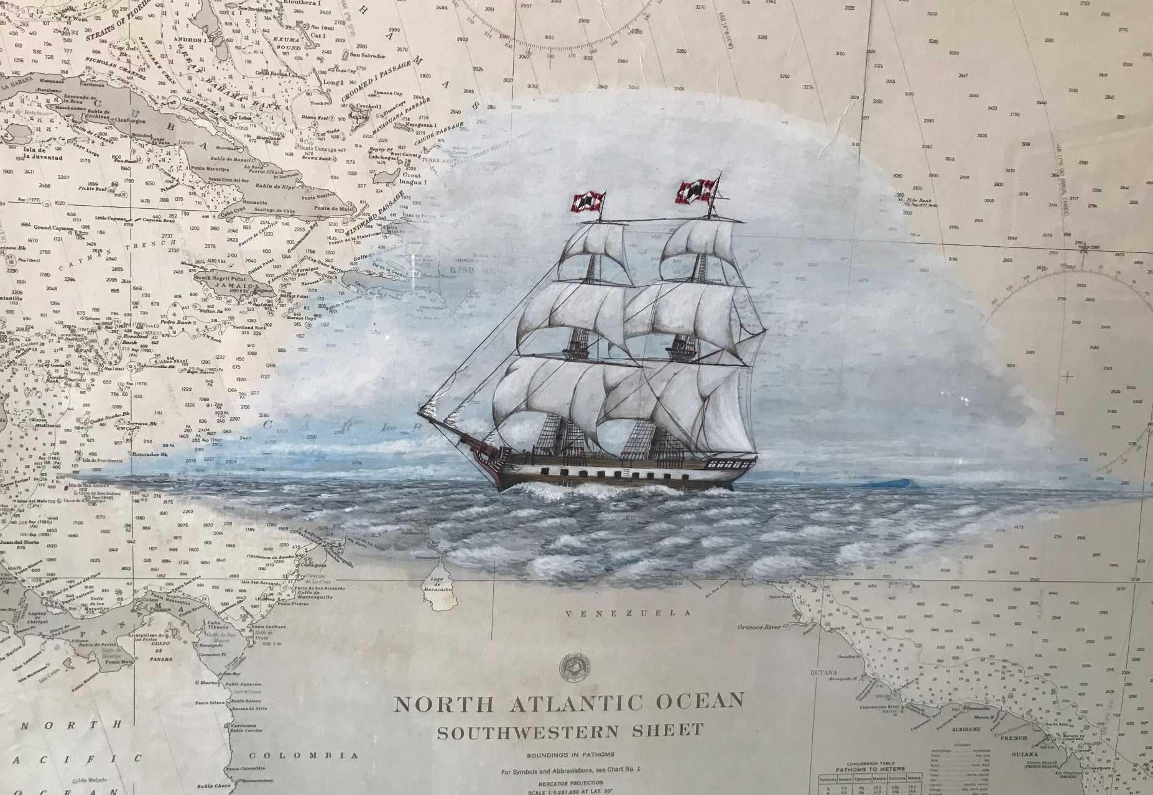
Lecturers: OLGA LUCIA BONFANTE LOZADA PhD (c)
ACADEMIC PROPOSAL OF A METHODOLOGY TO STANDARDIZE THE REGIONAL ENC SCHEMES.
CASE OF STUDY: CARIBBEAN SEA
Director
RAFAEL RICARDO TORRES PARRA
MSc, PhD.
MACHC Meeting, 26th November – 1st December 2018

Slide 3
MAIN GOAL:
To propose an standardization on the ENCs regional schemes which allows to compile efficient and consistent products, aimed at contribute with a safe navigation through the implementation of a case of study (Caribbean Sea).

Slide 4
BACKGROUND
ENCs (ECC) and INT Paper Charts Committee (ICC) | The Committee promotes the availability of the ENC data and INT charts.
MACHC Meeting | Committee | Results and actions
XIII, Guatemala 2012 | ECC - ICC | First approach to a consistent plan to compile and maintain the cartographic scheme in the Caribbean region, monitoring the compilation process. The Integrated Cartography Committee of MACHC - MICC is established.
XIV, San Martin 2013 | MICC | Stakeholders carry on working, planning and improving their ENCs. The folio is increasing its ENC according the needs of the region.
May 2017 (videoconferencia) | MICC | Still remain to solve some overlap issues both in INT paper charts and ENC. 64 of 252 ports still don´t have ENC coverage.
VI, Noruega, 2016 | WENDWG6 | WENDWG6-04.1A2 Overlapping Data: Report on scenarios and test cases on ECDIS (IC-ENC)
VIII, Argentina 2018 | WENDWG | New IHO technical decision: remove the overlaped data in areas with evident risks for navigation. CL 19/2018 Adopted new resolution of IHO.

Slide 5
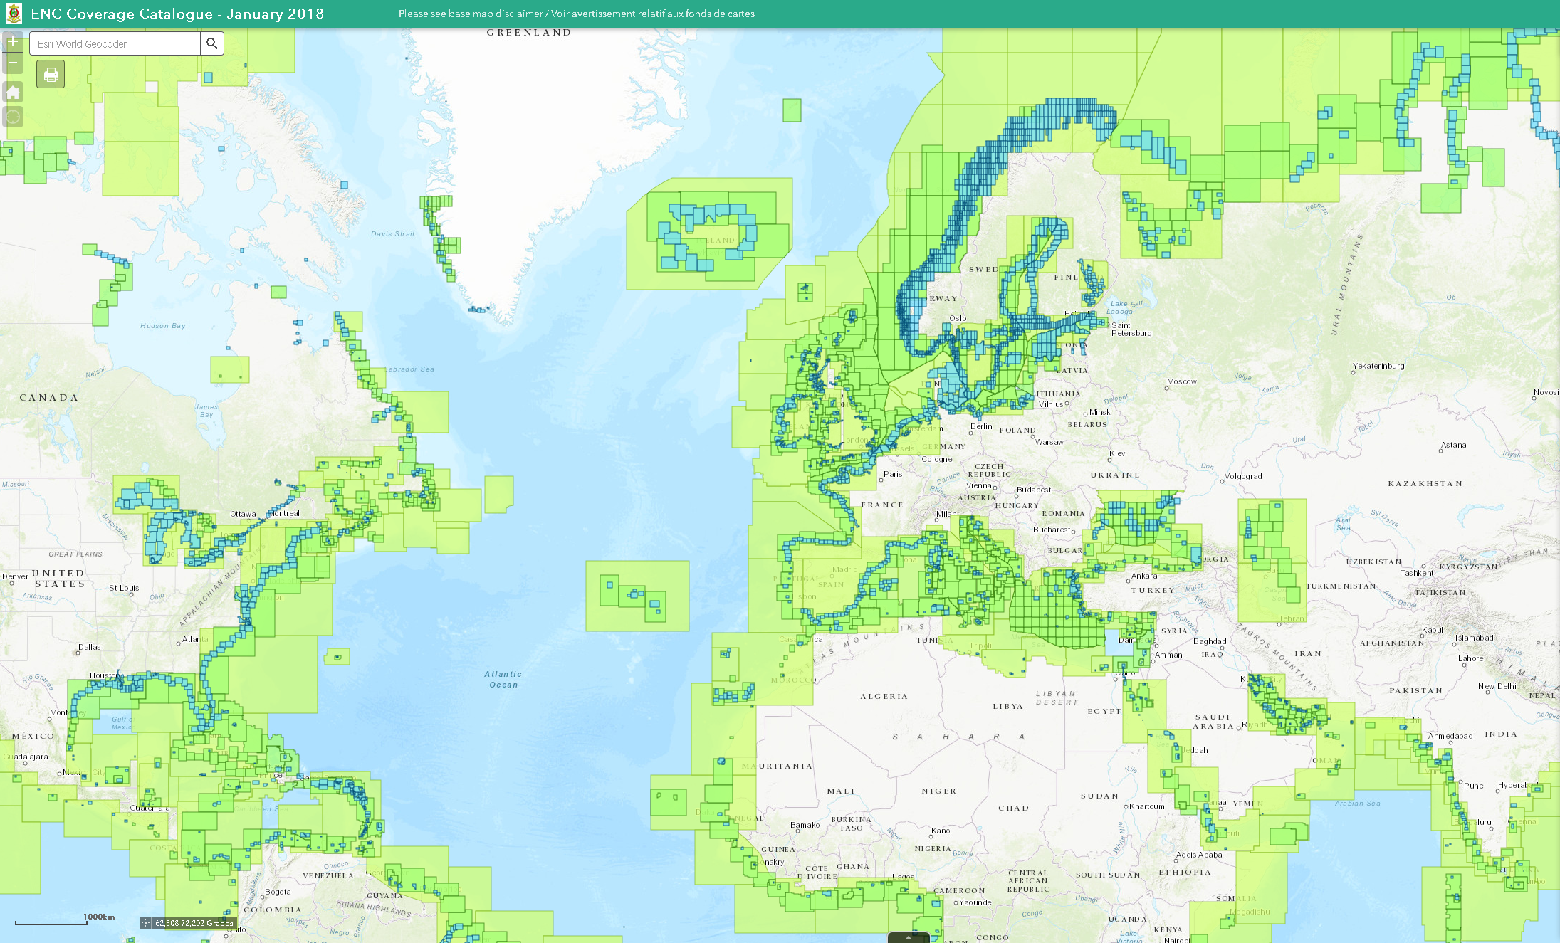
There were not ENCs regional schemes according the standards and there were not approved by all the members states.
the unpredictable behavior of ECDIS, in overlapping areas
Source: https://iho.int/iho_pubs/IHO-bulletin/briefmeetingreports/2016/Marzo_SP_2016.pdf
STATUS
Catalogue online IHO coverage and avalibility of ENCs
Fuente: http://iho.maps.arcgis.com/apps/webappviewer/index.html?id=459311d1c7144a2696f44773b922d058

Slide 6
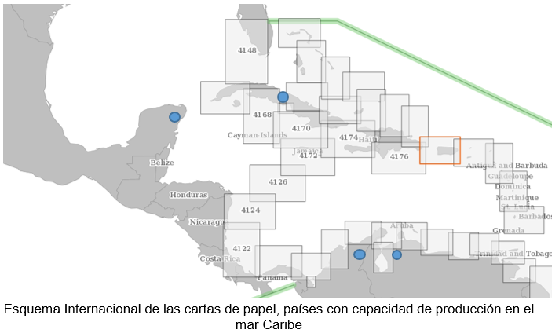
Are the ENCs equivalents to the paper chart Scheme INT ?
Irregular form of the data
Different compilation scales
http://chart.iho.int:8080/iho/main.do
Coverage and availability of electronic nautical charts, coastal purpose.
Source: UKHO Digital Catalogue

Slide 7
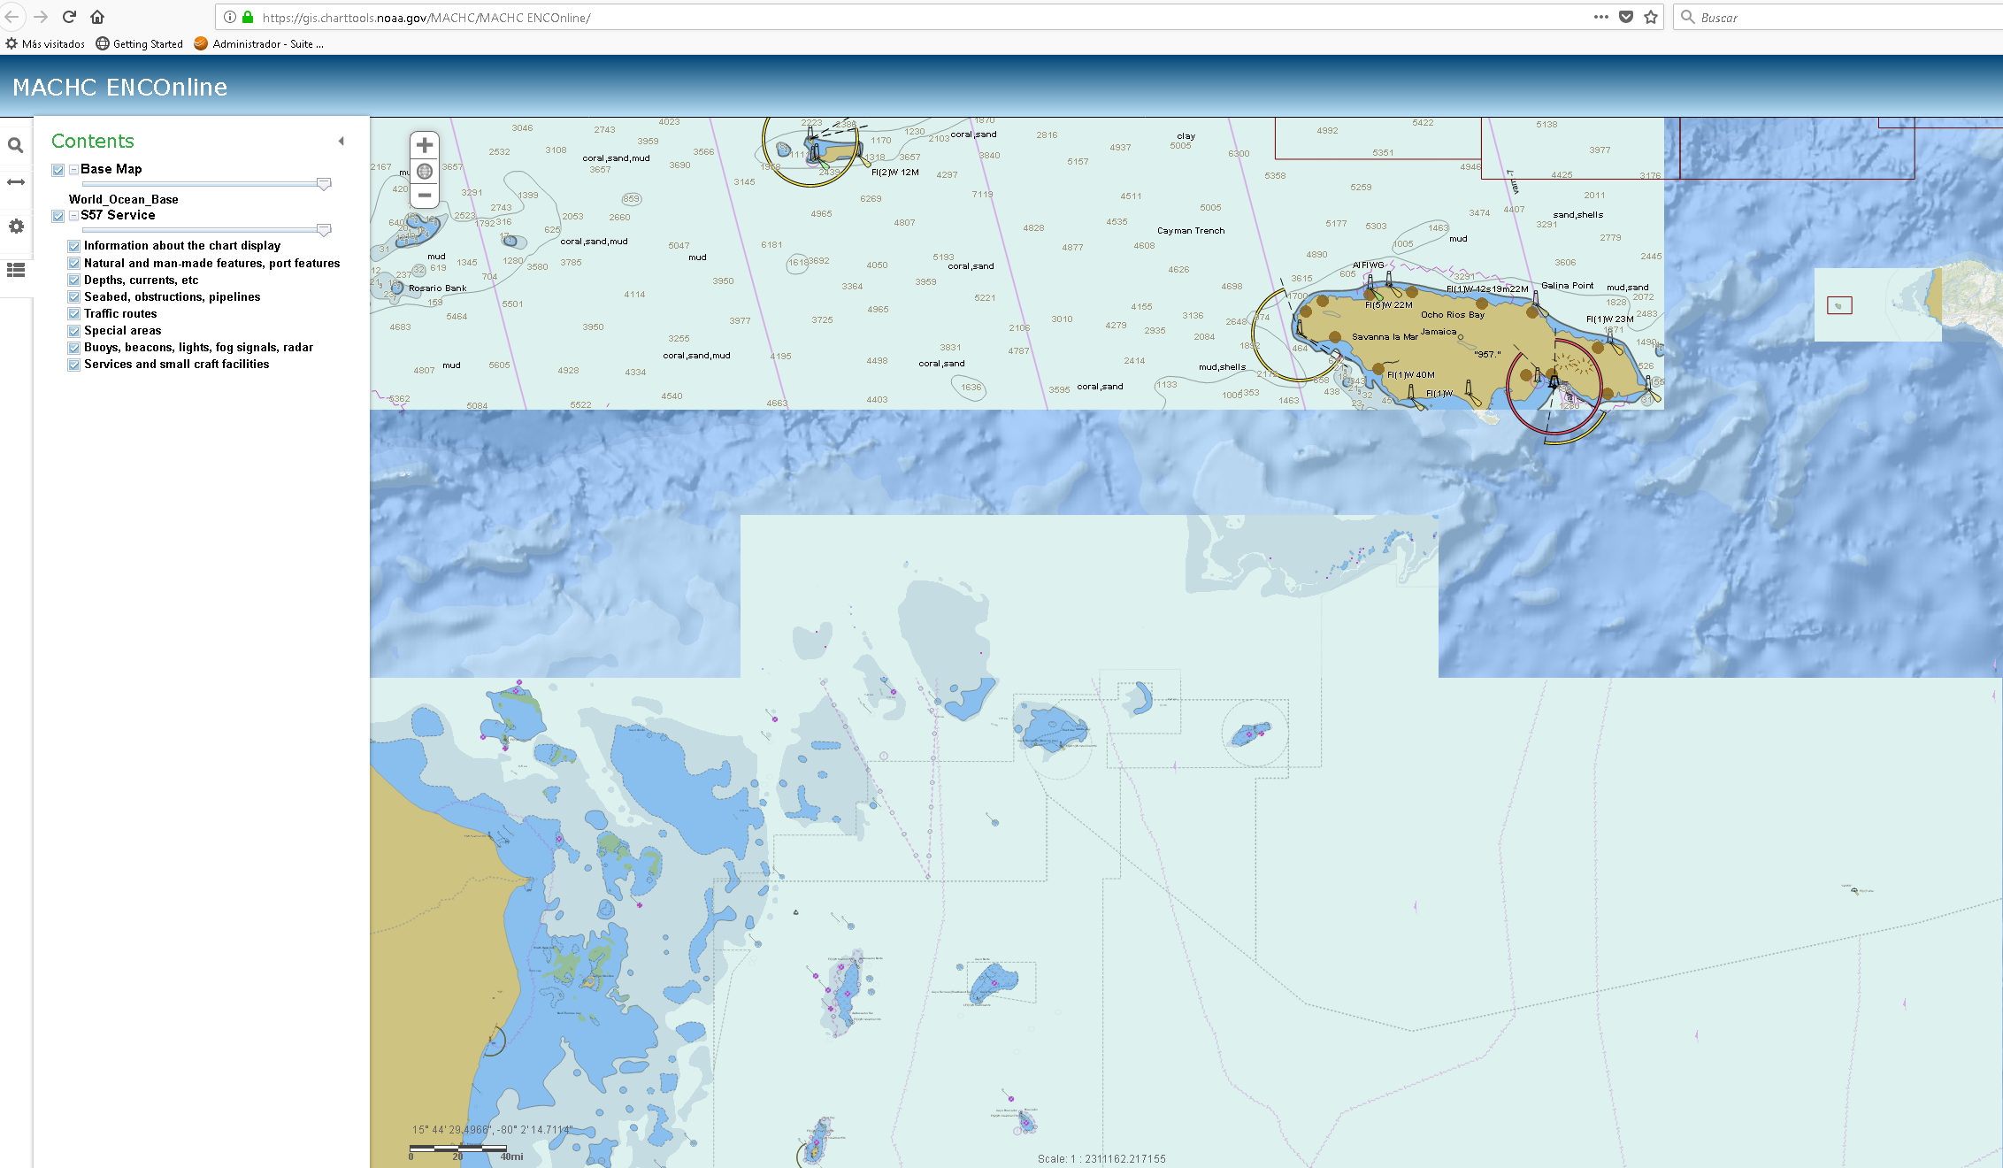
Without regional standardized Schemes, not uniforms SCAMIN values

Slide 8
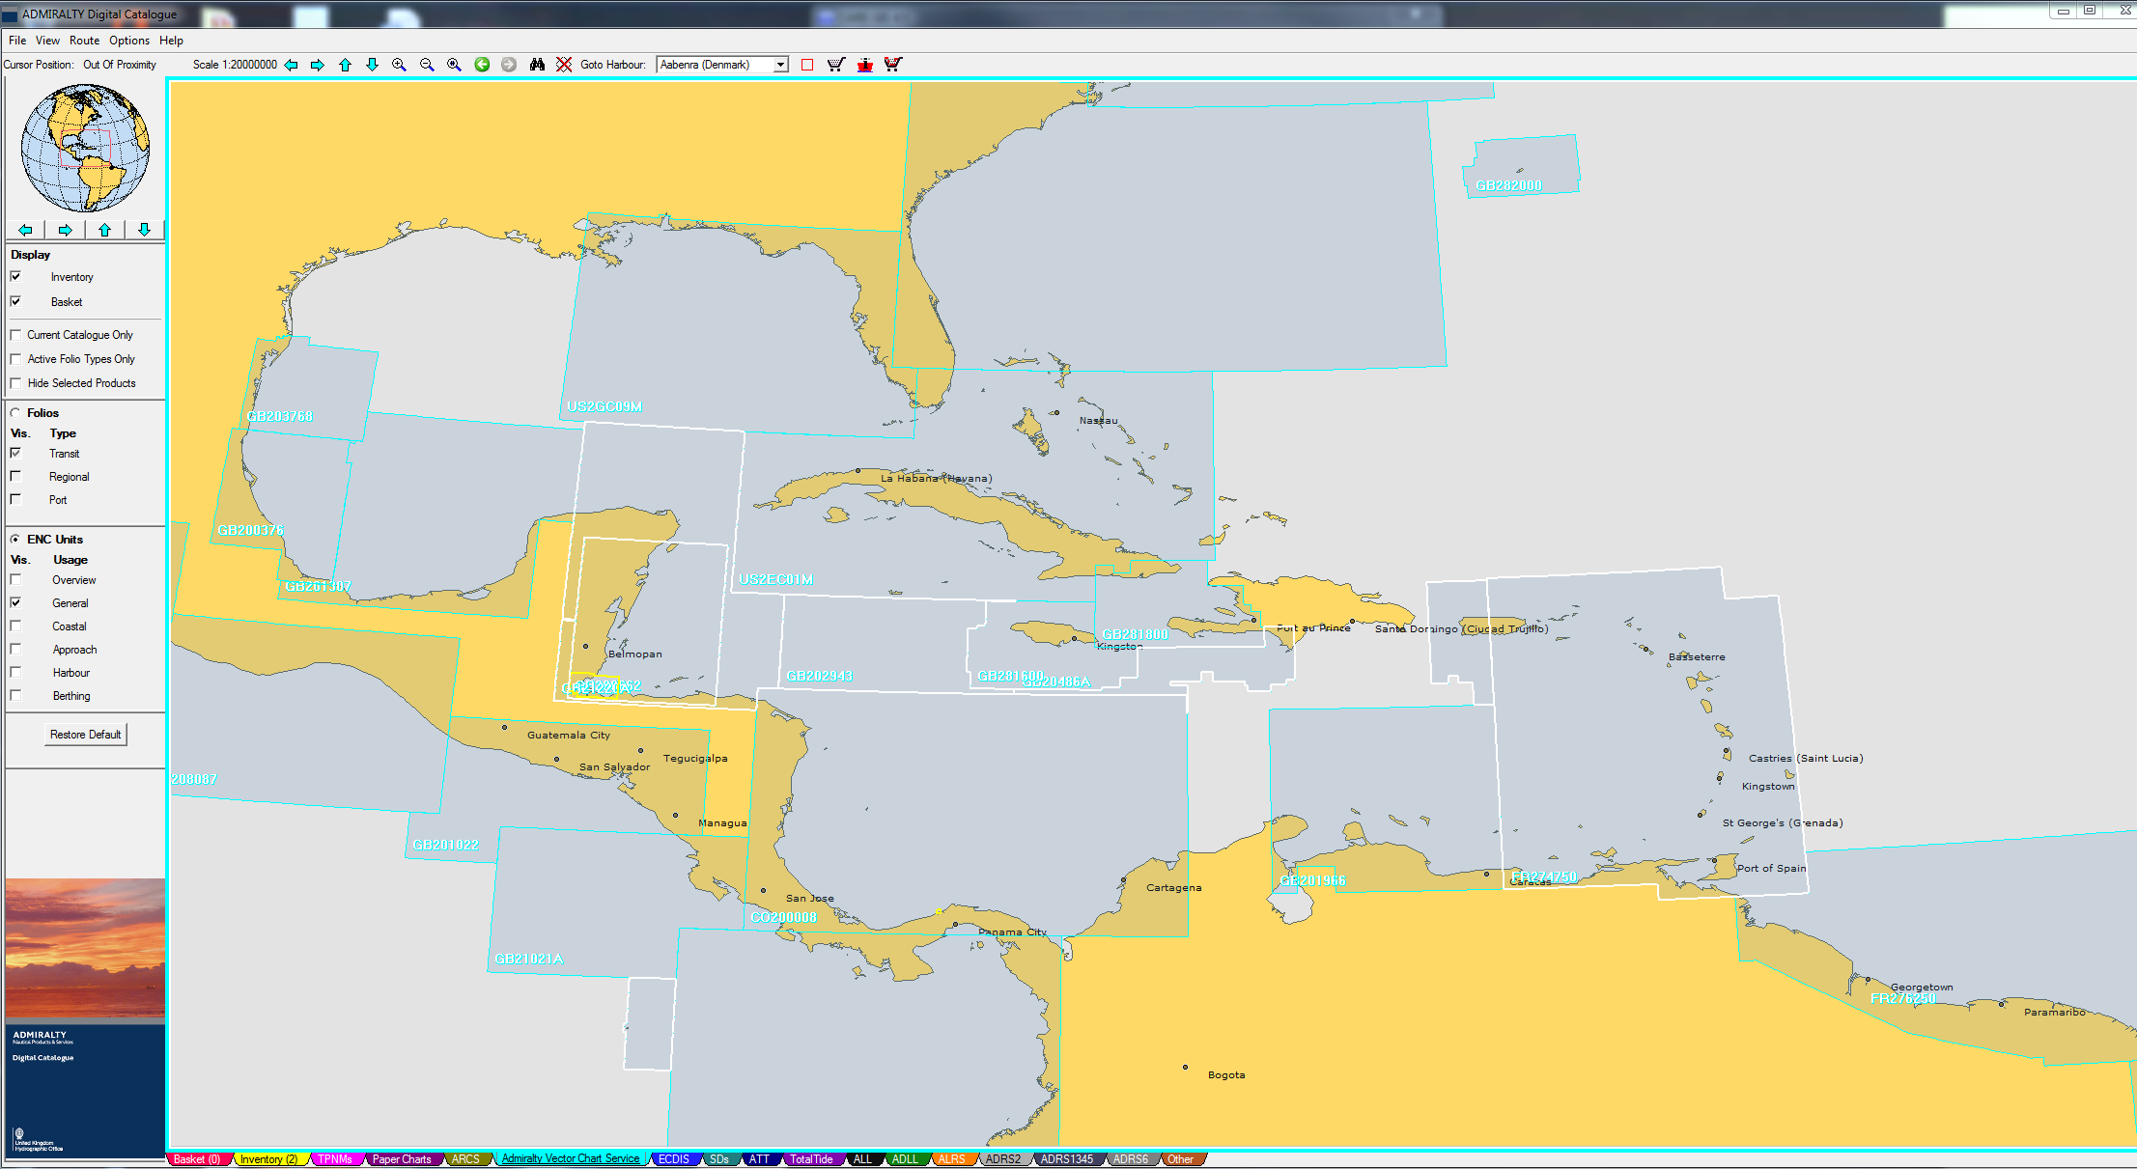
Gaps, not full coverage
Coverage and availability of electronic nautical charts,
General purpose (2).
Source: UKHO Digital Catalogue

Slide 9
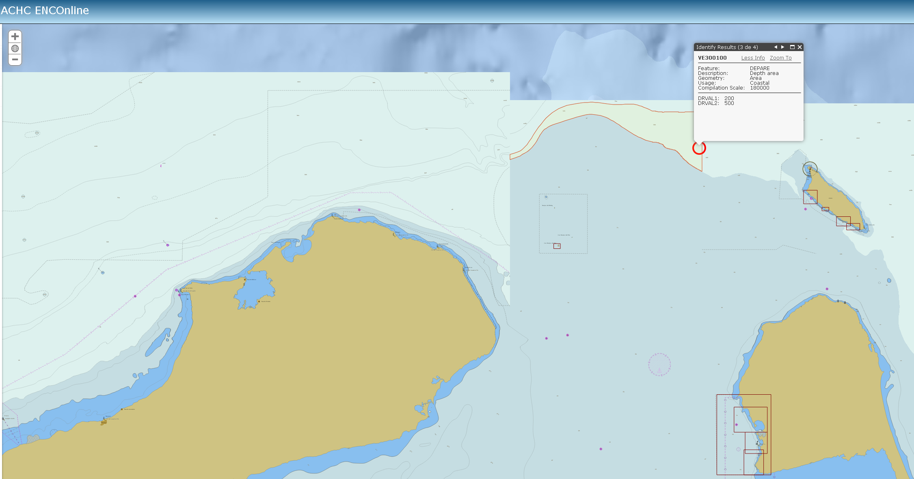
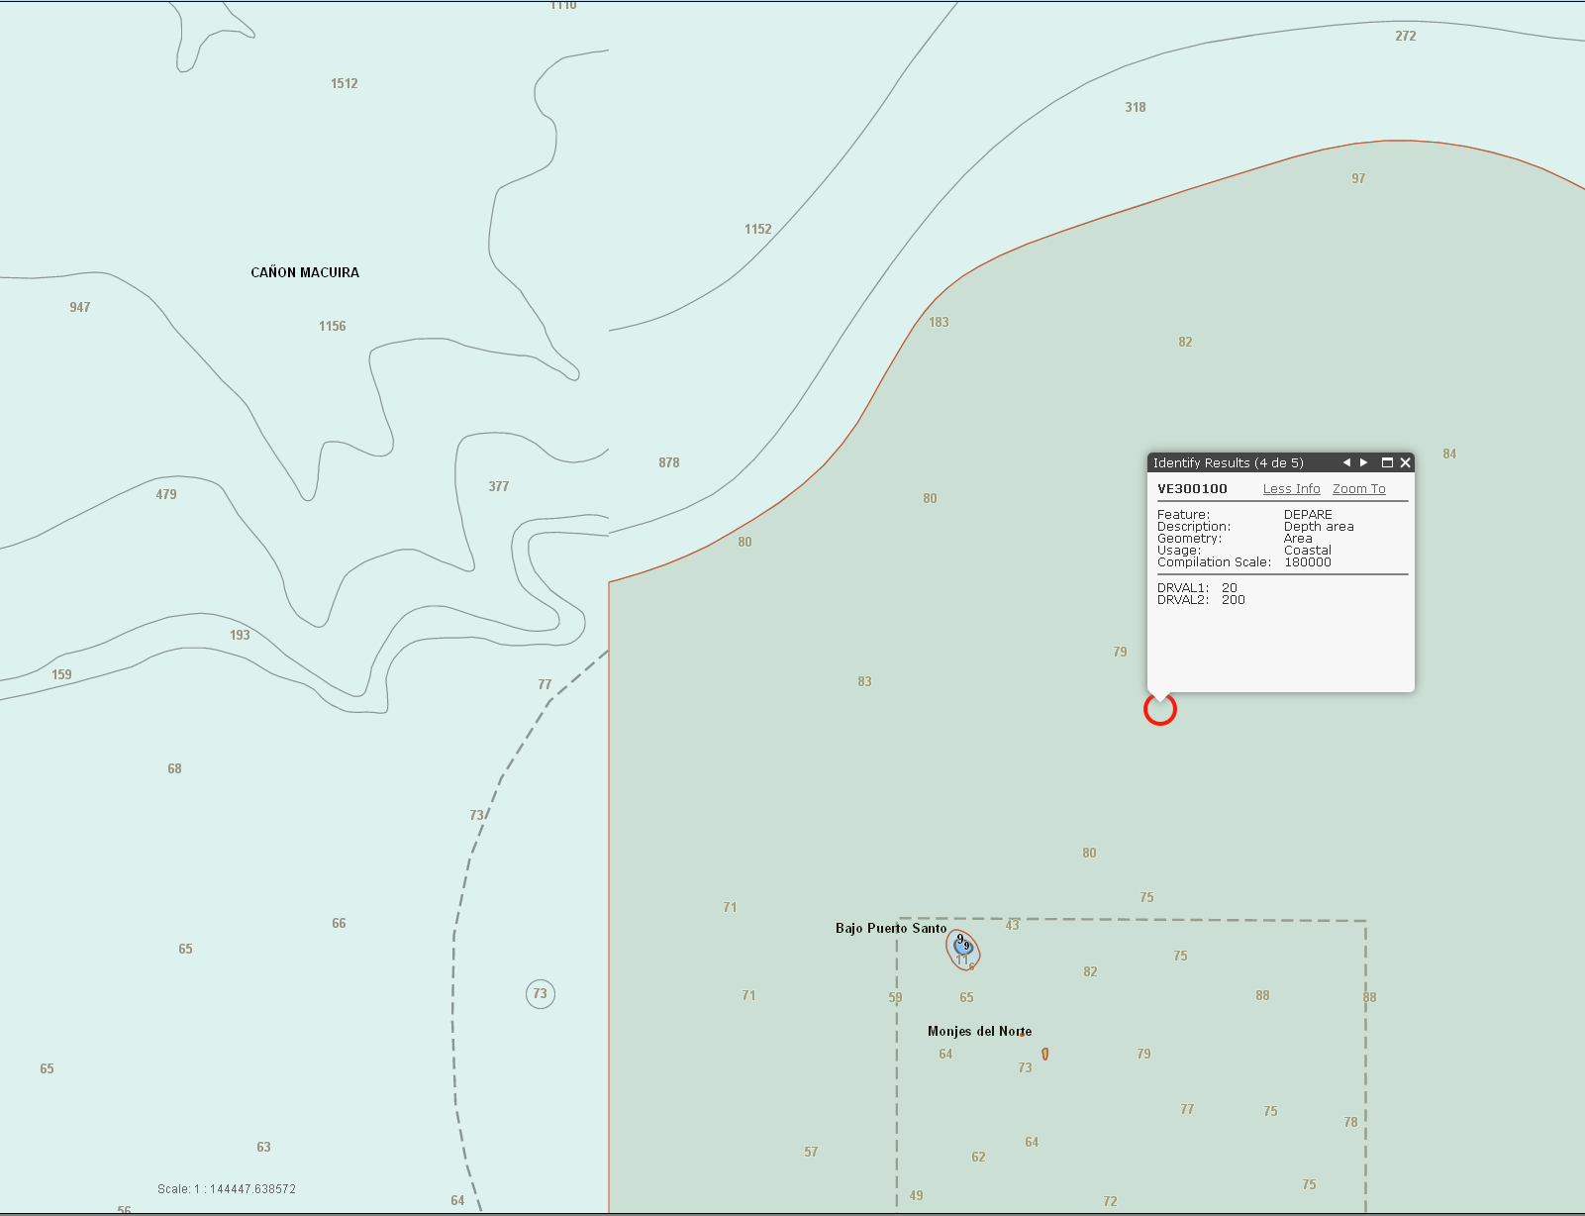
The same usage band and the same compilation scale
Not horizontal consistency CO300026 - VE300100
Catalogue online de la MACHC - OHI

Slide 10
What We want to get with this?
Establish a regional scheme for usage bands 1, 2 and 3.
How will we do it?
UNIFY :
Compilation scale by purpose
Using similar cell size, coverage area (respectable geographic extent bands 1, 2, 3)
Rectangular / adjacent cells
Use of SCAMIN (We all do not apply the recommended by OHI)
Horizontal Consistency
Data quality CATZOC
Stronger the WEND principles, Agreements between countries.

Slide 11
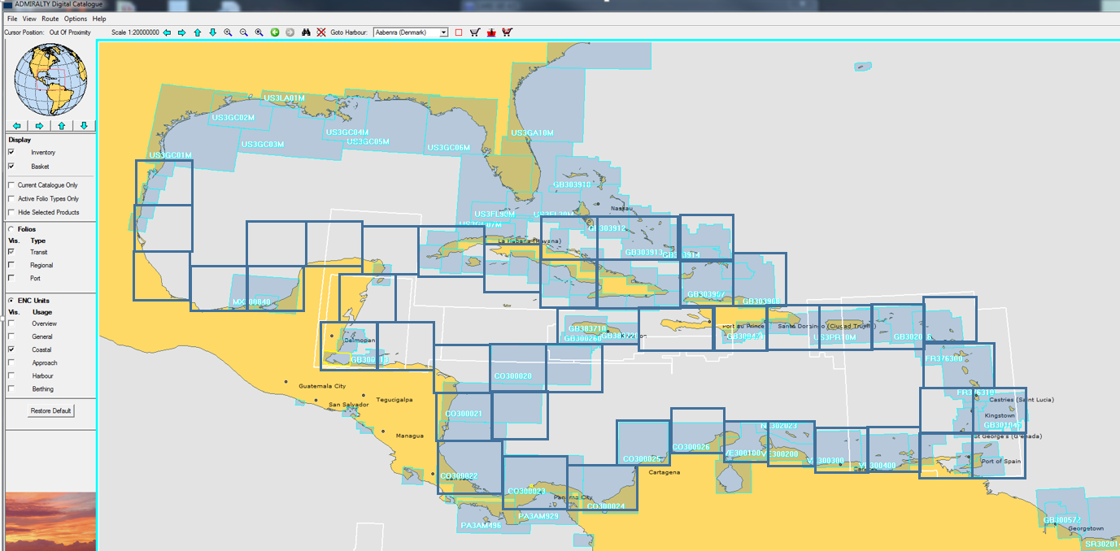
Preliminary example proposal.
Usage coastal (3)
Compilation Scale 180.000

Slide 12
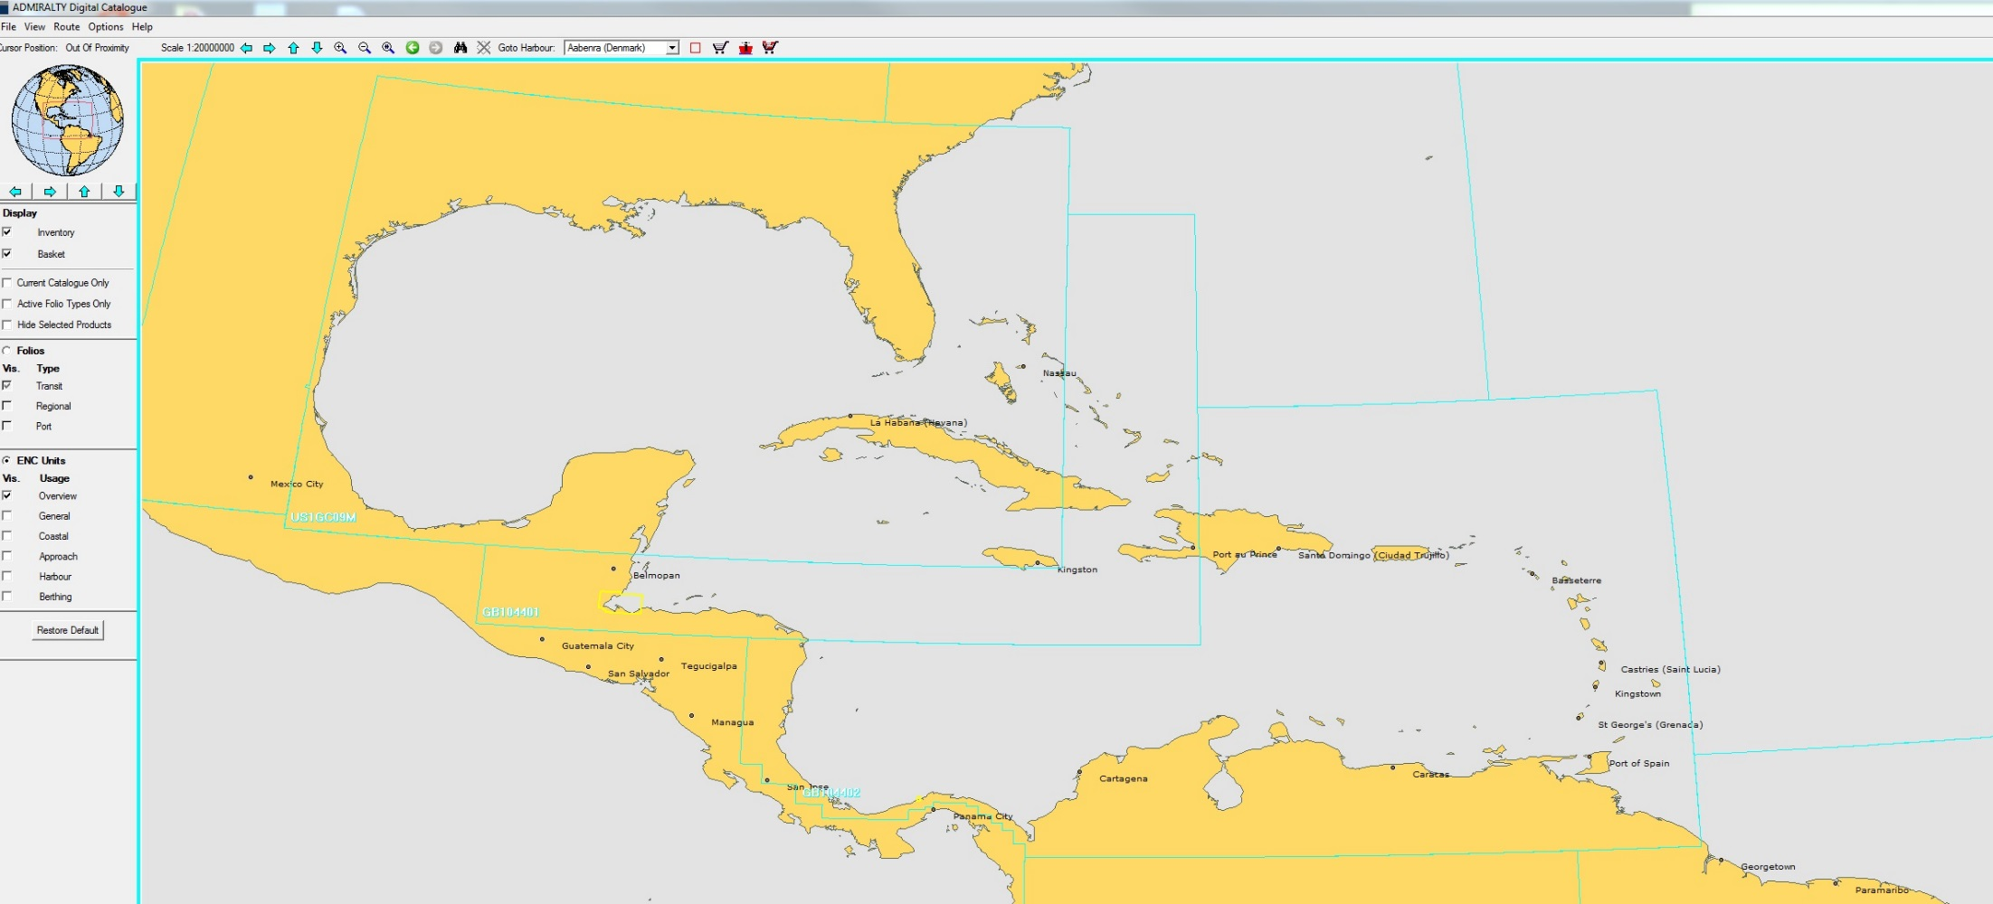
Preliminary example proposal.
Usage General (2)
Compilation scale 700.000

Slide 13
BENEFITS
Guarantees display on the ECDIS of uniform coverage and information at the appropriate scales for different nautical purpose.
Remove areas of overlap
Avoid gaps
Organization in production and reduce maintenance by numerous cells
Basis for the generation of the other products

Slide 14
Countries must produce as a region, to ensure that our charts satisfy the need of the end user. To achieve this, it is necessary to adopt standardized schemes by the CHR and assume the challenge of making agreements for the publication of data.

Slide 15
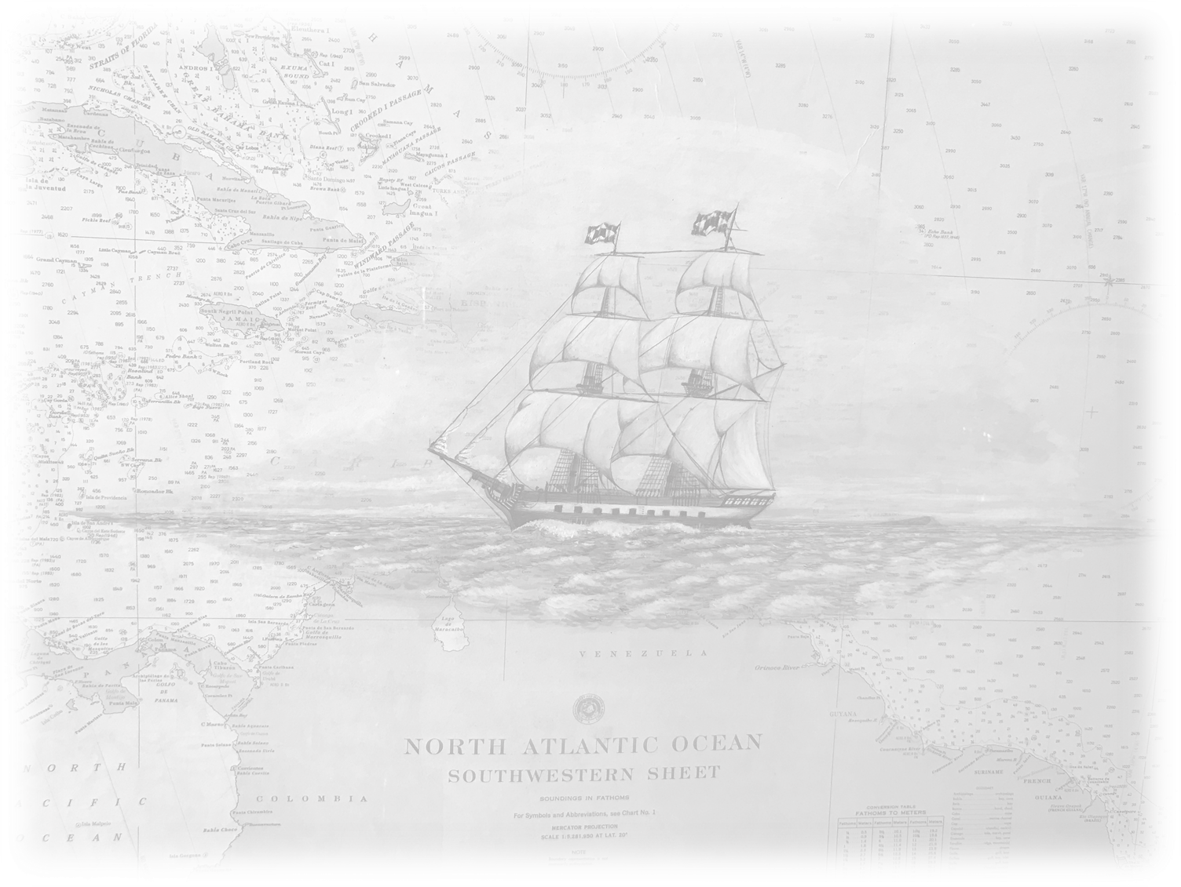
Thank you

