Slide 1
19th Meeting of the Meso America – Caribbean Sea Hydrographic Commission National Report by
[COLOMBIA]

Slide 2
Main achievements during the year
95%
Paper chart scheme
73%
ENC´s scheme
200.000 km²
2012 - 2018

Slide 3
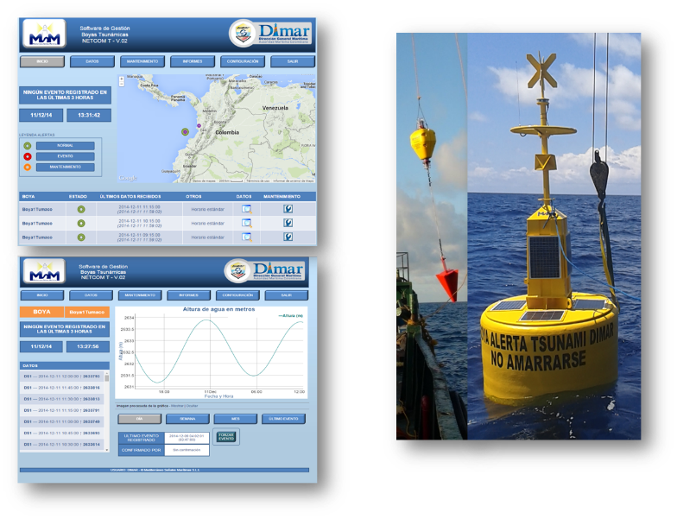
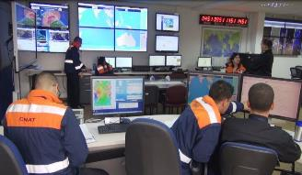
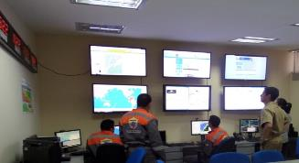
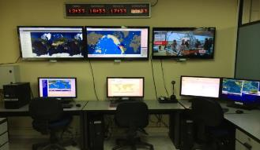
Main achievements during the year

Slide 4
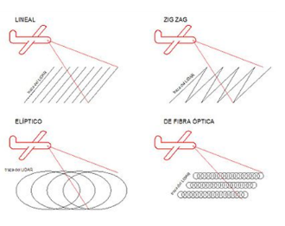
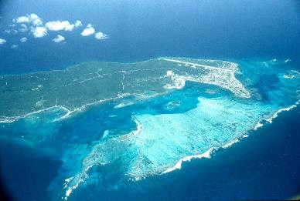
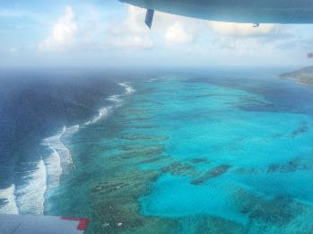
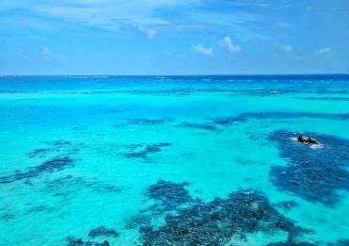
Main achievements during the year
NAVOCEANO - COL

Slide 5
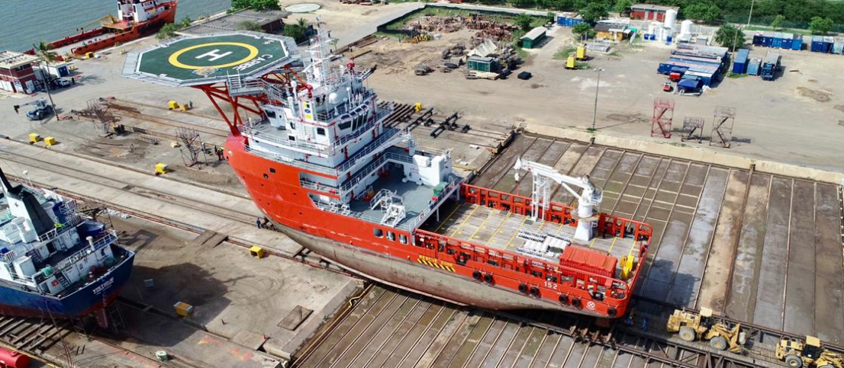
Main achievements during the year

Slide 6
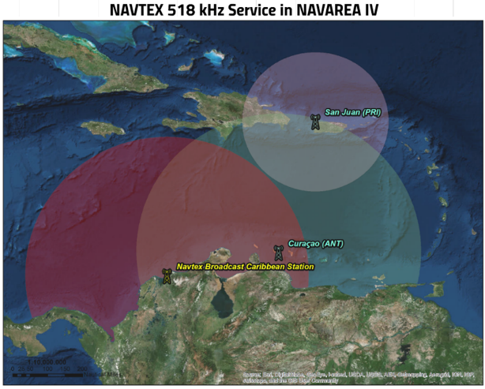
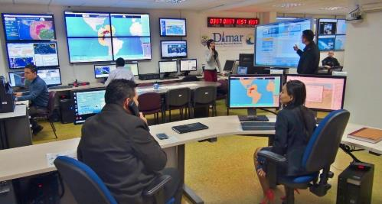
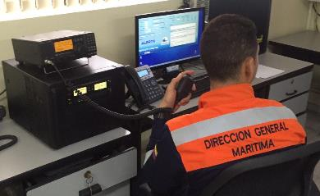
Main achievements during the year

Slide 7
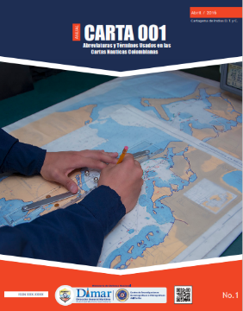
Main achievements during the year

Slide 8
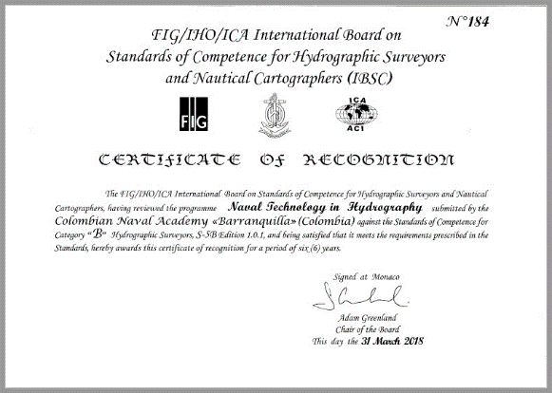
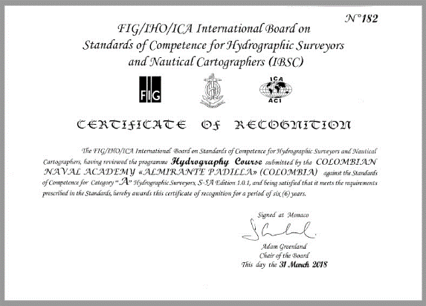
Main achievements during the year

Slide 9
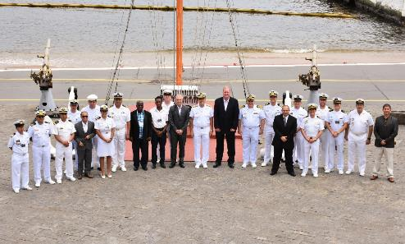
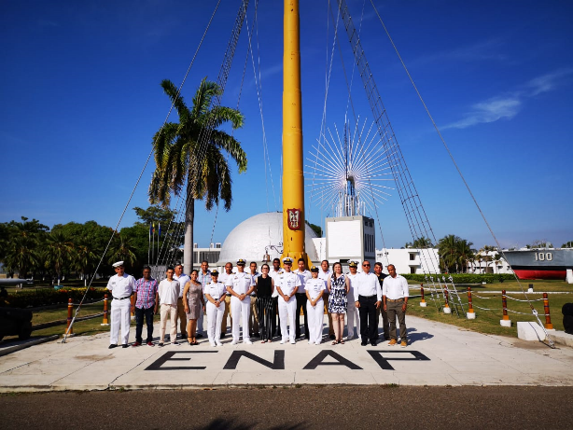
Main achievements during the year
Maritime Safety Information
Aids to Navigation Level 1
2018. Lidar course (ECU).
2018. MSI (BRA)
2018. CAT B Hydro course (KOA)
2018. Multibeam data processing (COL)
2018. MSI (CHL)
2018. AtoN (COL)

Slide 10
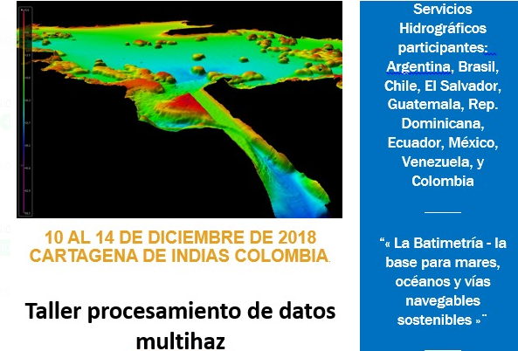
Main achievements during the year
MACHC
SEPRHC
SWAtHC

Slide 11
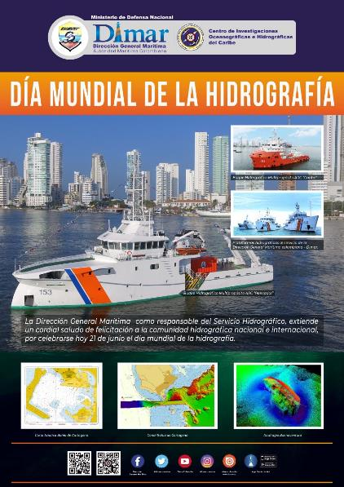
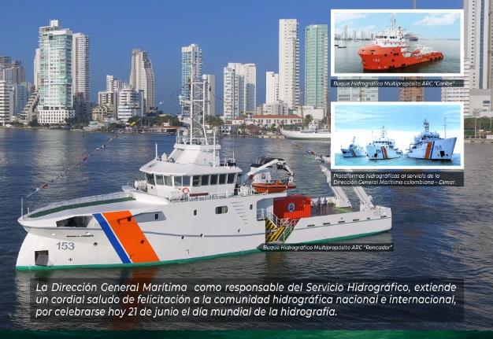
Main achievements during the year

Slide 12
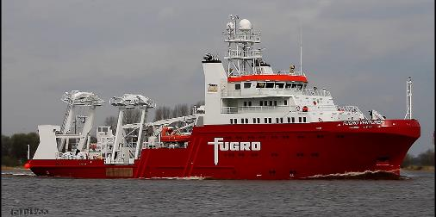
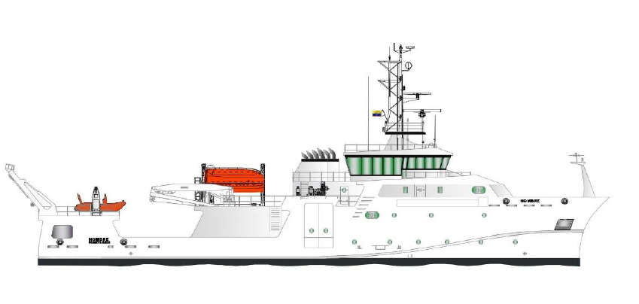
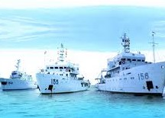
Main challenges and/or obstructions

Slide 13
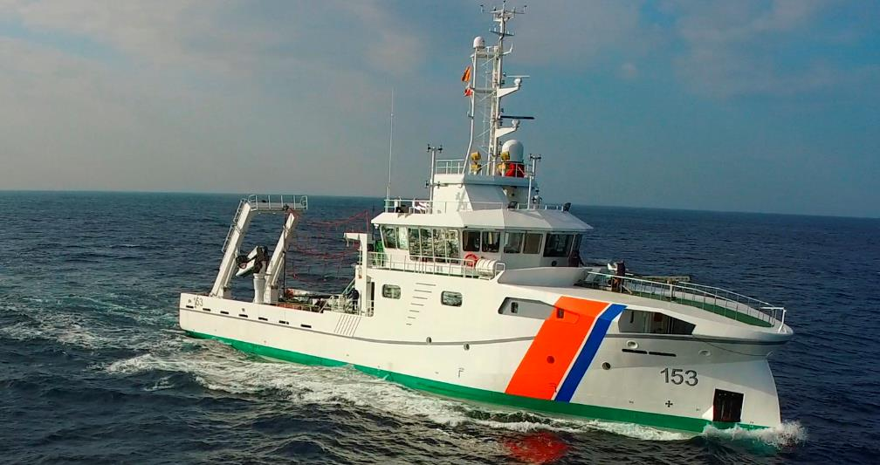
Main challenges and/or obstructions

Slide 14
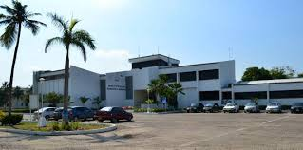
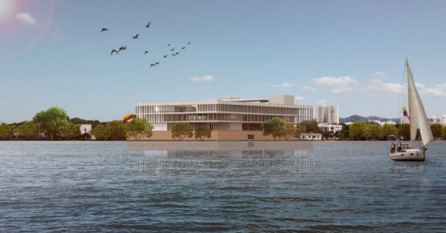
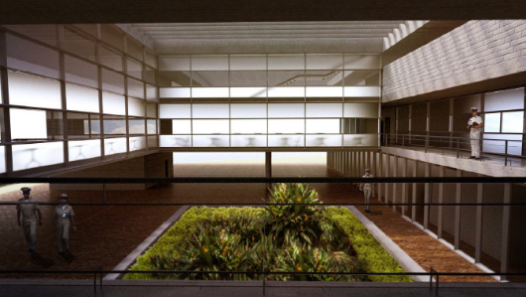
Main challenges and/or obstructions

Slide 15
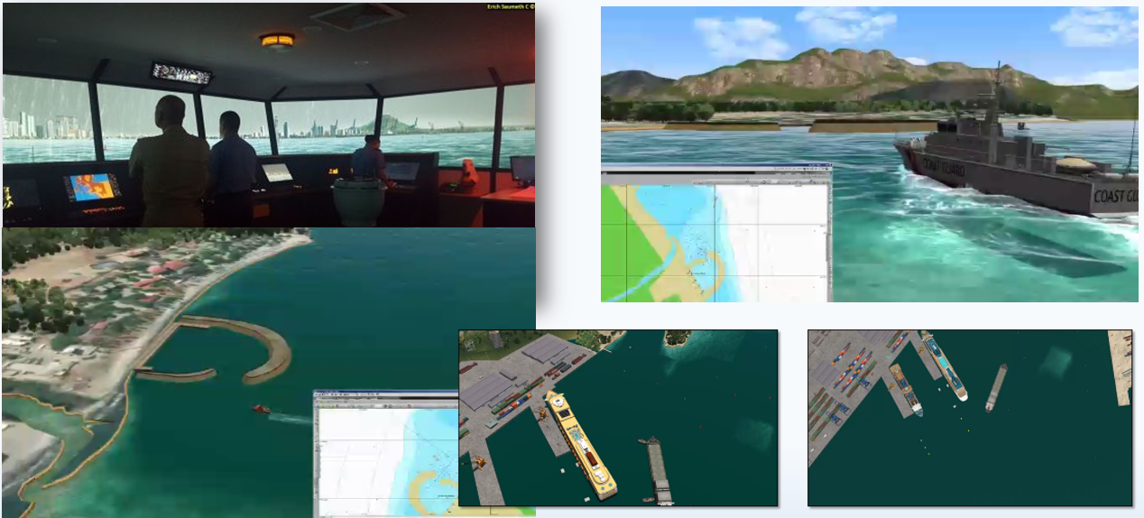
Main challenges and/or obstructions

Slide 16
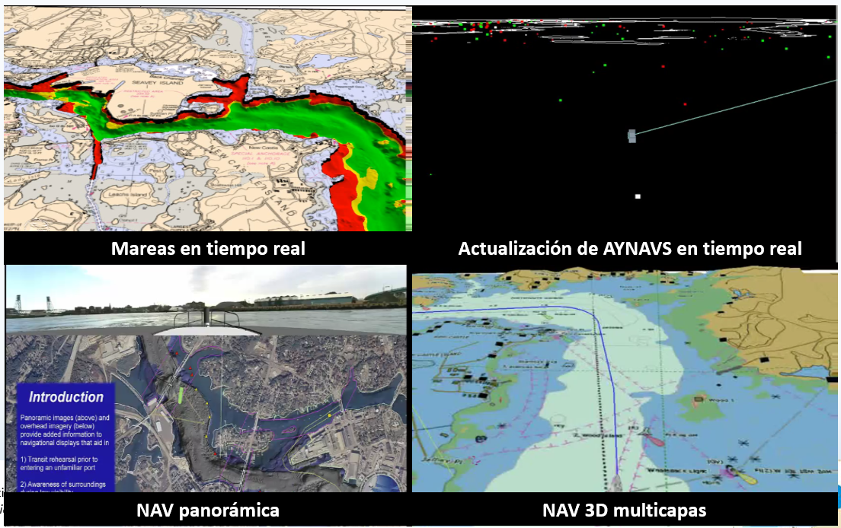
Main challenges and/or obstructions

Slide 17
Main obstructions
Financial and physical resources
High rotation of specialized people
High demand of naval requirements
Hydrography political awareness
Materialization of coordination and cooperation intentions

Slide 18
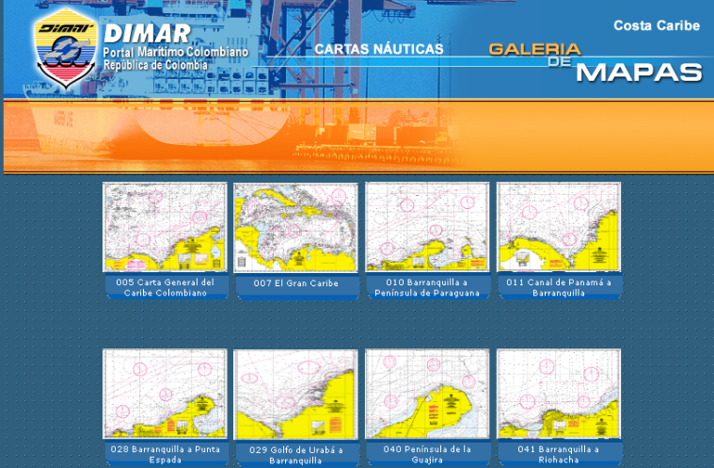
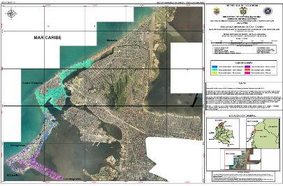
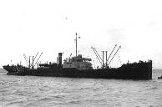
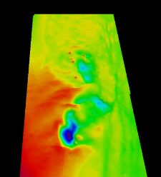
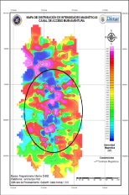
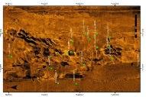
Progress on MSDI

Slide 19
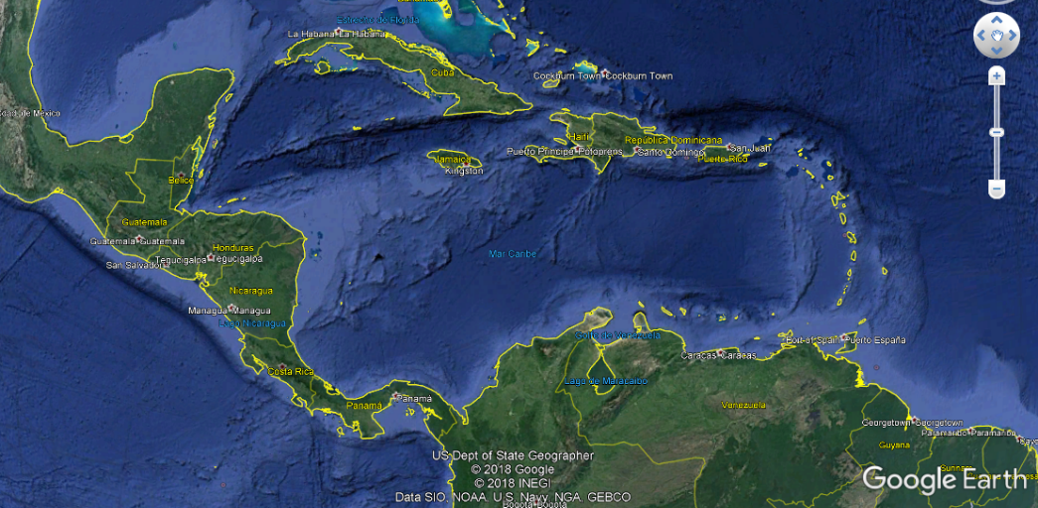
Plans that affect the region
ROCRAM – CA
OHI COUNCIL

Slide 20
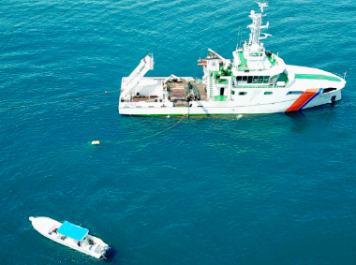
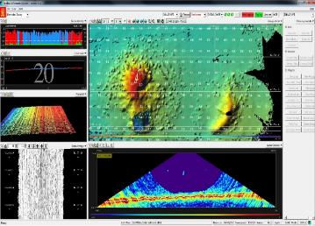
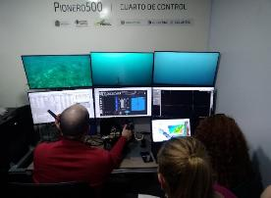
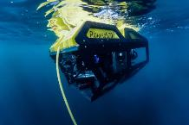
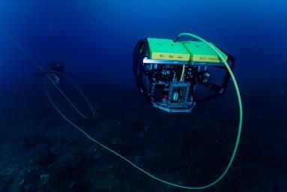
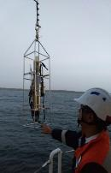
Plans that affect the region

Slide 21
Para una región como Mesoamérica y el Caribe,
la hidrografía es Sinónimo de progreso y prosperidad.
Gracias.

