Slide 1
20th Meeting of the Meso America – Caribbean Sea Hydrographic Commission National Report by
Belize C.A.
Presented by: Mr. Michael Jenkins, Safety and Security Manager Belize Port Authority

Slide 2
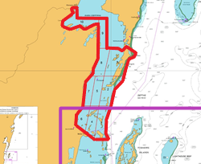
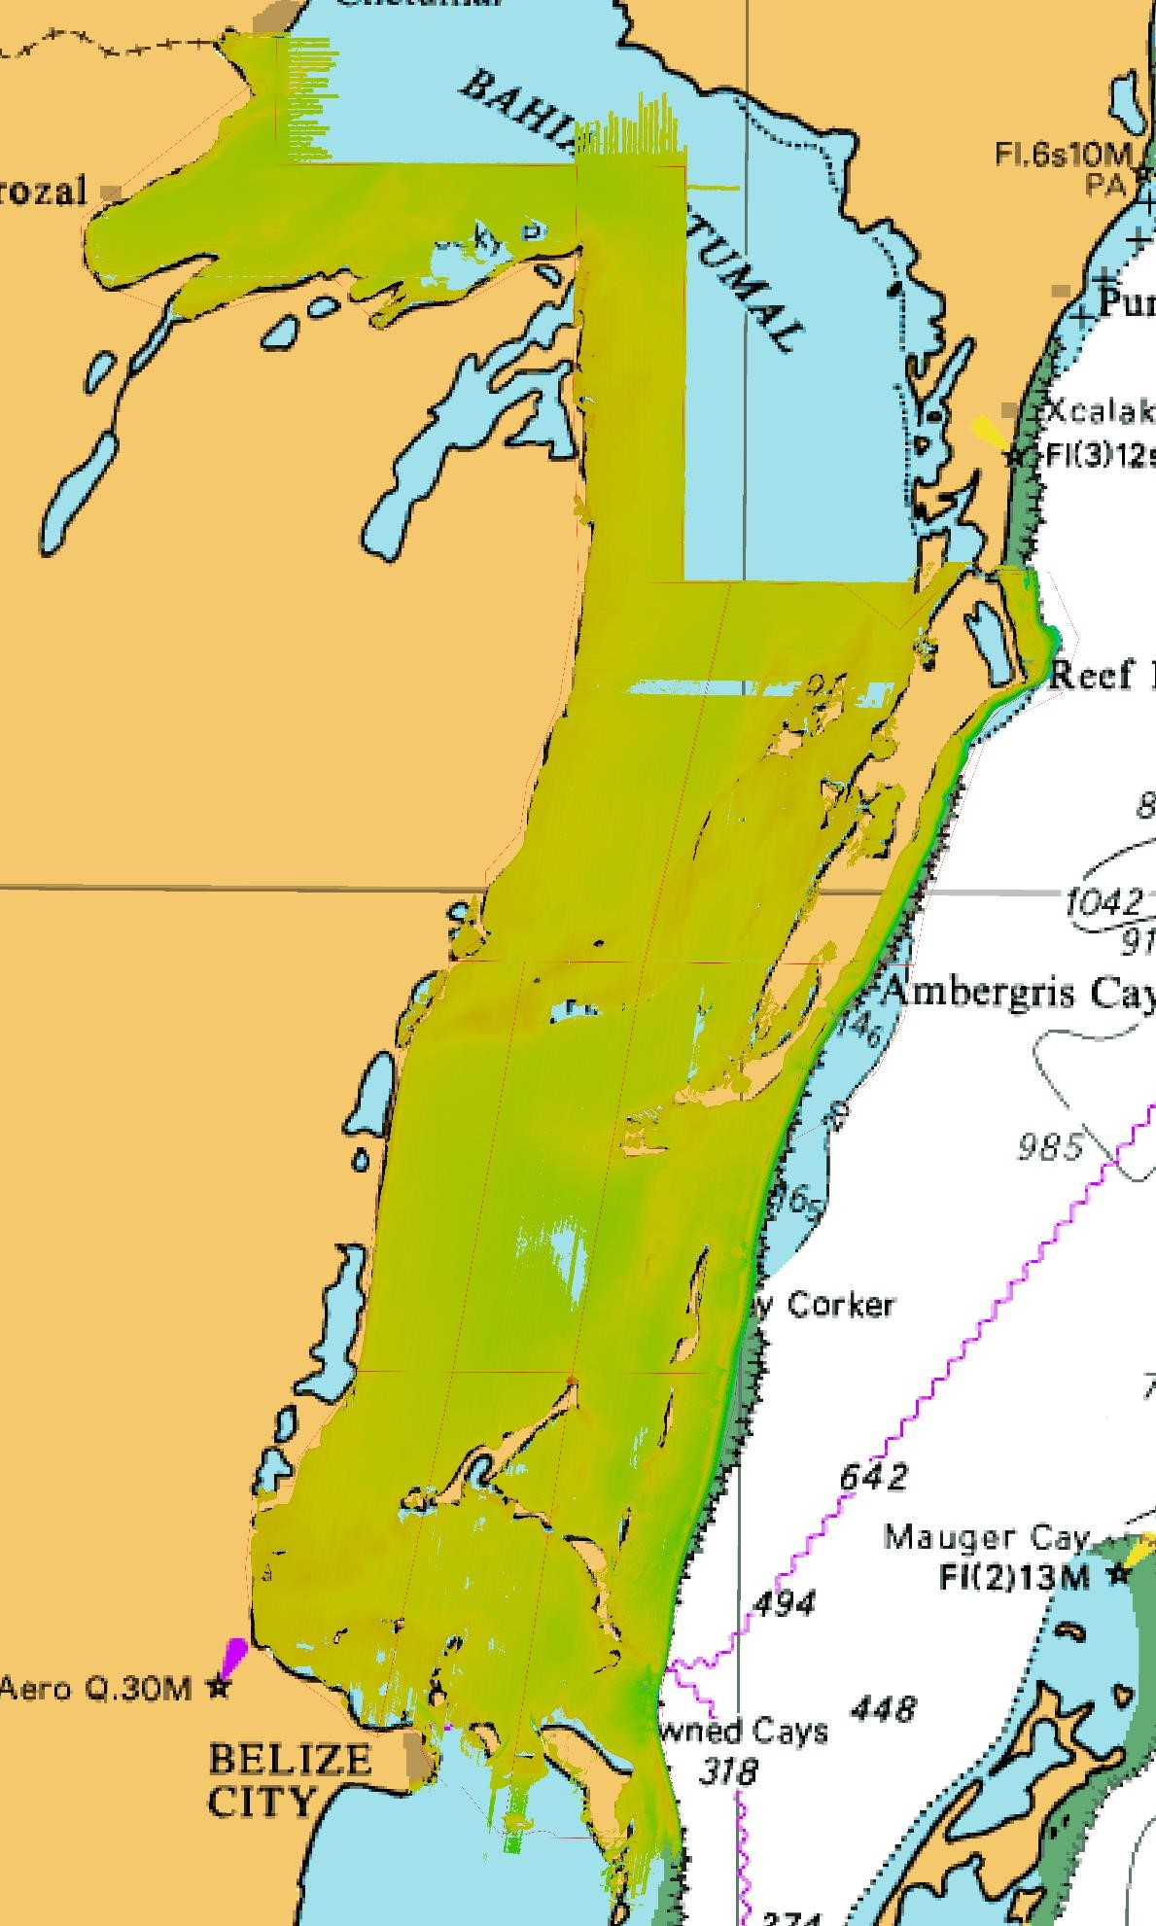
Top achievements during the year (3 maximum)
1
0
9
Through the CME program the country of Belize was able to conduct approximately 2575 Km² LIDAR survey in the northern internal waters of Belize.
.
8
3
7
5
2
6
1
4

Slide 3
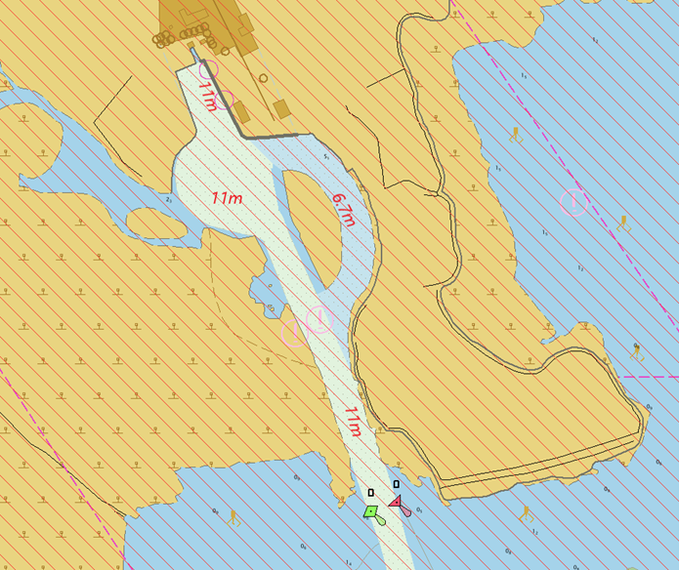
2. The Big Creek Port in February completed the dredging of their access channel to 11 meters. The US Coast Guard in September completed the surveys of this channel which will now be used to update Admiralty nautical chart #1797.
3. It is the first time that Belize has received the full data sets of all surveys conducted in Belize over the past two years. This data will allow us now to better plan, protect and develop our Blue Economy.

Slide 4
Top challenges and/or obstructions (3 maximum) (Such as capacity building gaps)
The Belize Port Authority is still in possession of the Gulf of Honduras hydrographic equipment. The Authority has identified this as a challenge in the way forward to firstly get a proper assessment of equipment’s functionality for repairs and or acquiring funding to purchase a new suit of survey equipment.
There are several areas in our territorial waters that does not have any updated hydrographic coverage. This is of great concern since our waters are becoming increasing congested with private pleasure craft the numerous water taxi service and the commercial vessels transiting the islands and neighboring country of Chetumal Mexico and Barrios Guatemala.
The Belize Port Authority has also identified another challenge to be the manipulation of the survey data just recently received and the establishment of a functional MSDI department central for the storage and release of all spatial data.

Slide 5
Top Plans that affect the region (3 maximum) (Charts, surveys, training, other)
As it pertains to the IHO capacity building phase reference, it has been recently discussed that for the MACHC region it might be ideal to include a new phase 0. This phase 0 would be the building of awareness within each country and the need to undertake assessments of countries ability to achieve the other 3 phases of capacity building.
Belize through the 5 C’s (Caribbean Community Climate Change Center) has acquired a plane with LIDAR capabilities. As regional center it is the intention that the Caribbean community would be able to utilize the use of this plane and since it is already located here in the region the cost of logistics would be significantly lower hence conducting LIDAR surveys would be cheaper.
The UKHO and National oceanographic Center in the United Kingdom has developed what is called the CAMEL ( containerized autonomous maritime environmental research laboratory) which is a shallow water vessel capable of mounting deferent measuring instruments to conduct much needed bathymetric and oceanographic surveys. Its easy deployment can mean a wider uses among the Caribbean region.

Slide 6
Top 2 recommendations for MACHC plenary (Criteria: Greatest collective regional impact, return on investment, potential for leveraging resources/partnerships)
What is your greatest capacity building priority to recommend for IHO CB funding consideration (Phase 1)? (Select one)
High-level visit (political awareness and buy in into the importance of having hydrographic survey capabilities.
What is your greatest capacity building priority (Phase 2 or Phase 3) for which to seek other partnership/funding opportunities outside of IHO CB?
The Belize Port Authority greatest capacity building priority is to receive training in Category A and Category B Hydrographic studies and to be able to acquire a multibeam hydrographic suite of equipment.

Slide 7
IHO Capacity Building Phase Reference

Slide 8
Reference: IHO Capacity Building Strategy Phases of Development
Phase 1
Collection and circulation of nautical information, necessary to maintain existing charts and publications up to date.
Phase 2
Creation of a surveying capability to conduct:
Coastal projects
Offshore projects
Phase 3
Produce paper charts, ENC and publications independently.
Notes:
National Activities
Phase 1
Form National Authority (NA) and/or National Hydrographic Coordinating Committee (NHCC).
Create/improve current infrastructure to collect and circulate information
Strengthen links with charting authority to enable updating of charts and publications
Minimal training needed
Strengthen links with NAVAREA Coordinator to enable the promulgation of safety information
Phase 2
Establish capacity to enable surveys of ports and their approaches
Maintain adequate aids to navigation
Build capacity to enable surveys in support of coastal and offshore areas
Build capacity to set up hydrographic databases to support the work of the NA/NHCC
Provide basic geospatial data via MSDI
Requires funding for training, advising & equipment or contract survey
Phase 3
The need shall be thoroughly assessed. Requires investment for production, distribution and updating
Alternatively, bi-lateral agreements for charting can provide easier solutions in production and distribution (of ENC through RENCs) and rewards.
Further development of MSDI

