Slide 1
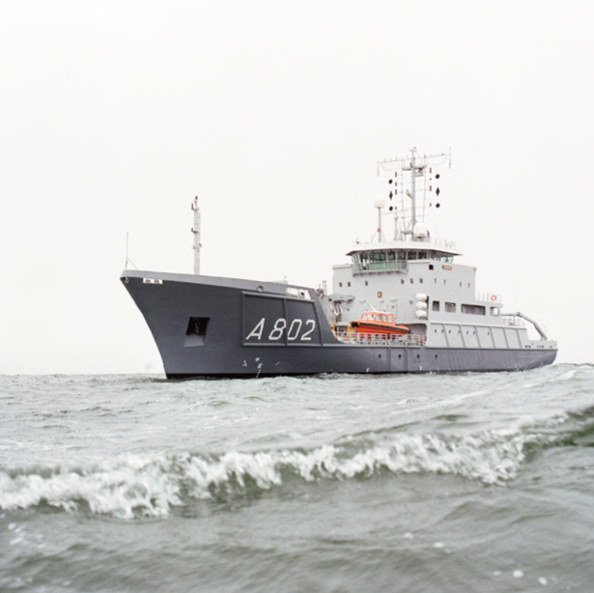
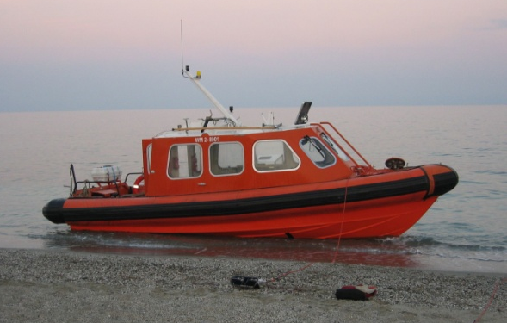
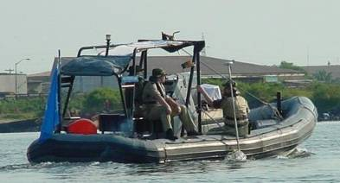
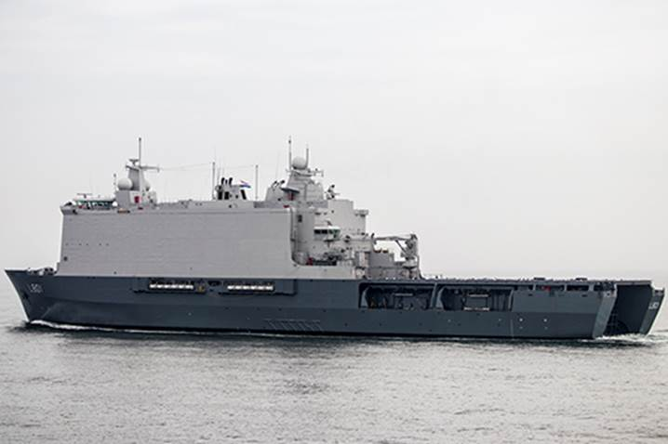
HNLMS Snellius (HSV)
THE BAHAMAS
Survey Motor Boat
Mobile Hydro. Package 2
Finding maritime access to Abaco for disaster relief after Huricane Dorian
HNLMS Johan de Witt (LPD)
Mobile Hydro. Package 1
Lt. Karel Buizer and
Leendert Dorst
Notes:
Van Ness
Eventuele voettekst
1

Slide 2
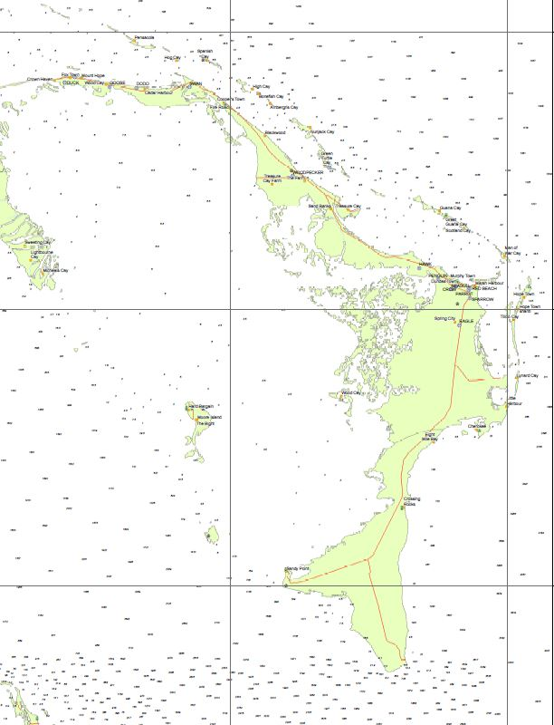
Overview
Area 1
Marsh Harbour – Initial entry and main delivery location of aid
Area 2
Sandy Point - Exit

Slide 3
Marsh Harbour – entry point
Where
‘Ground Zero’ of hurricane Dorian
Disaster relief with Landing Platform Dock and landing vessels into Marsh Harbour
Unknown bathymetry, outdated (1831) survey, local knowledge not available – normally only leisure-craft and local traffic in area
How
Provide safe boat lane and unloading area:
Prove sufficient bathymetry
Detect (and possibly remove) obstacles in harbour
Surveyed using multi-beam mobile hydrographic suite mounted on RHIB

Slide 4
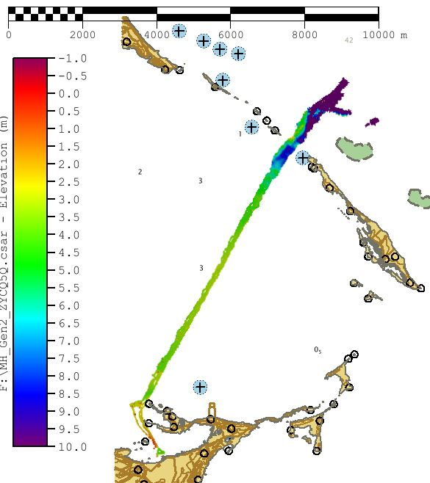
Marsh Harbour
Total approach 5.2NM
Rapid Environmental Assessment
so not IHO-compliant with regard to vertical control system or quality control

Slide 5
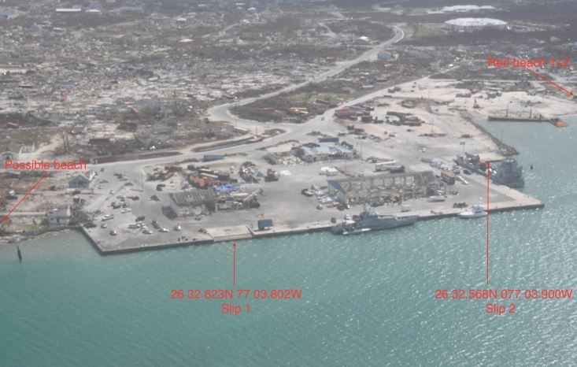
Marsh Harbour

Slide 6
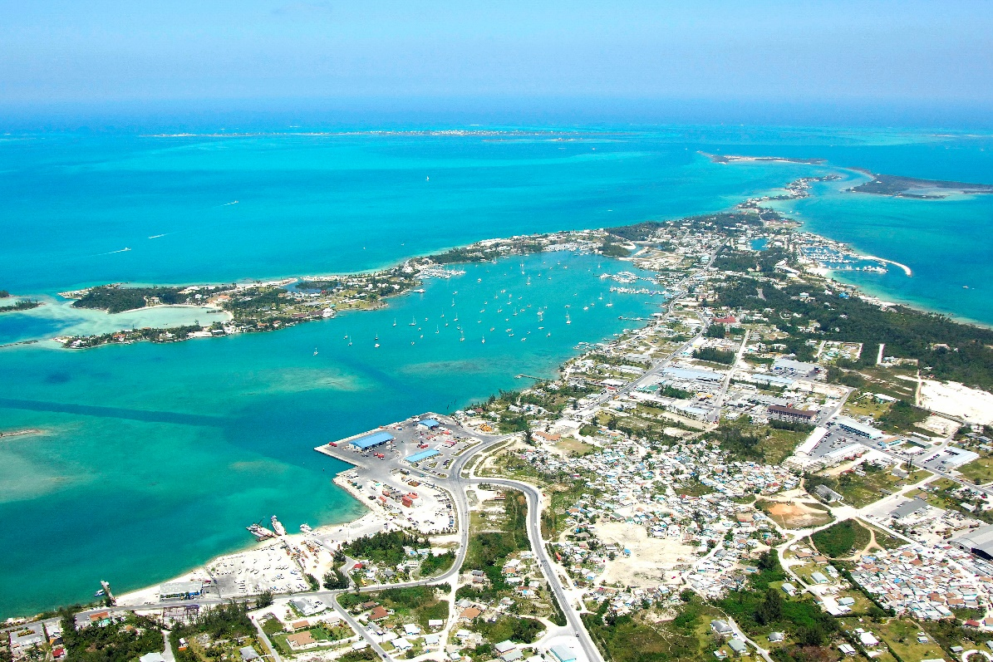
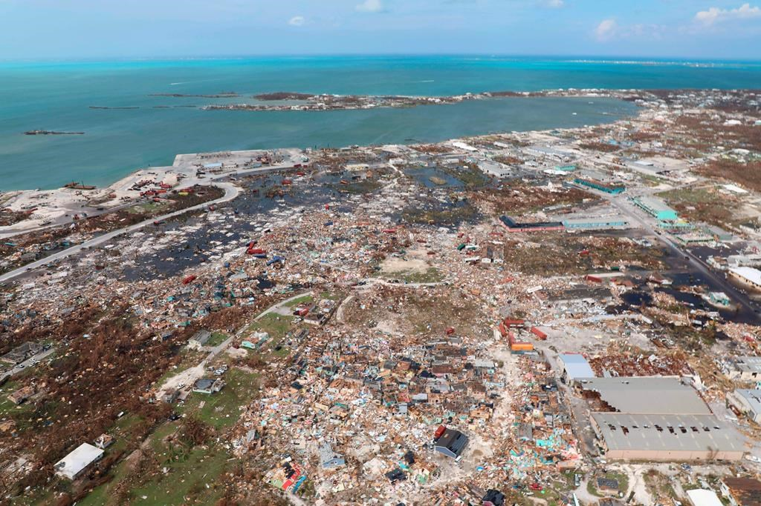
Marsh Harbour
Marsh Harbour
Before
Affected neighboorhoods
After
Port area

Slide 7
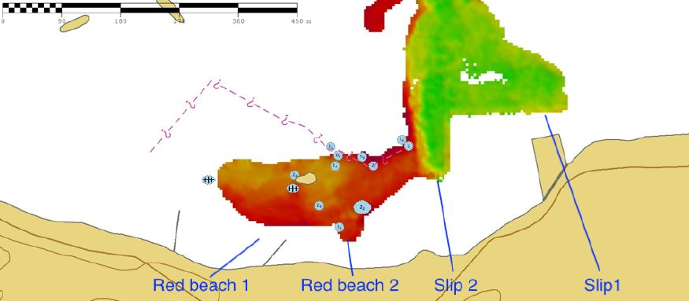
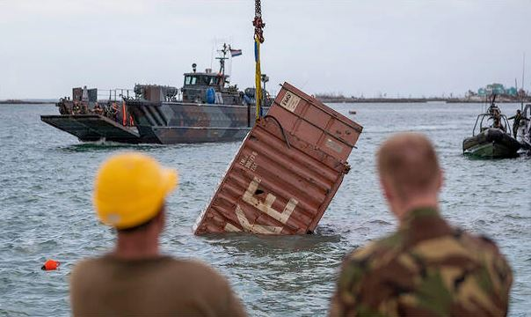
Marsh Harbour
Port area detail
Dredged channel of 4 m depth, marked with buoys
20 ft container (removed)
Various other objects washed into sea
Red Beach 2 and slip 2 used for amphibious landings
Note: new/extended (?) dockyard not charted
Background: DNC H1609999 (2017)

Slide 8
Sandy Point – exit point
Where
Sea state too high for retrieval of material on East side of Abaco at conclusion of disaster relief operation; next storm already on its way so waiting was not an option
Possible exit on leeward side of island – Sandy Point
However, no usable chart available
How
After tracking the AIS of a local ferry, back-surveyed its track to investigate suitability as a boat lane
Successful survey; waypoints of safe route promulgated to landing crafts - successful retrieval of all personnel and material

Slide 9
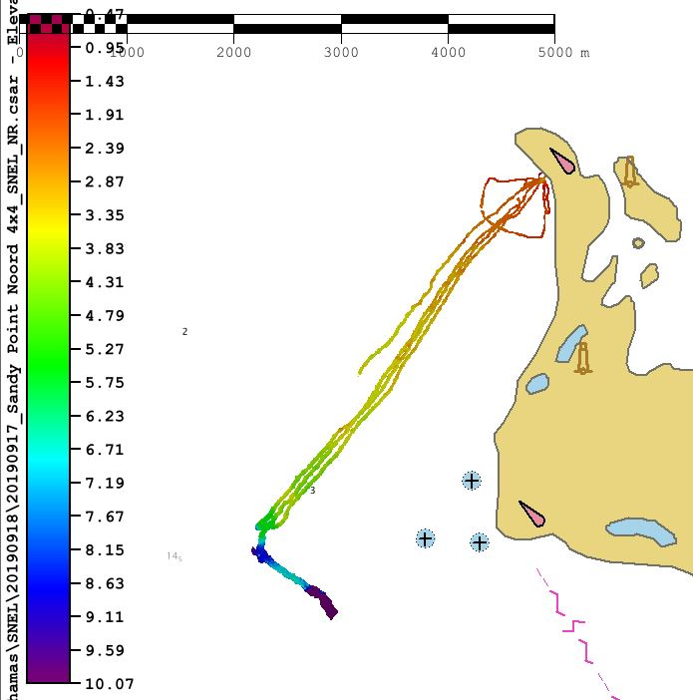
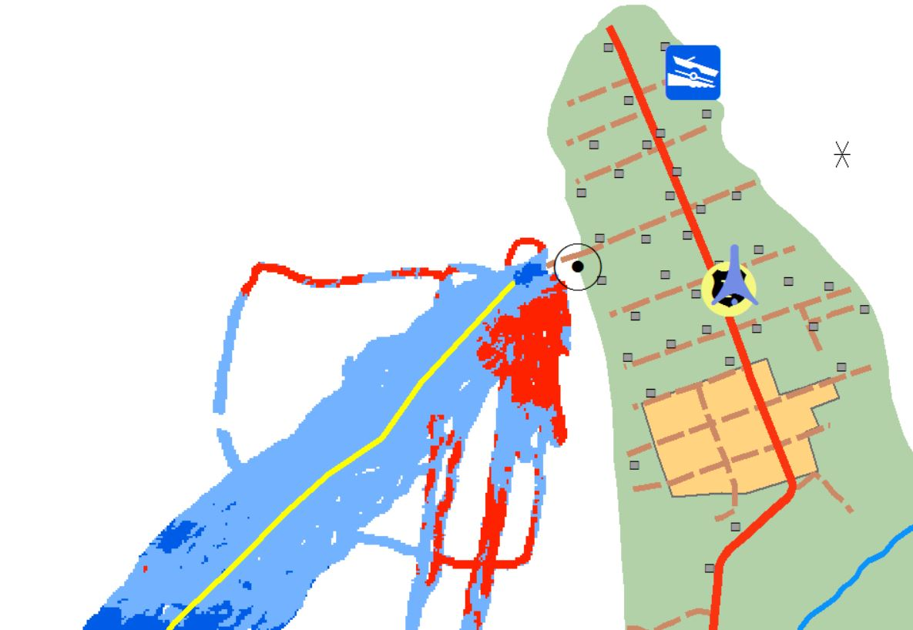
Sandy Point
Detail of landing point, survey data integrated in self-made topographic map; colorization customized for NL landing craft (red is NOGO)
Background: DNC COA16C (2017)

Slide 10
Observations (1)
Diplomatic clearance
Expedient
Arranged during transit to area (2 days)
Communications
Communication outside RNLN mil means difficult.
Satellite bandwidth limited
“The only communication means that worked was Whatsapp.”
Data
Started with no data
Handover from UK MOD: aerial photos, recce reports
Post-hurricane data is crucial for quick start-up
Key infrastructure data
DNC proved to be outdated

Slide 11
Observations (2)
CDEMA
Website very useful: accurate and up to date.
CDEMA situation reports: original shape files available?
MAP Action
Useful, but only PDF
Also supplier to CDEMA
NGA
Portal with a lot of data , but also big files
Not or difficult to download over limited satellite bandwidth.

Slide 12
Recommendation
Disaster Relief portals need to:
be very light on data sizes;
have an “expert use” section with GIS-downloads;
have updated post-event data

