Slide 1
21th Conference of the Mediterranean and Black Seas
Hydrographic Commission
(MBSHC)
National Report by
[FRANCE - Member]

Slide 2
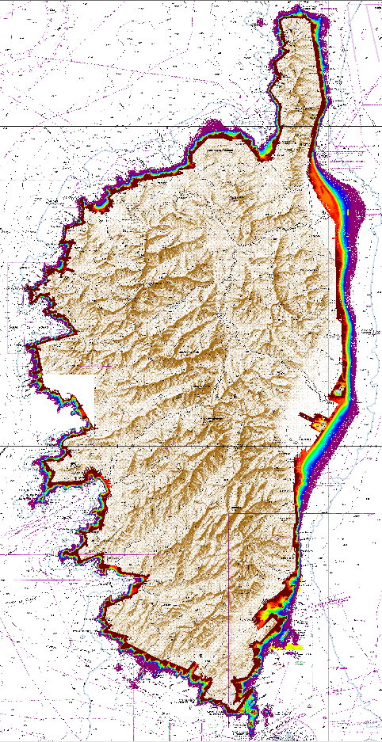
Progress on surveys
In Corsica, around the following harbours: Ajaccio, Propriano, Bonifacio, Porto-Vecchio, Macinaggio and Sant’Ambroggio
Oceanographic campaigns in Western Mediterranean sea
Lidar surveys

Slide 3
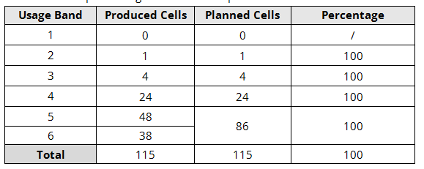
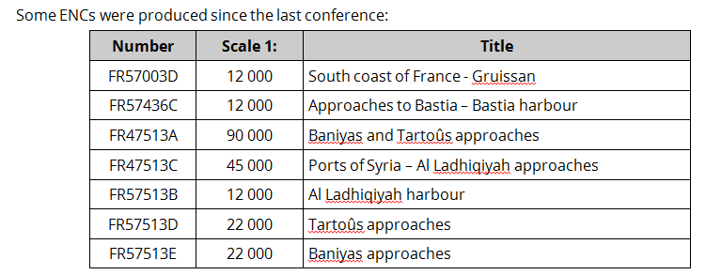
Progress on charting (ENC)
As of 1st May 2019, Shom has produced 687 ENCs, of which 115 ENCs within region F.
The ENC schema is now complete in region F. Details are provided in the table below:

Slide 4
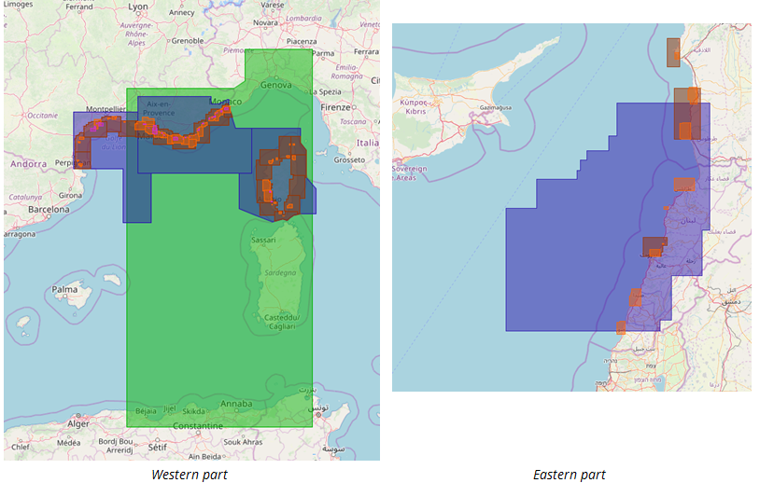
Progress on charting: ENC
The following figures are extracts from the online PRIMAR catalogue http://www.primar.org showing Shom ENC coverage within the MBSHC (region F) area:

Slide 5
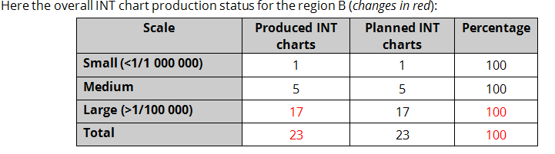
Progress on charting: INT – National charts
National charts - Since the last MBSHC conference:
27 charts have been produced or edited
+ 33 fac similes

Slide 6
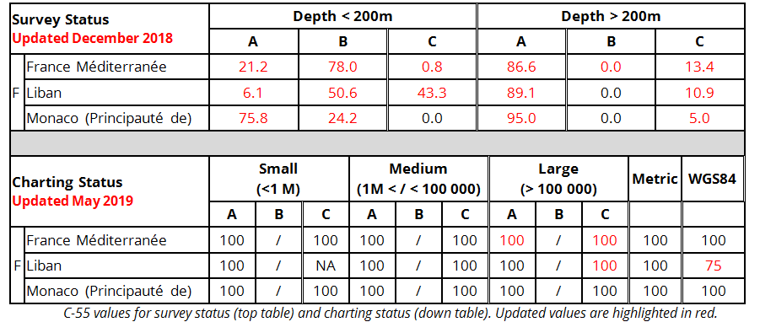
C-55 Latest update – Surveying and charting statutes
Updated values regarding Region F areas under Shom responsibility are summed up in the following tables :
A: adequately surveyed – B: Re-survey required - C: Never systematically surveyed
A: covered by INT or other paper charts – B: covered by RNC - C: covered by ENC

Slide 7

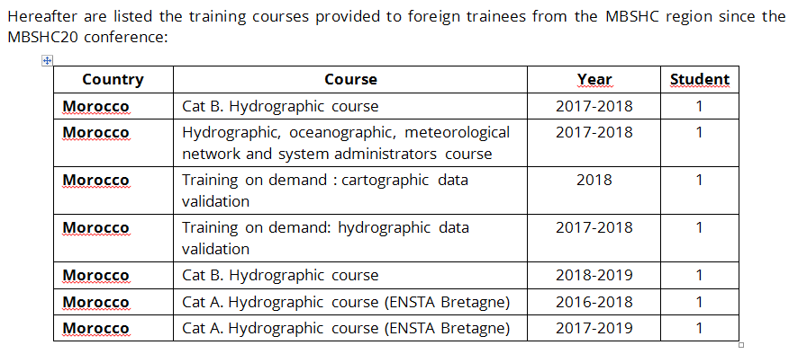
Capacity Building
FIG-OHI-ACI courses:
category B for hydrographic surveyors (Shom / Brest)
category B for nautical cartographers (Shom / Brest)
category A course for hydrographic surveyors (ENSTA Bretagne / Brest)

Slide 8
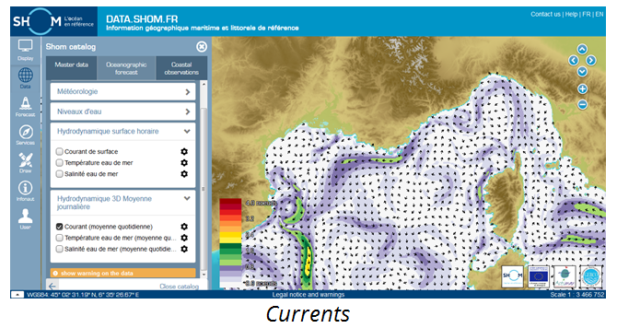
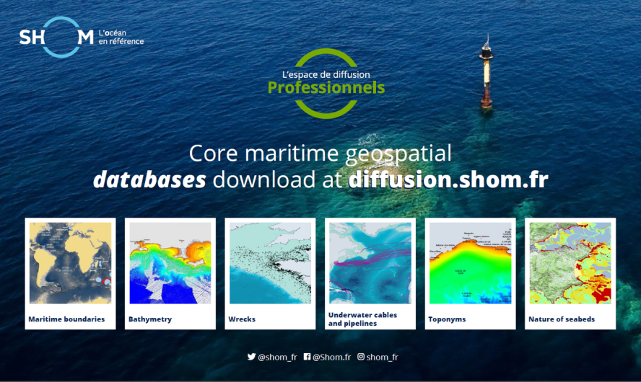
Progress on MSDI - Shom’s maritime and coastal geographic information portal
A detailed description of the portal functions and contents is available on Shom website (http://www.shom.fr/les-services-en-ligne/portail-datashomfr/).
Data available on that portal are organised according to the following topics:
Master data: charts, maritime boundaries, maritime and coastal databases, coastal altimetry , bathymetry, vertical datums, sedimentology, tides and currents and marine archives ;
Oceanographic forecast : sea state, meteorology, sea level, hydrodynamic ;
Coastal observations : tide gauge data

Slide 9
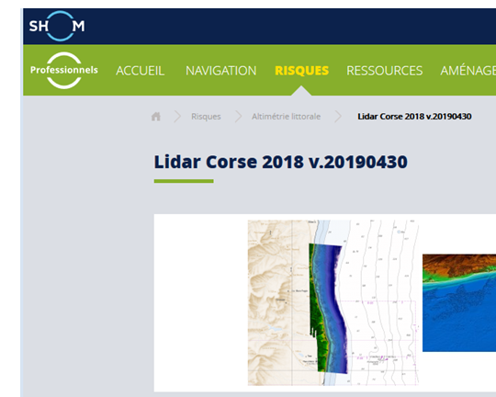
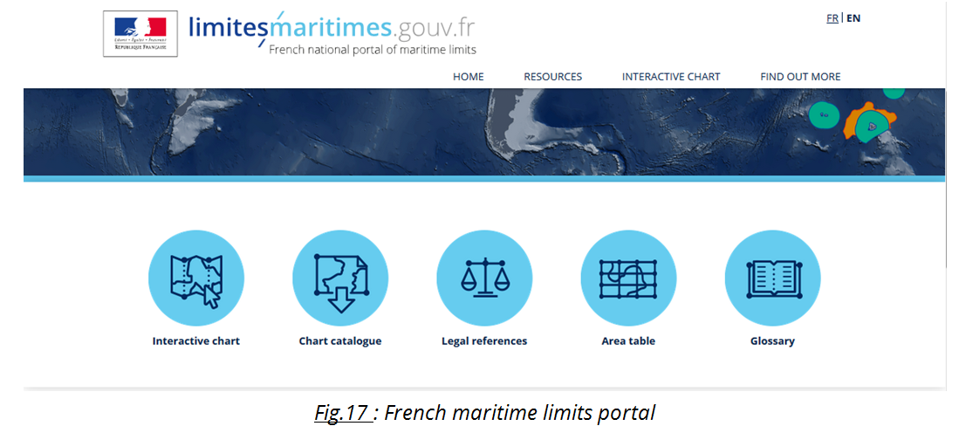
Progress on MSDI - Shom’s maritime and coastal geographic information portal

Slide 10
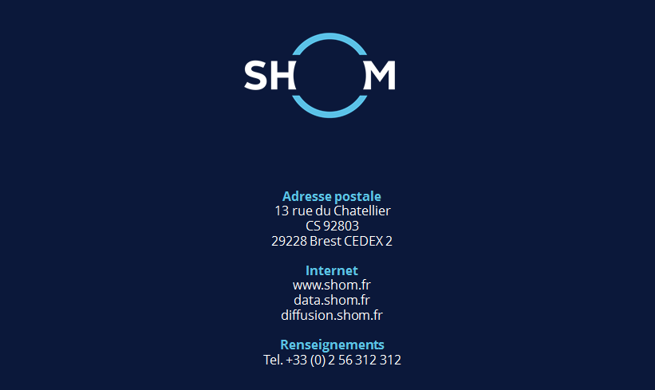
Thank you for your attention

