Slide 1
IRCC10 OUTCOMES: Introduction
IRCC work is guided by the IHO Work Programme 3
“Inter-Regional Coordination and Support” and by the Council key Priorities.
*IRCC10 was held in Goa, India, from 4 to 6 June 2019, hosted by the Indian National Hydrographic Office.
*The meeting was attended by the Chairs, or their representatives, of the 15 Regional Hydrographic Commissions (RHCs) and the IRCC subordinate bodies and 27 observers .
*Chaired by Dr Parry Oei (Singapore).
International Hydrographic Organization
Organisation Hydrographique Internationale

Slide 2
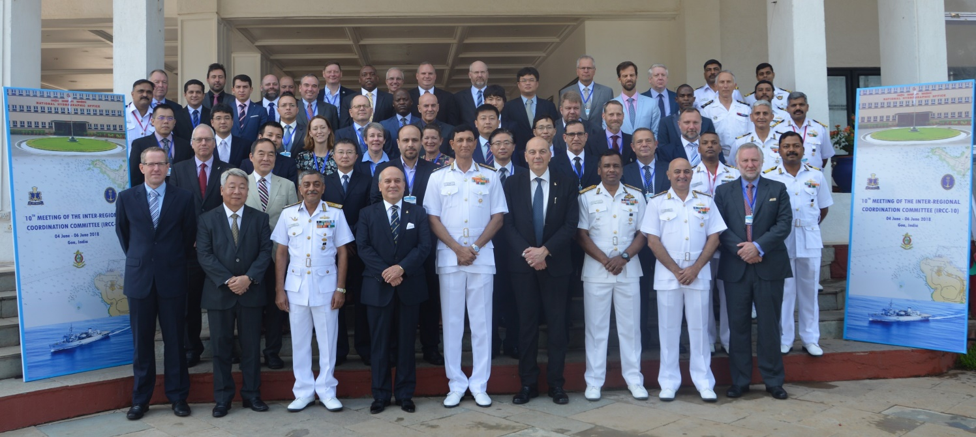
IRCC10 PARTICIPANTS:
The Participants to the IRCC10 Meeting
International Hydrographic Organization
Organisation Hydrographique Internationale

Slide 3
IRCC10 OUTCOMES- General:
*IRCC reviewed the reports and activities of its subordinate bodies and the RHCs and considered the need for enhancing regional coordination and cooperation.
*IRCC also considered the outcomes of the 1st meeting of the IHO Council (C-1), acknowledged the accomplishments and challenges of the Capacity Building programme and IBSC activities, examined the developments on Crowd-Sourced Bathymetry (CSB) and ocean mapping activities and considered issues related to the Worldwide ENC Database (WEND).
International Hydrographic Organization
Organisation Hydrographique Internationale

Slide 4
IRCC10 OUTCOMES:
*The IRCC reviewed and endorsed the amendments to the IRCC ToRs and RoPs proposed by the IHO Secretariat.
*The Committee considered and agreed on the revision of IHO Resolution 2/1997 as amended (Establishment of Regional Hydrographic Commissions - RHC).
International Hydrographic Organization
Organisation Hydrographique Internationale

Slide 5
IRCC10 OUTCOMES - Capacity Building :
*The meeting was informed of the achievements of the Capacity Building Programme and acknowledged the generous financial support from the Republic of Korea and from the Nippon Foundation of Japan, the in-kind support from Member States and industry stakeholders and the work of the RHC CB Coordinators and Project Leaders in these achievements.
International Hydrographic Organization
Organisation Hydrographique Internationale

Slide 6
IRCC10 OUTCOMES- Capacity Building, IBSC :
*The IRCC endorsed the proposed amendments to the CBSC ToRs and RoPs.
*The IRCC acknowledged the work done by the IBSC in the delivery of the new framework for the Standards of Competence for Hydrographic Surveyors and Nautical Cartographers.
*The meeting considered the impact of the work done by the IHO Secretariat to maintain publication C‑55 - Status of Hydrographic Surveying and Nautical Charting Worldwide.
International Hydrographic Organization
Organisation Hydrographique Internationale

Slide 7
IRCC10 OUTCOMES- WWNWS, MSI:
*IRCC10 was informed of the activities on World-Wide Navigational Warning Service (WWNWS), NAVAREAs and the progress on documentation of WWNWS.
*The Committee considered that MSI training courses led by the WWNWS-SC and sponsored by the CBSC are a critical issue for the continued success of MSI capacity building and the lack of qualified trainers, in particular in French and Spanish languages, will need to be addressed.
International Hydrographic Organization
Organisation Hydrographique Internationale

Slide 8
IRCC10 OUTCOMES- WEND:
*IRCC reviewed progress towards the full implementation of the WEND Principles and noted with concern that overlapping ENCs create confusion onboard ships and that the IHO community should strive to eliminate overlapping data.
*The Committee endorsed the proposal that the management of overlap cases should be addressed by RHCs.
*IRCC noted the WENDWG recommendation that all ENC data should be made available to the RENCs, not only for ensuring Quality Control in general, but also for risk assessment of overlapping ENCs.
International Hydrographic Organization
Organisation Hydrographique Internationale

Slide 9
IRCC10 OUTCOMES- WEND, RENCs:
*IRCC noted the recommendation that RENCs should consider offering an S-57 license management service to support safety of navigation for all classes of vessels.
*IRCC commended the work undertaken by both RENCs on their high-quality support to hydrographic offices and end-user service providers and for their contribution to Joint-RENC technical meetings.
*The Committee approved the proposed revisions to the WENDWG ToRs and RoPs and the continuation of the WENDWG activities.
International Hydrographic Organization
Organisation Hydrographique Internationale

Slide 10
IRCC10 OUTCOMES- GEBCO, Seabed2030:
*IRCC10 was informed of the activities of the General Bathymetric Chart of the Oceans (GEBCO) Project in particular the progress on Seabed 2030 Project.
International Hydrographic Organization
Organisation Hydrographique Internationale

Slide 11
IRCC10 OUTCOMES- CSB:
*IRCC endorsed the final draft version of the B-12 Guideline (IHO Guideline on Crowd-sourced Bathymetry, Edition 1.0.0) prior to final approval by the Council and Member States.
*The Committee approved the proposed revisions to the CSBWG ToRs and RoPs and tasked the WG to continue its work under the proposed revised ToRs in order to safeguard the implementation phase and future work on Edition 2 of the Guidelines.
*IRCC also acknowledged the work done by the CSBWG in the production of the draft CSB Guidance Document.
International Hydrographic Organization
Organisation Hydrographique Internationale

Slide 12
IRCC10 OUTCOMES- MSDI:
*IRCC10 reviewed the progress on global Marine Spatial Data Infrastructure (MSDI) activities and considered the development in Marine Spatial Planning (MSP) implementation worldwide.
*The Committee considered the impact of newly established United Nations Committee of Experts on Global Geospatial Information Management (UN-GGIM) Working Group on Marine Geospatial Information (MGIWG).
*The IRCC established the IHO Project Team on the implementation of the UN-GGIM Shared Guiding Principles for Geospatial Information Management (PPT) and endorsed the ToRs and RoPs of the PPT.
International Hydrographic Organization
Organisation Hydrographique Internationale

Slide 13
IRCC10 OUTCOMES- IHR, GIS:
*The Committee reviewed and endorsed the proposed amendments to the IHO Resolution 6/2009 (International Hydrographic Review - IHR).
*IRCC also noted the outcomes of HSSC10 and its relation to the IRCC activities.
*The meeting considered the benefits of having solid infrastructure in the IHO Secretariat to support the IHO Member States and the subordinate bodies, and the developments in databases and online services, in particular the IHO Geographic Information System (GIS) tools.
International Hydrographic Organization
Organisation Hydrographique Internationale

Slide 14
IRCC10 OUTCOMES- Key Priorities:
*IRCC considered and agreed with its key priorities for 2019:
Capacity Building Provision,
INT chart and ENC schemes,
Crowd Sourced Bathymetry,
Project Seabed 2030,
Marine Spatial Data Infrastructures.
International Hydrographic Organization
Organisation Hydrographique Internationale

Slide 15
IRCC10 OUTCOMES- Next Meeting:
*11th meeting of the IRCC will take place in Genoa, Italy, from 3 to 5 June 2019, hosted by the Italian Hydrographic Institute
*The 12th meeting is planned to be held in Poland (in 2020).
International Hydrographic Organization
Organisation Hydrographique Internationale

