Slide 1
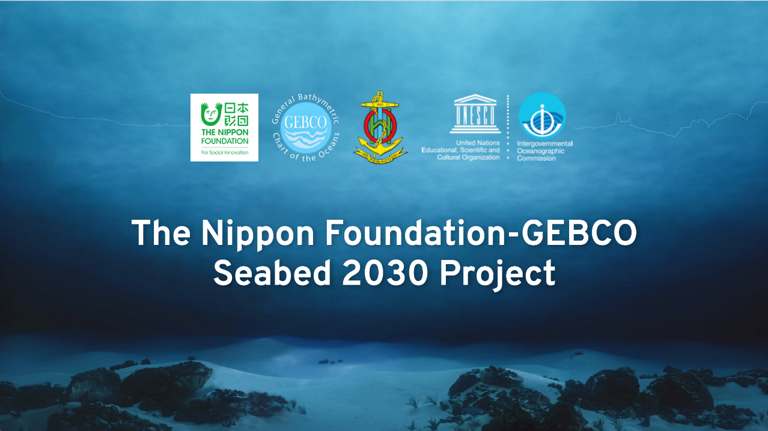
Vicki Ferrini, PhD
Head, Seabed 2030 Regional Data Center for the Atlantic and Indian Oceans
Lamont-Doherty Earth Observatory of Columbia University

Slide 2


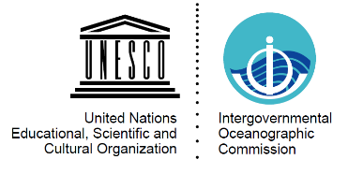

Seabed 2030
A collaborative project between The Nippon Foundation and GEBCO to inspire the complete mapping of the world’s ocean by 2030 and to compile all bathymetric data into the freely-available GEBCO Ocean Map.
-The Nippon Foundation is a private Japanese-based, non-profit grant-making organization with a mission based around philanthropic activities to pursue global maritime development and assistance for humanitarian work.
-The General Bathymetric Chart of the Oceans (GEBCO) organization operates under the joint auspices of the International Hydrographic Organization (IHO) and the Intergovernmental Oceanographic Commission (IOC) of UNESCO

Slide 3
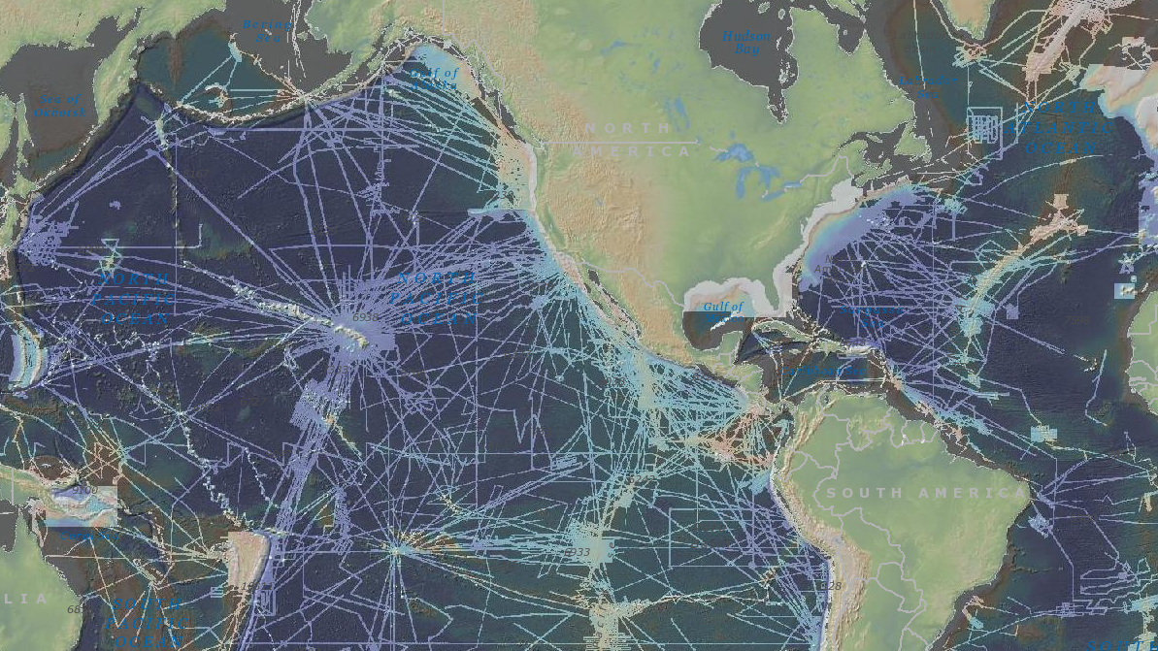
Empower the world to make policy decisions, use the ocean sustainably, and undertake scientific research that is informed by a detailed understanding of the global ocean floor.
Only a small portion of the ocean has been mapped with direct measurement.
~ 50% of the world’s coastal waters remain unsurveyed*
*IHO publication C-55, Status of Surveying and Charting Worldwide

Slide 4
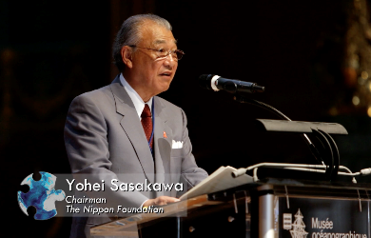
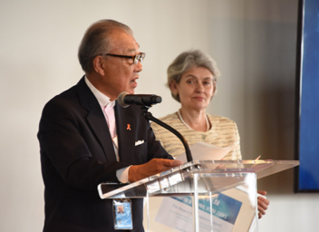
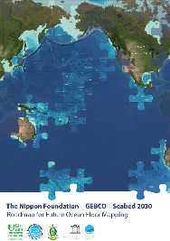


The Nippon Foundation – GEBCO Seabed 2030 Project
Vision Established through 2016 Forum for Future Ocean Floor Mapping
Project Announced at 2017 UN Ocean Conference

Slide 5
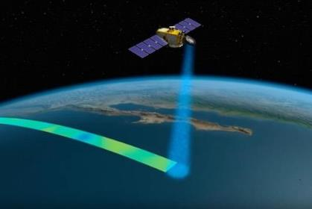
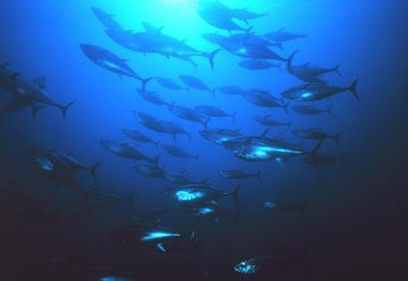
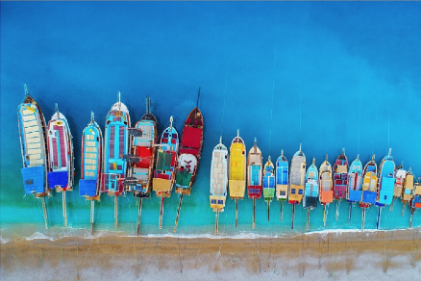
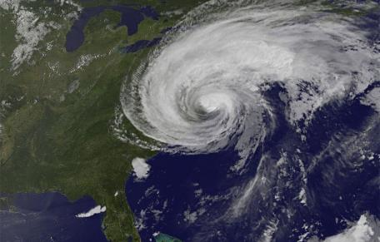
Why are Bathymetry Data Important?
Nautical charts
Oil and gas exploration
Safety and storm surge/tsunami inundation models
Ecosystem identification and management
Emergency response
Satellite verification models
Ocean Models
Coastal/Marine Spatial Planning
Coastal Hazard Assessment
Ocean Exploration
Coastal Change Analysis
Sea Level Rise Mitigation
New Energy Siting
Marine heritage

Slide 6
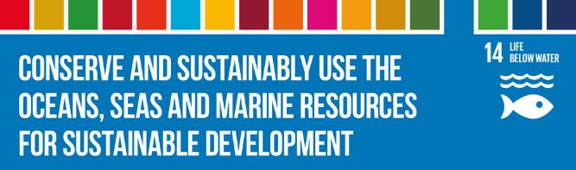
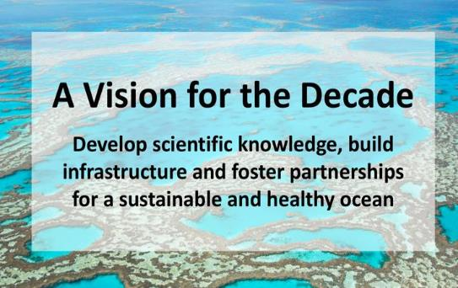
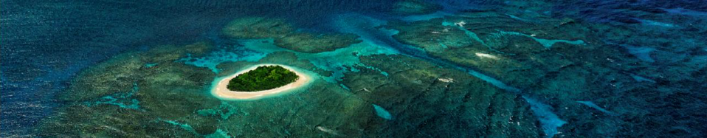
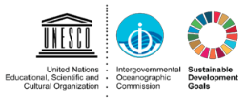
The UN Decade of Ocean Science
for Sustainable Development (2021-2030)
SDG14 will not be achievable without a
comprehensive map of the world ocean floor

Slide 7
Seabed 2030 Strategy
Partnership
Work with all stakeholders to form a global coalition dedicated to giving the world a complete GEBCO Ocean Map.
Sharing and acknowledging
Encourage and facilitate the sharing of bathymetric data, giving due acknowledgement to Partners and data contributors.
Invest in human capacity development
Invest in capacity development to increase skills and greater capacity in ocean mapping, and meet growing needs of big data analysis and visualization.
Leverage technology innovation
Work with technology partners to apply new mapping and data analysis techniques to support Seabed 2030’s mission.

Slide 8
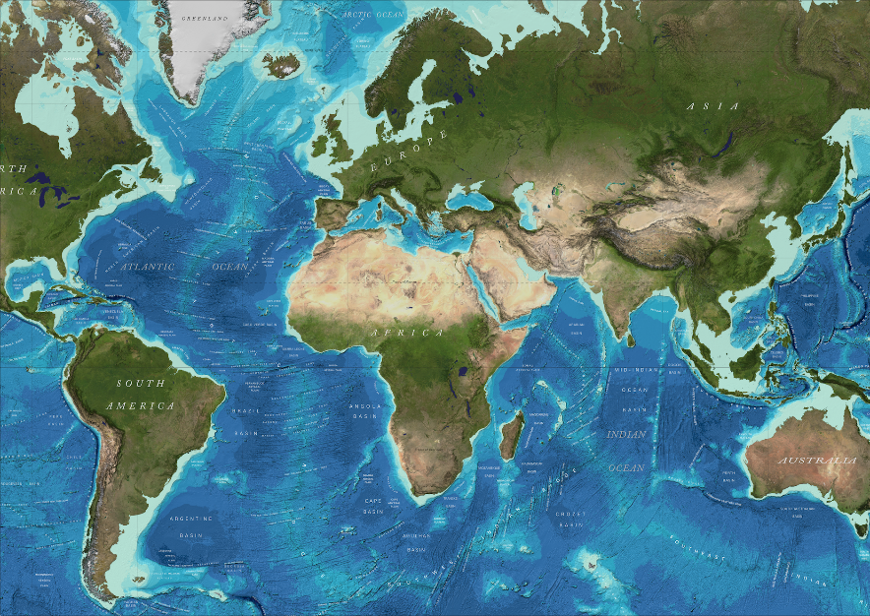
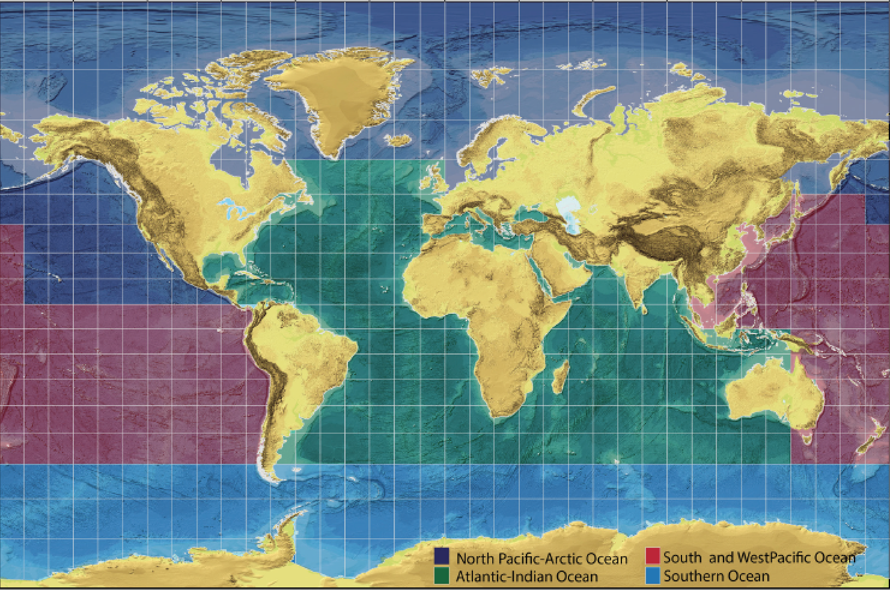
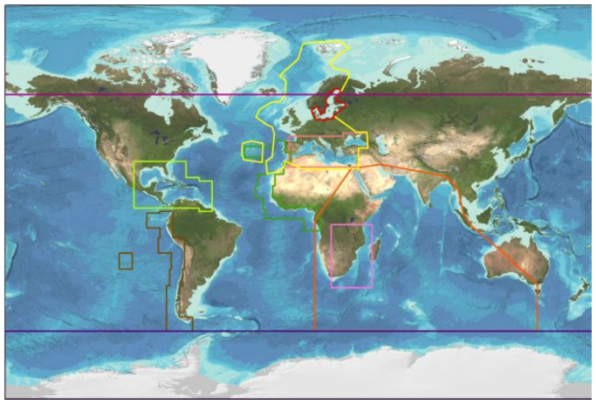
Seabed 2030 Regional Data Assembly
Global
Regional
National
Collaboration and cooperation at local, regional and global scales
Regional IBCs
Seabed 2030 Regional Compilations
GEBCO Global Products

Slide 9
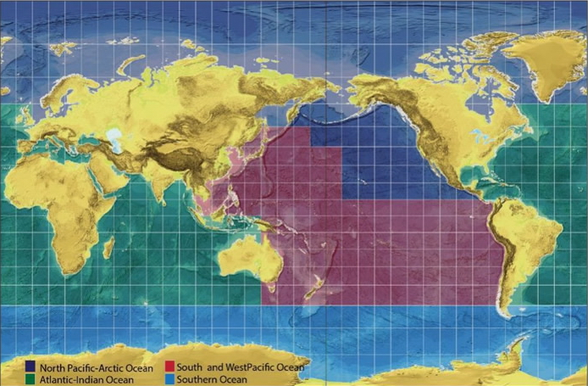
Seabed 2030: Data Centers
Coordinate with stakeholders
Build upon ongoing regional efforts including IBCs
Develop mechanisms for attribution
Assemble regional & global data products
SU
AWI
NOC
CCOM
LDEO
NIWA/GNS/LINZ

Slide 10




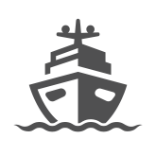
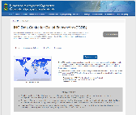
Data Sources: Power of the Crowd
Fishing
Government
  Survey Vessels
Academic
  Research Vessels
Industry
  Survey Vessels
  Cruise Ships
  Fishing Boats
Public
  Private Boats and Yachts
  Recreational Mariners
Tourism
Private
Survey
Research

Slide 11
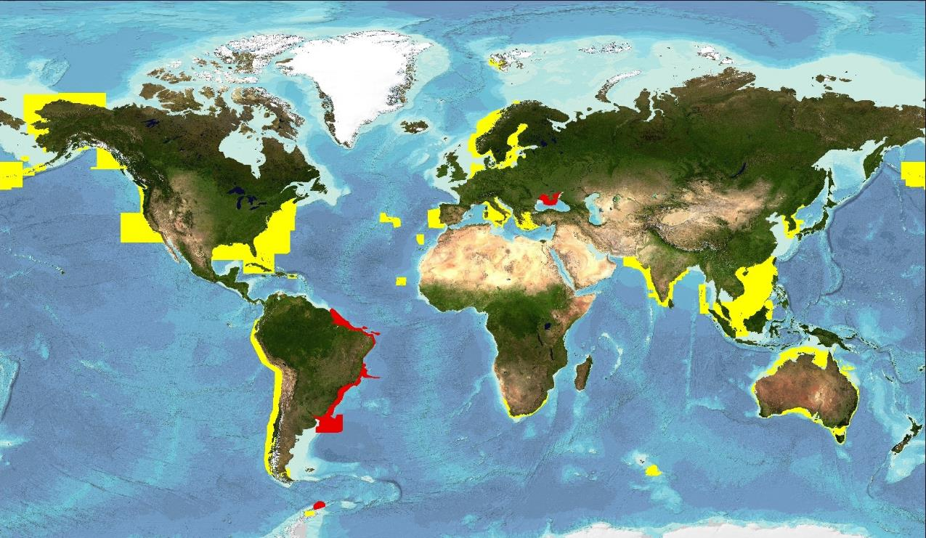
ENC Data Contributions to GEBCO
Usage bands 2 & 3 provided after IHO calls
2006 (yellow) and 2016 (red)

Slide 12
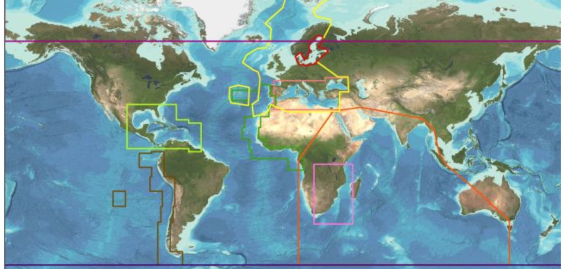
Coordinating with IBCs
Seabed 2030 Atlantic/Indian Oceans Data Center
  IBC of the Caribbean Sea & Gulf of Mexico (IBCCA)
  IBC of the Central Eastern Atlantic (IBCEA)
  IBC of the Mediterranean (IBCM)
  IBC of the Western Indian Ocean (IBCWIO)
Seabed 2030 South & West Pacific Data Center
  IBC of the South Eastern Pacific (IBCSEP)
Seabed 2030 Arctic/North Pacific Data Center
  IBC of the Arctic Ocean (IBCAO)
  IBC of the Caribbean Sea & Gulf of Mexico (IBCCA)
Seabed 2030 Southern Ocean Data Center
  IBC of the Southern Ocean (IBCSO)
Global
Regional
Regional

Slide 13
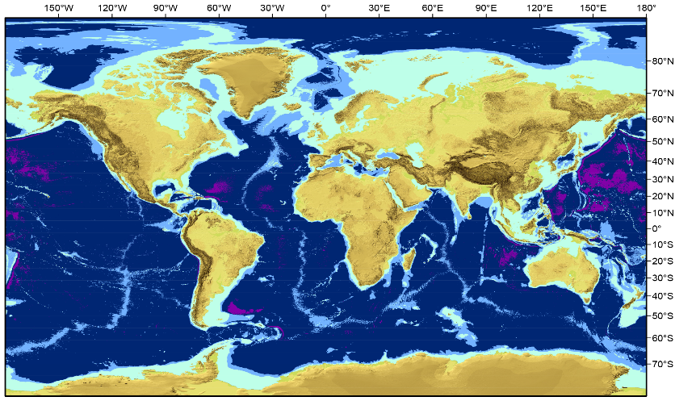
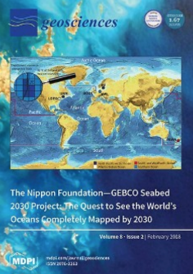
What does “100% mapped” mean?
Depth-dependent resolution goals
100x100 m (0-1500 m)
200x200 m (1500-3000 m)
400x400 m (3000-5750 m)
800x800 m (5750-11000 m)
Mayer et al., 2018

Slide 14
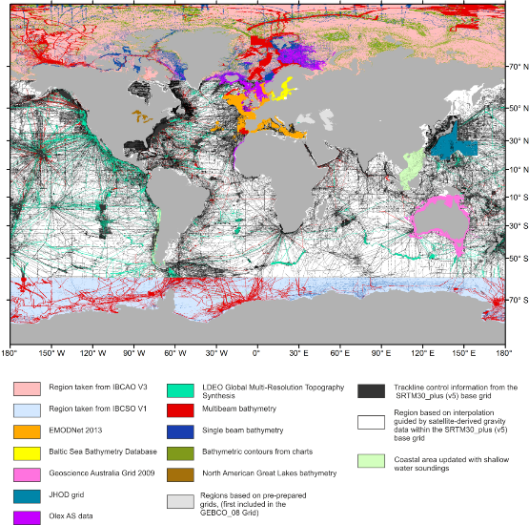
How much of the ocean is mapped?
X + Y + Z = 100%
known
X: Data in GEBCO products
Y: Data that exists but are not yet integrated
  Public
  Embargoed
Z: Data that must be acquired
unknown

Slide 15
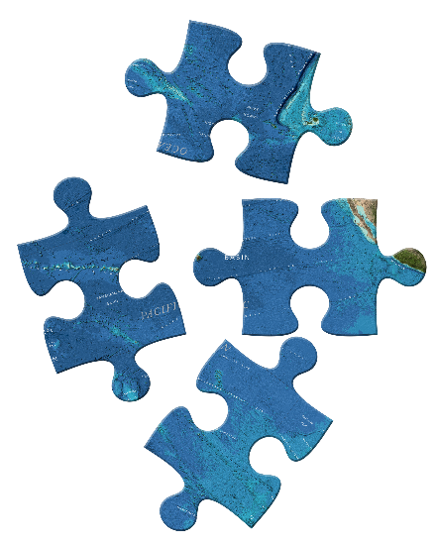
Completing the Map
Existing data not yet integrated
Gather information about existing data even if embargoed
Facilitate data sharing
New Data Acquisition
Identify gaps in coverage
Inform new acquisition
Technology innovation
Accelerate uptake of new technology
X + Y + Z = 100%

Slide 16
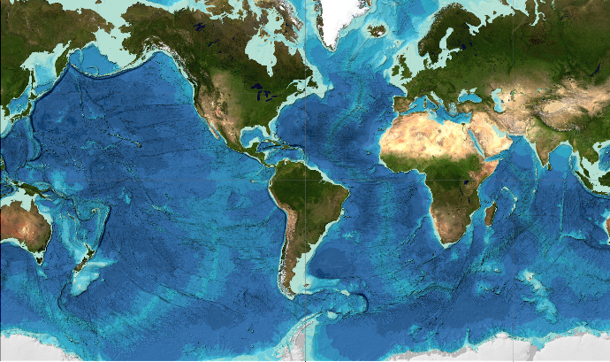
GEBCO 2019
Released April 2019
15 arc second grid
Coverage more than doubled
  GEBCO 2014: 6% of goal
  GEBCO 2019: 15% of goal
New data from all sectors
  Government
  Academia
  Industry
  Private
doi:10/c33m

Slide 17
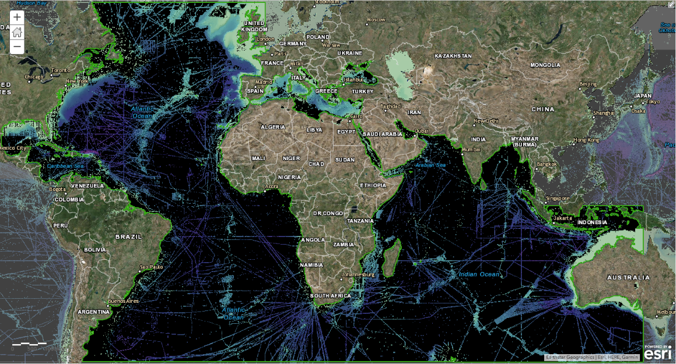
GEBCO 2019 – Atlantic/Indian Region

Slide 18
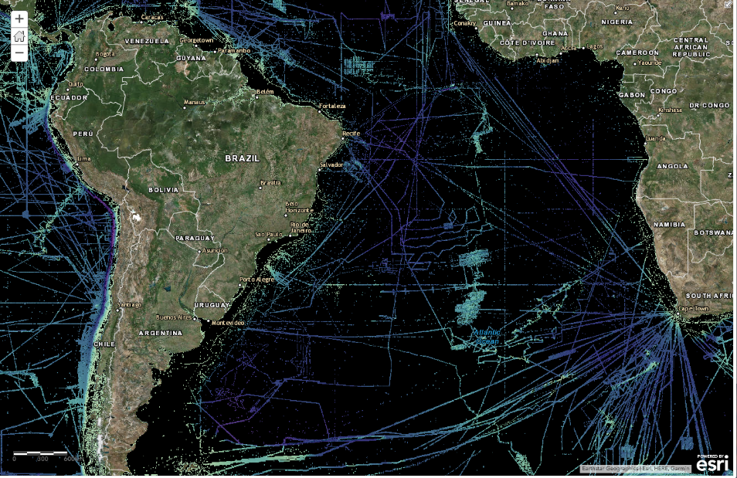
GEBCO 2019 – South Atlantic

Slide 19
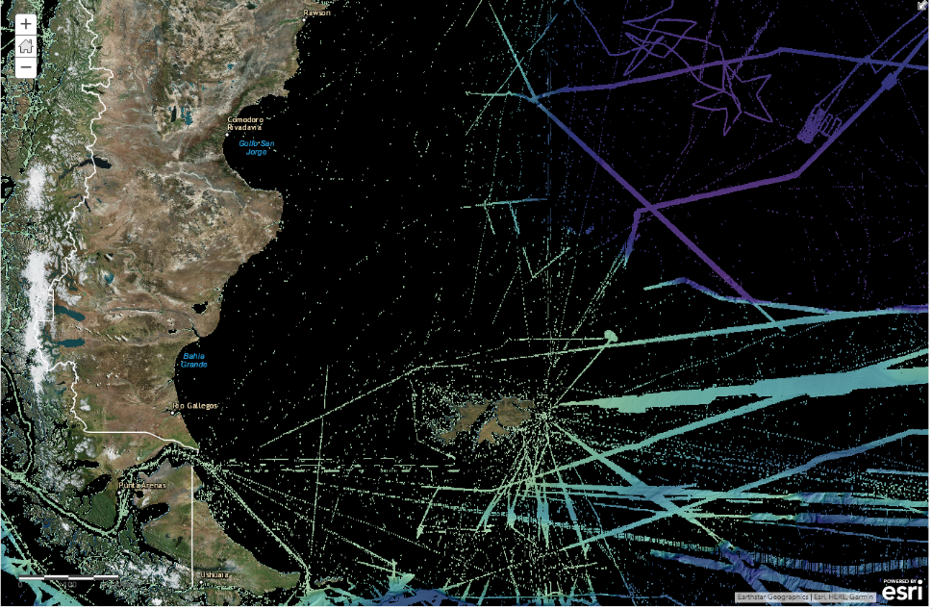
GEBCO 2019 – Southwest Atlantic

Slide 20
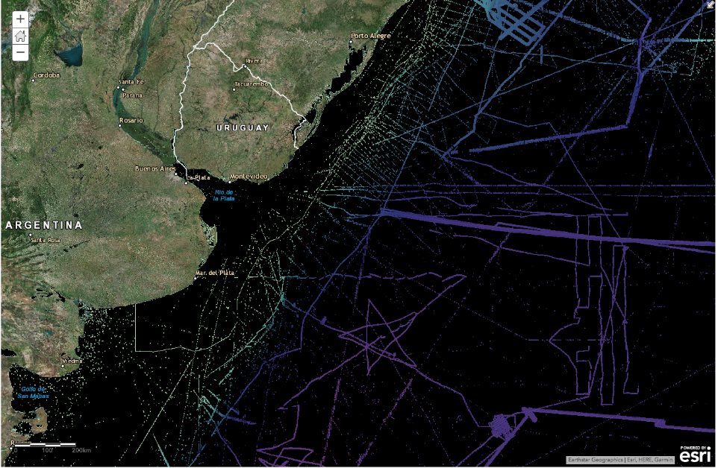
GEBCO 2019 – Southwest Atlantic

Slide 21
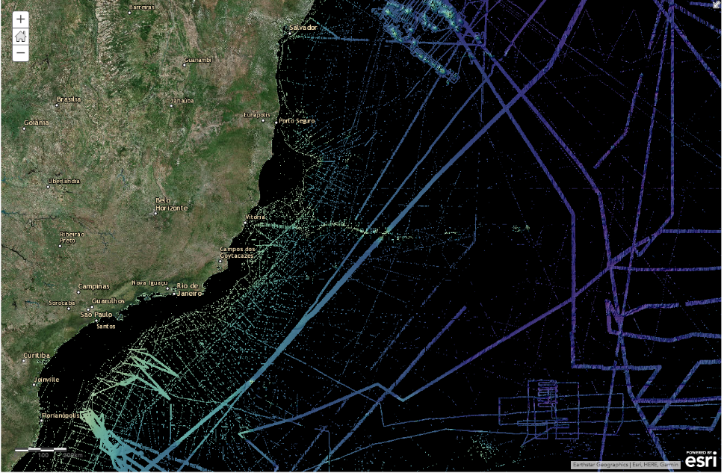
GEBCO 2019 – Southwest Atlantic

Slide 22
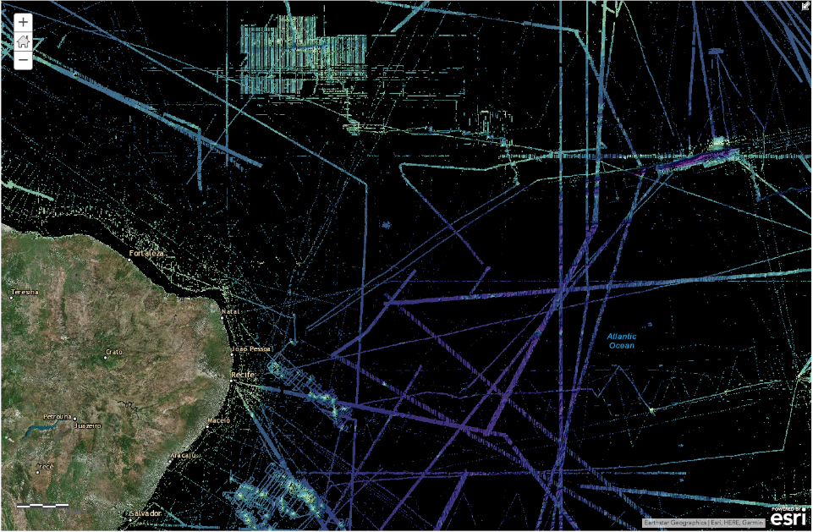
GEBCO 2019 – Southwest Atlantic

Slide 23
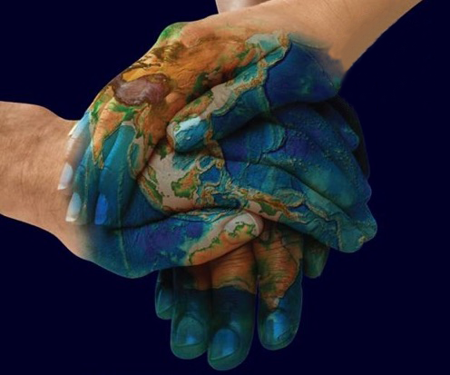

How to participate
Contribute information about existing data coverage
Contribute data
  Gridded data products
  Points from ENCs
Share information about future mapping plans
Engage with Data Centers
Support and promote GEBCO activities and products
seabed2030.org
@seabed2030

Slide 24
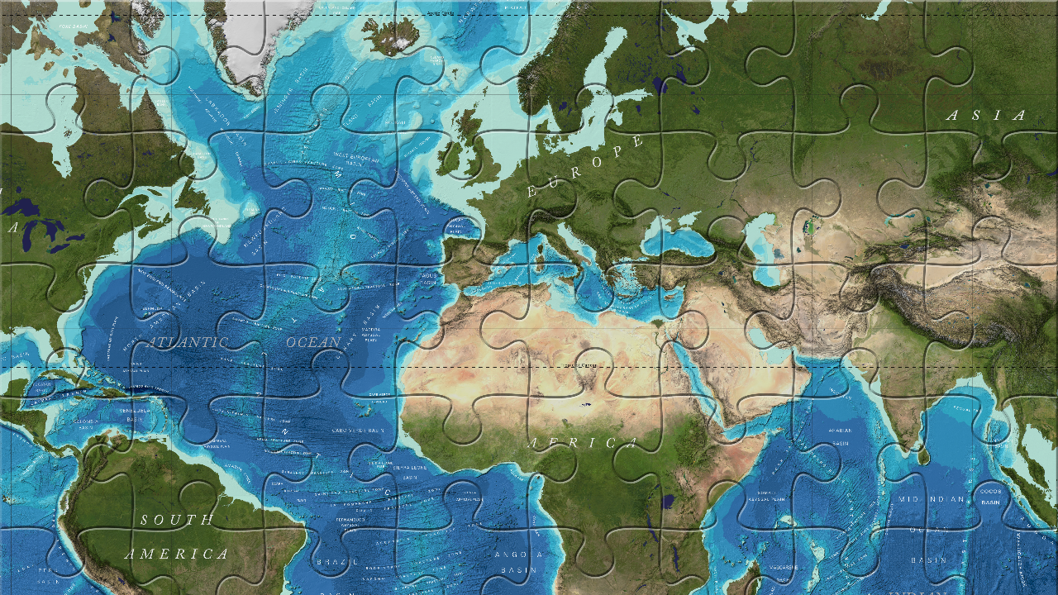
Thank you!
seabed2030.gebco.net

