Slide 1
15th Meeting of the
South West Pacific
Hydrographic Commission
Report by the IHO Secretariat

Slide 2
Entry into force of the Amendments to the IHO Convention and its supporting Basic Documents
Revised Convention entered in to force: 8 November
  the term International Hydrographic Bureau (IHB) is replaced by the term IHO Secretariat;
  the Directing Committee, comprising a President and two Directors ceases to lead the IHB (Secretariat of the IHO). Instead, the Secretariat of the IHO is now led by a Secretary-General assisted by two subordinate Directors;
  the term International Hydrographic Conference is replaced by the term Assembly. The ordinary sessions of the Assembly will be held every three years instead of every five years for the Conference. The first session of the IHO Assembly (A-1) was held in Monaco from 24 to 28 April 2017, at which time an IHO Council was established. The first meeting of the Council (C-1) took place in October 2017 and annually thereafter.

Slide 3
Ratification of Protocol of Amendments on IHO Convention
the subsidiary organs, including the Committees, of the IHO will report to the Council that will then refer endorsed proposals for adoption either to the Assembly or to the Member States through correspondence;
the planning cycle for the IHO work programme and budget changes from a five-year to a three-year cycle. The next cycle will run from 2018 to 2020.
for States wishing to join the IHO that are already Member States of the United Nations there is no requirement to seek the approval of existing Member States of the IHO; and
in future, decisions will be taken based on a majority of the Member States that cast a vote, rather than the existing arrangements where a majority of all the Member States entitled to vote is required. A minimum number of at least one-third of all Member States eligible to vote must vote positively for a vote to stand.

Slide 4
  Regional States not yet MS of the IHO
UN MS eligible to join IHO without requirement for IHO MS approval
Kiribati
Marshall Islands
Micronesia (Federated States of)
Nauru
Palau
Samoa
Solomon Islands
Tuvalu
Notes:
Solomon had applied before the amendments came into force. Need to apply under the news rules.

Slide 5
Eligible to join IHO, but requiring special consideration
Cook Islands
Niue
Neither are Member States of the United Nations, but, have had their "full treaty-making capacity" recognised by the United Nations Secretariat

Slide 6
INT Chart and ENC Production Coordination - Region L
The current web-based version of S-11 Part B for Region L is Edition 3.0.3 dated January 2018.
This new edition reports that 62 INT charts are available to date, out of 67 charts.
Note CL11/18 - Adoption of revision 3.1.0 S-11 Part A
Note CL19/18 – Adoption of new IHO resolution on the elimination of overlapping ENC data. WENDWG will consider the outcome of this resolution at 8th mtg scheduled in MARCH 2018.
SWPHC ENC Producers to provide their CATZOC guidelines to the DQWG.

Slide 7
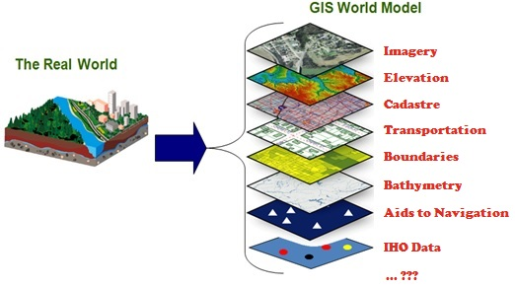
IHO GIS and Databases
avoid duplication of data and inputs
enable data visualisation
enable data fusion and analysis
provide GIS data layers for RHCs and Member States
enable publication and website updates (P-5, C-55, etc.)

Slide 8
IHO GIS and data base developments
Country Information Data base
  Is your data up to date in the Yearbook / database ?
“C-55” database
  Is your data up to date in the C-55 database ?
  Important to liaise with the Primary Charting Authority
ENC catalogue
INToGIS database
  INT chart coverage

Slide 9
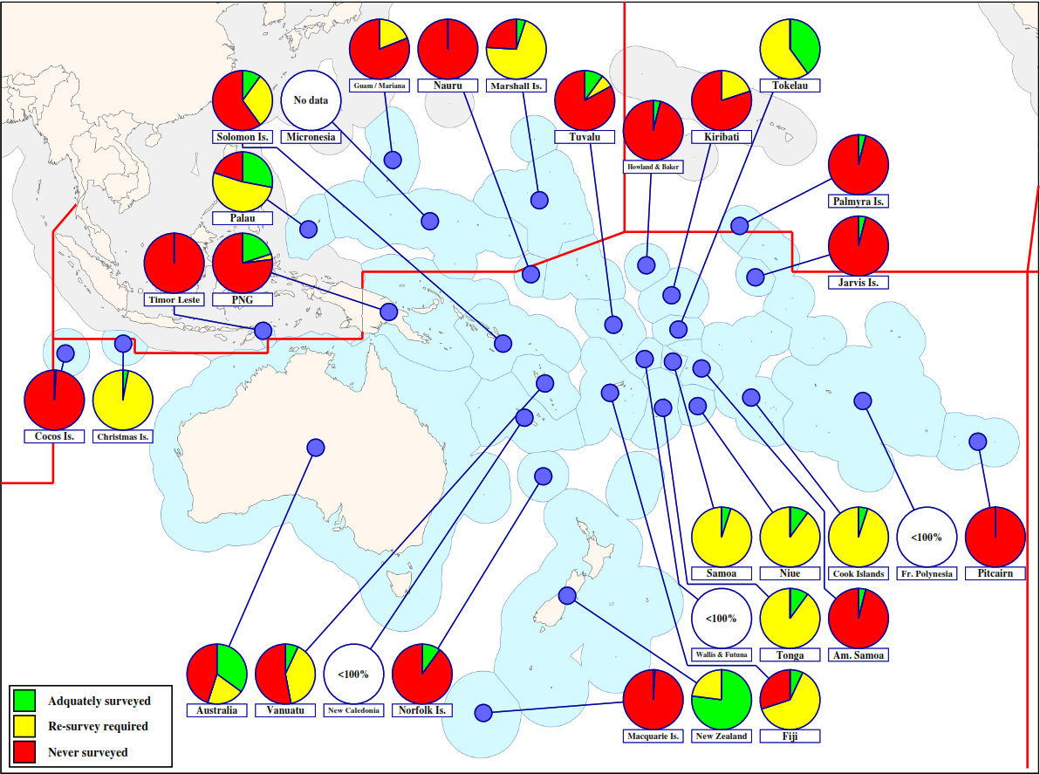
IHO GIS and Databases - C-55 …..
Status of hydrographic surveys for depths < 200m

Slide 10
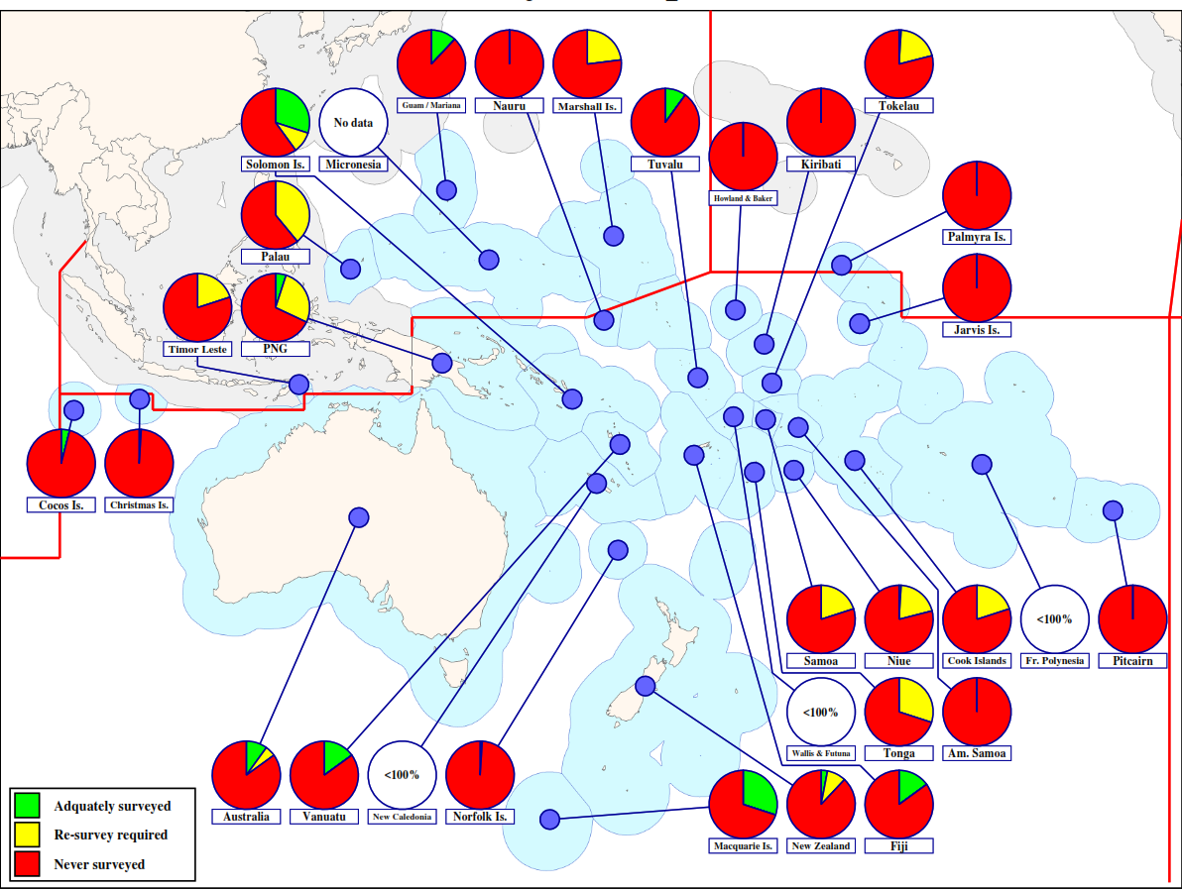
IHO GIS and Databases - C-55 …..
Status of hydrographic surveys for depths > 200m

Slide 11
IHO Council established by A-1 in 2017. Summary:
annual meetings in October
Seats allocated to a region, but a country - not a region, occupies the allocated seat(s)
no substitutes or changeovers during the inter-Assembly period
most proposals will be considered by the Council before being presented to all Member States for voting
Council will approve annual budget and work programme

Slide 12
1st Meeting of the IHO Council
17 to 19 October 2017 in Monaco
  Committee/IHO Secretariat reports on WP progress
  Amendments to IHO Resolutions endorsed
  new Resolution about the methodology and timetable to deal with financial statements endorsed
  Revised publications endorsed
  Proposals for Member States’ approval

Slide 13
1st Meeting of the IHO Council (cont.)
SG established a full-time CB Assistant at the Secretariat by re-arranging other positions
key priorities in the IHO 2018 work programme and budget endorsed
Strategic Plan Review Working Group (SPRWG), France (Chair), Japan (Vice-Chair), Canada (Sec.)
Next meeting: London, UK (9-11 October 2018)

Slide 14
Publicity and Outreach
World Hydrography Day 2018:
  Bathymetry – the foundation for sustainable seas, oceans and waterways
International Hydrographic Review

Slide 15
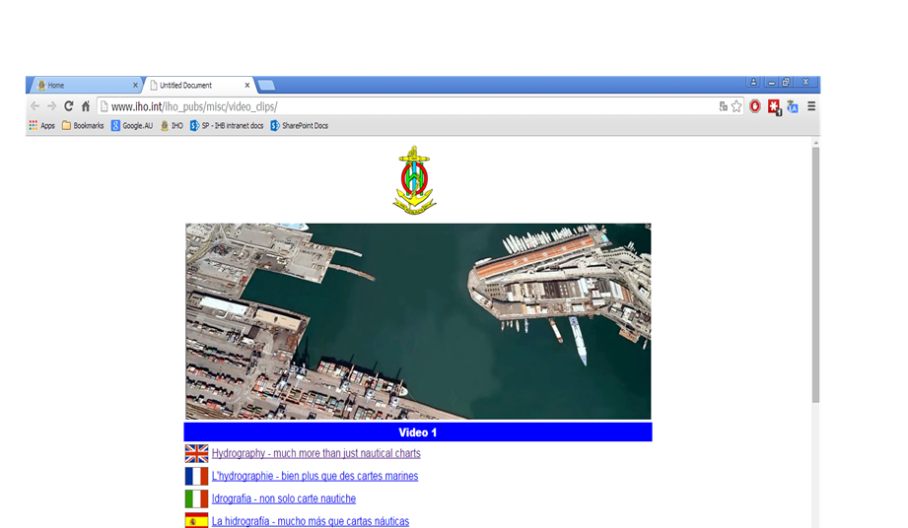
Publicity and Outreach
video clips on “what is hydrography ?”
available from the IHO website in English, French, Spanish, Italian, Portuguese, Japanese, Korean, etc.
New video: “… become a hydrographer” (Hydrography as a career)

Slide 16
Actions requested of SWPHC:
to note this report
to consider the recommendations on Charting as presented in Paragraph 10 of the report:
  a) providing report and inputs to the WENDWG, prior to the 8th meeting in March
  b) providing CATZOC practices to the DQWG
  c) the maintenance of ENC Schemes when the INToGIS Phase II is commissioned
  d) keeping to the IHO Secretariat informed of the existence of their bilateral agreements if they act as primary charting authorities on behalf of small island States.

Slide 17
Actions requested of SWPHC (cont.):
to consider the recommendations on MSI as presented in Paragraph 13 for all coastal States in the SWPHC to:
  a) provide the regional NAVAREA Coordinators with regular flow of MSI
  b) maintain regular communication with the regional NAVAREA Coordinators and inform of any change of personnel or contact details
  c) use and following the guidance provided in S-53 – Joint IMO/IHO/WMO Manual on Maritime Safety Information
to consider the recommendations as presented in Paragraph 14 for the SWPHC Chair to direct the regional NAVAREA Coordinators to provide a clear indication on the state of the provision of MSI within the region.

Slide 18
Actions requested of SWPHC (cont.):
to consider the recommendations on GMDSS as presented in Paragraph 17 for all coastal States in the region to check the information published in the IMO GMDSS Master Plan and that published by the IHO in C-55 (often different)
to consider investing in the preparation of candidates for the Category "A" hydrography programme (Paragraph 21)
to consider applying for the Category "B" cartography programme (Paragraph 22)
to review entries related to IHO C-55 and P-5 (Yearbook) at least annually (Paragraph 30)

Slide 19
Actions requested of SWPHC (cont.):
to consider appropriate arrangements to prepare for the 2nd Meeting of the IHO Council (Paragraph 32)
to consider submitting papers for publication in the International Hydrographic Review (Paragraph 34)
take any other actions as considered appropriate

Slide 20
IHO Secretariat, here to help you! www.iho.int abri.kampfer@iho.int alberto.neves@iho.int

