Slide 1
Capability
For
Hydrographic
Capacity Building:
Industry Partnering
Derrick R. Peyton
IHO SWPHC
February 2018

Slide 2
IIC Technologies
is a
Global Provider Of Geospatial Solutions And Services
www.iictechnologies.com

Slide 3
Capacity Building..…
Capacity Building (CB) - Concept
CB is defined as the process by which the IHO assesses and assists in sustainable development and improvement of the States, to meet the objectives of the IHO and the obligations and recommendations related to hydrography, charting and maritime safety as described in SOLAS Chapter V, UNCLOS and other international instruments.
Training is not capacity building but an activity that is a component of a capacity building strategy…

Slide 4
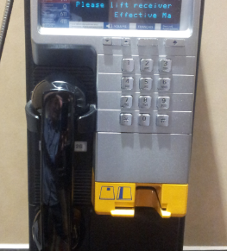
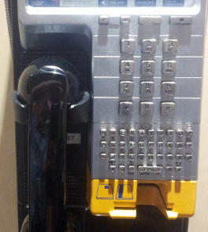
Capacity has many variations…
Did this company have the capacity to jump to cell phones?
“Sometimes the Capacity Builders do not have the Capacity”

Slide 5
Hydrographic Value Chain
Data Value Chain
Data Acquisition
Survey Data Processing
Marine Products
Verification & Validation
Updating & Maintenance
Hydrographic
Geophysical
Oceanographic
Airborne Lidar
Satellite
Bathy Data Cleaning
Surface Modeling
Image processing
Deconfliction
ENCs / IENCs
Military Overlays
Paper Charts
Geophysical Products
Spatial Accuracy
Feature Verification
Logical Consistency
3rd Party Checks
Vertical/Horizontal Consistency
Database maintenance
Data Assessment
Data critical updates
Data management
Data warehousing
Education & Training

Slide 6
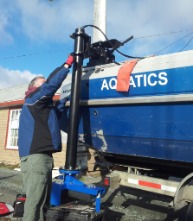
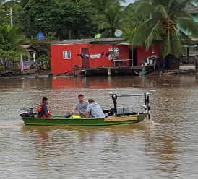
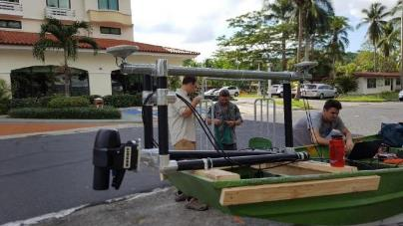
Data Acquisition…
Canada
Satellite Derived Bathymetry / Airborne Bathy Lidar / Multibeam Surveys

Slide 7
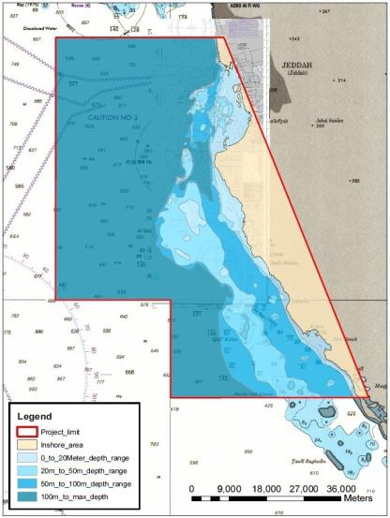
MV Mariner (54m length)
MBES / SBES
Survey on ellipsoid
Survey on chart datum
Bottom sampling
MBES Imagery
DF SBES sub-bottom
QC QC data processing
Observe conspicuous objects
Measure water currents
Measure Sound Velocity
L&R 9m survey launch
Report of Survey
Bathy Lidar Survey
Airplane
Hawkeye lidar
Initial post processing
Initial QA/QC processing
Sub-Report of Survey
Processing Centre
MBES / SBES / Lidar
Cleaning
Field sheet generation
Data management
Sub-Report of Survey
Survey Launch (9m length)
MBES hydrographic
Survey on ellipsoid
Survey on chart datum
Shoal & wreck exam
Bathy Lidar gaps
MBES Imagery
Project Support
Ship supplies, water , fuel
Licensing, visas, clearances
Land transport, hotel
Aircraft logistical support
GCS client liason
Support Vessel
Secchi disc
People transfer
Grab sampling
Data transfer
Medical transfer
Establish 2m x 2m cube
MBES hydrographic
Survey on ellipsoid
Survey on chart datum
Shoal & wreck exam
Bathy Lidar gaps
MBES Imagery
Establish Tide Gauges
survey, install benchmarks
Survey geodetic coordinates
Establish Base stations
Survey geodetic coordinates
Establish GPS RTK stations

Slide 8
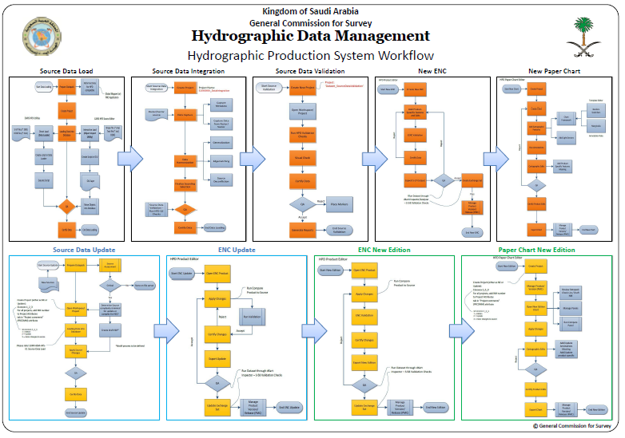
ISO 9000, SOPs, WfMS, Training, Web Portal…

Slide 9
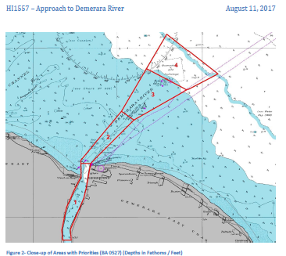
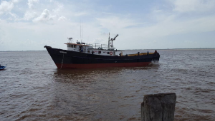
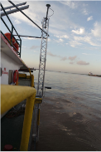
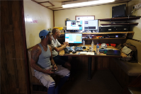
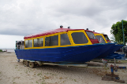
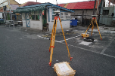

Slide 10
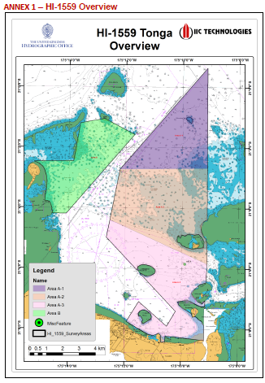
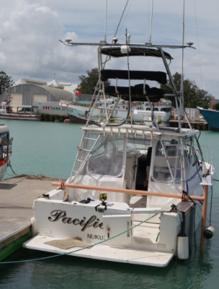
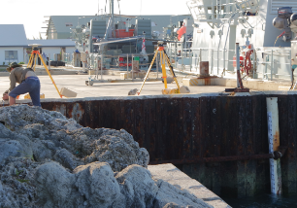
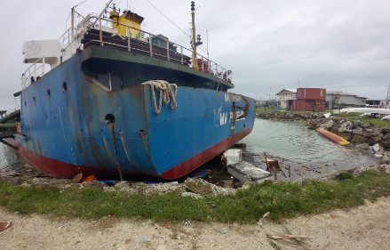
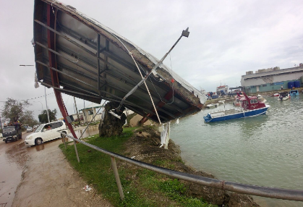

Slide 11
Hydrographic Value Chain
Data Value Chain
Data Acquisition
Survey Data Processing
Marine Products
Verification & Validation
Updating & Maintenance
Hydrographic
Geophysical
Oceanographic
Airborne Lidar
Satellite
Bathy Data Cleaning
Surface Modeling
Image processing
Deconfliction
ENCs / IENCs
Military Overlays
Paper Charts
Geophysical Products
Spatial Accuracy
Feature Verification
Logical Consistency
3rd Party Checks
Vertical/Horizontal Consistency
Database maintenance
Data Assessment
Data critical updates
Data management
Data warehousing
Education & Training

Slide 12
Data Production / Data Management…
16 cartographers embedded in NOAA charting division
Hydrographic Data Base (HDB) using Citrix technology
Hydrographic Data Base (HDB) using Citrix technology
HPD Paper Chart Master creation and loading & production of charts for Samoa, Cook Islands, Nuie, and Tonga
Production of approx. 84 charts from source over 4 years

Slide 13
Hydrographic Value Chain
Data Value Chain
Data Acquisition
Survey Data Processing
Marine Products
Verification & Validation
Updating & Maintenance
Hydrographic
Geophysical
Oceanographic
Airborne Lidar
Satellite
Bathy Data Cleaning
Surface Modeling
Image processing
Deconfliction
ENCs / IENCs
Military Overlays
Paper Charts
Geophysical Products
Spatial Accuracy
Feature Verification
Logical Consistency
3rd Party Checks
Vertical/Horizontal Consistency
Database maintenance
Data Assessment
Data critical updates
Data management
Data warehousing
Education & Training

Slide 14
Training…
Category B
S5 (Hydrographic Operations)
S8 (Nautical Cartography)
S8 (Nautical Cartography)
Deliverable at IIC Academy, India
Portable: Deliverable at customer site
Deliverable at IIC Academy, India

Slide 15
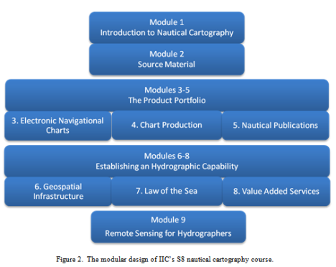
Training… modular, flexible, blended

Slide 16
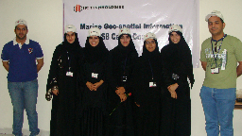
Training experiences….
Oman Hydrographic Office
IHO Cat B S8
IHO Cat B S8 Portable
Data Production &
Database Management
Multi-Disciplinary Hydrographer (MDH) training

Slide 17
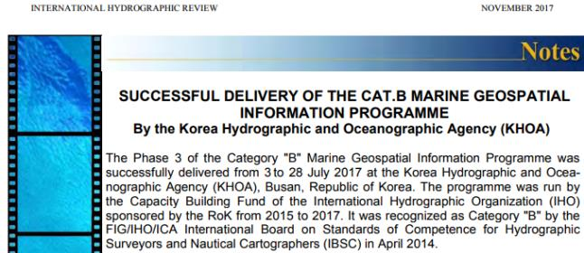
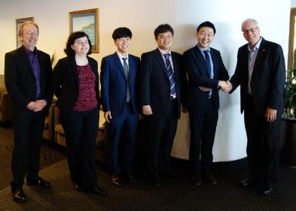
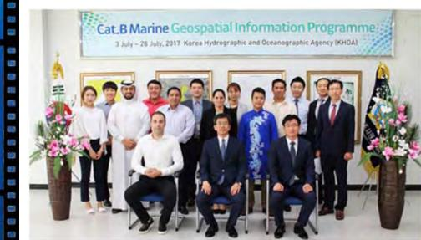
Korea Cat B S5 & S8 Programs….
Cat B S8
Cat B S5

Slide 18
Capacity Building activities can take on many forms with the overall objective of assisting the hydrographic organization to reach their goals and achieve their obligations.
Training, hydrographic surveying, chart production and database management through the provision of technical solutions and services are activities that IIC Technologies undertakes as part of the capacity building strategy.

Slide 19
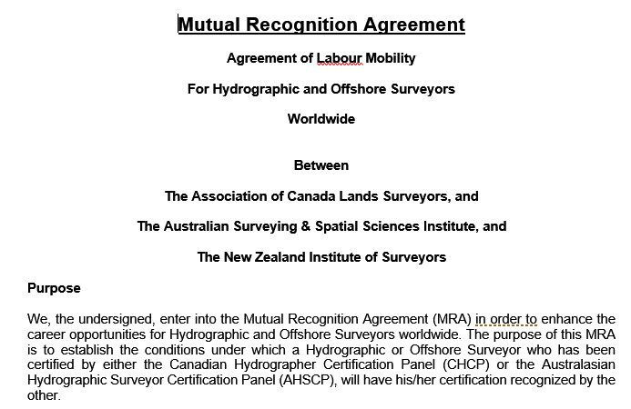
Beyond Capacity Building….

Slide 20
www.iictechnologies.com

